Slide 1





2024 Country Summit
PROMOTING GENDER INCLUSIVE LOCAL ECONOMIC DEVELOPMENT Template
NAME OF ENTERPRISE Dulivhadzimu Recycling Cooperative
PRESENTERS’ NAME & SURNAME NOREST JIMU
Please use your background photos to make your presentation unique. Quotes and any other visuals make your presentation more engaging!
“Promoting Gender Inclusive Local Economic Development”

Slide 2
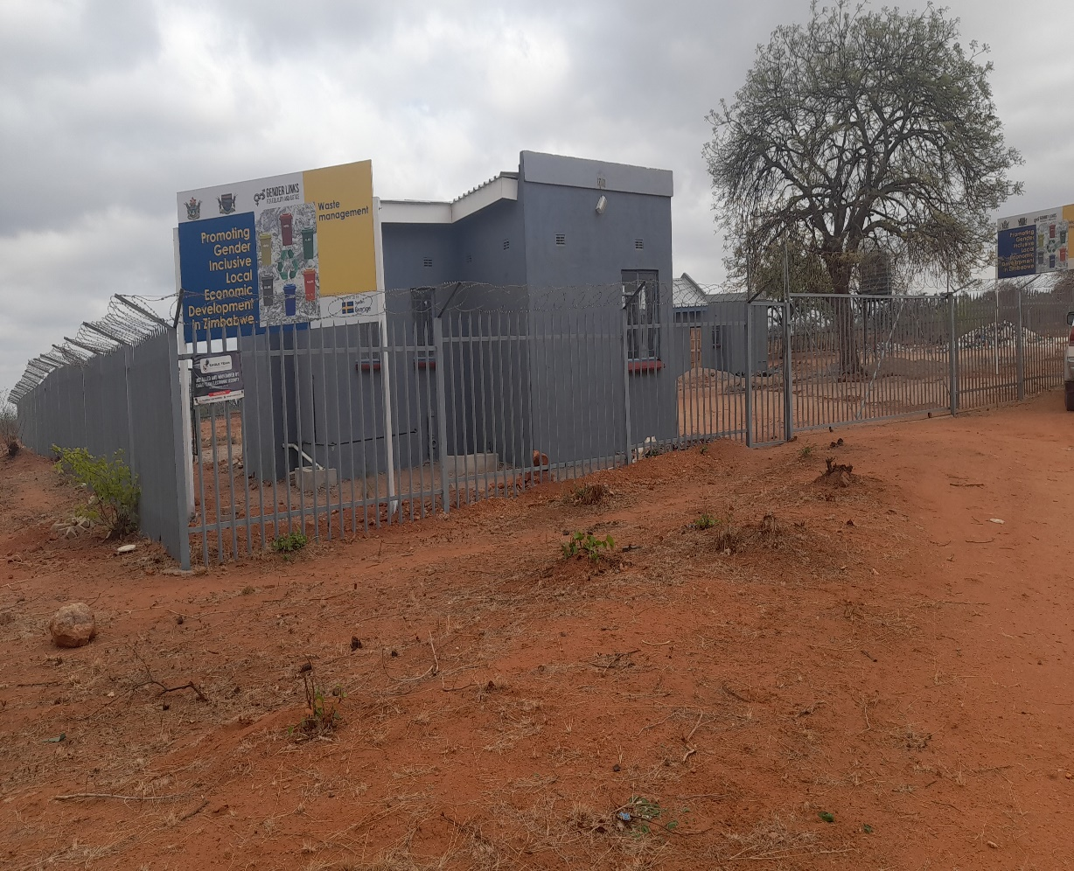
PLEASE DESCRIBE THE ENTERPRISE
Dulivhadzimu recycling picks recyclable material, sorts it into categories, washes and then compacts it into bales for sale.
The enterprises consists of 31 females and 15 males. Of the total 15 are youths.
The group in this enterprise is in the process to register as a cooperative with the Ministry of Youth, Small enterprises
The Cooperative meets on a fortnightly basis for administrative work.
Insert Photo or video
“Promoting Gender Inclusive Local Economic Development”

Slide 3
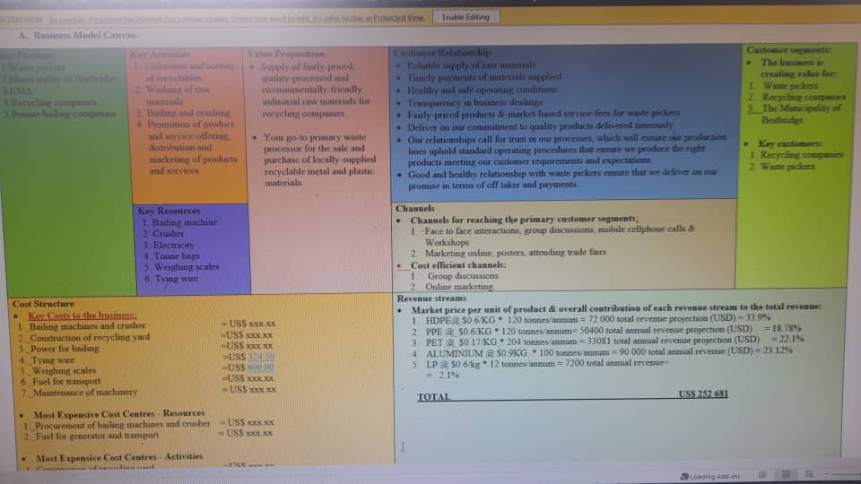
BUSINESS PLAN & MODEL
The enterprise does have a business plan in place which it is currently implementing.
Our business model entails the collection of recyclable material, sorting cleaning and then baling for sale.
Our business received three machines namely a crusher and 2 baler machines, had a recycling yard constructed with water supply and training of members of the cooperative on entrepreneurial skills.
Insert Photo
“Promoting Gender Inclusive Local Economic Development”

Slide 4
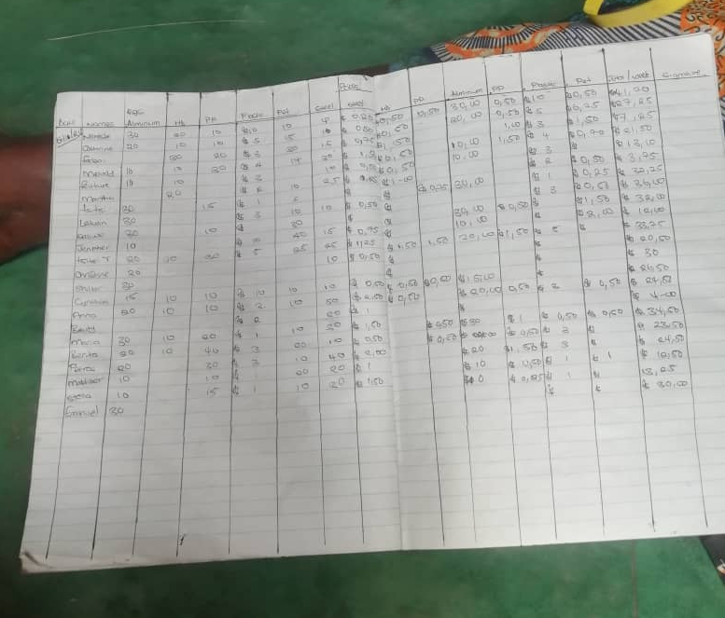
BUSINESS AND FINANCIAL
MANAGEMENT
There is currently no budget forecasting
The cooperative maintains records of materials collected and the revenue generated.
However, the cooperative has no bank account as it has not completed its registration.
“Promoting Gender Inclusive Local Economic Development”

Slide 5
INCOME AND EXPENSES FOR THE BUSINESS FOR
THE LAST TWELVE MONTHS
Month | Jan | Feb | Mar | Apr | May | Jun | Jul | Aug | Sept | Oct | Nov | Dec | Total
Sales (USD) | 932 | 842 | 699 | 676 | 729 | 662 | 687 | 689 | 741 | 752 | 913 | 1165 | 9487
Quantity (Kgs) | 2661 | 2403 | 1996 | 1931 | 2085 | 1889 | 1963 | 1967 | 2117 | 2148 | 2608 | 3327 | 27090
Expenses | 60 | 30 | 30 | 30 | 10 | 140 | 30 | 30 | 60 | 30 | 60 | 30 | 540
“Promoting Gender Inclusive Local Economic Development”

Slide 6
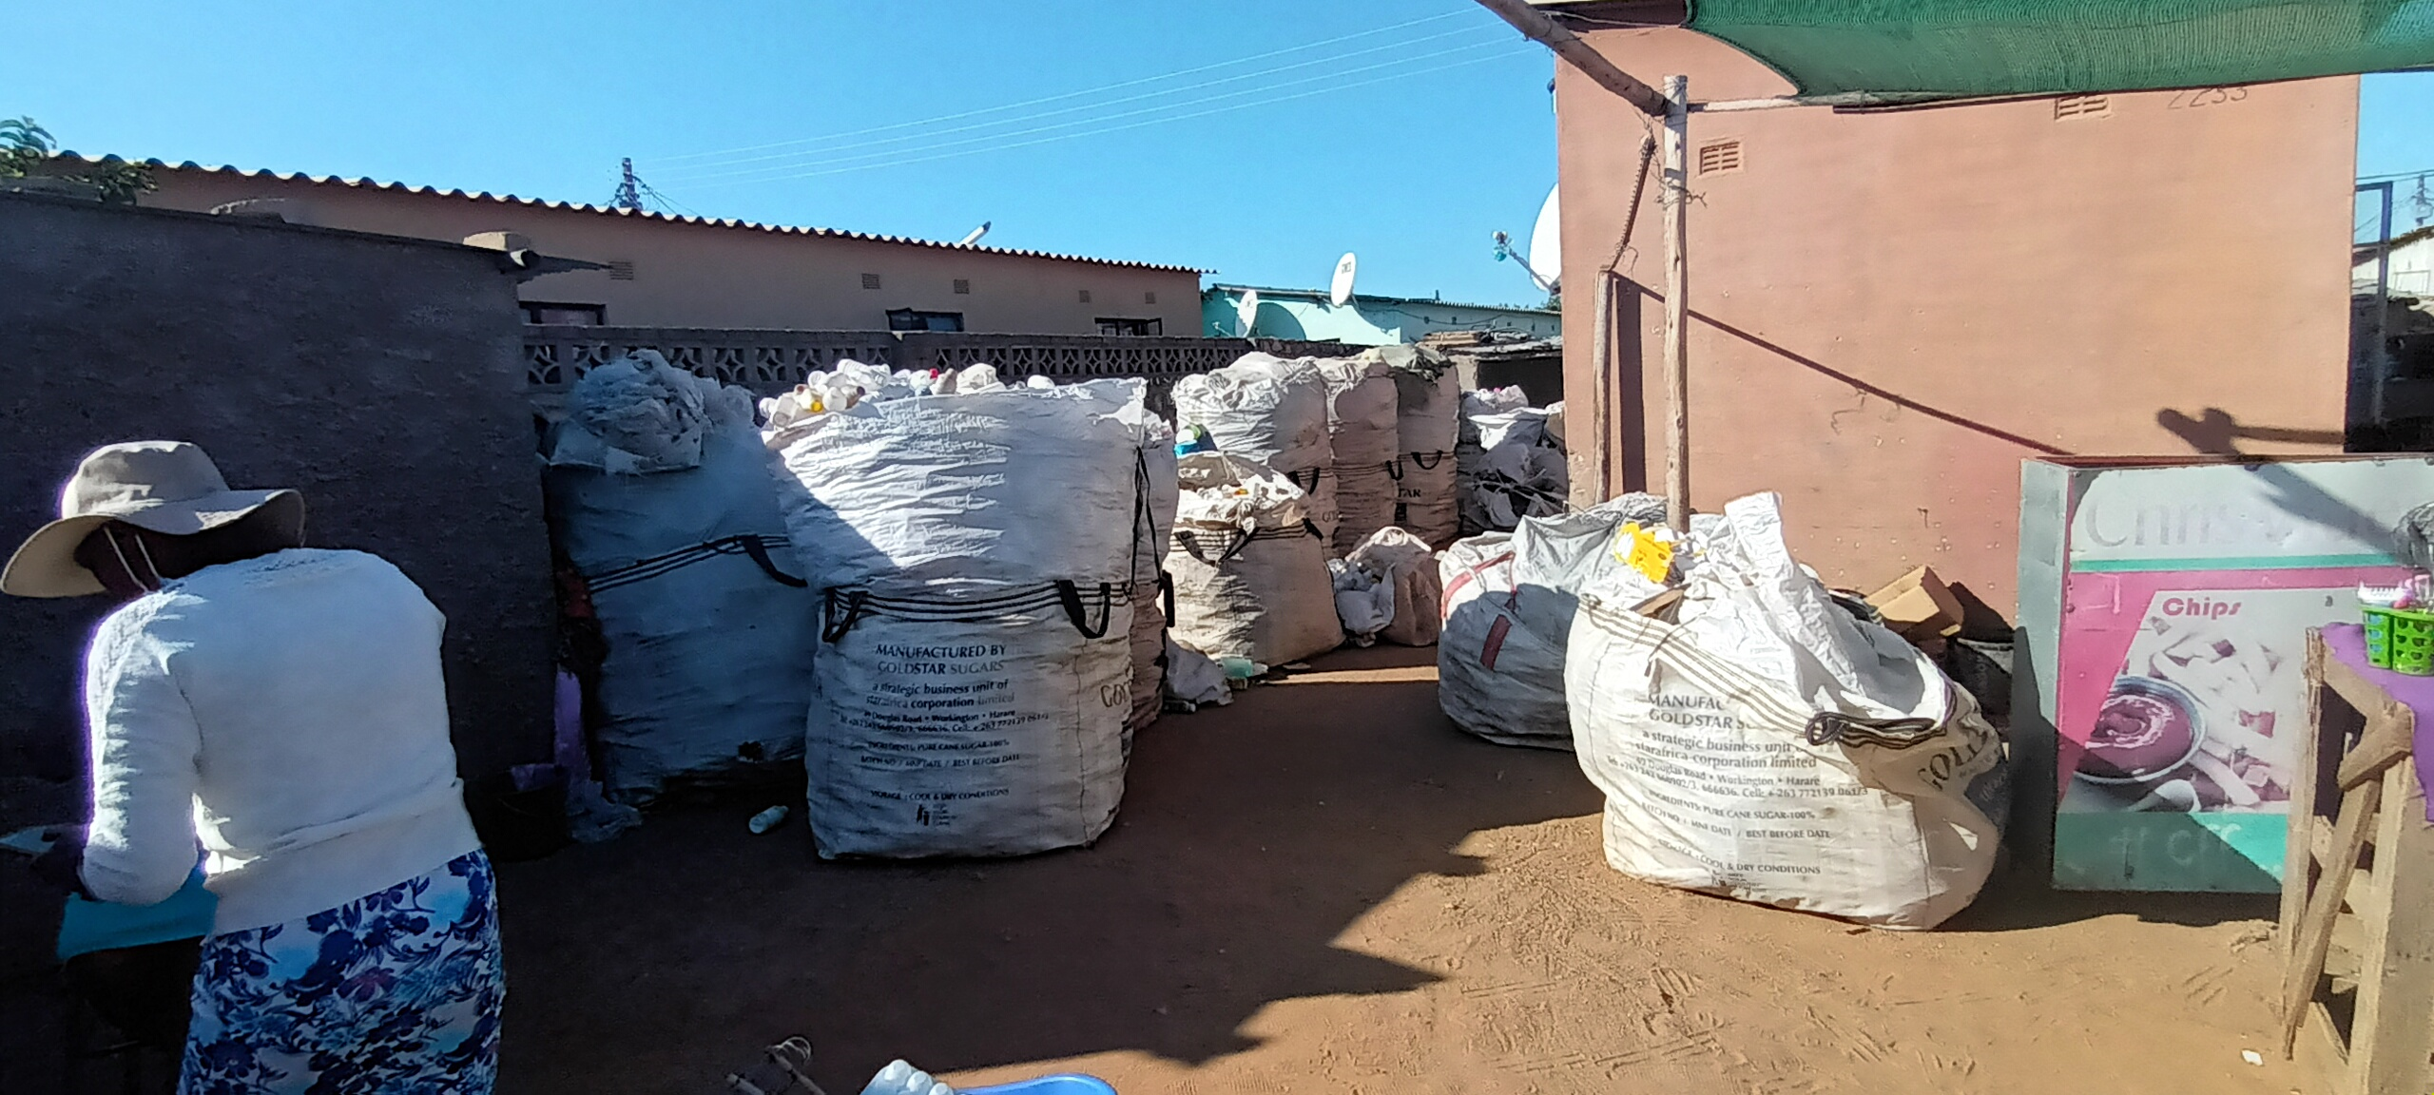
MARKETING AND
SAVINGS
Our main market are recycling companies.
We have segmented our market to determine which material is sent where and to whom.
We currently do not have direct linkages with the market and as such have to use middle men.
There is great demand for recyclable material in the region and wish to utilise online platforms to market of products and services.
Insert Photo
“Promoting Gender Inclusive Local Economic Development”

Slide 7

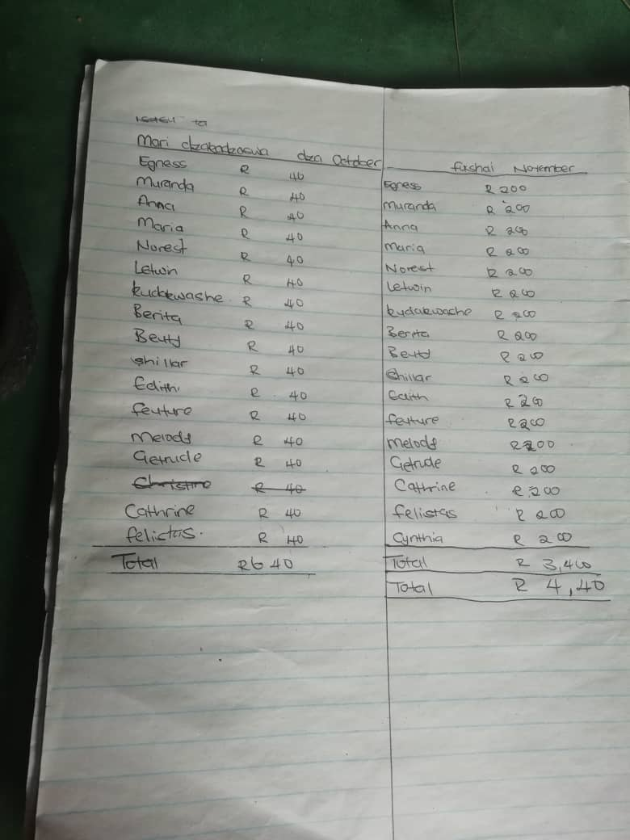
MARKETING AND SAVINGS
There are currently no savings for the enterprise.
There are 2 savings groups which are helping cooperative members in their finances.
They have helped members purchase assets such as tools for their value addition individual businesses and participation in the recycling cooperative.
We have received advice on financial services provided by various institutions.
“Promoting Gender Inclusive Local Economic Development”

Slide 8

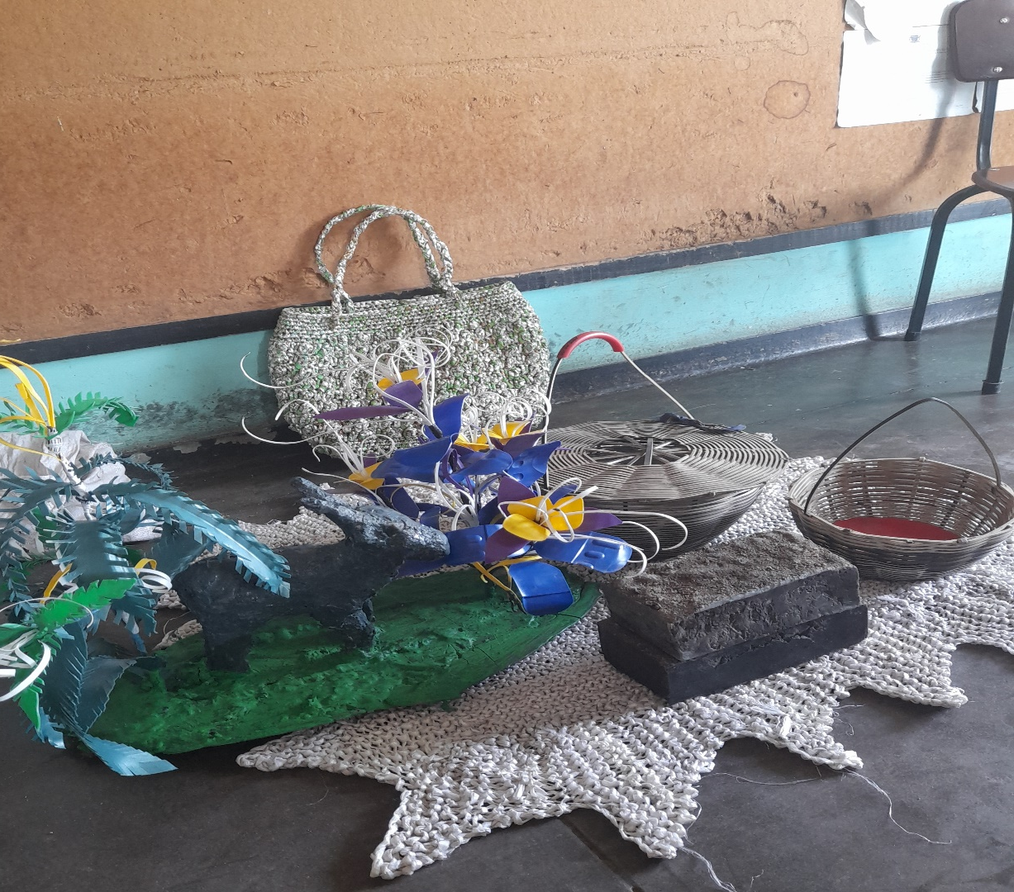
WHAT PLANS HAVE YOU MADE TO GROW YOUR BUSINESS IN
THE NEXT 6 MONTHS?
To strengthen value addition activities conducted by individuals within the enterprise.
To enhance market linkages with recycling companies.
To develop partnerships with local businesses and institutions for material recovery.
Insert Photo
“Promoting Gender Inclusive Local Economic Development”

Slide 9

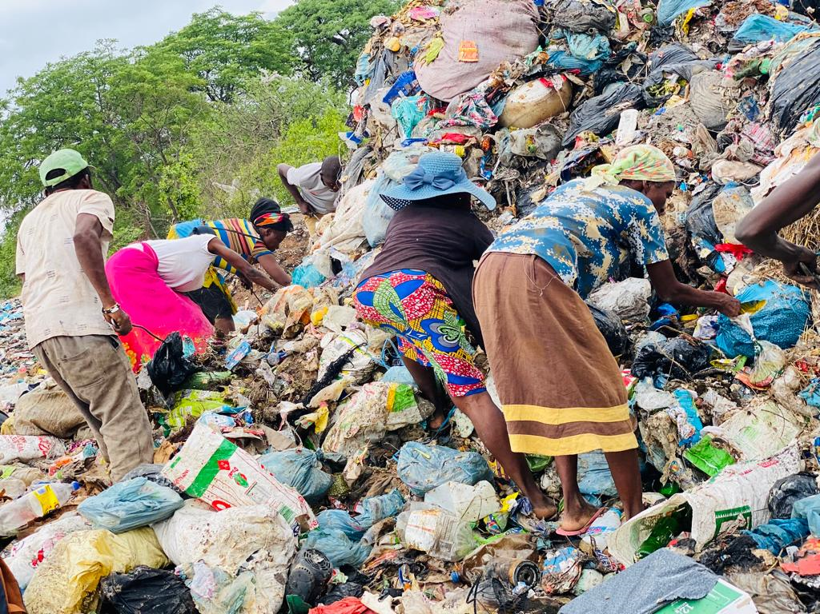
ENVIRONMENTAL PRACTICES
The enterprise practices recycling and re-use as it recovers waste disposed in the Municipality.
“Promoting Gender Inclusive Local Economic Development”

Slide 10
CHALLENGES LESSONS
LEARNED
Conflict with local communities during material recovery and fluctuating market prices.
We have engaged local leadership and the Municipality to raise awareness on our activities and no face less conflict.
We now carry out value addition activities for times when market prices are low and demand is low to ensure our members continue to receive an income.

Slide 11

LESSONS LEARNED
The importance of maintaining market linkages. This can be achieved by meeting delivery timelines and meet quality requirements as specified.
We have also learnt the importance of teamwork. This helps to meet targets and generate income much faster. This will be achieved thorough good relations amongst members and transparency in transactions.

Slide 12

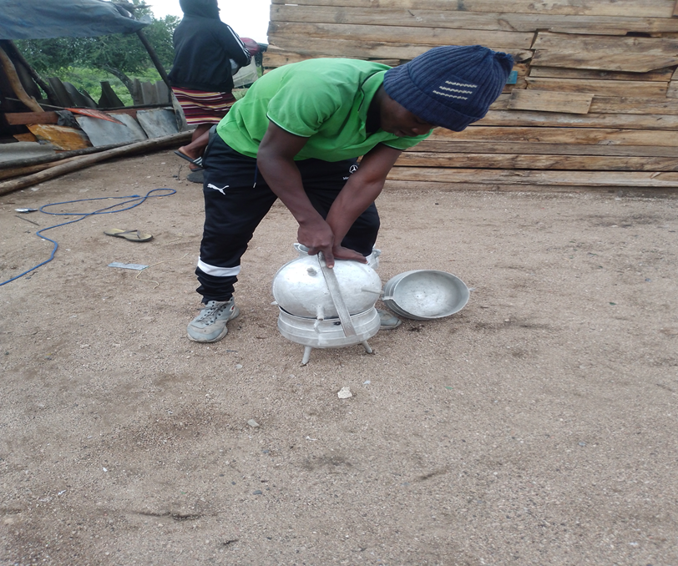
SUSTAINABILITY
The cooperative will recruit waste pickers so as to improve on material recovery.
The cooperative will strengthen its value addition activities to ensure there is improved revenue generation and continual cash flows.
The cooperative once machinery is running will have a enforce the adherence of its maintenance plan to ensure longevity of the machines.
Insert Photo
“Promoting Gender Inclusive Local Economic Development”

Slide 13
Next Steps
Provision of power with assistance of partner our Genderlinks and the local authority to kick start waste baling and crushing.
Capacitation on the use of the equipment provided.
Capacitation on the production of plastic products such as pavers, bricks and irrigation pipes.
Expansion of client base to include regional market.

