Slide 1
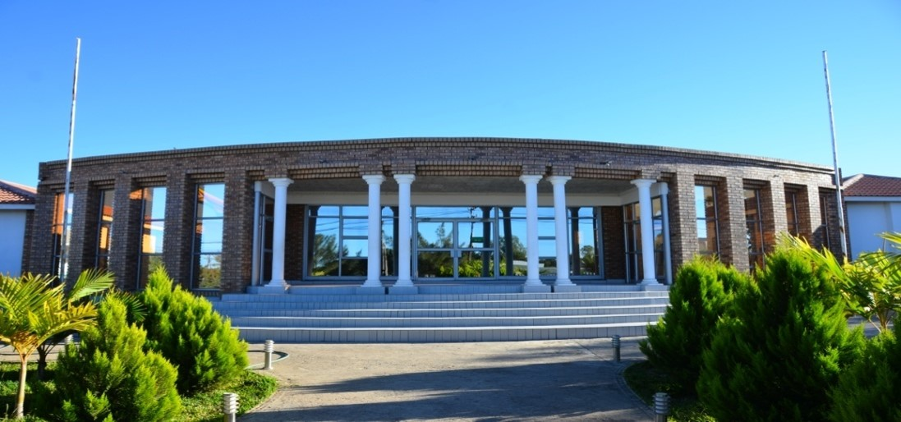





SADC PROTOCOL@WORK SUMMITS AND AWARDS
2024 GENDER RESPONSIVE BUDGETING
.
Zimbabwe, Beitbridge Municipality, Nov 2024 and Anymore Mbedzi

Slide 2
OVERVIEW
COUNTRY | ZIMBABWE
COUNCIL | BEITBRIDGE MUNCIPALITY
GENDER CHAMPION | COUNCILLOR BRENDA MAWORERE
GENDER FOCAL PERSON | MAGIC SHOKO
Latest score (year)
 | Income | Expenditure | % GRB
Budget
 | Women | Men | Total | % Women
Council | 4 | 4 | 8 | 50%
Management | 7 | 15 | 22 | 31%
Council staff overall | 91 | 317 | 408 | 22%
Population served
Key characteristics | The Municipality of Beitbridge houses the busiest border post in Sub-Saharan Africa with transit population of over 12000 per day and over 20000 during peak times. It experiences low rainfall and very high temperatures of about 42 degrees celcius.

Slide 3
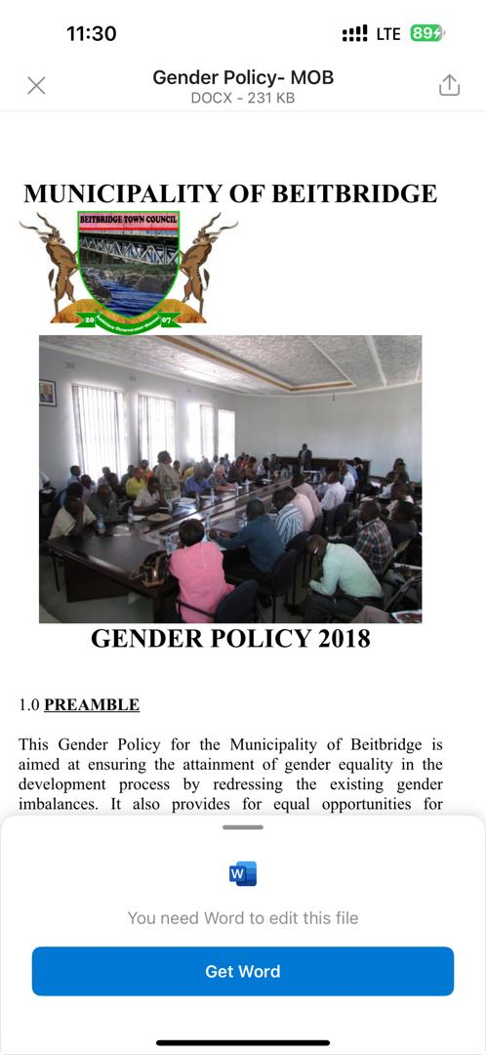
  I. POLICY FRAMEWORK
The gender provisions and policies that guided the council budget are The Constitution of Zimbabwe in section 56, which provides a strong framework for the protection and promotion of the rights of women and men, girls and boys. It recognizes the equality of all persons and goes further to explicitly outlaw discrimination on the grounds of sex or gender, the National Gender Policy, National Development Strategy 1, Regional Protocols e.g., SADC Protocol on Gender and Development and International Protocols e.g., CEDAW - the Convention on the Elimination of All Forms of Discrimination Against Women, and Sustainable Development Goals (SDGs).
The Municipality of Beitbridge has a gender policy in place. The Gender policy was adopted in 2018, and addresses issues related to gender budgeting.

Slide 4
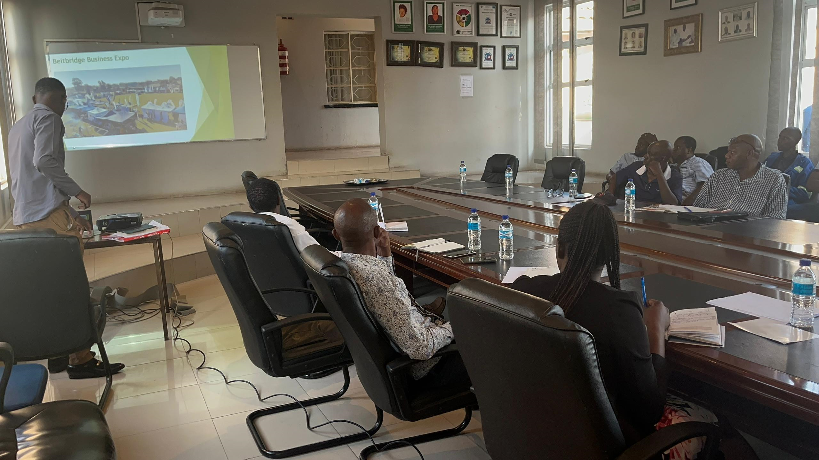
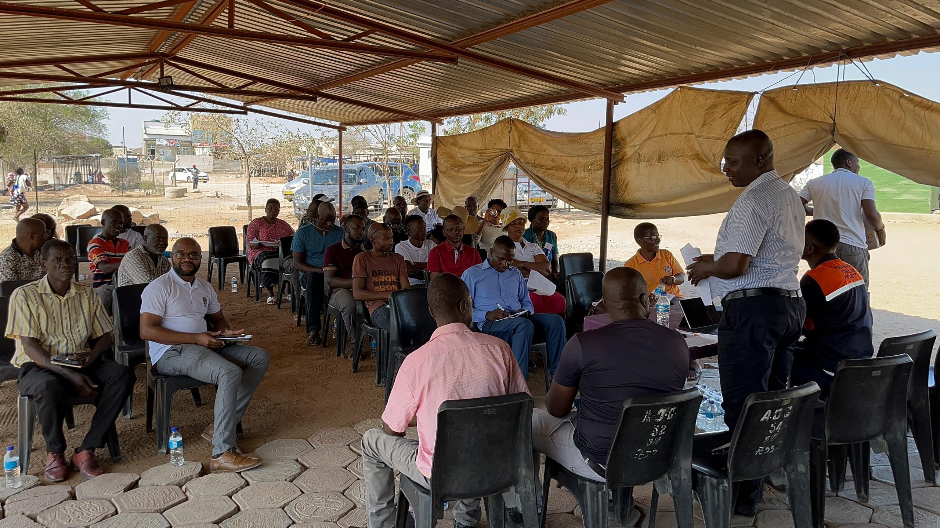
II. THE BUDGET PROCESS
Detail
Evidence
Key stakeholders and key clusters, engaged
6 wards,
women
youth,
business associations, Small to Medium enterprises, Pastors Fraternity, Residence Associations
Times and venues for the consultative meetings were arrived at in liaison with the ward councilor.
Consultation fora included
ward meetings, whatsapp groups and the Municipality website and the print media

Slide 5
II. THE BUDGET PROCESS
The Municipality has sex and age statistics on those who participated in the consultations
Consultation | Women |  |  |  |  | Total | Men |  |  |  |  | Total | % W
 | Age |  |  |  |  |  | Age
 | Below 15 | 15-35 | 36-59 | 60+ | PLWD |  | Below 15 | 15- 35 | 36-59 | 60+ | PLWD |  | (Total women)/Total people consultedx100
Ward 1 | 0 | 1 | 1 | 0 | 0 | 2 | 0 | 3 | 14 | 2 | 0 | 19 | 10%
Ward 2 | 0 | 0 | 1 | 0 | 0 | 1 | 0 | 6 | 6 | 0 | 0 | `12 | 8%
Ward 3 | 0 | 5 | 4 | 1 | 9 | 10 | 0 | 7 | 0 | 0 | 0 | 11 | 48%
Ward 4 | 0 | 7 | 14 | 7 | 0 | 28 | 0 | 2 | 16 | 2 | 0 | 20 | 58%
Ward 5 | 0 | 1 | 9 | 0 | 0 | 10 | 0 | 3 | 9 | 2 | 0 | 14 | 42%
Ward 6 | 0 | 1 | 9 | 0 | 0 | 10 | 0 | 6 | 14 | 2 | 0 | 22 | 31%
Women and Youth | 0 | 12 | 12 | 1 | 0 | 25 | 0 | 12 | 9 | 0 | 0 | 21 | 54%
Business Association | 0 | 5 | 13 | 1 | 0 | 19 | 0 | 8 | 36 | 2 | 0 | 46 | 29%

Slide 6
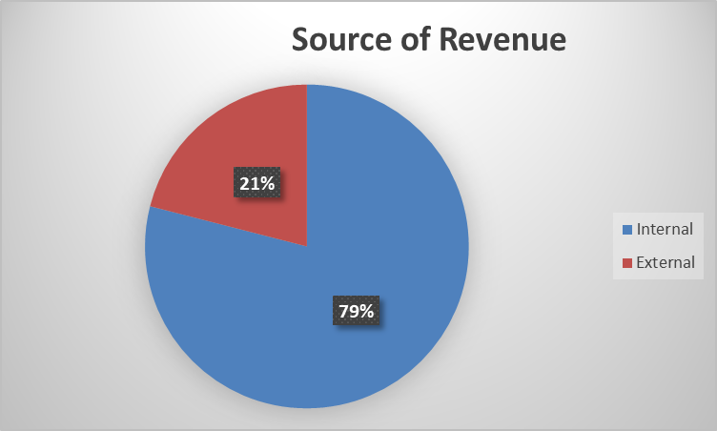
III. REVENUE
Internal sources of funding contributed 79 % while external sources of funding contributed 21%
Gender considerations did not affect revenue budgeting, however MOB is aware men and women have different access to resources.
Through budget consultations and disaggregating data, MOB understood different roles and responsibilities that Genders hold in communities hence identification of specific needs. For example,Women required more support in health & education while men liked construction and infranstructure
External funding is not directly targeted to Gender,but it does achieve Gender Mainstreaming

Slide 7
IV. EXPENDITURE
Type of Expenditure | Amount ($) | Proportion (%)
Gender Management System (GMS) | 403,496.37 | 3
Employment expenditure (Human Capital Expenditure) | 2,767,765.75 | 21
Gender Specific Programming | 672,493.95 | 5
Mainstream Programmes | 9,337,125.98 | 69
Other | 0 | 0
Total | 13,449,878.99 | 100

Slide 8
IV. EXPENDITURE

Slide 9
IV. EXPENDITURE- GMS
Gender Champion is a councillor selected from the women’s quota
The Junior Councillors Patron is a councillor also selected through the women’s qouta
Gender focal person who is in a middle management position
Council has established a gender desk committee that consists of departmental focal persons.
The gender desk committee sits quarterly and submits its recommendations to the health and housing committee.
GMS activities budgeted for include
Hub/ spoke activities
exhibitions,
Training,
Exchange visits
The Budgets are in the Governance and Administration Program budget.

Slide 10
IV. Gender Specific expenditure
Gender Training Workshops- 2 Gender training were conducted for
Councillors and Management
Shopfloor workers had training on Domestic Violence. A specialist from Legal Resources Foundation falicitated the training
2. Junior Councils- There is a Junior Council comprising of 4 Females and 3 Males
3. Commemoration of 16 days of activism- was done in partnership with stakeholders such as the Ministry of Women Affairs, ZRP, IOM, Social Development, Church fraternity etc
Sexual reproductive health and rights- We established a new satelight clinic at Madinginye surbab
Maternal Health-
These budget lines are found in the Governance and Administration budget and also the Health budget
3% is allocated for Gender Specific Programming
The 3% is not adequate, The Municipality intends to increase budget allocation to 5% in 2025
The Gender Training workshops have helped to clarify issues of gender to both men and women. Women have benefited mainly on understanding their rights, how to prevent serious and legal issues that may arise due to Gender based violence, sexual harassment, bullying or discrimination.
The expenditure on gender specific programmes is measured through outcomes and impact evaluations (Theory of Change)

Slide 11
IV. EMPLOYMENT EXPENDITURE
 | Women |  |  | Men |  |  | Total | % women
 | Managers | Staff | Total | Managers | Staff | Total |  | Managers | Staff | Total
Full Time | 7 | 54 | 61 | 19 | 143 | 162 | 223 | 27 | 27
Part time | 0 | 30 | 30 | 0 | 155 | 155 | 185 | 0 | 16
Casual | 0 | 0 | 0 | 0 | 0 | 0 | 0 | 0
Total | 7 | 84 | 91 | 19 | 298 | 317 | 408 | 27 | 16
Women-22.30% of the work force
Women in management -25.93% of management
Women are in full time employment- 14.95% of the workforce

Slide 12
IV. EMPLOYMENT EXPENDITURE- Gender Wage Gap Analysis
 | Women | Women- Total earned | Women average earned | Men-no | Men total earned | Average earnings
Full Time | 61 | 482,651,379 | 7,912,334 | 162 | 1,334,910,367 | 8 240 187
Part Time | 30 | 132,308,606 | 4,410,287 | 155 | 688,762,822 | 4,443,631
Casual | 0 | 0 | 0 | 0 | 0 | 0
Total | 91 | 614,960,985 | 12,322,621 | 317 | 2,023,673,189 | 12,683, 818
The average annual earnings of men is Z$12 683 818 while that of women is Z$12 322 621
The Gender wage gap is small to immaterial, showing that staff wages are based on a the job’s grade and not on gender related issues
Concentration- Men (Engineering) Women ( Environmental Health and Finance)
The Gender wage gap is 0.0293

Slide 13
EMPLOYMENT EXPENDITURE- Gender Wage Gap Analysis
The Gender wage gap indicates that there are more men in management positions than women. There are also very few women in some departments especially technical. This has a bearing on the overall employment statistics
The Municipality intends to promote women, mostly at supervisory levels, however based on merit

Slide 14
V. EXPENDITURE- GENDER IN MAINSTREAM BUDGET
Programmes | Amount | % budget
Governance & Administration | 6,262,919,51 | 47
Water Sanitation & Hygiene | 2, 029,265 | 15
Social Services | 1,666,131 .48 | 12
Roads | 3,449,589 .1 | 26
Public Safety & Security | 41,973.90 | 0.3
Natural Resources & Conservation | 0 | 0
Total | 13, 449,878.99 | 100

Slide 15
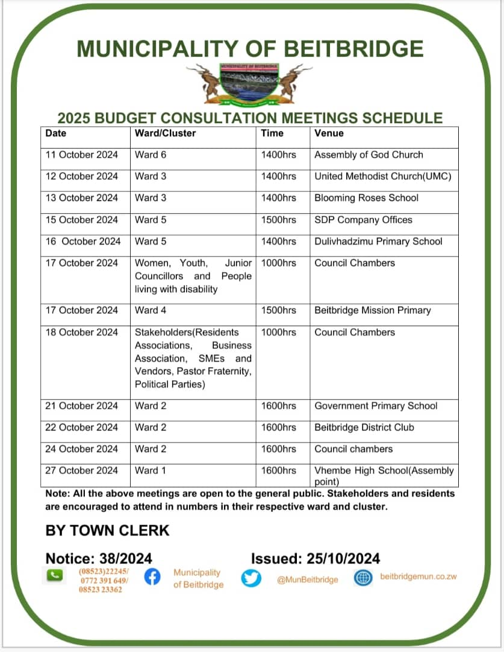
V. EXPENDITURE- GENDER IN MAINSTREAM BUDGET
Incorporating Gender perspectives in budgeting promotes gender equality and ensures that men,women,girls and boys benefit from public spending leading to broader societal benefits
Recognising the distinct impacts of budgeting on different genders and classes helps create more just and effective public policies that cater to the needs of all individuals in the Society

Slide 16
V. EXPENDITURE- GENDER IN MAINSTREAM BUDGET – EXAMPLE
 | Amount | No of beneficiaries | Percentage
Total Expenditure
No. of Men benefiting from council allocations |  | 141 | 56
No. of Women benefiting from council allocations |  | 110 | 44
Total beneficiaries |  | 251 | 100%

Slide 17
VI. BUDGET CROSS SUBSIDISATION ANALYSIS
 | Income (A) | % of total budget | Expenditure (B) | % of total budget
Governance & Administration | 6,262,919.51 | 47 | 3,347,544.21 | 25
Water, Sanitation & Hygiene | 2,029,265.00 | 15 | 3,792,636.45 | 28
Social Services | 1,666,131.48 | 26 | 2,273,258.55 | 17
Roads | 3,449,589.10 | 26 | 2,941,344.10 | 22
Public Safety and Security | 41,973.90 | 0.3 | 1,095,095.68 | 8
Natural Resources & Conservation Mgt | 0 | 0 | 0 | 0
Total | 13,449,878.99 | 100 | 13,449,787.99 | 100

Slide 18
VI. BUDGET CROSS SUBSIDISATION ANALYSIS
The budget has no surplus or deficit
Governance and Administration generate more income than expenditure
Social Services, Roads and Public Safety expend more than the income that they generate
The Municipality does not have policy that guides cross subsidization
Gender considerations have influenced cross subsidization in order to promote equality and access, here is how:
Disparities- considerations identified gaps in service usage. Cross subsidization is planned to ensure that services most used by women are funded adequately
Women often undertake a larger share of unpaid labour,eg, caregiving for Children and the elderly. To address this,cross-subsidization can fund services that alleviate this burden
Cross subsidization ensure that vital services like healthcare and education are affordable for lower income individuals or families which often includes more woman due to systematic inequalities. This helps reducing barriers to access that women face

Slide 19
VII. CONCLUSIONS AND NEXT STEPS
Gender Budgeting has led to an improvement in the provision of services that are mostly accessed by women for example rehabilitation of vending markets, drilling and equipping boreholes, erection of tower lights in business areas, new temporary selling areas and awareness campaigns.
Next steps regarding Gender Budgeting
Review Gender Policy- to check objectives,scope and guidelines for incorporating gender perspectives into the budgeting process
Capacity Building-Continue training staff and stakeholders on gender analysis,budgeting process and the importance of Gender-responsive budgeting
Monitoring and Evaluation-Establish mechanisms to monitor the implementation of gender budgeting initiatives and their impacts
Report and Communicate-Prepare reports that detail the Municipality’s gender budgeting efforts,outcomes and ongoing challenges and share this information publicly to promote transparency and accountability
Create and Uphold partnerships- Continue collaboration with other Councils,organisations and Government depts to share knowledge,resources and best practices related to Gender budgeting

