Slide 1







LEARNING
AND SHARING
SUMMIT 2025
RWVL Joint Campaigns
(South Africa, Johannesburg, 5-6 March 2025)
Presentation by: Boitumelo Tefo
Women’s Voice and Leadership Learning and Sharing Summit 2025

Slide 2
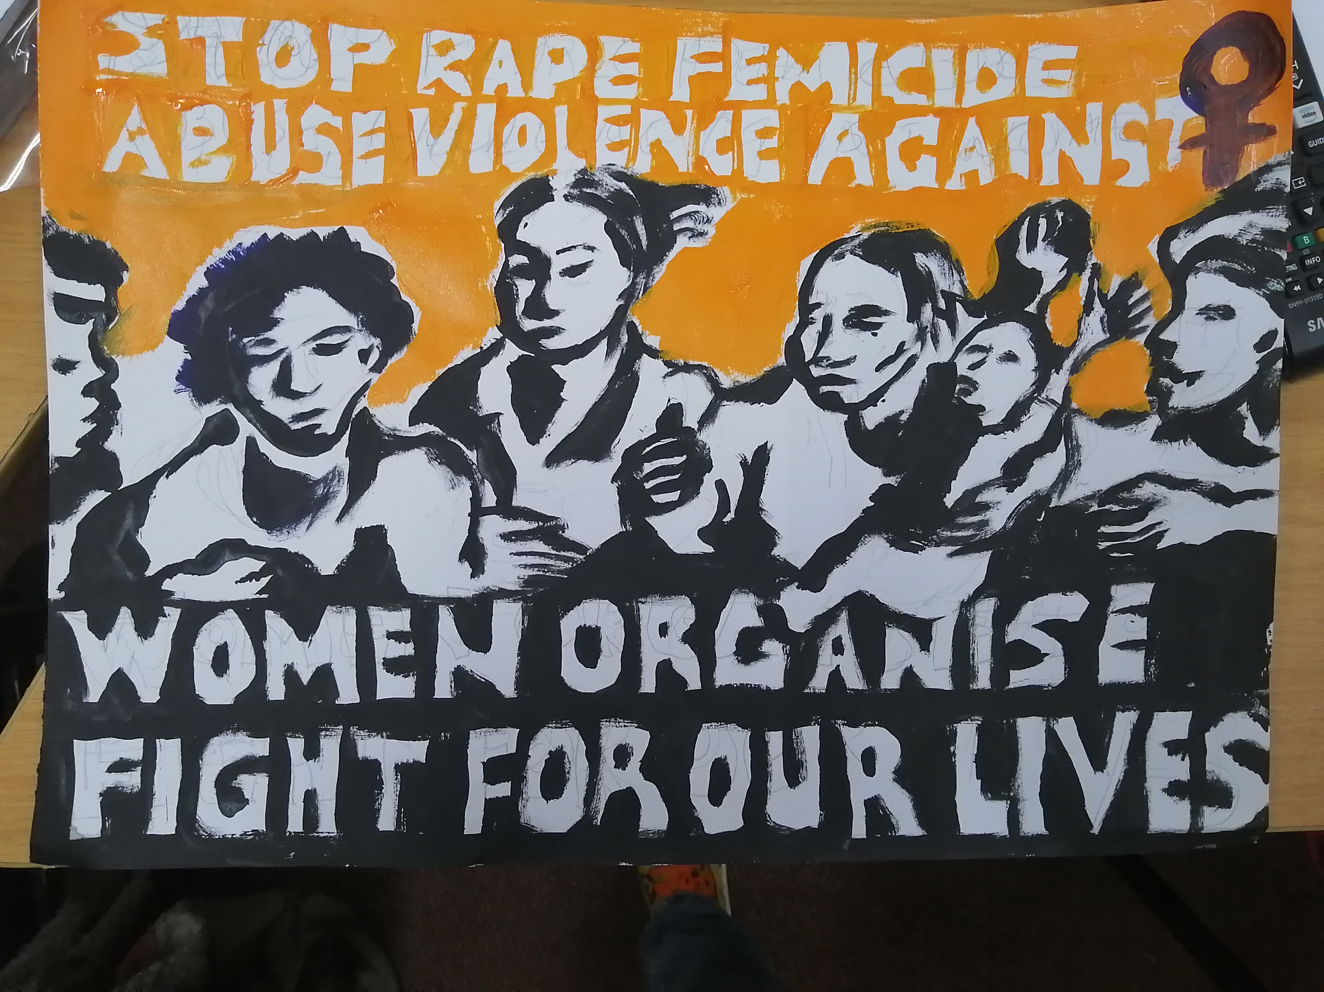
Summary
Siqhubeka Ukwakha – Rebuilding Our Community 2.0
The project aims to create space for women to come together to share, think, and develop strategies and actions to address issues faced by women in our communities, particularly gender-based violence and Femicide; to amplify our voices and document our experiences. It aims to encourage and increase critical thinking around issues affecting womxn at a local and global level by strengthening participants' understanding of feminism and feminist theory. In this phase, we aim to involve older women in intergenerational learning and rebuilding women's relationships with each other across generations. We strive to change the narratives of women's experiences.
Voice and Choice Learning and Sharing Summit 2025

Slide 3
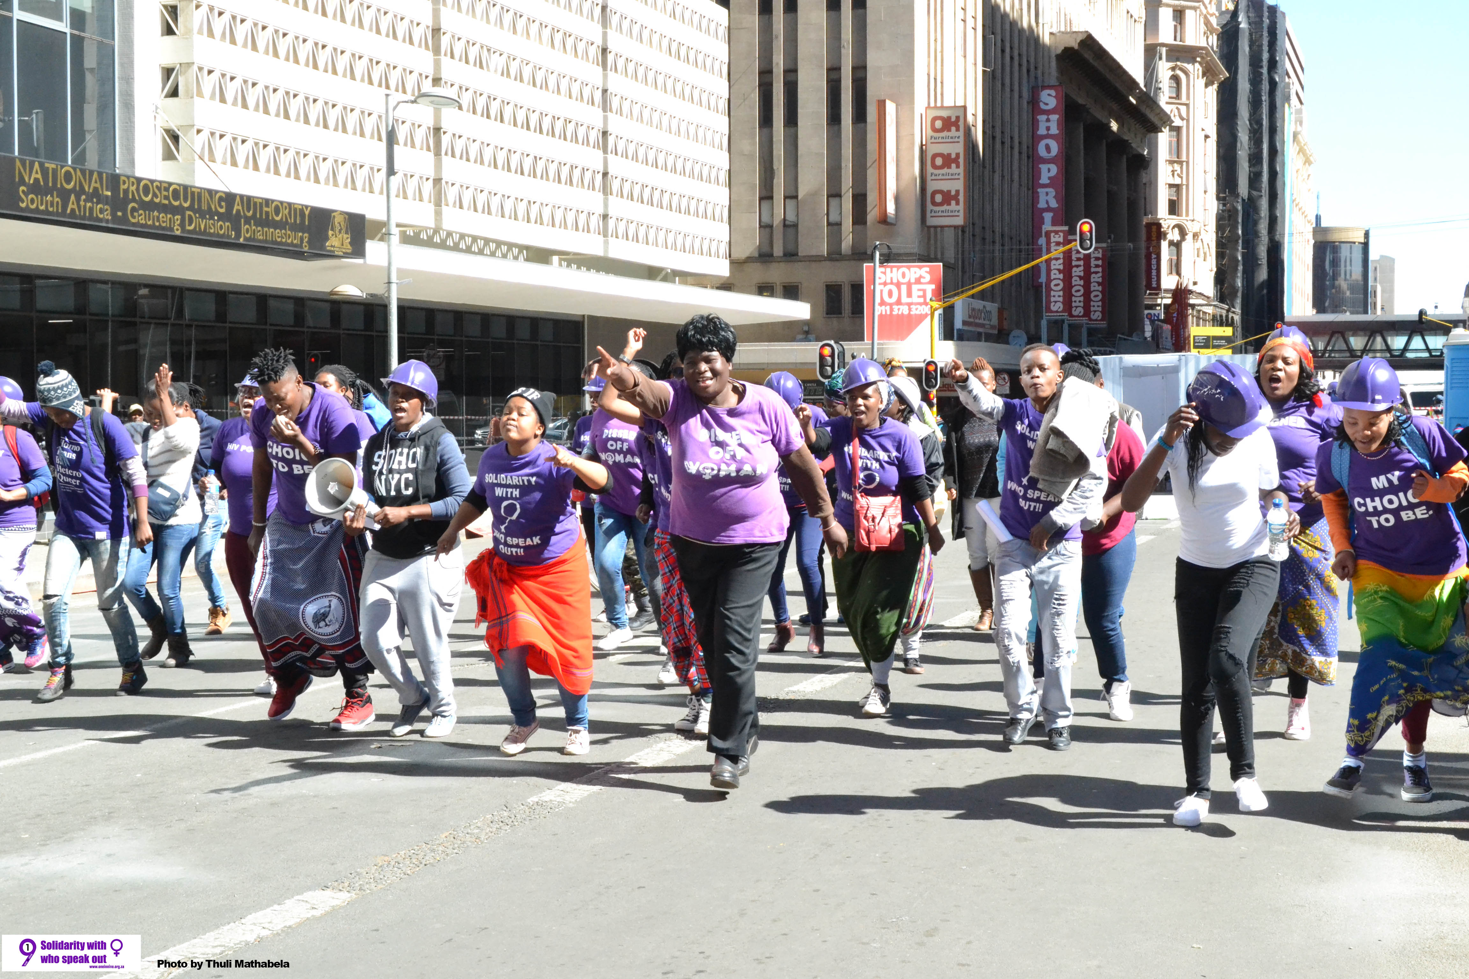
Initiatives and strategies
How will your initiative contribute to building stronger and more inclusive movements?
Our initiative is about acknowledging women’s experiences and seeing how generational and historical trauma has affected how we see ourselves and each other, and how it has affected our current experiences. This is important for the movement because we need to know how to heal as a collective so we can understand how the system has stacked oppressions on women’s bodies and how we advocate for our freedoms and our autonomy
What strategies will you use to strengthen collaboration and solidarity?
Working to increase women’s access to knowledge to strengthen our critical thinking around issues that affect us daily.
Bringing women from different backgrounds, perspectives and diversities together to strengthen solidarity with each other.
Using art as the tool to strengthen advocacy and solidarity with women across social justice issues.
Rebuilding communication in our communities with different ages, classes, sexual orientation, gender to build safer communities for vulnerable groups.
Voice and Choice Learning and Sharing Summit 2025

Slide 4
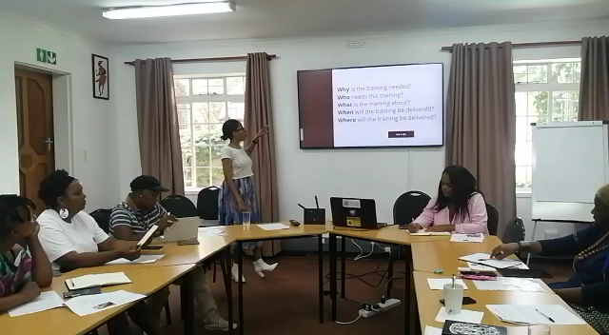
Governance & Resource Allocation
How will you ensure active participation and decision-making from all members?
One of the feminist principles is accountability and responsibility. Ending GBV is a collective responsibility and therefore requires us to work together in finding solutions and advocating against violence on women’s bodies. GBV and patriarchy affect us all in different ways and it costs the country a lot, which takes away from resources that could be used to rebuild our country. It is in all our best interests to work together to end it.
How will you distribute resources across partners to promote equity and sustainability within the movement?
We work with several community organisations at the same time to strengthen their advocacy and their constituency and promote solidarity across different social justice areas and the resources are spread through training and working with all organisations at the same time. We also invest in mentorship with the organisations to strengthen their organisational development, skills development and sustainability (proposal writing, networking and meeting donors, financial management, facilitation skills etc.). Most community-based organisations do not have access to decision making spaces and donors; we share these spaces with the organisations we work with so that they gain access through working with the One in Nine Campaign.
A video clip of community leaders in a facilitation and organizing skills training (part of our mentorship programme for community-based organizations)
Voice and Choice Learning and Sharing Summit 2025

Slide 5
Inclusive Leadership & Coordination
How will you leverage expertise and diverse connections to strengthen advocacy efforts?
Strengthening existing partnerships and networks
Utilize feminist popular education and capacity building to equip participants with tools for advocacy, critical thinking and movement building.
Use advocacy campaigns and community mobilization.
Policy advocacy and institutional engagement.
Knowledge production and strategic documentation
What strategies will you implement to coordinate campaigning?
Implementing multi-level advocacy and movement building by working closely with feminist alliances to align campaign messaging and activities at a local, provincial and national level.
Develop and plan a campaign strategy that has a strong, intersectional feminist narrative that centers on lived experiences of women, particularly around gender-based violence (GBV), economic empowerment, and systemic oppression. Use evidence-based advocacy and leverage important calendar dates to develop a timeline for key campaign actions and awareness.
Invest in digital and traditional media mobilization.
Community-led mobilization.
Voice and Choice Learning and Sharing Summit 2025

Slide 6
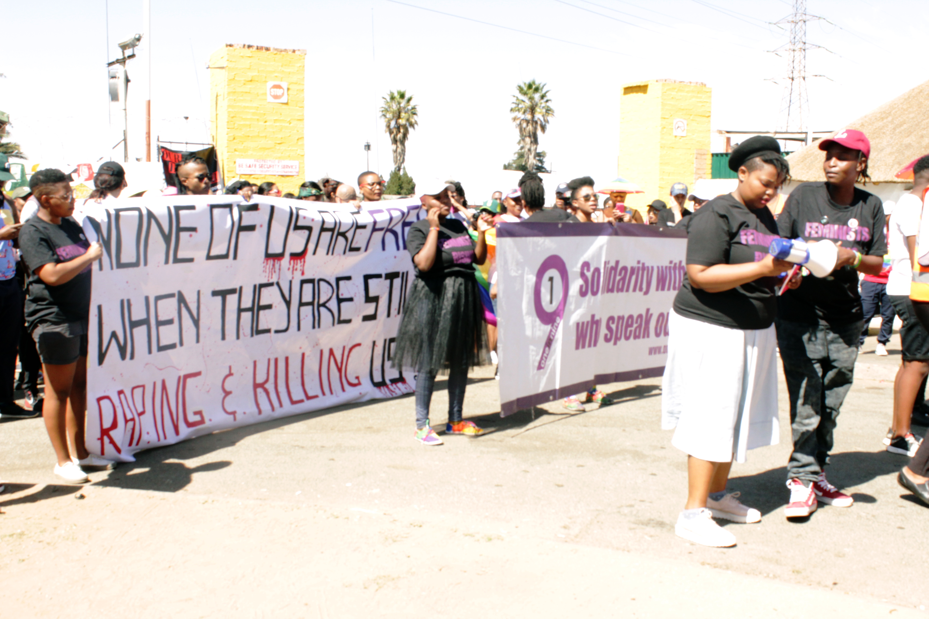
Connecting & Community-Building
What approaches will you use to build and sustain relationships within the advocacy community?
Strengthen our community networks by working in solidarity with each other and in addressing cross-cutting issues in our communities.
Consistent and transparent communication, staying in touch with communities and showing interest in other issues that the community deals with.
Encourage collective decision-making on activities and strategies within the community structures.
Capacity building and shared learning.
Long-term relationship building and sustainability.
How will you facilitate mentoring, convening, and peer exchanges among professional advocates and emerging leaders?
Implementing structured mentorship programs.
Through our community dialogues and imbizos.
Work with partner organizations' leadership to include feminist learning as part of their internal activities.
Encourage collective creation of an online exchange/learning hub, skills sharing amongst participating organizations
Cross-movement learning and solidarity
Voice and Choice Learning and Sharing Summit 2025

Slide 7
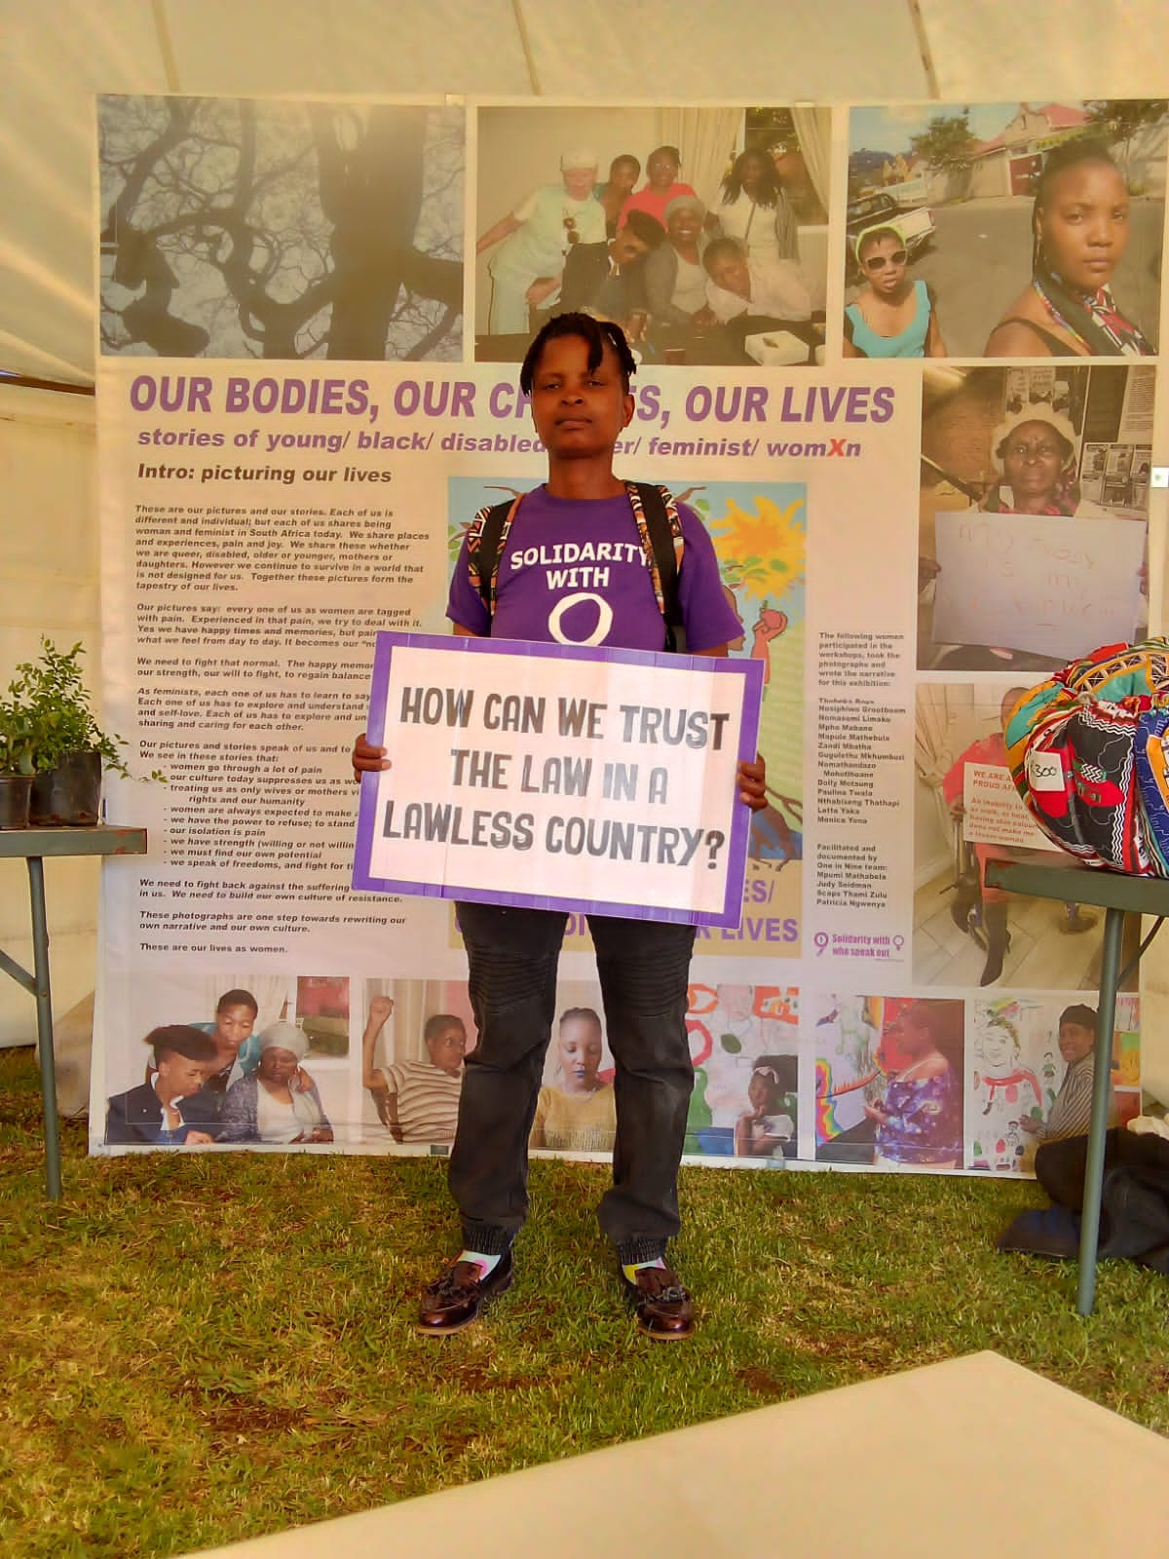
Linking & Learning
How will you foster a culture of continuous learning and best practice sharing?
Knowledge production and documentation.
Hosting regular learning and reflection sessions.
Building community networks that will continue the work.
Embedding best practices into organizational cultures.
Using technology for continuous learning.
What mechanisms will you use to document and share lessons learned?
Internal structured documentation and knowledge management processes to keep regular detailed reports on successes, challenges, impact etc.
Regular inter-organizational feedback sessions on project progress.
Monitoring and Evaluation and adaptive learning.
Voice and Choice Learning and Sharing Summit 2025

Slide 8
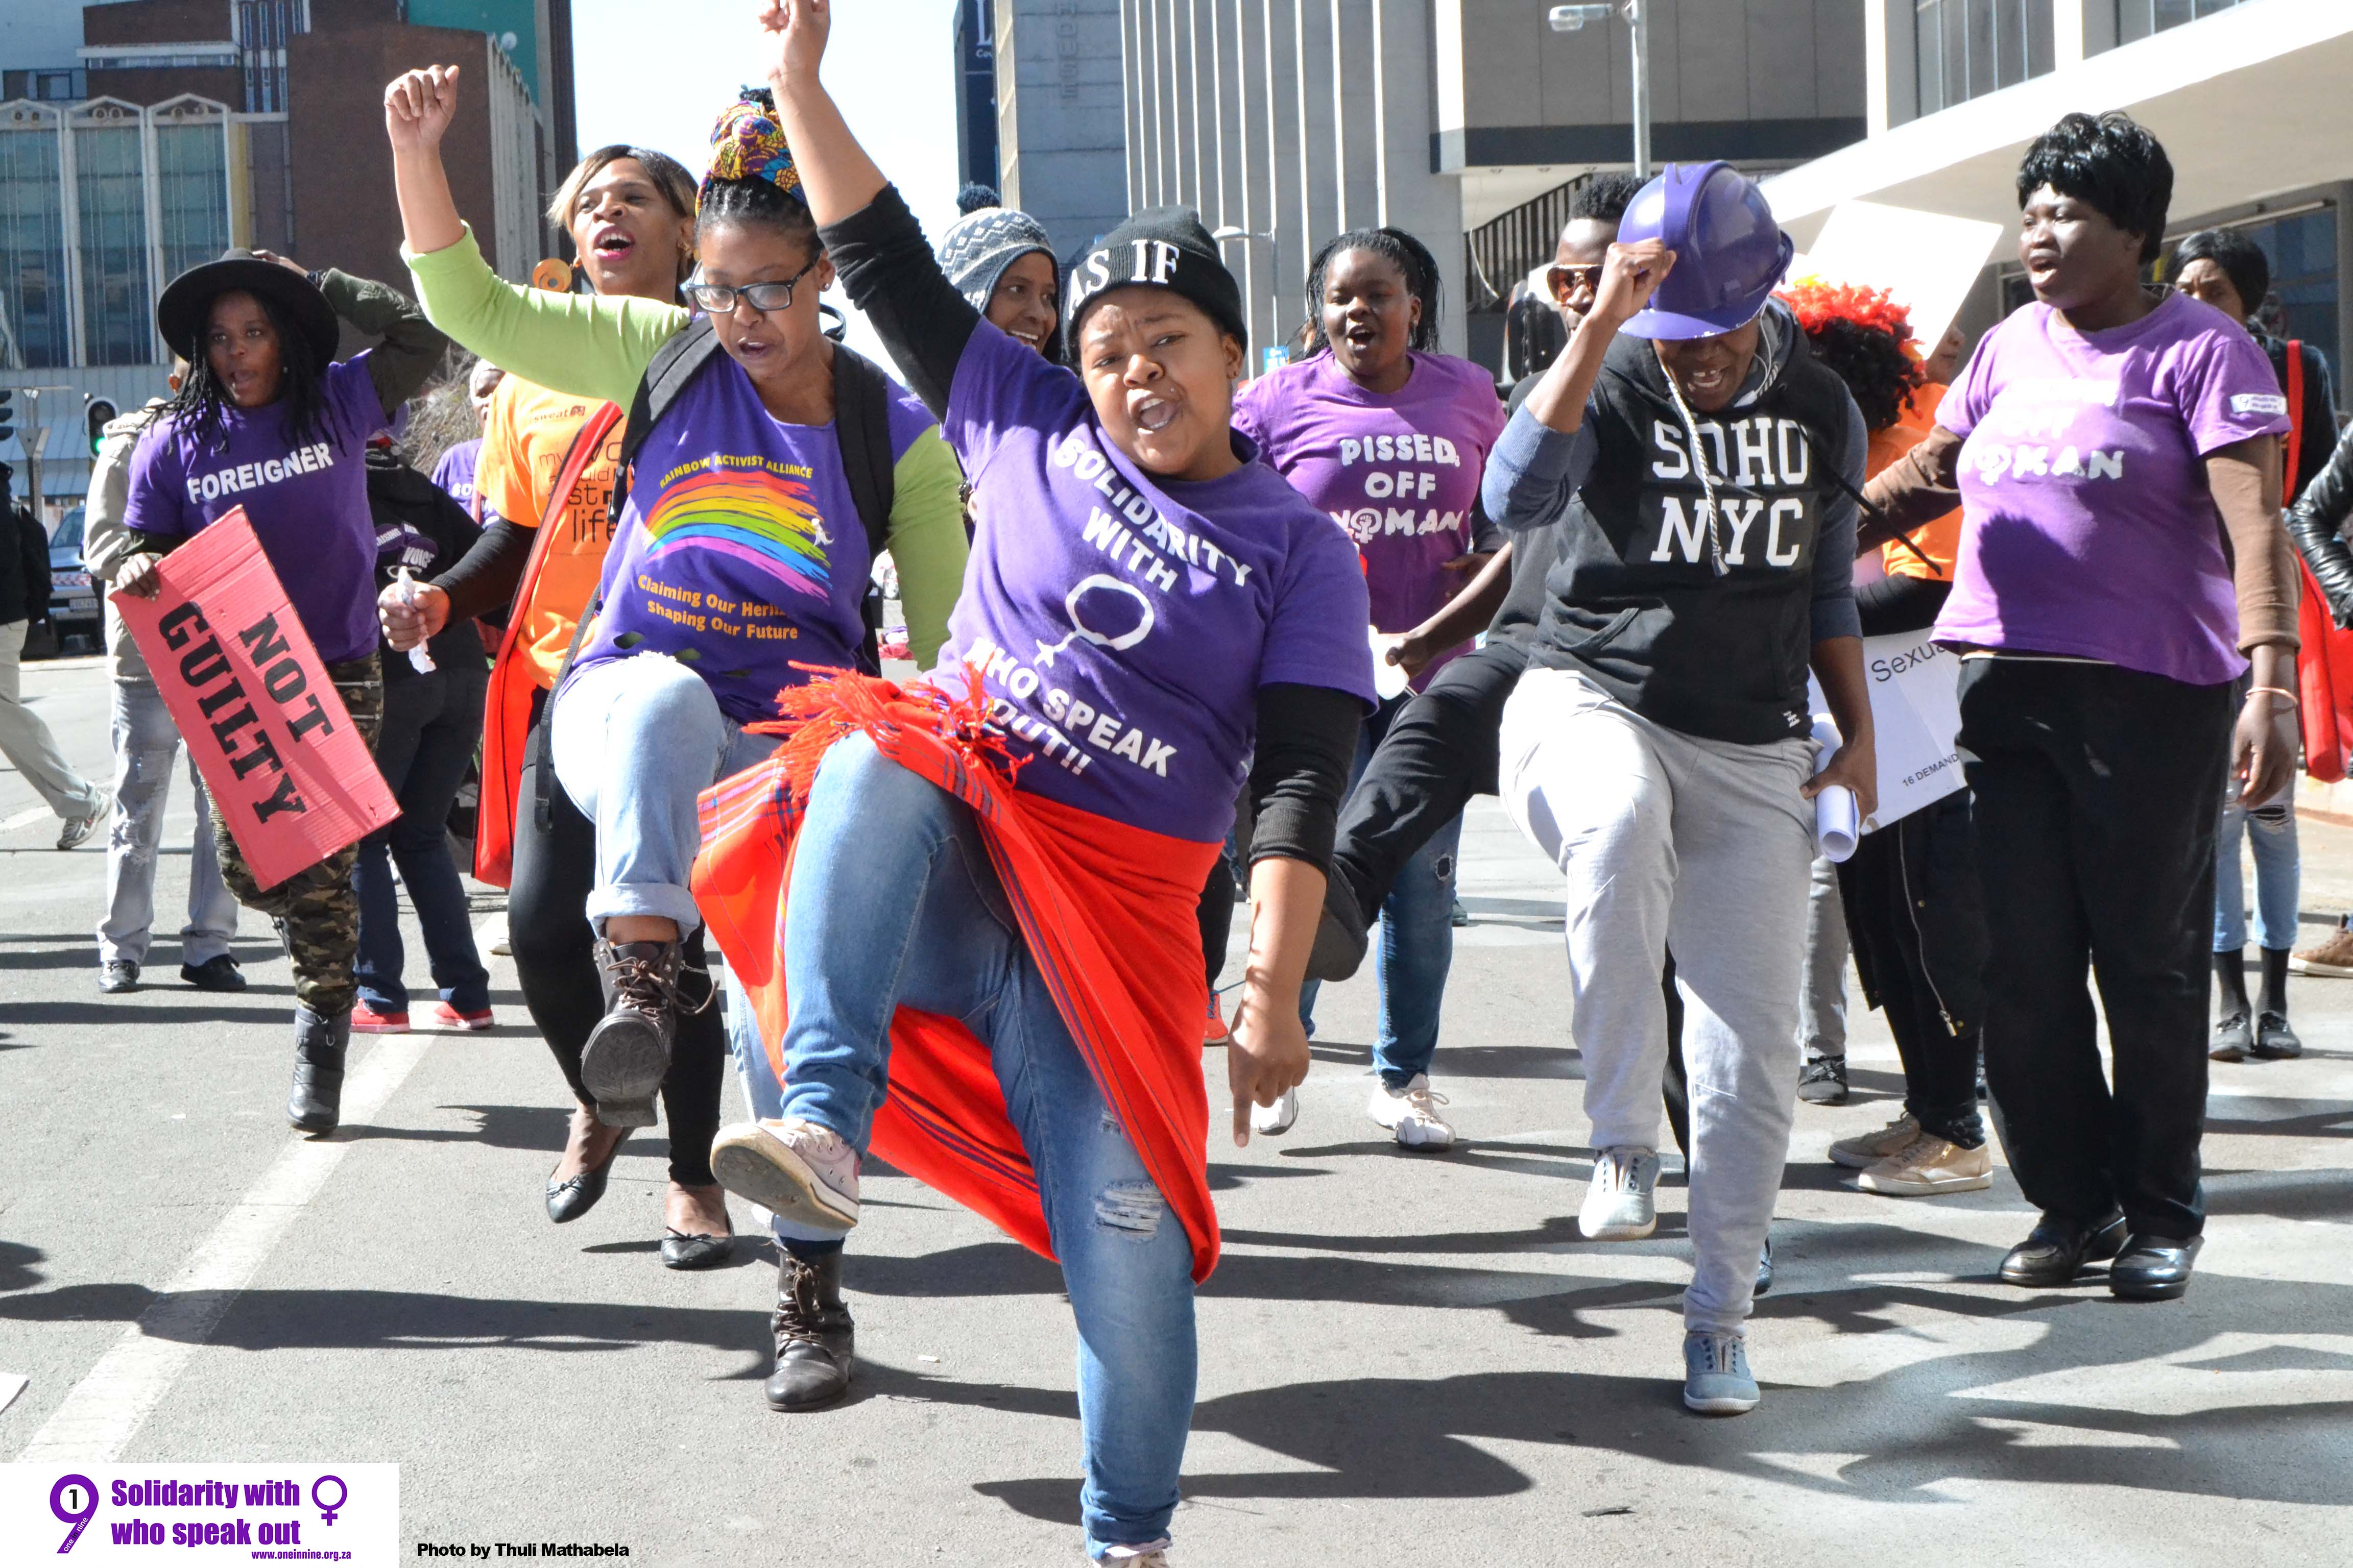
NEXT STEPS
What will be your key priorities moving forward
Strengthening advocacy and movement building.
Enhancing knowledge production and storytelling.
Strengthening economic empowerment and leadership development.
Leveraging technology for advocacy, awareness and consciousness raising.
Strengthening organizational sustainability and partnerships.
Strengthening our monitoring and evaluation and adaptive learning.
Women’s Voice and Leadership Learning and Sharing Summit 2025

