Slide 1




SADC PROTOCOL@WORK SUMMIT 2024
Youth Leadership Template
(Zimbabwe, Harare, date Tinotenda Pardon Matenda )
Please use your own background photos to make your presentation unique. Quotes and any other visuals make your presentation more engaging!

Slide 2
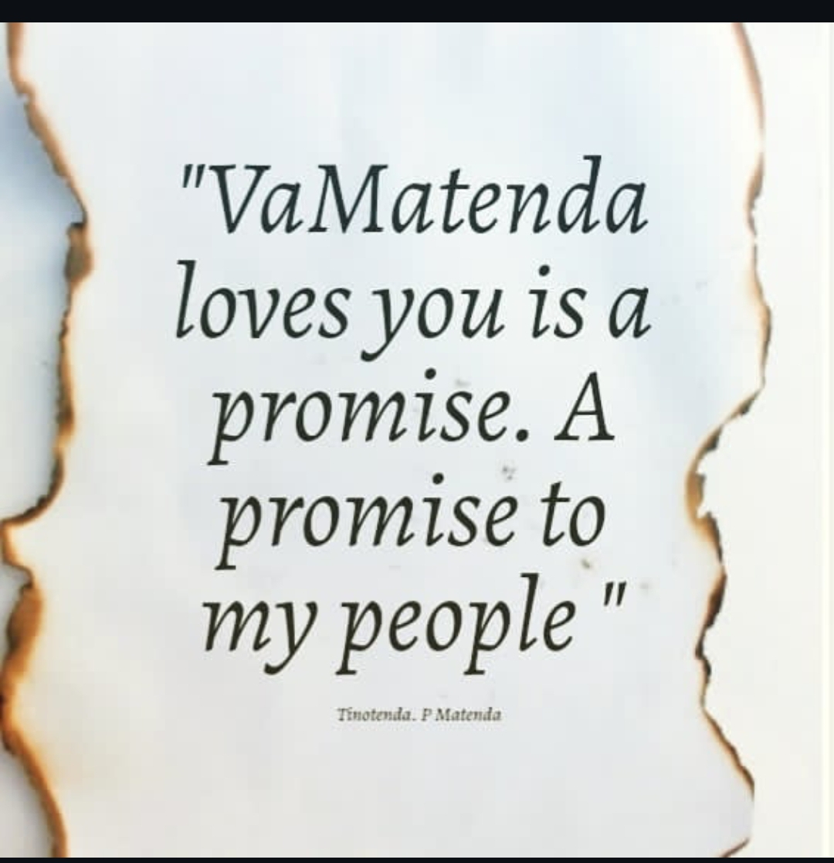
Quotable Quotes
Vamatenda Loves you is a promise , a promise to my people
It is a constant reminder that whenever i say vamatenda lovesyou i ama making a apromise to better the lives of communities and individuals who constantly trust me to lead. it is a personal inspiration to be a faithful and dedicated leader who leads with love .

Slide 3
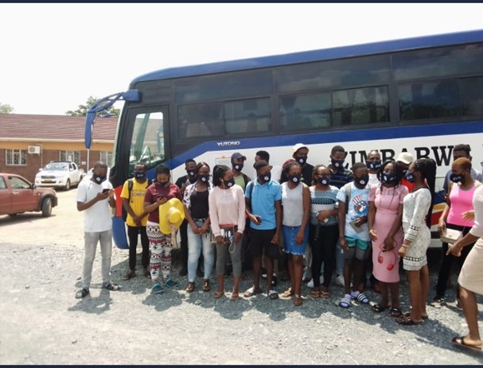
Experience as a leader
the definition of a leader is not one who holds positions and titles. for me being a laeader is a out the long term impact that my services makes. titles have a tenure and when that ends it is the results,impacts, lives inspired and lives transformed that counts. Coming bfrom the dusty streets of chitungwiza to rise gradually from leading my small community as a junior councillor, junior mayor, going to regional representation and international plartforms is the pinacle of my story. from the sewer filled streets of chitungwiza young people can dream big and achieve far beyond their imaginations that has been my story and the greatest impact i have made so far is to give hope to other children and youths trough myblife.
Insert photo
with support from the Zimbabwe Red Cross Society i led a team that did the training of campus GBV champions

Slide 4
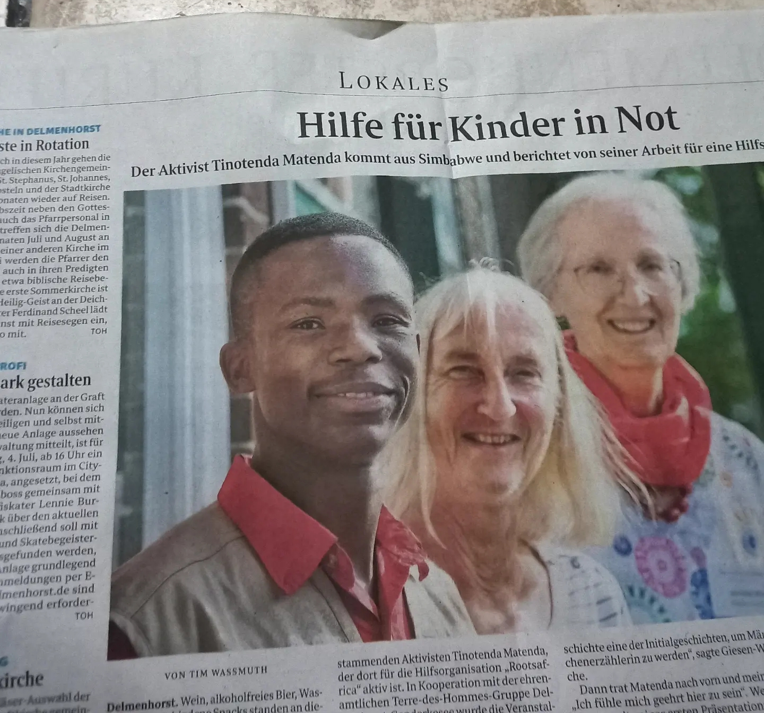
WHO IS THIS YOUTH CHAMPION?
Detail
Born 21st of April in the hyear 2001 at st marys clinicin chitungwiza. i am a young zimbabwean leader who is primarily interested in youth participation, youth empowermnet and gender equality. The first son in a family of six and the most senior brother amongst my many cousins. this gives me a greater responsibility to the world i represent but also from the family set up which is the primary unit for a community . I hold a degree in Social Work from Zimbabwe Ezekiel Guti University and an executuve certificate in project monitoring and evaluation from the Bindura University of Science education.
Include Photos or videos

Slide 5
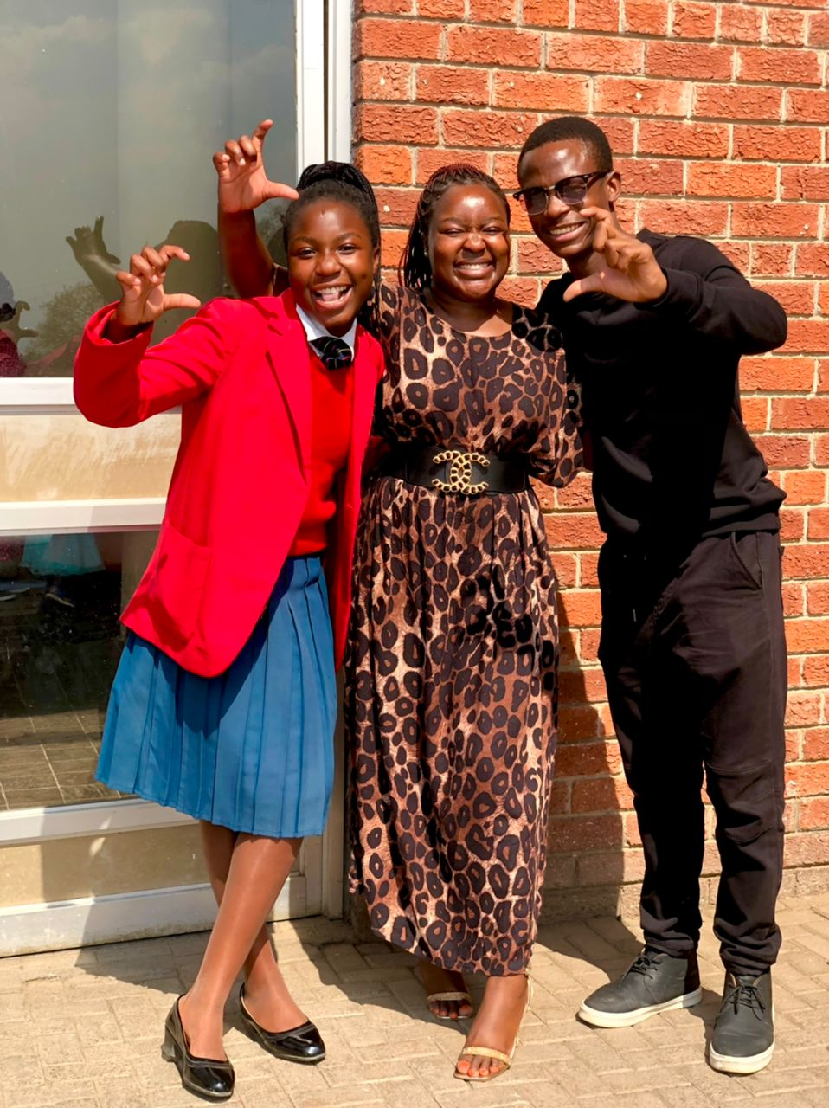
WHAT DRIVES YOU?
Detail
My Vision is to be a visionary leader who inspires and empowers people young and old to be active citizens and to dream big and conquer
to be successful socially, economicslly while politically indipendent to better contribute to the development of my family and society
during form 1 and 2 , i was a science student interested in engineering and making inventions like the electronic green book thst i created for the science exibition competitions in 2016. even within the sciec=nce space i took up places of influence and leaderhsip naturally. through my interaction with the police force and junior council i began to have a deeper appreciation of challenges affceting children and youths. at the sane time recognising that not all the children and young people have the oppoetunity to engage high level platforms thus i dedicated my engagemebnts to empower young people and their communities including by promoting gender equality . i put my sisters in the shoes of the struggle that i hear other women face and this drives me to contribute to a better society where even those close ro me can thrive and prosper
Include Photos or videos

Slide 6
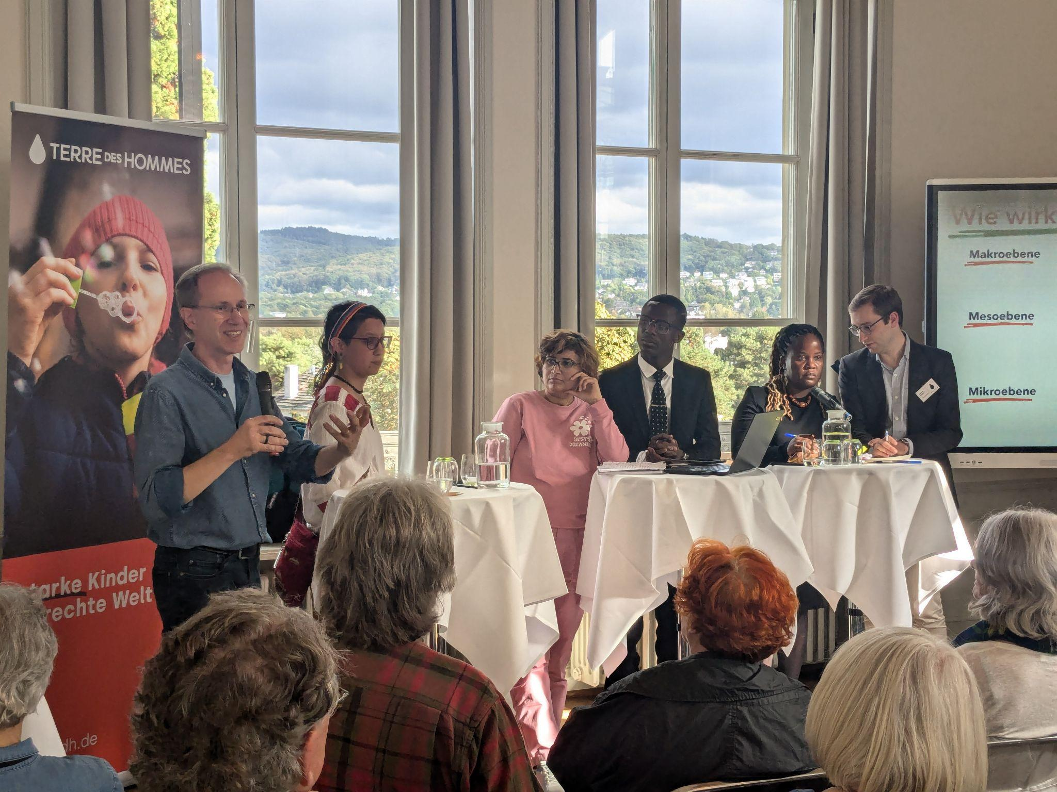
WHAT DO YOU DO?
Detail
i represent youth at differnt levels including the International Youth Network of terre des hommes Germany . and i have been working to empower youths working in climate change, gender and those in the context of migration . i have influenced the increase of youth participation at the hghest making decision of the international organization. i also work at community level engaging with traditional and religious leaders and other community structures

Slide 7
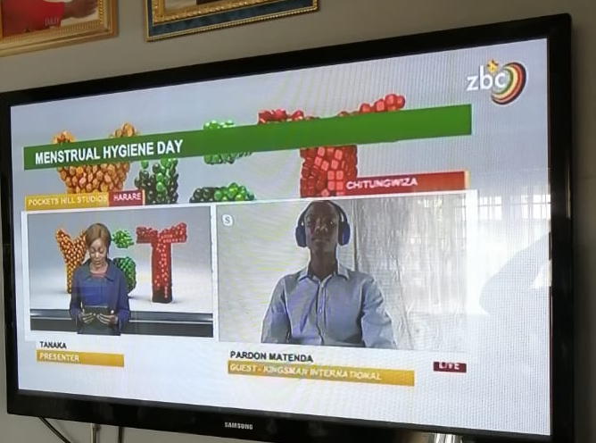
CHALLENGES
The greatest challenge has ben, being a young person. when you try to engage communities and leaders they will primarily treat you as another young person challenging their authority. however by using respect and cultural competence as well as being adequaltely informed on relevant issues, i have ensured that i can engage with seniors and peers without being judged about my age
Share videos/photos of evidence

Slide 8
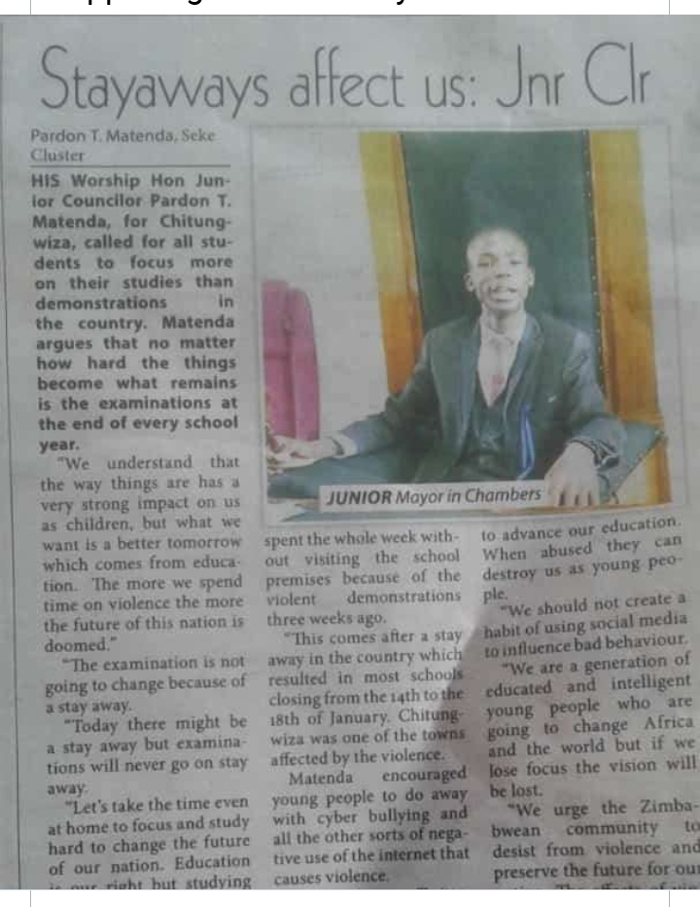
What has changed in your life?
i have grown to be a responsible family man and a good brother through my work on gender and youth empowerment. getting to interact with various people across all levels give me a greater appreciation of how i can be a better man and better leader

Slide 9
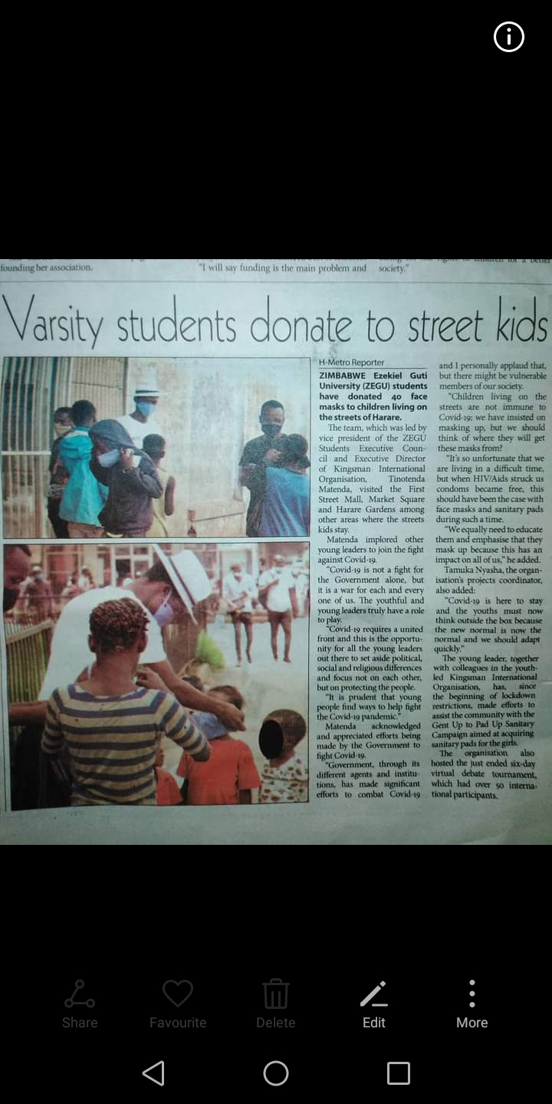
What Capacity Building Initiatives Have You Initiated?
i have organised and facilitated leadership development trainings for young people and specific groups like junior councillor building on my professional and personal experince. i have initiated charity drives t support vulnerable families and opharns to have basic resources and access to sanitary ware as well as sexual and reproductive health information.
through my work with ROOTS i have been able to assist build confidence and self esteem for AGYW who are members of girls clubs and otger community members at grassroot, national regional and international levels

Slide 10
Lessons Learnt
there is a very strong relationship between how you help and develop yourself as a leader and how you help and represent others.in ths day and time people we lead are moved by results and evidence

Slide 11
NEXT STEPS
my future plans are to further enhance my academic qualifications by obtaini ng furter studies in International law. this will help me better manueveer the global development landscape combining my social work knowledge and legal knowledge. especialky around advocacy.

