Slide 1




SADC PROTOCOL@WORK SUMMITS AND AWARDS
2024
BUBI RDC GENDER RESPONSIVE BUDGETING Template
(Zimbabwe, Bubi Rural District Council,06112024 B Ndebele)
.

Slide 2
OVERVIEW
COUNTRY | ZIMBABWE
COUNCIL (HUB/SPOKE) | BUBI RURAL DISTRICT COUNCIL
GENDER CHAMPION | COUNCILOR SIBONGILE NDLOVU
GENDER FOCAL PERSON | CHARLOTTE SIDUDUZILE MAPHOSA
Latest score (year)
 | Income | Expenditure | % Gender Specific
Budget (YEAR) | 2024
 | Women | Men | Total | % Women
Council | 11 | 19 | 30 | 37%
Management | 3 | 4 | 7 | 42.9%
Council staff overall | 22 | 83 | 105 | 21%
Population served
Key characteristics

Slide 3

  I. POLICY FRAMEWORK
Council does have a gender policy approved in March 2024.
Photo of the Gender Policy

Slide 4
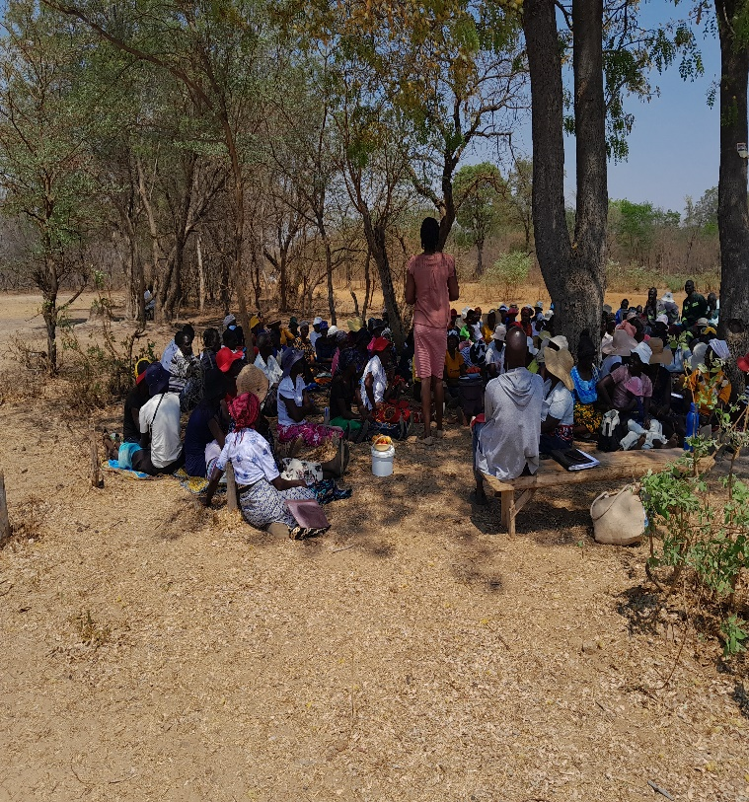
II. THE BUDGET PROCESS
Detail
Evidence
We ask women what they want during consultations for example Mother’s shelter, clinics, education facilities, water.
The register disaggregated data per gender, majority of the people were women.
Public notices were sited at business centers and through councilors and traditional leaders who stay with people.
Photos or video of budget consultation

Slide 5
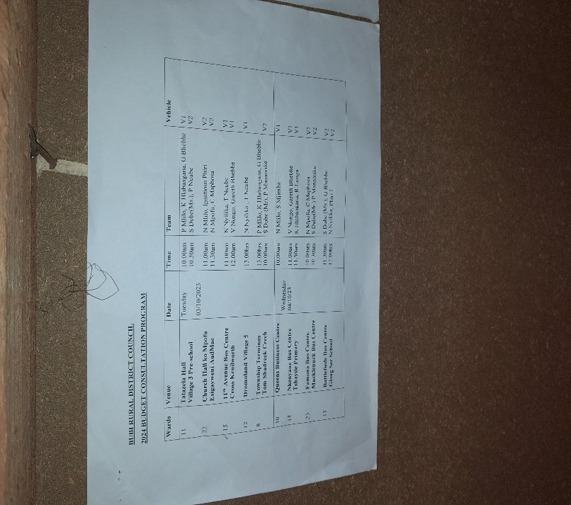
II. THE BUDGET PROCESS
Detail
Evidence
Yes through the village head and ward leadership, they were consulted.
Yes, but it is at leadership level, working towards having ward and village WhatsApp groups.
This method was not very effective as some women live in remote areas without network

Slide 6
II. THE BUDGET PROCESS
Does the council have sex/age/PLWD statistics on those who participated in the consultations? – refer to consultation registers and populate table below
Consultation | Women |  |  |  |  | Total | Men |  |  |  |  | Total | % Women
 | Age |  |  |  |  |  | Age
 | - 15 | 15-35 | 36-59 | 60+ | PWD |  | - 15 | 15-35 | 36-59 | 60+ | PWD
 | 2 | 121 | 236 | 51 | 12 | 422 | 3 | 54 | 246 | 108 | 12 | 423 | 50%
% |  | 29 | 56 | 12 | 3 | 100% | 0 | 13 | 58 | 26 | 3 | 100% | 50%

Slide 7
III. REVENUE
Internal 51%
External 49%
In some cases we reduced tariffs after realising that some people will not afford.
Women complained that they did not have income generating projects and are not employed, thus they do not have money.
Devolution fund; specifies the projects such as boreholes, clinics and schools.

Slide 8
IV. EXPENDITURE
Type of expenditure | Amount | %
Gender Management Systems | 82,080,00 | 0%
Employment Expenditure (Human Capital Expenditure) | 3,999,161,772 | 20%
Employment Equity related expenditure | 7,106,795,408 | 37%
Gender Specific Programming | 1,416,000,000 | 7%
Main Stream Programmes | 6,681,755,318 | 36%
Other | 36,900,00 | 0%
Total | 19,332,692,498 | 100%
Insert Pie Chart/Table

Slide 9
IV. EXPENDITURE
Type of Expenditure | Amount | Proportion (%)
Gender Management System (GMS) | 82,080,000 | 0%
Employment expenditure (Human Capital Expenditure) | 3,999,161,772 | 20%
Employment equity related expenditure | 7,106,795,408 | 37%
Gender Specific Programming | 1,416,000,000 | 7%
Mainstream Programmes | 6,681,755,318 | 36%
Other | 36,900,000 | 0%
Total | 19,322,692,498 | 100%

Slide 10
IV. EXPENDITURE- GMS
Council has Gender and LED Committee, Gender Focal Person and Gender Champion.
Council budgeted for GMS activities, specifically in the Gender Budget.

Slide 11
IV. Gender Specific expenditure
Council has Commemoration of International Day, Junior Council, Gender training workshops.
They are visible in the Gender and LED Budget working papers.
2%
The projects budgeted for were informed by budget consultations.
Boreholes to be drilled will alleviate the crisis of access to water, reduce long distances walked to fetch water, Construction of clinics will also reduce distances walked to access health services, Construction of schools will create access to education for a girl child.
Through the Gender Responsive Budgeting

Slide 12
IV. EMPLOYMENT EXPENDITURE
 | Women |  |  | Men |  |  | Total | % women
 | Managers | Staff | Total | Managers | Staff | Total |  | Managers | Staff | Total
Full Time | 2 | 12 | 14 | 3 | 10 | 12 | 27 | 33% | 39 | 52
Part time | 0 | 5 | 5 | 1 | 4 | 5 | 10 | 0% | 16 | 50
Casual | 0 | 0 | 0 | 0 | 0 | 0 | 0 | 0% | 0 | 0
Total | 2 | 17 | 19 | 4 | 14 | 18 | 37 | 33% | 55 | 51
Women workforce 55%
Women in Management 33%
Women in full time, part time an casual labor force 16%
To the number of posts that have been offered to women in the organisation

Slide 13
IV. EMPLOYMENT EXPENDITURE- Gender Wage Gap Analysis
 | Women | Women- Total earned | Women average earned | Men-no | Men total earned | Average earnings
Full Time | 14 | 1,695,220,740 | 121,087,195.71 | 13 | 1,474,632,072 | 113,433,236.31
Part Time | 5 | 432,186,480 | 86,437,296.00 | 5 | 397,122,480 | 79,424,496.00
Casual | 0 | 0 | 0 | 0 | 0 | 0
Total | 19 | 2,127,407,220 | 111,968,801.05 | 18 | 1,871,754,552 | 103,986,364.00
$1,871,754,546.02
Men are more than women. 3, More women are occupying positions that are less paying compared to men. For example, in management women are only 3 and men are 4
In posts that are upcoming council plans to employ women for example in planning department a woman was employed.

Slide 14
V. EXPENDITURE- GENDER IN MAINSTREAM BUDGET
Programmes | Amount | % budget
Governance & Administration | 19,541,730,780 | 39
Water Sanitation & Hygiene | 6,161,466,000 | 12
Social Services | 9,742,080,000 | 20
Roads | 12,565,290,480 | 25
Public Safety & Security
Natural Resources & Conservation | 1,948,806,000 | 4
Total |  | 100
Draw Pie chart here

Slide 15
V. EXPENDITURE- ANALYSIS OF ONE SECTOR EG
 | Women |  |  |  |  |  | Men
 | Age |  |  |  |  |  | Age
 | Below 15 | 15-35 | 36-59 | 60+ | PLWD | Total | Below 15 | 15-35 | 36-59 | 60+ | PLWD | Total
Education | 60% | 20% | 15% | 0 | 5% | 853,057,392.00 | 42% | 40% | 6% | 2% | 10% | 950,446,608.00
Housing | 3% | 12% | 55% | 20% | 10% | 76,140,000.00 | 5% | 20% | 40% | 15% | 20% | 85,860,000.00
Social amenities | 5% | 40% | 30% | 5% | 20% | 1,943,666,736.00 | 5% | 30 | 35% | 5% | 25% | 2,165,565,264.00
Total | 68% | 72% | 100% | 25% | 35% | 2,872,864,128 | 52% | 90% | 81% | 5% | 55% | 3,124,871.87

Slide 16
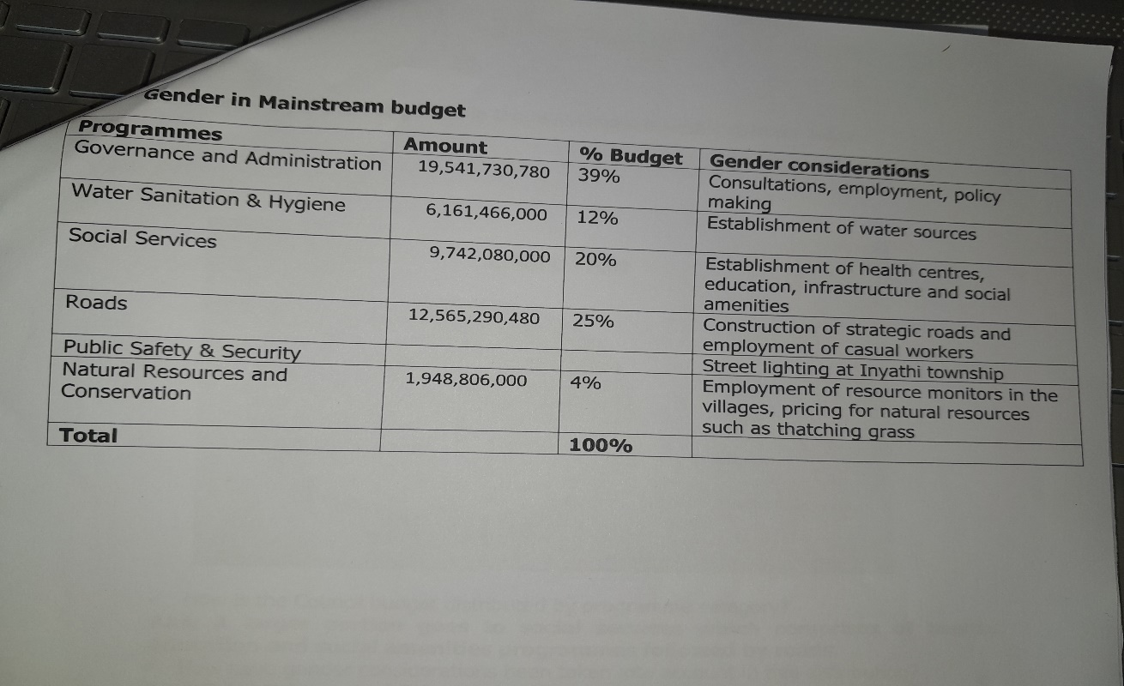
V. EXPENDITURE- GENDER IN MAINSTREAM BUDGET
PHOTO
Stakeholder engagements
Budget consultation of all groups

Slide 17
V. EXPENDITURE- GENDER IN MAINSTREAM BUDGET – EXAMPLE
 | Amount | No of beneficiaries | Percentage
Total Expenditure | 39,253,920.33
No. of Men benefiting from council allocations |  | 2,477 | 67%
No. of Women benefiting from council allocations |  | 1,239 | 33%
Total beneficiaries |  | 3,716 | 100%

Slide 18
VI. BUDGET CROSS SUBSIDISATION ANALYSIS
 | Income (A) | % of total budget | Expenditure (B) | % of total budget | Surplus/Deficit
Governance & Administration | 19,541,730,780 | 39% | 19,541,732,048 | 39% | 1,268
Water, Sanitation & Hygiene | 6,161,466,000 | 12% | 6,161,466,000 | 12% | 0
Social Services | 9,742,080,00 | 20% | 9,742,080,00 | 20% | 0
Roads | 12,565,290,480 | 25% | 12,565,291,080 | 25% | 600
Public Safety and Security
Natural Resources & Conservation Mgt | 1,948,806,000 | 4% | 1,948,806,000 | 4% | 0
Total | 49,959,373,260 | 100% | 49,959,373,260 | 100% | 1,868

Slide 19
VI. BUDGET CROSS SUBSIDISATION ANALYSIS
All programs generate income that is equal to expenditure, the differences are insignificant and were due to exchange rates.
NIL
NO
Public facilities- inadequate sanitation and hygiene facilities for women.
Gender disparities in funding- girls’ education is often underfunded particularly in STEM fields.
Scholarships and grants- women often have limited access to financial aid.
Gender specific diseases- research and treatment for conditions like breast cancer and prostate cancer receive unequal funding
NIL

Slide 20
VII. CONCLUSIONS AND NEXT STEPS
Schools, health centres, waiting mother’s shelters and inviting development partners who target specific type of gender.
Council intends to do training on gender budgeting with its staff, like the CEO, Treasurer and Council Chair have been trained externally.

