Slide 1




SADC PROTOCOL@WORK SUMMIT 2024
GENDER DRIVERS OF CHANGE Template
(Zimbabwe, Vungu Rural District Council ,11-12 November 2024
presented by Councillor Yeukai Paradza)

Slide 2
Quotable Quotes
Provide a quote from the work/project you are presenting.
How does this reflect your leadership capabilities/qualities?
Evidence
NAME YEMURAI T GUVEYA
CONTACT DETAILS 0779636625
COMMENT ,the activities to which Councillor Paradza is handling in the society have greatly impacted in social change of many women and youth ,the idea disembarks a lot of the above mentioned from idleness and hence destroys opportunities be it of drug and substances abuse ,unwanted pregnancies ,and even alcohol abuse and prostitution. She has helped in and still assisting in schools to curb challenges for learners by providing school work and school necessities

Slide 3
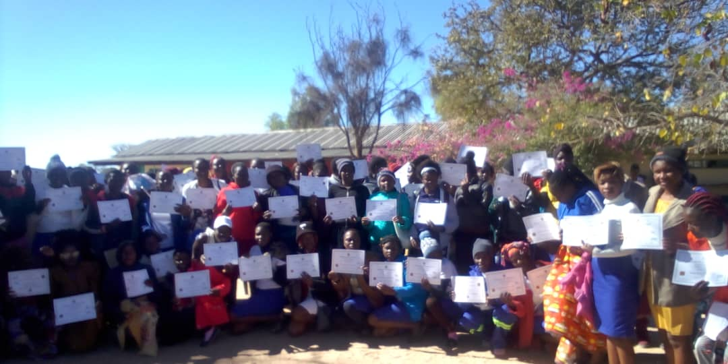
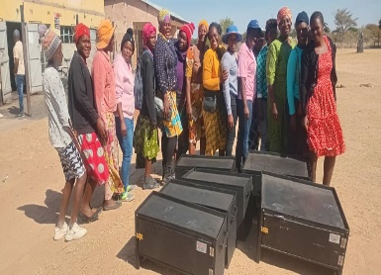
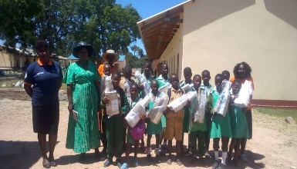
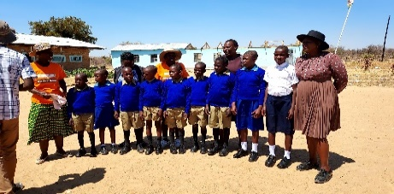
Experience as a leader
Share a short story of your leadership journey.
In what way do you qualify to be a leader/driver of change?
Insert photo
I was elected to be a councillor in 2018 upto date i got inducted and went to went various workshops with gender links ICLD (Swedish internation centre for local democracy)2022 . As a gender champion I introduced the program of ndoga stoves where women bake buns and sell to business people, school and in turn get resources to sustain their families. I also introduced nutrition gardens and cob shellers as away of empowering my communities.. These programs have changed the lives of many residents as they can now make ends meet. These programs were introduced to the widows and widowers in different villages .
I work to reach Sdg 4 ,Sdg2 and sdg 1
A leader recognise wher she/he needs growth and where you need change , be honest with yourself , be committed , accept critism accept to loan be prepaired to make change . You need to deligate some of your work

Slide 4
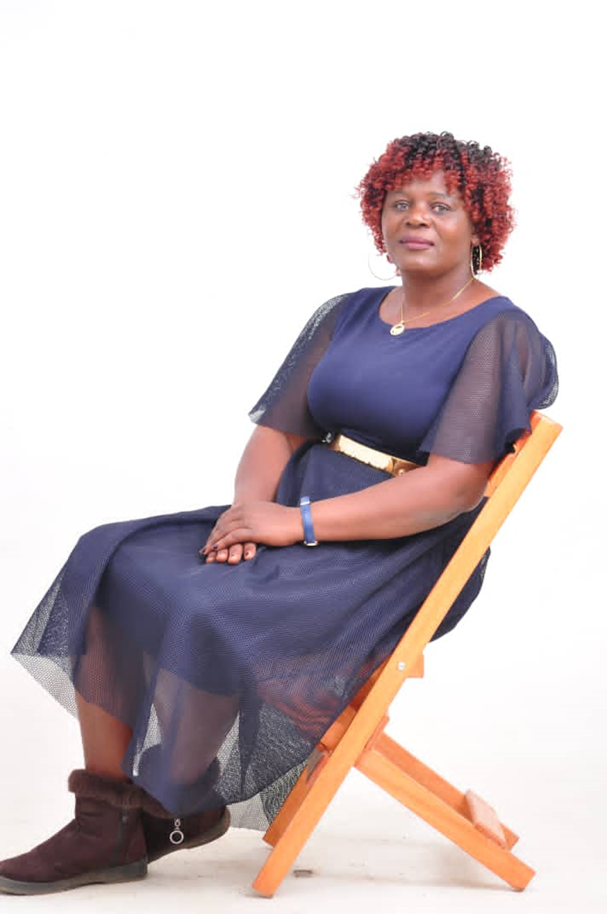
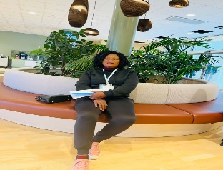
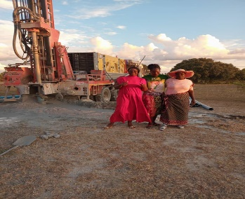
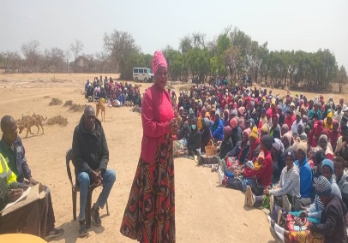
WHO IS THIS LEADER?
Detail
Who you are
Where you are from
What makes you unique
Include Photos or videos
Councillor Yeukai Paradza ward 12 from Vungu rural district council Gweru . Married blessed with 3 girls
Hardworking , innovative , driver of empowerment for all the groups of people

Slide 5
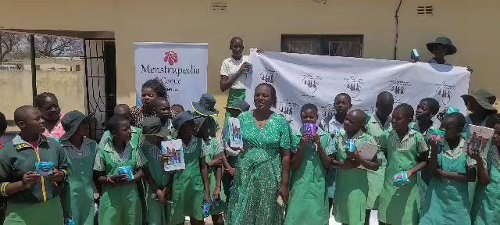
WHAT DRIVES YOU?
Detail
Vision
Objectives
Your commitment to gender equality
Include Photos or videos
Equal opportunities for everyone
Uplifting the livelihood for women and the child in the societies to transform discrimination practises together
sustainable development and human rights
Sdg goal number 5 ,10,3

Slide 6

WHAT DO YOU DO?
Detail
Describe your work and how you have influenced gender equality e.g. gender mainstreaming, gender budgeting etc.
Include Photos or videos
Equal opportunities for everyone in program implementation , budget consultations and in discussion making
Sdg 10 reduces inequality ,17 partnership for the goal ,8 Descent working and economic growth and 6 Clean water and sanitstion for all

Slide 7
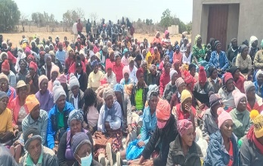
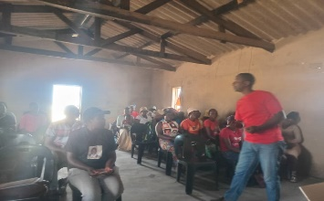
GENDER EQUALITY CHALLENGES
Describe the challenges faced in pushing for gender equality in your community and organisation.
How have you addressed the challenges?
Share videos/photos of evidence
Resistance to change
Cultural and social believes
Pull her down syndrome
Educating through dialogs and workshops
Empowering women , gain power
Give them access to resources eg training employment to state their projects

Slide 8
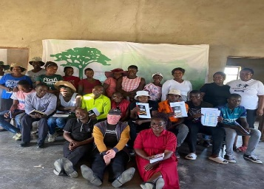
CHANGES AT INDIVIDUAL LEVEL
How has championing gender influenced your life?
What has changed in your life?
What/who do you attribute this/these changes to?
What are your achievements?
Include Photos or videos
Now a gender champion
Now gender neutral
The community at large
Women and youth participation

Slide 9
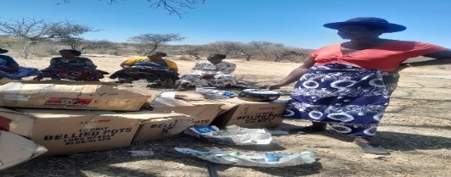
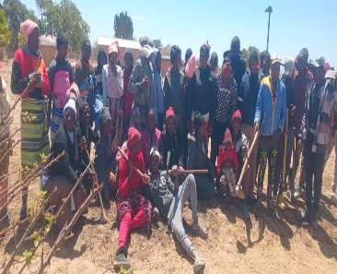
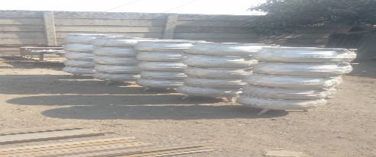
CHANGES AT THE HOUSEHOLD LEVEL
How has championing gender equality led to changes within your family and close circle?
Include Photos or videos
Iam a strong leader
I am able to understand and manage emotion at all cost
Share house hold chores
Placed an end to gender discrimination

Slide 10
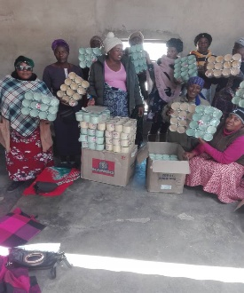
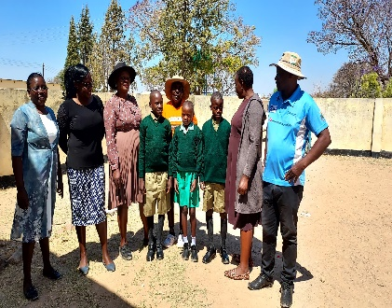
CHANGES AT THE INSTITUTIONAL LEVEL
How has championing gender equality led to changes within your institution especially in gender management systems, and gender budgeting?
Include Photos or videos
Placed an end to gender discrimination and women empowerment has increased
Reduction in crime rate
Reduction in drug and substance abuse
Reduced GBV
Insure in gender budget and having a gender policy at work

Slide 11


CHANGES AT POLICY LEVEL
To what extent have you contributed towards gender equality policy changes in the council?
Have you advocated or lobbied for any changes in the budget to make it more gender-responsive?
What other policies have you influenced or advocated for?
Include Photos or videos
To a large extent through different empowerment schemes such as Donga stoves.
Yes we have lobbied for gender responsive budget and implemented a gender committee
To eradicate gender discrimination and inequalities in all spheres of life and development

Slide 12
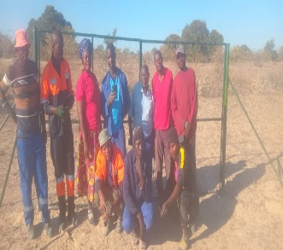
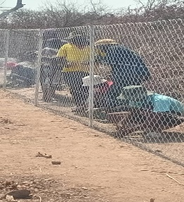
INFLUENCE AT COMMUNITY LEVEL
How have you influenced community/citizen participation in local government processes including public meetings, budget processes, and other programmes?
Include Photos or videos
Implemented nutrion gardens
Initiated ward development meetings , and consultation days
Did workshop

Slide 13
Lessons Learnt
What lessons have you learnt?
learnt how to navigated through gender biased communities and how to teach people living in such communities about the impotence of gender equity and equality

Slide 14
NEXT STEPS
What are your future plans?
Use graphics and tables to illustrate the next steps
Improvement | SDG number
Reduction of inequality ie getting women into power | 10
Gender equality full partiction of both genders in desscion making | 5
Make education gender sensitive | 4
Promote indigenisation through various projects to get rid of poverty | 1

