Slide 1




SADC PROTOCOL@WORK SUMMITS AND AWARDS
2024
INSTITUTIONAL COE
(ZIMBABWE, RUSAPE TOWN COUNCIL , 6 NOVEMBER 2024 Presenter AUYA PATRICIA:)
.

Slide 2
OVERVIEW
COUNTRY | ZIMBSBWE
COUNCIL | RUSAPE TOWN COUNCIL
GENDER CHAMPION | MRS CHRISTINE MUREMBWE
GENDER FOCAL PERSON | MS AUYA PATRICIA
RUSAPE TOWN COUNCIL IS A HUB
Latest score (year)
 | Women | Men | Total | % Women
Council | 5 | 8 | 13
Management | 1 | 7 | 8
Council staff overall | 85 | 168 | 253
Population served | +-45 0000
Key characteristics

Slide 3
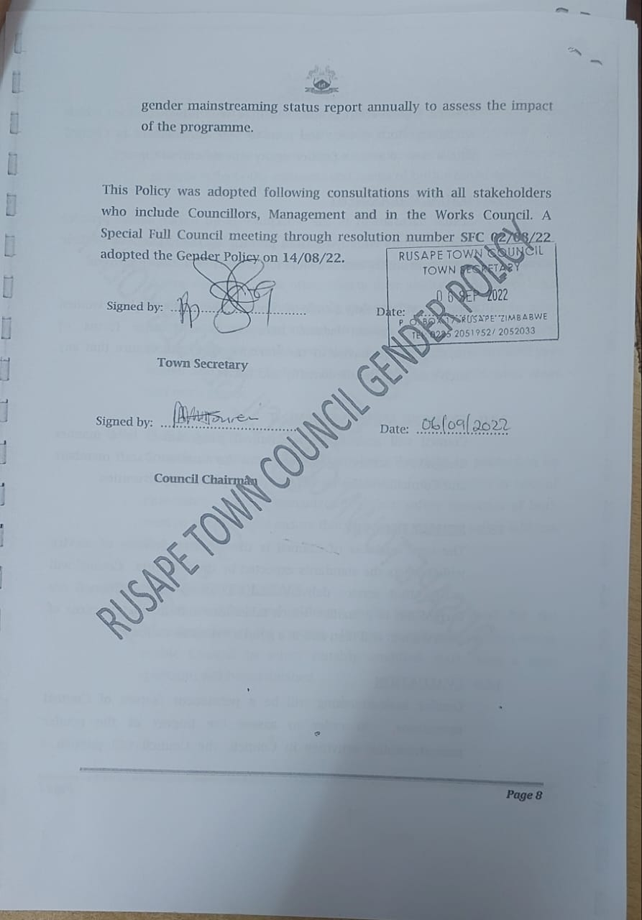
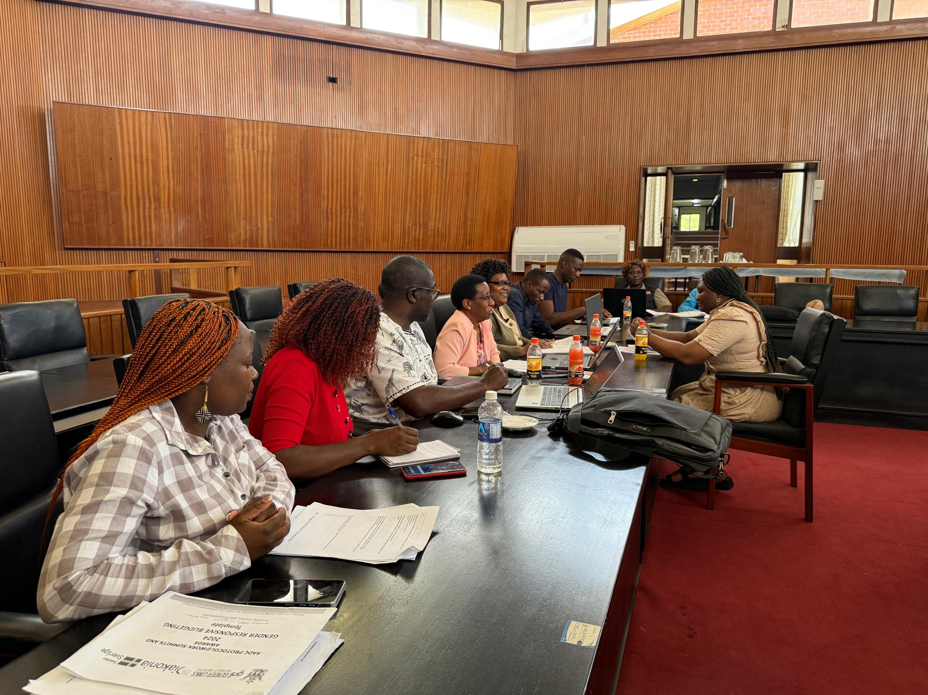
I. GENDER POLICY, ACTION PLAN, HUB AND SPOKE
Rusape Town Council has gender policy and action plan that incorporates the Post 2015 SADC Gender Protocol, SDGs and other relevant statutory.
The policy is well known and has a high profile champion Mrs Christine Murembwe and a vibrant focal person Ms Auya who pushes for policy review when neccessary
Photo of the Gender Policy

Slide 4
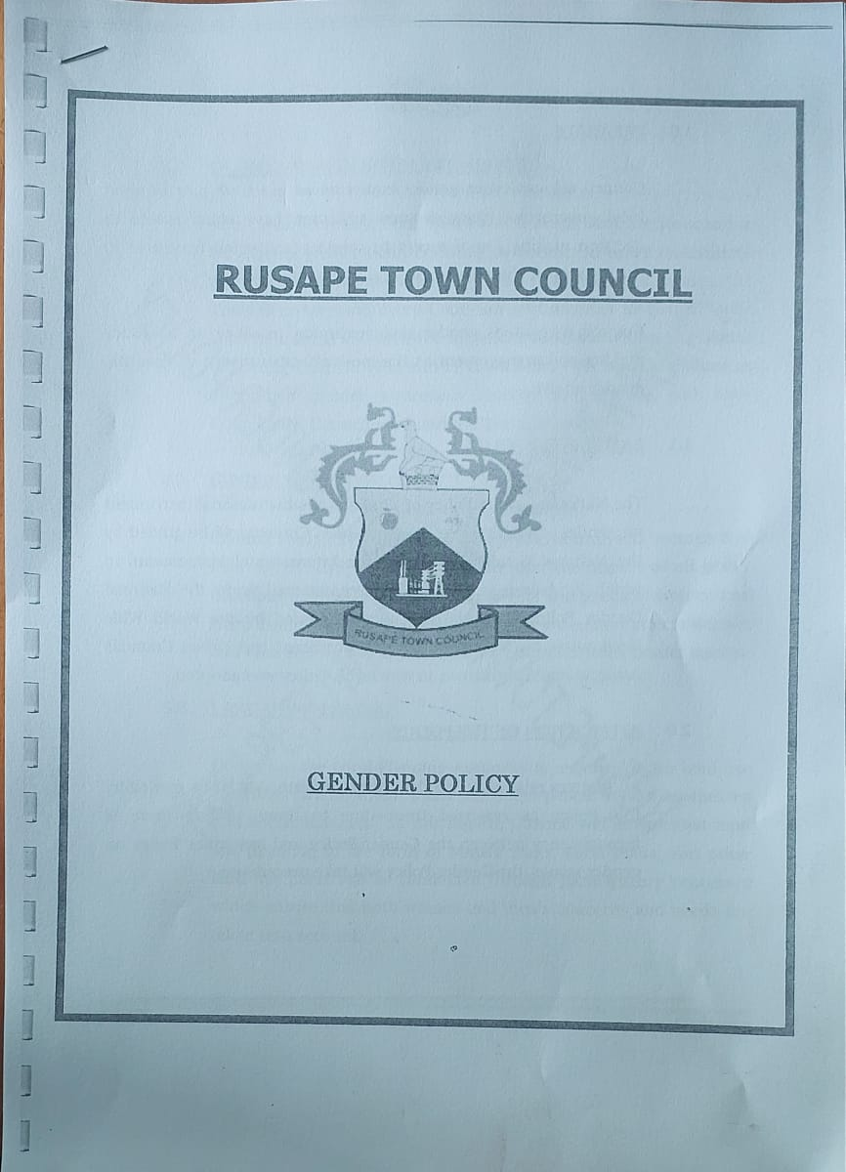
I. GENDER POLICY, ACTION PLAN, HUB AND SPOKE
Rusape Town Council contributed to the hub and spoke activities by attending summit preparatory meeting .
Hub and spoke activities are usually conducted 2 times per quarter however due to financial constraints we managed to meet once at Mutare civic centre
Photo of the Gender Policy

Slide 5
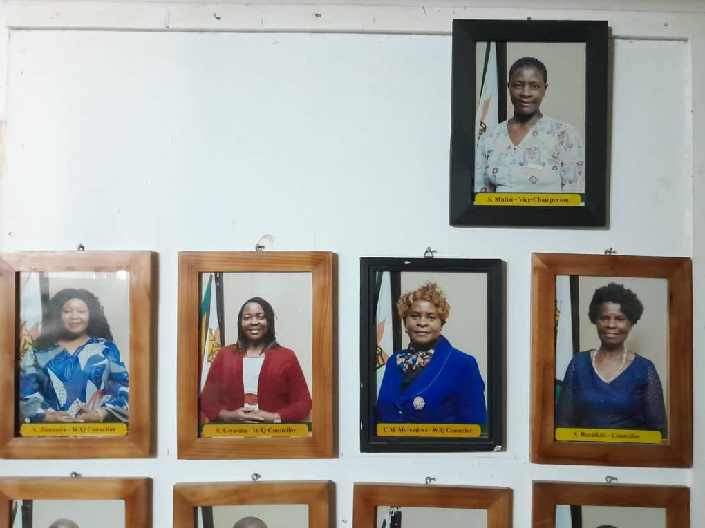
II. GOVERNANCE
Detail
Evidence
Rusape Town Council has 13 councillors 5 are female and 8 are male . which is 5: 8 proportion.
Out of the the 5 women 2 female councillors are elected and 3 are from women’s quota)
Rusape Town Council has 5 committees
Ony 1 committee is chaired by a woman (Housing, health and environment committee chaired by Cllr Redemptor Gwasira).
There is no committee chaired by PWD
women/ youth/ PWD participate in council consultations and decision-making through stakeholder consultation voicing their needs and priorities and also participate through civic organisations which represents their needs and perspectives
Photos or video of women leaders.
‘’WE ARE MORE POWERFUL WHEN WE EMPOWER EACH OTHER’’ Coco Channel

Slide 6
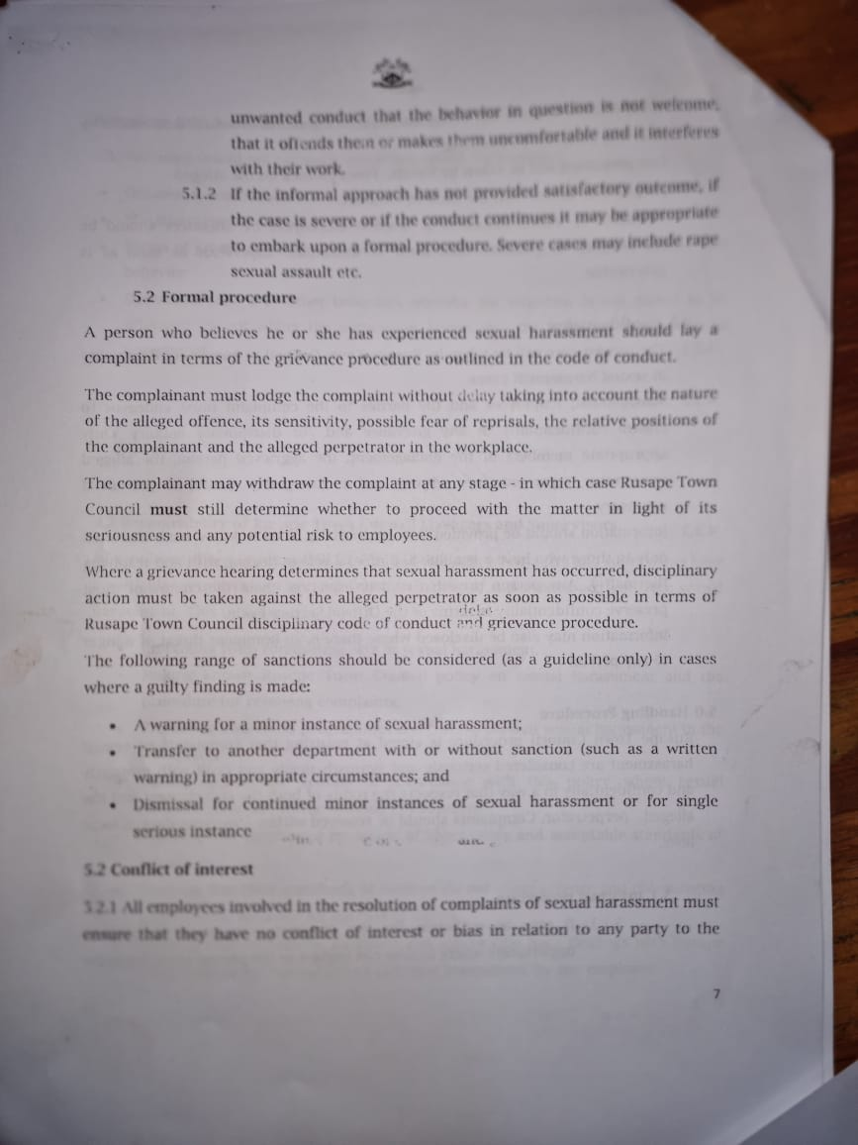
III. WORK PLACE POLICY AND PRACTICE
How gender sensitive is the workplace?
Provide examples.
The proportion of women workforce is 34% (84:253)
Council suports women in the work place by advertising internally , encouraging women to apply for high positions
The proportion of youth and PWD in council is 0.37%
Rusape Town Council has sexual harassment policy in place
How sexual harassment cases are dealt with
one complains through grievance procedure outlined in the code of conduct an investigation team wil conduct all neccesary information to the case , sensetivity and official secrecy is guaranteed, if the victim withdraws the case Rusape Town Council will determine wether to continue with the case or not or a disciplinary hearing action is needed. or if the case needs intervention fthe (ZRP)Zimbabwe Republic Police sexual harrasement policy page 7
Evidence – Include photos and articles as evidence here.

Slide 7
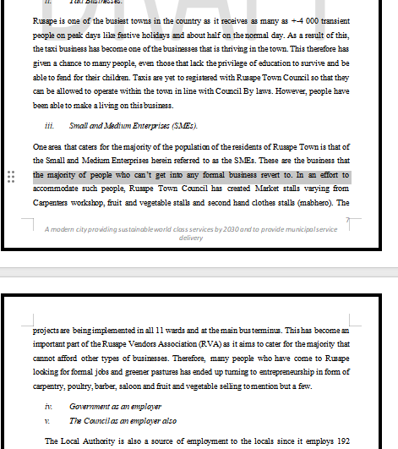
IV. LOCAL ECONOMIC DEVELOPMENT
Rusape Town Council has a local economic development plan which is being reviewed , there are also projects that target women, PWD, and youth for example land allocation for
On designed market places 60% of stands are allocated to men 38% is located to women , PWD and youth are located 2% on an equal opportunity basis.
There is no existence of entrepreneurship finance schemes that are linked to Council.
Counciil provides land and permitts for operating businesses which can be used as collateral for example Mukwecheni issue and some times proof of residence which is a requirement by the banks when opening personal accounts this has helped to promote access to finance for local entrepreneurs, especially women, PWD and the youth?
Rusape Town council allocate tenders based on Procurement Regulatory Authority of Zimbabwe PRAZ rules and regulations which does not state allocation based on gender plus most companies are share owned which is private information .
PRAZ guidelines makes it difficult to determine tenders allocated to women or men.
LED budget is incoprarated in the social services budget which is 9% of the total budget
Include photos, videos and articles or newspaper clippings here.

Slide 8
V. INFRASTRUCTURE AND SOCIAL DEVELOPMENT
Land and housing
Sex disaggregated data of land allocations for council & community beneficiaries.
Sex disaggregated data for housing allocations
Water and sanitation
there are 17 water committees
There is one water project in Rusape :kuture piped water scheme and 16 boreholes The project is gender-responsive since i the boreholes are placed at the centre of the general populace and is accessible to women, men, youth and people with disabilities
.
Housing Allocations | Number | Proportion (%)
Women | 7 | 33%
Men | 14 | 67%
Total | 21 | 100
Water Committees | Number | Chairpersons of Water Committees | Vice Chairpersons of water committees
Women | 3 | 0
Men | 14 | 14 | 0
Total | 17 | 14 | 0
‘’ALL MEN SHOULD BE FEMINISTS IF MEN CARE ABOUT WOMEN’S RIGHT THE WORLD WILL BE A BETTER PLACE WE ARE BETTER OF WHEN WOMEN ARE EMPOWERED IT LEADS TO A BETTER SOCIETY’’ John Legend

Slide 9
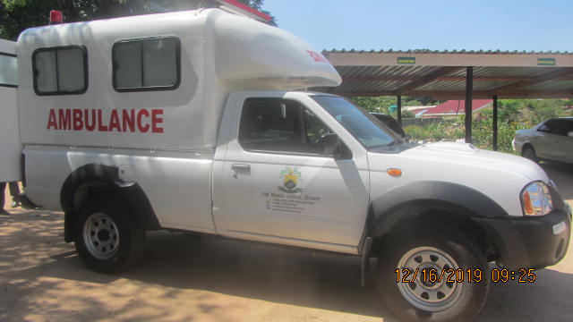
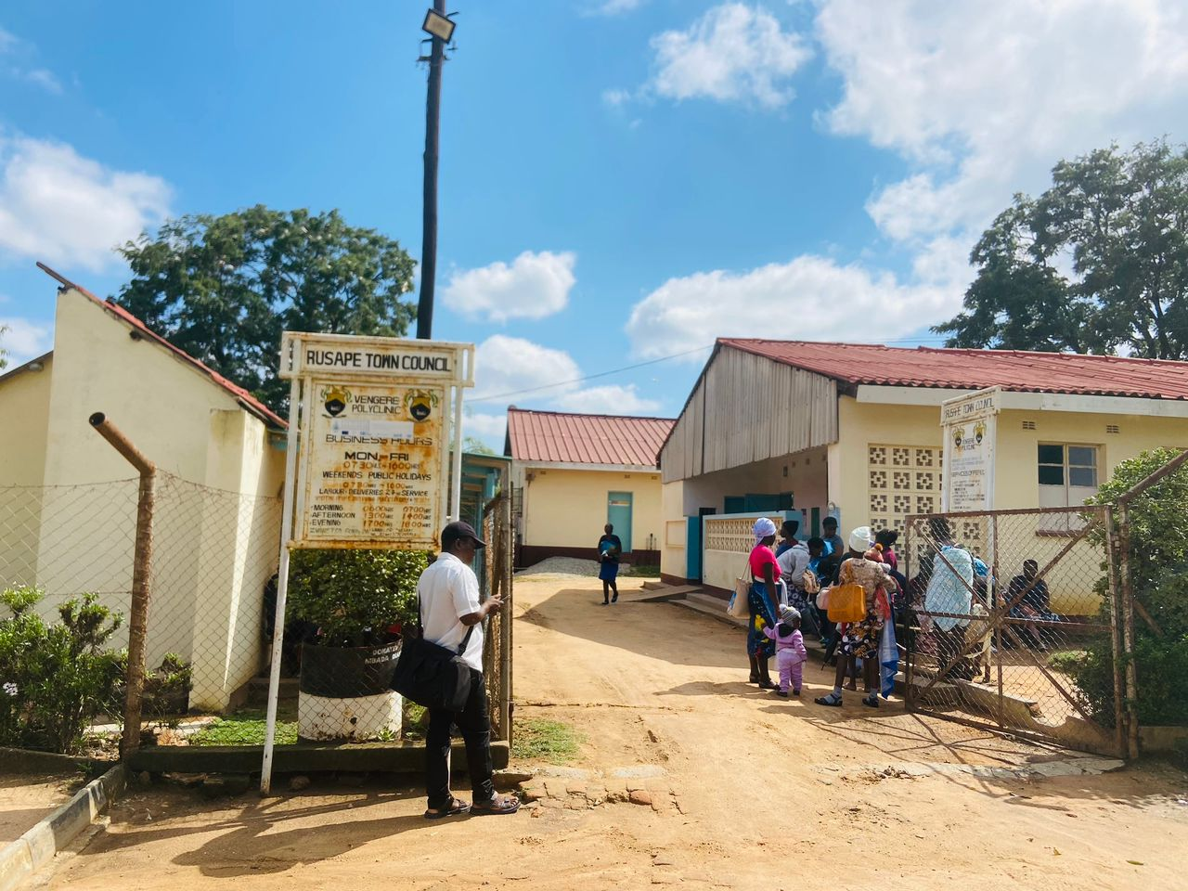
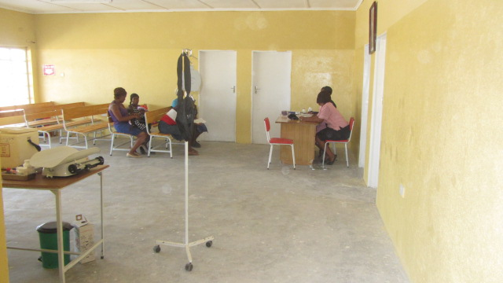
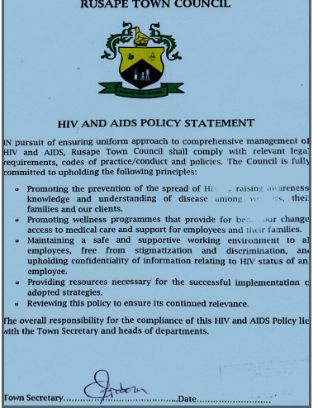
VI. SEXUAL AND REPRODUCTIVE HEALTH, HIV AND AIDS
Rusape Town Council promote SRHR through conducting awareness campaigns programmes , commemorating world aids day. Council has a displayed Aids policy which is against discrimination council also participates in cancer awareness programmes
women, men, people living with disability and youth have access to health facilities and easy access to treatment at all Local Clinics for example distribution of ARV’s
council has ensured that health/SRHR facilities are more accessible to all groups of people all our clinics eg at vengere shopping centre which caters for vengere population , tsanzaguru clinic and Mabvazuva clinic are are located 1 to 2km away from the general populace fo easy access and the facilities are user friendly they have a ramp for disabled persons on wheel chair.
H Council encourage or support Comprehensive Sexual Education (CSE) in school through through the use of Junior Councillors and and health workers clubs .
Evidence – photos/videos of projects and imp

Slide 10
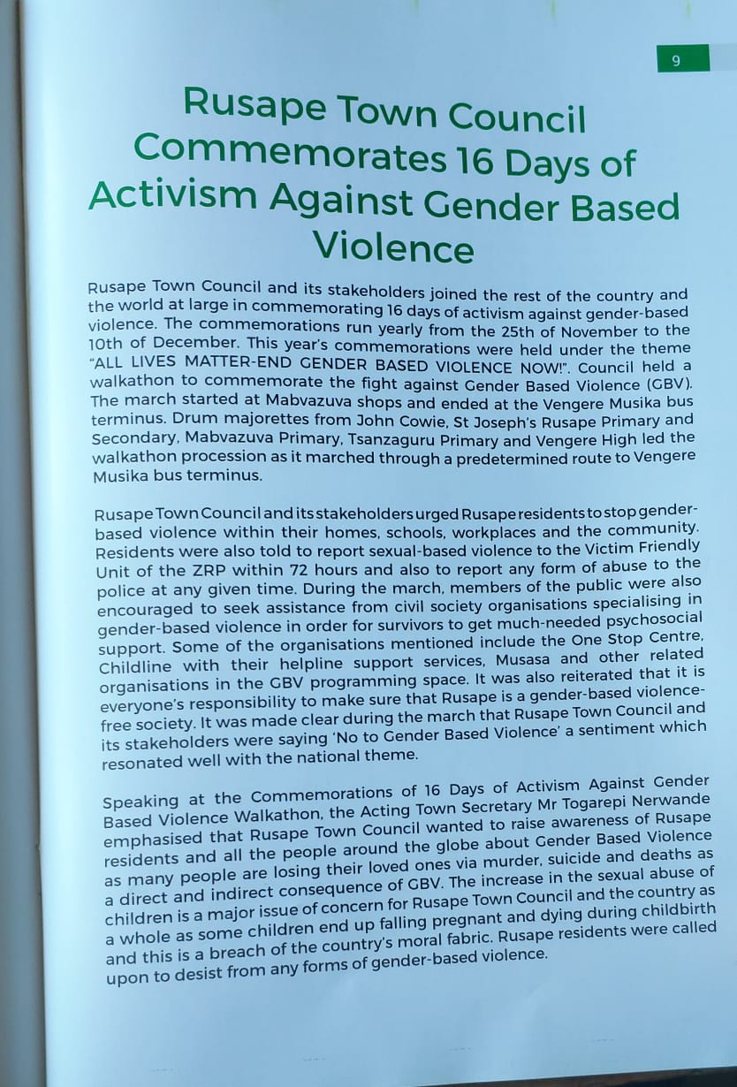
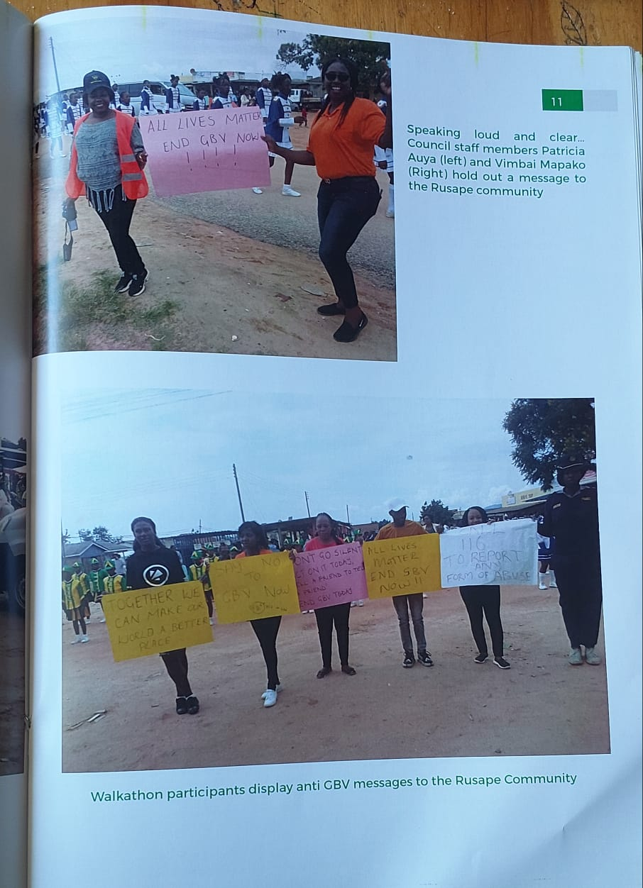
VII. GENDER BASED VIOLENCE
key actions council has taken towards gender based violence
Prevention
Public awareness
Response and coordination
Support and empowerment
Include evidence here

Slide 11
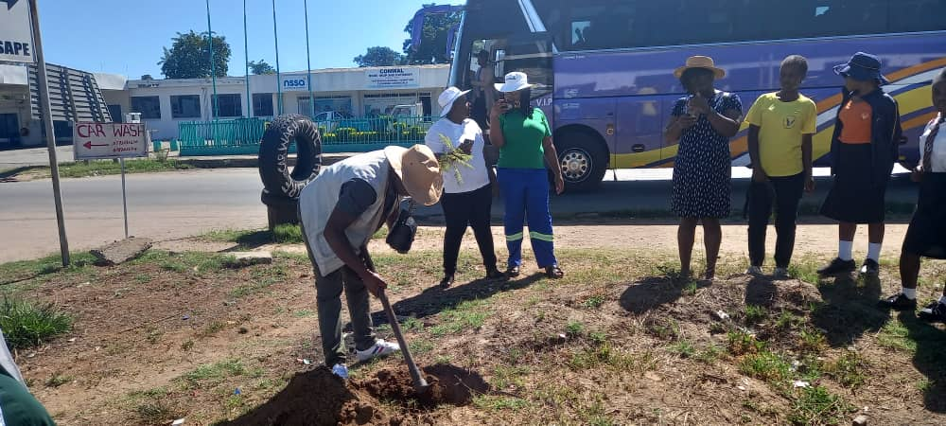
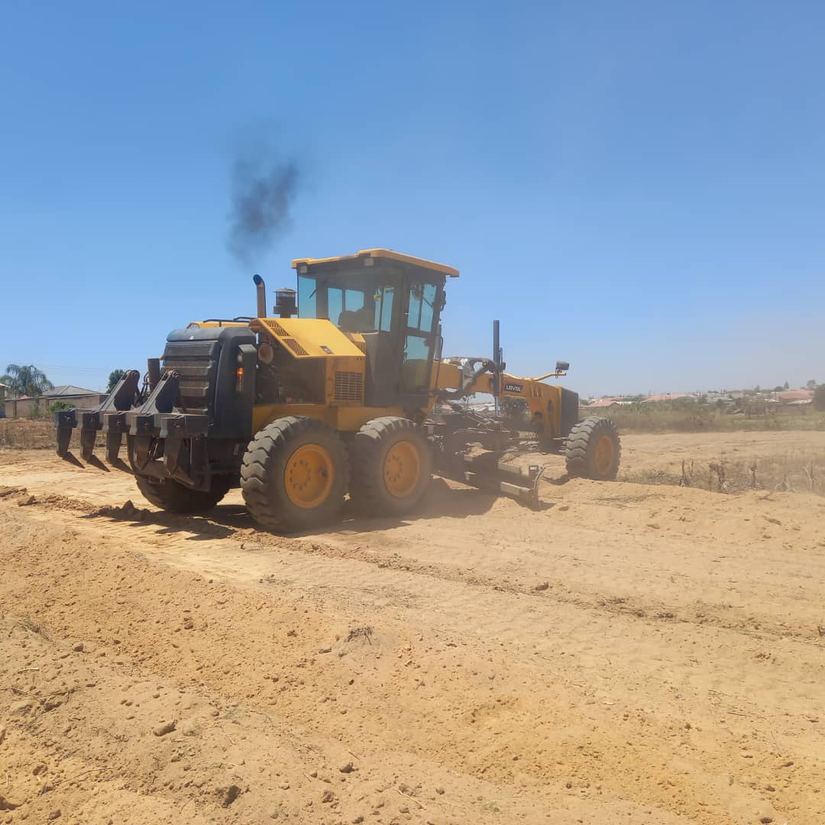
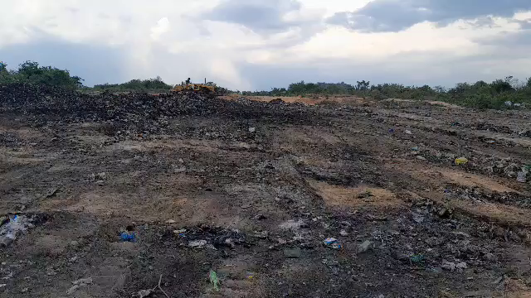
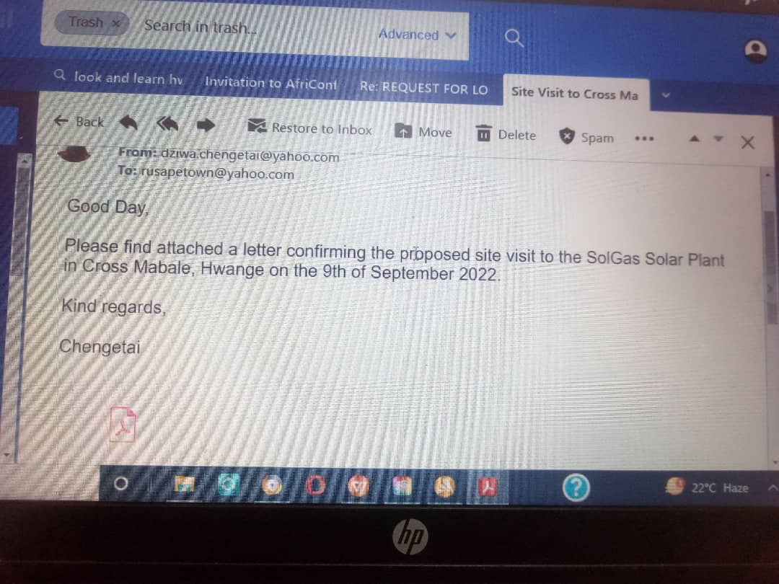
VIII. CLIMATE JUSTICE
Does council have a climate change policy however its under safety, health and environment policy which they are adopting from National climate change response strategy
There is a group of of women, PWD, and youth who are are equally involved in projects that prevent climate change such as waste management, sustainable energy and recycling they are yet no t registered with council but they benefit from economic opportunities arising from this such as getting funds from reselling paper and pastics .
council adapted or mitigated against climate change through tree planting around town , sending prohibition letters of river bank cultivation, dumpsite compaction , land reclamationand engaging solar companies to invest in Rusape

Slide 12
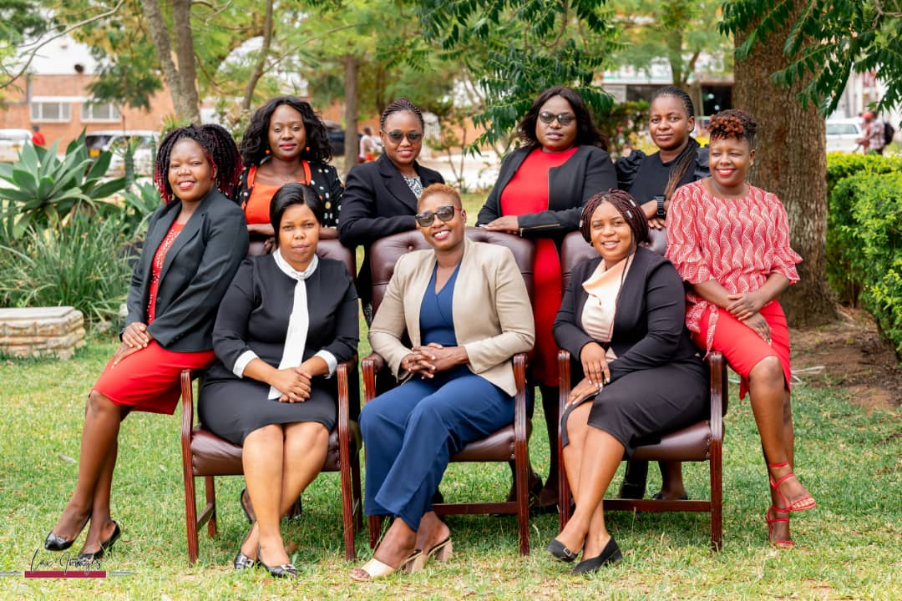
IX. GENDER MANAGEMENT SYSTEM
Rusape Town Council has a . Gender focal persons gender champion and is part of the district gender committee
Gender Action Plan aligned to the Council’s strategic plan
Job descriptions of key functionaries has no gender elements written.
Council monitors and evaluation gender by making sure there women in high position though they are not manegerial posts
Photo
Photo

Slide 13
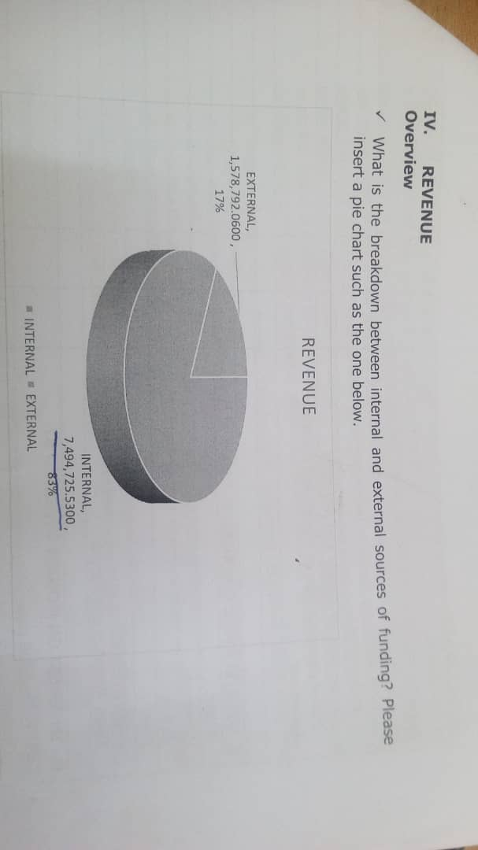
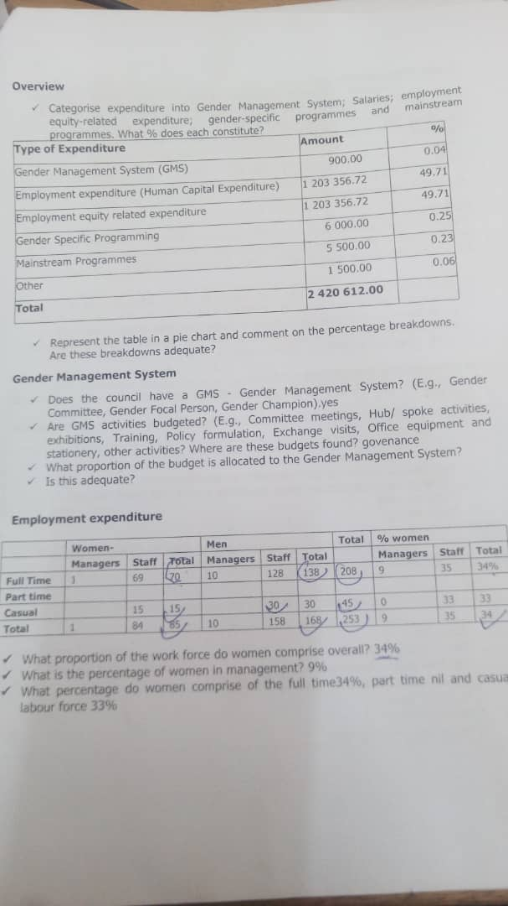
X. GENDER RESPONSIVE BUDGETING
Photo
Rusape Town Council submitted an entry in the GRB category
Council has a drawn up Gender Responsive Budget statement as per Ministry Guidelines
the following are the key highlights of the gender statement.
the GRB statements works together with council’s detailed revenue and programme expenditure budgets which icludes sex dissagregated data of men, women, youth and PWD
Council has a gender policy which is adopted from other national and international framewoks eg the Constituion of Zimbabwe
it states the budget process from planning to implementation stage
Revenue overview source of funding of Council funds.

Slide 14
CHALLENGES
The main challege of the gender management system there is less resource allocation for advocating for resources that support gender initiatives.
Lack of awareness and cultural barriers where there are parochial elements that create barriers for advancement of gender equality.
this has been overcomed by efforts to include gender equality issues by incorpaarating gender budget allocation for activities to do with gender issues.
by encouranging women to participate in application of vacancies of high posts

Slide 15
LESSON LEARNED AND INNOVATION
I have learned that in the COE, hub and spoke process there is need for coordination and financial support for the activities to be effective and that there should be a budget allocated for gender issues.
Council is pushing for a viable budget for gender mainstreaming issues and for CEO and hub and spoke issues.

Slide 16
SUSTAINABILITY AND REPLICATION
COE, hub and spoke work can be sustained within our organisation through having a budget allocated for contributions and participation on activities cordinated by the hub at provincial level.
A clear budget for procurement of promotional materials such as awareness materials eg T-shirts , banners, PA system for entertainment and mobilization flyers , etc
COE and spoke and hub can be sustained if there is a blue print / guidelines that guarantees support from our local authority first.
‘’ IAM NOT A WOMAN TRYING TO IMPRESS IAM A WOMAN TRYING TO PROGRESS’’

