Slide 1




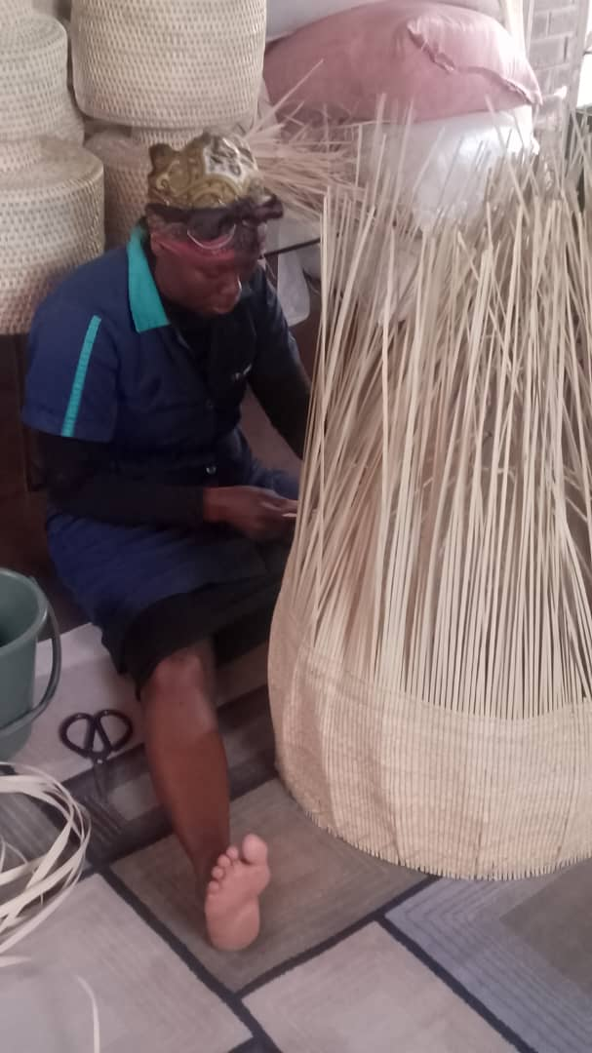

PROMOTING GENDER-INCLUSIVE LOCAL ECONOMIC DEVELOPMENT IN ZIMBABWE
Business name: AMAL
Participant name: Ncamusile Ngwenya
City of Bulawayo
Ncamusile Ngwenya making a gourd basket at Bulawayo Home Industries in August 2023.

Slide 2
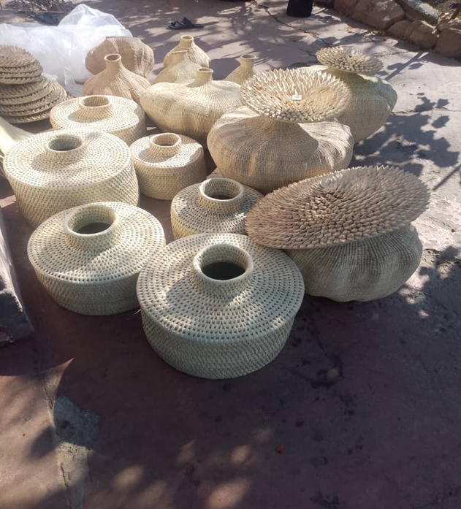
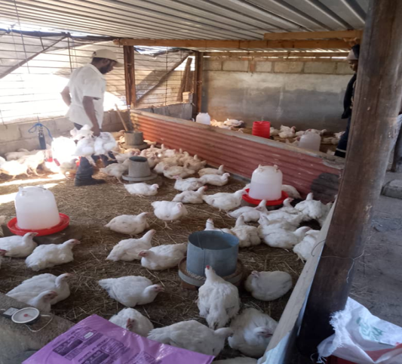
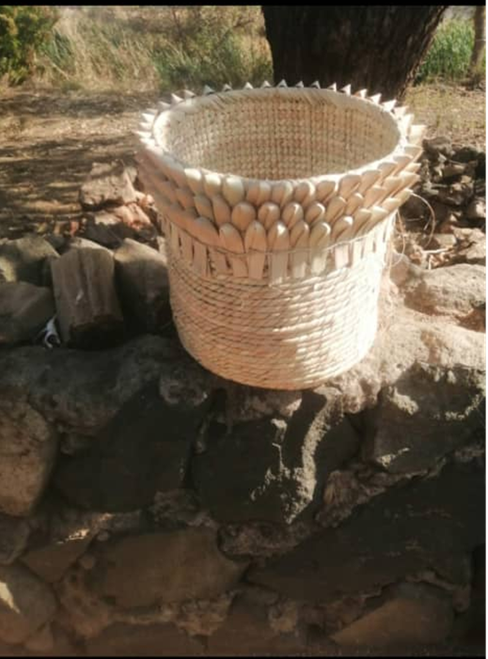
THE BUSINESS
A dual-focused business combining traditional basket making to serve local and regional markets and poultry
Basket Making Craft: Handmade, eco-friendly baskets using traditional technique
Poultry Farming: High-quality, fresh poultry (chickens).
Business products

Slide 3
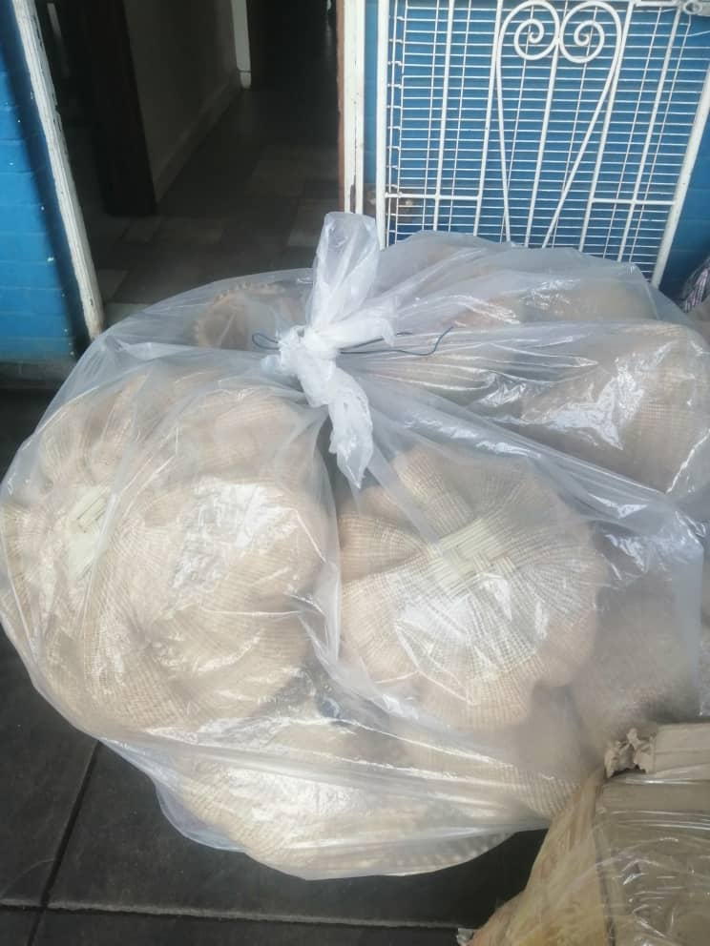
CUSTOMER BASE?
The basket-making segment primarily serves customers in South Africa, with significant demand from Cape Town and Durban.
The number of customers have increased since starting the LED Programme
Baskets packaged for transportation to Capetown

Slide 4

COMPETITION
Competition:
Basket Making: Competing with artisans and larger handicraft businesses in and outside the region.
Poultry: Competing with other local and regional poultry producers.
Competitive Strategies:
Basket Making
For large orders, leveraging community support by enlisting and compensating local artisans with commissions.
Customization: Offering unique, handcrafted products
Poultry:
Cost Efficiency: Mixing own chicken feed to reduce expenses and offer competitive pricing tailored to customer preferences.
Finished gourd baskets and mats

Slide 5
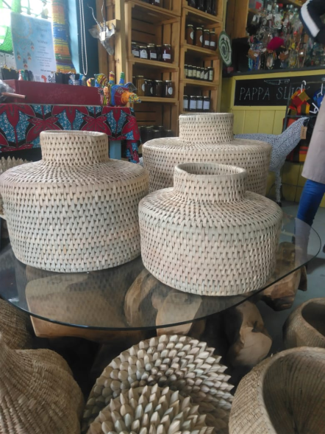
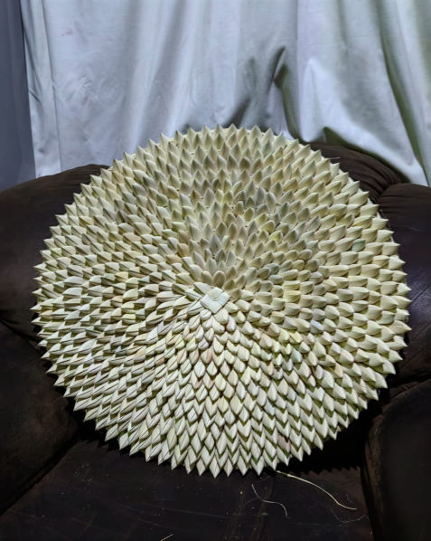
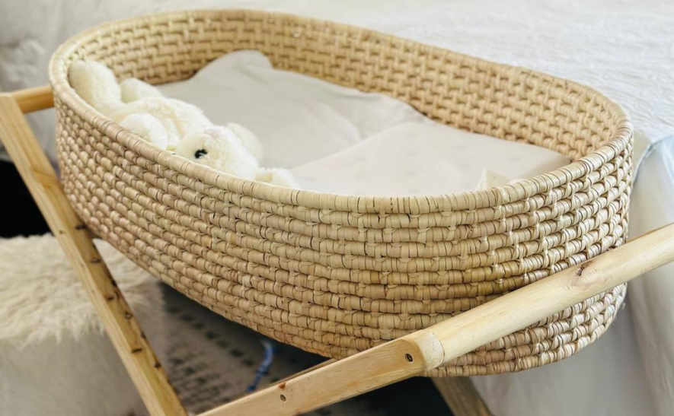
NEW PRODUCTS OR SERVICES?
Recently introduced Tiffany Baskets, baby coat bed and Porcupine wall hangers
They have quickly become a popular choice, outperforming previous basket products.
The business has leveraged social media platforms, particularly WhatsApp, to share product images and engage directly with customers for inquiries and orders.
New products that the business has produced

Slide 6
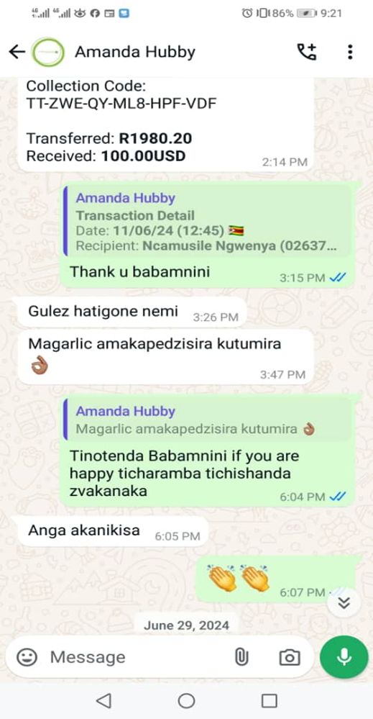
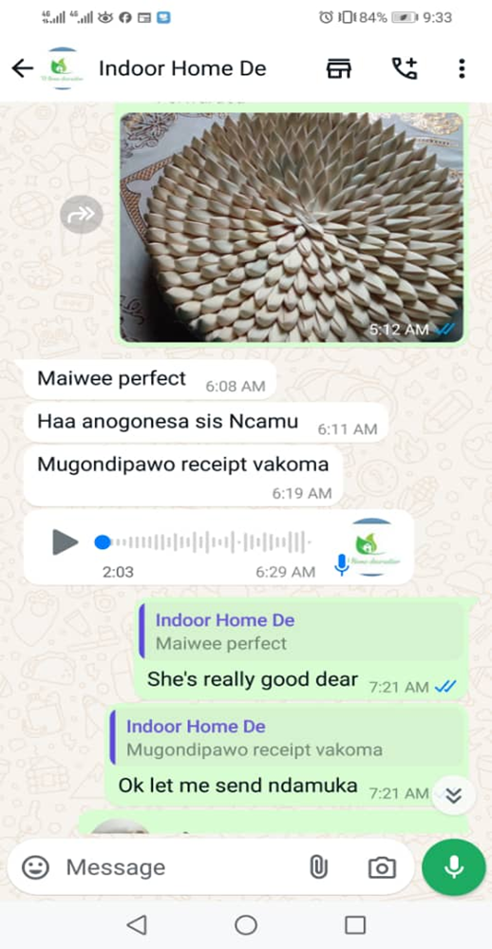
QUALITY AND PACKAGING
Customer Feedback:
High Satisfaction
Word-of-Mouth Growth
Branding & Packaging:
Current Status: Branding efforts are still in development to strengthen market presence.
Growth Strategy: While formal branding is not yet established, the business leverages direct customer interactions and exemplary service to build reputation and attract new clients.
Customer feedback

Slide 7
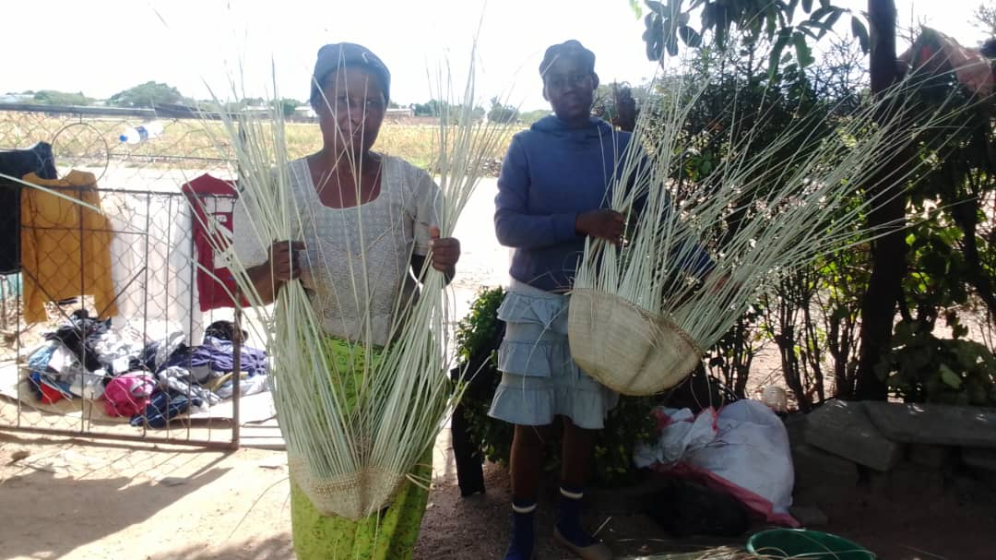
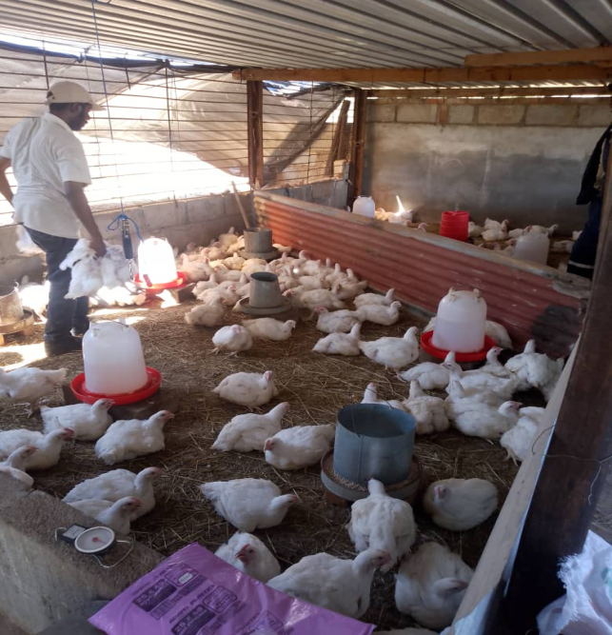
BUSINESS MANAGEMENT
Workforce:
Basket Making: 7 part-time artisans engaged for weaving,
Poultry: 2 full-time employees.
Stock Management:
On-Demand Production: Baskets are crafted exclusively per order to maintain resource efficiency and reduce inventory costs.
Pricing Strategy:
Dynamic Pricing: Product prices are adjusted based on market demand and the type of materials used, allowing for better budgeting and profitability while aligning with customer needs
Some of the employees employed in the business

Slide 8
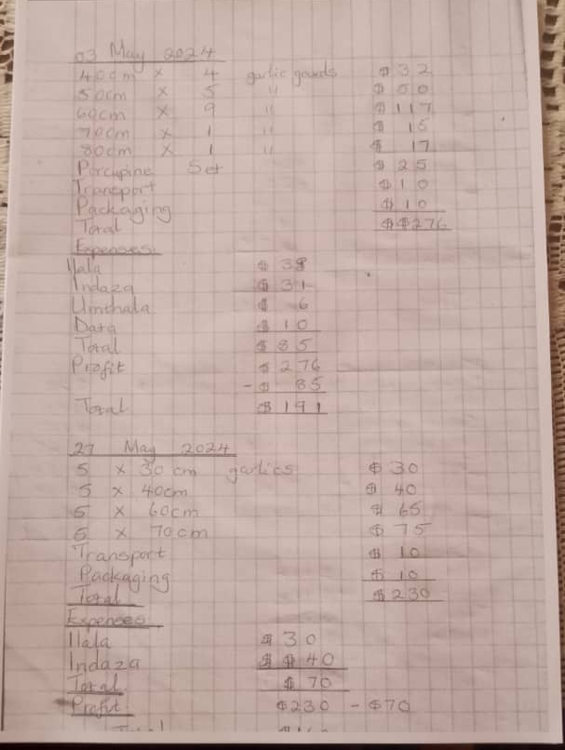
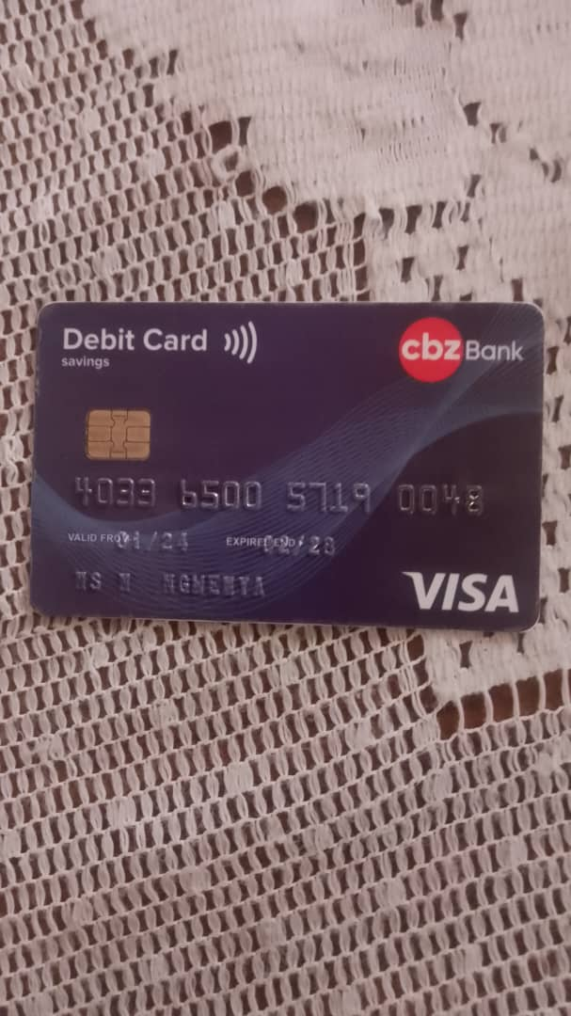
FINANCIAL MANAGEMENT
Record-Keeping System:
Method: Manual bookkeeping is employed to track profits and losses.
Banking Services:
Platforms Used: Financial transactions are managed through Mukuru, Mama Money, Shoprite Send and CBZ Bank
Evidence of the business record keeping and business bank card

Slide 9
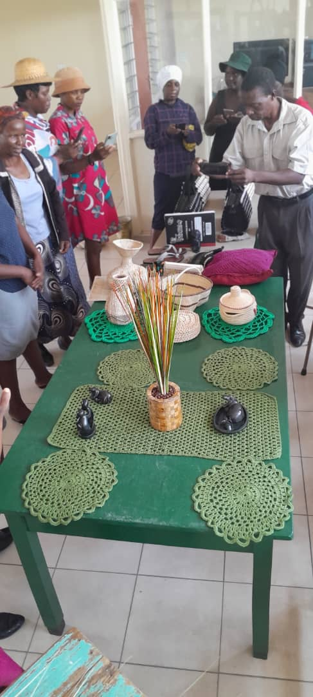
SAVINGS AND SELF SUFFICIENCY
Savings Group:
Name: Thandokuhle, a savings group under Gender Links, which began 2 months ago.
Status: The group is still in its early stages, and savings have not yet been accumulated.
Household Income:
Increase: Despite the savings group being new, the household income has experienced growth, likely due to the business success and increased financial management.
Members of the Thandokuhle Cooperative

Slide 10
INCOME AND EXPENSES FOR THE BUSINESS FOR THE PAST SIX MONTHS
Income
Expenses
ITEM | AMOUNT USD
Baskets | $2898
Poultry | $1979
TOTAL | $4877
ITEM | AMOUNT USD
Basket expenses -Ilala -Indaza -umthala -transport -packaging -data -Salaries Total | $588 $511 $42 $60 $60 $80 $268 $1609
Poultry -booking of chicks -Feed -Vaccines -Transport -Coal -Electricity -Bales -salary Total | $330 $1011 $45 $40 $24 $30 $24 $80 $1584
TOTAL | $3193

Slide 11
INCOME AND EXPENSES FOR THE BUSINESS FOR
NEXT SIX MONTHS
Income
Expenses
ITEM | AMOUNT USD
Baskets( 70 per month) | $3500
Poultry (2 weeks spacing $600) | $2400 (monthly)
TOTAL | $5900
ITEM | AMOUNT USD
Basket expenses -Ilala -Indaza -umthala -transport -packaging -data -Salaries Total | $588 $511 $42 $60 $60 $80 $268 $1609
Poultry -booking of chicks -Feed -Vaccines -Transport -Coal -Electricity -Bales -salary Total | $330 $1011 $45 $40 $24 $30 $24 $80 $1584
TOTAL | $3193

Slide 12
WHAT PLANS HAVE YOU MADE TO GROW YOUR BUSINESS IN THE NEXT 6 MONTHS?
Over the next six months, the business will grow by focusing on key targets and actions:
IMAL to have Customer Growth
IMAL to have Sales Volume
IMAL to have Staff Expansion
IMAL to Improve on Monthly Income and Monthly Expenses
Improve IMAL Customer Service

Slide 13
CHALLENGES
Transportation of Baskets:
Challenge: Transporting baskets to Cape Town is difficult due to Bulawayo that has limited bus services, with only one bus leaving on Tuesdays.
Solution: Exploring alternative transport options like using Harare route to ensure more timely and cost-effective deliveries.
Poultry Farming:
Challenge: The waiting period for chickens to reach 6 weeks can sometimes lead to rejections, impacting productivity and profits.
Solution: Implementing better management practices to monitor chicken growth closely and ensuring healthier stock to reduce the likelihood of rejections

Slide 14
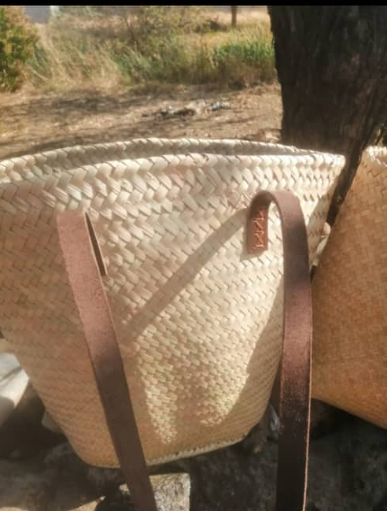
SUSTAINABILITY
To sustain and grow IMAL:
1.Diversification
2. Quality Control
3. Marketing & Customer Engagement
4. Staffing & Training
5. Financial Management
6. Sustainability in Production
Handbag made out of ilala

Slide 15
ADDITIONAL INFORMATION?
Under Imal
Management: Imal has made significant improvements in managing finances, which has helped ensure better budgeting and profitability in the business.
Collaboration: Working with others, both staff and collaborators, has enhanced productivity and allowed for a more streamlined operation.
Personal growth
Marketing Strategies: There has been a notable shift in how the business approaches marketing. The focus on social media and word-of-mouth has proven to be effective in reaching more customers.
Self-Confidence: Confidence in promoting the business and communicating its value to potential customers has grown, which has played a key role in increasing customer engagement and sales.

Slide 16


SIYABONGA...
TATENDA...
THANK YOU...

