Slide 1




SADC PROTOCOL@WORK SUMMITS AND AWARDS
2024
GENDER RESPONSIVE BUDGETING
ZIMBABWE, KADOMA CITY COUNCIL
11 NOVEMBER 2024
CYRIL MUDZENGI

Slide 2
OVERVIEW
COUNTRY | ZIMBABWE
COUNCIL (HUB/SPOKE) | KADOMA CITY COUNCIL (HUB)
GENDER CHAMPION | JUDITH NDENGWA
GENDER FOCAL PERSON | SIKHANYISIWE MOYO
Latest score (2024) | 63
 | Income | Expenditure | % Gender Specific
Budget (2024) | 28,364,449.50 | 28,360,344.64 | 7
 | Women | Men | Total | % Women
Council | 5 | 17 | 22 | 25
Management | 16 | 39 | 55 | 29
Council staff overall | 105 | 248 | 353 | 30
Population served | 117380
Key characteristics | CENTRE OF EXCELLENCE AN EQUAL OPPORTUNITY EMPLOYER FEMALE DEPUTY CHAIRPERSONS OF COMMITTEES VISION: A SMART SERVICE SANCTUARY BY 2030

Slide 3
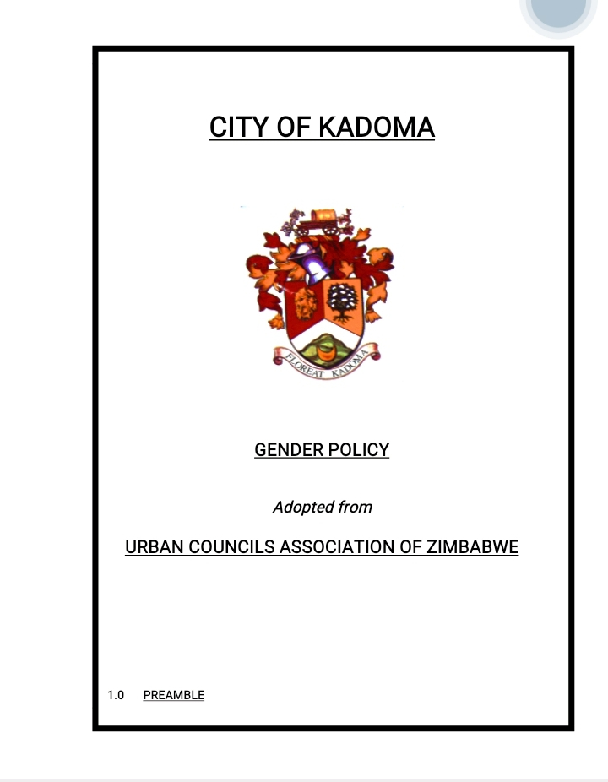
I. POLICY FRAMEWORK
Kadoma City Council`s budgeting process is guided by the National Constitution of Zimbabwe, National Gender Policy, Urban Council`s Act 29:15, Kadoma Gender Policy and the National Development Strategy 1 (NDS1).
Council has a functional gender policy which addresses issues on gender budgeting. As guided by the policy, the budget is crafted on the principle of inclusivity ensuring that the needs of women, men, youths and people living with disabilities are well represented in the budget.
Photo of the Gender Policy

Slide 4
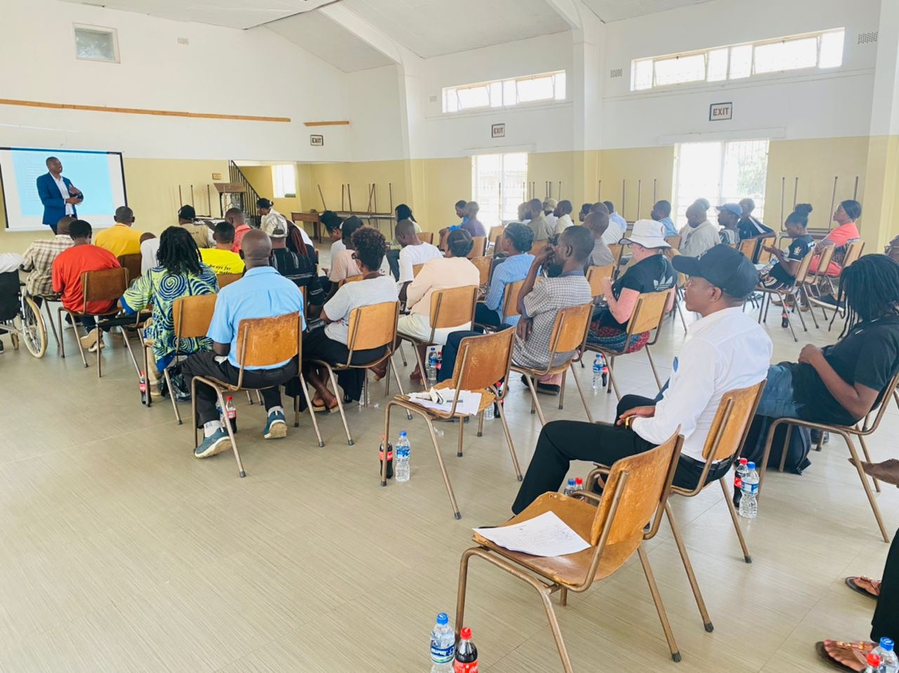
II. THE BUDGET PROCESS
Detail
Evidence
Council`s gender focal person and the Community Services Section where the mainstreaming budget resides , were asked to submit their input on gender specific needs to be addressed in the 2024 budget year.
An all stakeholder consultation meeting was held where all stakeholder groups were represented. In addition whatsapp groups were formed to enable online consultations.
Notices of budget consultative meetings at ward level were distributed through fliers, social media platforms and through short message service (sms) to eliminate transport costs to stakeholders being consulted. The meeting included representatives for people living with disabilities, people living with albinism, representatives from Ministries of Youth and Women’s affairs, church representatives and ward representatives.
Photos or video of budget consultation

Slide 5

II. THE BUDGET PROCESS
Detail
Evidence
The meetings were conducted from 1 to 10 November 2023 in 16 venues including community halls, sports fields, open spaces, school blocks, council chamber and a hired hall. The meetings were held at 10am, 2pm and 4pm. They were located at venues close to the residents being consulted to eliminate transport costs and encourage attendance. Women were consulted through stakeholder representatives in regards to time.
Council made use of Whatsapp application to get reach to stakeholders we formulated a Mayor’s engagement group.
It is an effective technological method as those who could not attend physical meetings could have a chance to contribute and also both parties council and stakeholders are able to convey responses/feedback remotely.

Slide 6
II. THE BUDGET PROCESS
Sex/age/PLWD statistics of budget consultation participants
Consultation | Women |  |  |  |  | Total | Men |  |  |  |  | Total | % Women
 | Age |  |  |  |  |  | Age
 | - 15 | 15-35 | 36-59 | 60+ | PWD |  | - 15 | 15-35 | 36-59 | 60+ | PWD
 |  | 130 | 362 | 22 | 1 | 515 |  | 179 | 673 | 36 | 3 | 891 | 37
% |  |  |  |  |  | 100% |  |  |  |  |  | 100%

Slide 7
III. REVENUE
Internal revenue contributes 83% whilst external revenue contributes 17% of the total budgeted revenue.
Gender considerations informed decisions concerning budgeting of revenue by making sure that a greater percentage of the gender mainstream revenue budget is dedicated towards water sanitation and Health (WASH)
Gender considerations have been taken into account in distribution of resources through allocation of more resources to water which as per consultation meetings results affects more women ,and youths than men. People living with disabilities are affected more and the funding of water expenditure can improve their situation. Also the plight of women particularly with regard to accessing health facilities
The capital grant from central government mainly targeted at areas which affect health, education, roads, water and sewer, social amenities and electrification affecting women and men, boys and girls.

Slide 8
IV. EXPENDITURE
Type of Expenditure | Amount | %
Gender Management System (GMS) | 31,000.00 | 0.11
Employment expenditure (Human Capital Expenditure) | 8,372,351.00 | 30
Employment equity related expenditure | 48,000.00 | 0
Gender Specific Programming | 1,996,625.00 | 7
Mainstream Programmes | 13,458,516.00 | 48
Other |  | 14
 | 4,458,067.00
Total | 28,364,559.00 | 100

Slide 9
IV. EXPENDITURE
Type of Expenditure | Amount | Proportion (%)
Gender Management System (GMS) | 31,000.00 | 0.11
Employment expenditure (Human Capital Expenditure) | 8,372,351.00 | 30
Employment equity related expenditure | 48000 | 0.17
Gender Specific Programming | 1,996,625.00 | 7
Mainstream Programmes | 13,458,516.00 | 48
Other | 4,458,067.00 | 14
Total | 28,364,559.00 | 100

Slide 10
IV. EXPENDITURE- GMS
Kadoma City has a Gender Management System (GMS), Gender committee, Gender focal person and a gender champion.
GMS activities are budgeted under Governance and Administration and Social Services Programs for Committee meetings, Hub/ spoke activities, Training, Policy formulation, office equipment and stationery.

Slide 11
IV. Gender Specific expenditure
Gender-specific programmes
Improve health facilities.
Improve housing facilities.
Improve social interaction and activities
Economic empowerment of the community
Improve education system in the City

Slide 12
IV. Gender Specific expenditure
Budget lines are visible under Governance and Administration and Social Services Programs.
We allocated $2,014,625 which is 7% of the total budget.
In line with the requirements of the Constitution and ministerial budget guidelines, budget preparation process takes the participatory approach which gathers input from the various stakeholder groups. In this regard, specific budget consultation meetings were done with the special gender interest groups listed below:

Slide 13
IV. Gender Specific expenditure
Kadoma Women
Kadoma Junior Council
Kadoma Youth
People Living with Disabilities
People Living with HIV

Slide 14
IV. Gender Specific expenditure
Input from these gender special interest groups formed the basis for budgetary allocations to gender specific programmes.
Improved access to housing facilities in the city provides opportunities for the previously marginalised gender group of women to own properties in the city as property ownership has for long been dominated by men.

Slide 15
IV. Gender Specific expenditure
The improved health facilities programme seeks to decrease maternal mortality and improve maternal health for women and new born babies.
The improved social amenities programme seeks to engage girls and boys in constructive social activities such as sports during their idle time so that they desist from drug abuse and other social vices.
Improved education facilities seeks to improve the net enrolment rate thereby improving access to basic education for both the girl child and the boy child
Economic Empowerment initiatives are through the support to Kadoma Women’s Club which empowers women with entreprenuerial skills for self employment.

Slide 16
IV. Gender Specific expenditure
Measurement of expenditure for gender specific programs is based on a comparison of the budgeted amounts and the actual expenditure.
An annual plan linked to the budget is prepared on a yearly basis. The annual plan breaks down budgetary allocations into outcomes, outputs, key performance indicators and impact. The achievement of the outcome, outputs and impact is measured through monitoring and evaluation which is part of the council’s performance management system.

Slide 17
IV. EMPLOYMENT EXPENDITURE
 | Women |  |  | Men |  |  | Total | % women
 | Managers | Staff | Total | Managers | Staff | Total |  | Managers | Staff | Total
Full Time | 12 | 85 | 97 | 32 | 198 | 230 | 327 | 27 | 30
Casual | 4 | 20 | 24 | 7 | 50 | 57 | 81 | 36 | 29
Parttime
Total | 16 | 105 | 121 | 39 | 248 | 287 | 408

Slide 18
IV. EMPLOYMENT EXPENDITURE
Women comprise of 30% in the workforce.
Women in management comprise of 29%
Full time 30%,casual 30% and 0% part time
This breakdown is entrenched in the traditional setting where jobs were mainly a preserve for men,with women resorting to housewife duties.

Slide 19
IV. EMPLOYMENT EXPENDITURE- Gender Wage Gap Analysis
 | Women | Women- Total earned | Women average earned | Men-no | Men total earned | Average earnings
Full Time | 97 | 1,320,228.00 | 13,610.60 | 230 | 3,397,452 | 14,771.53
Casual | 24 | 195,918.00 | 8,163.25 | 57 | 446,762 | 7,837.93
Part time | - | - | - | - | - | -
Total | 121 | 1,516,146.00 | 12,530.13 | 287.00 | 3,844,214 | 13,394.47
Gender wage gap is 0.07

Slide 20
IV. EMPLOYMENT EXPENDITURE- Gender Wage Gap Analysis
Men holding higher positions are more than women.
The work done by women and men is more or less the same hence the marginal difference in average earnings.
Equal employment opportunities between genders in all job levels.
Equal learning opportunities by giving educational loans.

Slide 21
V. EXPENDITURE- GENDER IN MAINSTREAM BUDGET
Programmes | Amount | % budget
Governance & Administration | 5028572 | 18
Water Sanitation & Hygiene | 8620174 | 31
Social Services | 8470111 | 28
Roads | 3855771 | 13
Public Safety & Security | 2365717 | 8
Natural Resources & Conservation | 20000 | 0
Total | 28360345 | 100

Slide 22
V. EXPENDITURE- ANALYSIS OF ONE SECTOR EG
 | Women |  |  |  |  |  | Men
 | Age |  |  |  |  |  | Age
 | Below 15 | 15-35 | 36-59 | 60+ | PLWD | Total | Below 15 | 15-35 | 36-59 | 60+ | PLWD | Total
Education
Housing
Social amenities
Total

Slide 23
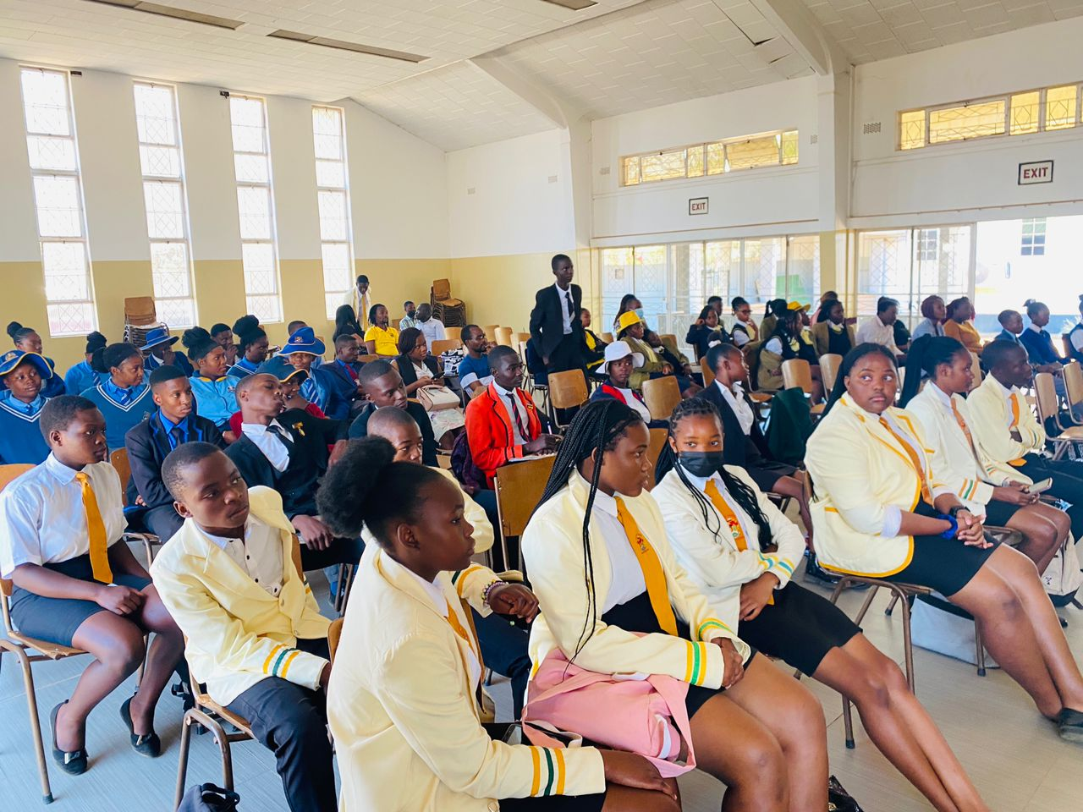
V. EXPENDITURE- GENDER IN MAINSTREAM BUDGET
The council budget is based on inputs gathered from various gender groups including women, men, boys and girls.
Council employs cross subsidisation of incomes and expenditures across programs to finance priority activities for the various gender groups
PHOTO

Slide 24
V. EXPENDITURE- GENDER IN MAINSTREAM BUDGET – EXAMPLE
 | Amount | No of beneficiaries | Percentage
Total Expenditure | 28,364,559.00
No. of Men benefiting from council allocations | 13,614,988 | 68,080 | 58
No. of Women benefiting from council allocations | 14,749,571 | 61,038 | 52
Total beneficiaries |  | 117380 | 100%

Slide 25
VI. BUDGET CROSS SUBSIDISATION ANALYSIS
 | Income (A) | % of total budget | Expenditure (B) | % of total budget | Surplus/Deficit
Governance & Administration | 7,834,719.00 | 28 | 5,028,572.00 | 18 | 2,806,147.00
Water, Sanitation & Hygiene | 9,126,039.00 | 32. | 8,620,174.00 | 30 | 505,865.00
Social Services | 4,814,346.00 | 17 | 8,470,111.00 | 30 | (3,655,765.00)
Roads | 4,715,662.00 | 17 | 3,855,771.00 | 14 | 859,891.00
Public Safety and Security | 1,854,473.00 | 7 | 2,365,717.00 | 8 | (511,244.00)
Natural Resources & Conservation Mgt | 19,320.00 | 0.07 | 20,000.00 | 0.07 | (680.00)
Total | 28,364,559.00 | 100.00 | 28,360,345.00 | 100.00 | 4,214.00

Slide 26
VI. BUDGET CROSS SUBSIDISATION ANALYSIS
Governance and administration, Water, Sanitation and Hygiene and Roads
Social service, Public safety and security and Natural resources and conservation management
These programs are funded by other programs which have a surplus. Activities been subsidised are mainly salaries and wages, disease outbreaks emerging awareness programs.
The urban council’s act supports cross subsidisation

Slide 27
VI. BUDGET CROSS SUBSIDISATION ANALYSIS
Services required by special gender groups such as women, youth, boys and girls and PLWD are given priority and are funded from other programs in instances were the particular program cannot fund such expenditure.
An allocation of 13% of the budget was made in favour of social services as a result of gender considerations falling within the program.

Slide 28
VII. CONCLUSIONS AND NEXT STEPS
The council continues to be on a progressive trajectory in promoting gender equality and women empowerment. In the 2024 budget more gender programs were added to address gender disparities.
Priority was given to areas of: maternal and infant health, housing provision, economic empowerment for women, education facilities for girls and boys.

Slide 29
VII. CONCLUSIONS AND NEXT STEPS
Council will continue addressing gender disparities in the 2025 budgets and beyond. Efforts are underway for the implementation of gender responsive procurement.

