Slide 1





Municipality of Redcliff
SADC PROTOCOL@WORK SUMMITS AND AWARDS
2024
GENDER RESPONSIVE BUDGETING
(ZIMBABWE, REDCLIFF MUNICIPALITY, 01/11/2024,EDWIN MUSHATI)

Slide 2
OVERVIEW
COUNTRY | ZIMBABWE
COUNCIL (HUB/SPOKE) | REDCLIFF MUNICIPALITY
GENDER CHAMPION | LINDIWE WHATA
GENDER FOCAL PERSON | KAUNYE RUMBIDZAI
Latest score (year) | 69% in 2022
 | Income | Expenditure | % Gender Specific
Budget (YEAR) | 33,088,068.89 | 33,088,068.89 | 1%
 | Women | Men | Total | % Women
Council | 6 | 6 | 12 | 50
Management | 3 | 8 | 11 | 27
Council staff overall | 89 | 171 | 260 | 34
Population served | 41 526 (2022 Population and Housing Census Preliminary Report)
Key characteristics | DIVERSE COMMUNITY IN TERMS CULTURAL AND SOCIAL BACKGROUND

Slide 3
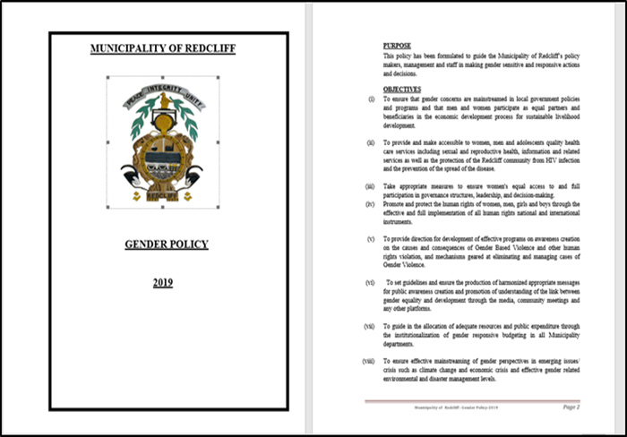
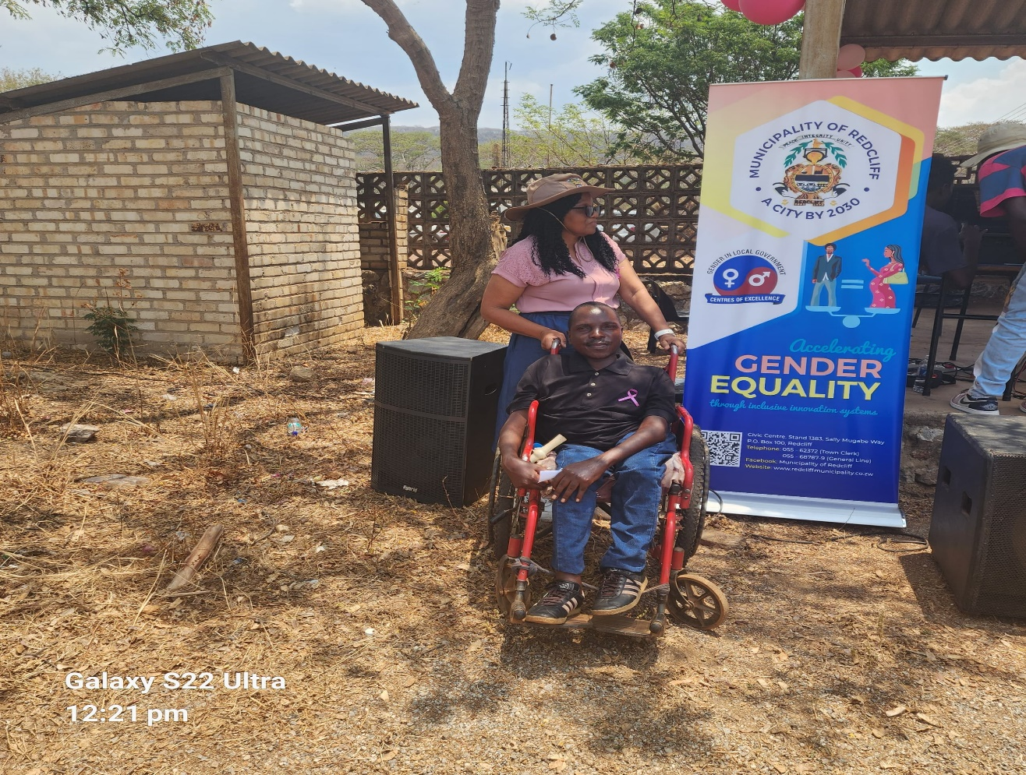
I. POLICY FRAMEWORK
Yes, Redcliff Municipality has a gender policy and action plan that incorporates the Post 2015 SADC Gender Protocol, SDGs and other relevant targets.
The policy is well known and has a high profile champion (Mrs. L. Whata) within the council.

Slide 4
THE BUDGET PROCESS
THE BUDGET WAS PREPARED USING THE PBB
BUDGETING TOOL - QUANTRIX
Budget Consultations were held physically were different groups were engaged and minutes were recorded.
All age groups, male, female, youth and PWD were consulted. The budget registers statistics were broken down as follows: Below 15, 15 -35, 36 – 59, 60+
Different groups were also consulted such as: Junior Council, Schools, Business Community, Churches, Resident Associations, Workers Representatives, PWD, Wards etc.
The budget consultation process was inclusive i.e., “no one is left behind”, for example, that every resident was notified about meetings through newspaper advertisements, public announcements, public notices in community WhatsApp groups, Facebook page.
The Citizen engagements were done in the Council Chambers, in Wards (at central points) and over different community WhatsApp groups.
In the community (Wards), the meetings were done usually from 4pm to ensure that everyone is included and all meetings recorded minutes and registers were signed.
Residents’ WhatsApp groups and council’s Facebook page were utilised to broaden the reach.
Adverts for objections were done in Local newspapers covering everyone in allspheres of Redcliff

Slide 5
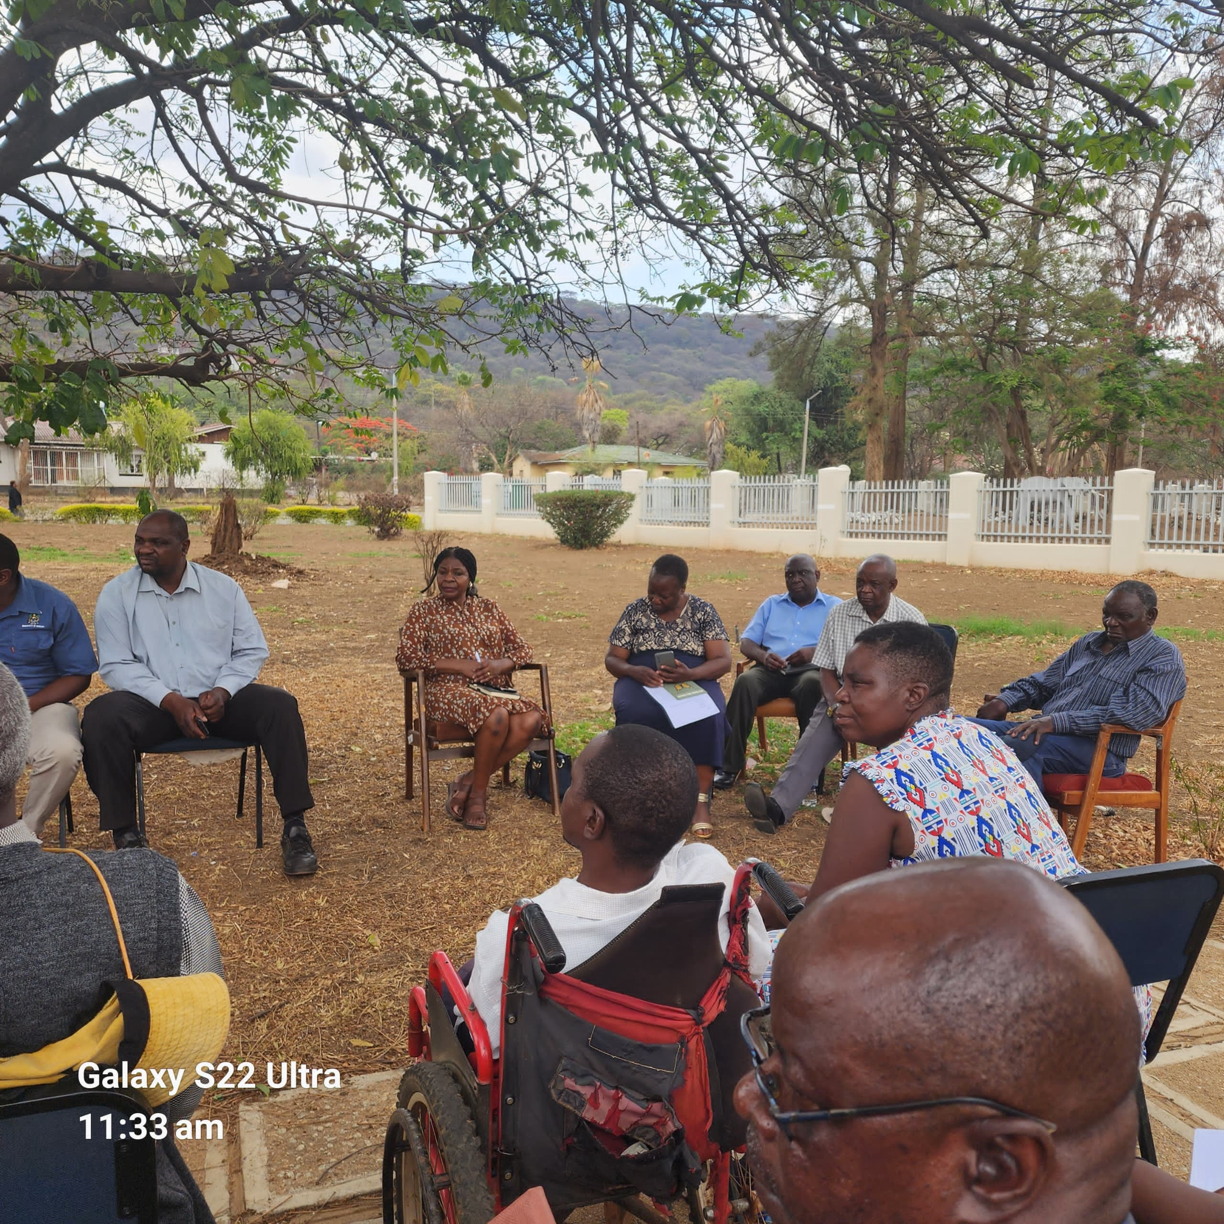
II. THE BUDGET PROCESS
Budget consultation meetings

Slide 6
II. THE BUDGET PROCESS
Consultation | Women |  |  |  |  | Total | Men |  |  |  |  | Total | % W
 | Age |  |  |  |  |  | Age
 | Below 15 | 15-35 | 36-59 | 60+ | PLWD |  | Below 15 | 15- 35 | 36-59 | 60+ | PLWD |  | (Total women)/Total people consultedx100
 | 5 | 19 | 64 | 12 | 24 | 124 | 3 | 41 | 82 | 29 | 13 | 168 | 42%
% |  |  |  |  |  | 100% |  |  |  |  |  | 100%

Slide 7
III. REVENUE
Internal sources amounted to USD 29,953,068.89 and External sources amounted to USD3,135,000.00
Both males and females came up with the tariff schedules for revenue formulation
Everyone was included in budget process both males and females.
External sources of finance targeted everyone in Redcliff bulk of external funds were to be used for water argumentation plan

Slide 8
IV. EXPENDITURE
Type of Expenditure | Amount | Proportion (%)
Gender Management System (GMS) | 4033370.361 | 12%
Employment expenditure (Human Capital Expenditure) | 8,042,654.16 | 24%
Employment equity related expenditure | 651,200.00 | 2%
Gender Specific Programming | 265,500.00 | 1%
Mainstream Programmes | 20095344.37 | 61%
Other
Total | 33088068.89 | 100%

Slide 9
IV. EXPENDITURE- GMS
The council have a GMS - Gender Committee which consists of departmental focal persons , Gender Focal Person who is a head, and a Gender Champion.
GMS activities have been budgeted for, e.g.,
Departmental Committee meetings,
campaigns,
Hub/ spoke activities, exhibitions,
Trainings, Policy formulation,
Exchange visits, Office equipment
stationery and IEC material.
The budgets are found in the Social Services BUT DO NOT have separate vote with related items..

Slide 10
IV. Gender Specific expenditure
Gender-specific programmes:
Gender Training workshops.
Junior Councils.
Girl child school fees sponsorship Programme through the Mayor’s Cheer fund Programme (100 school pupils (50/50).
Commemoration of international days e.g., Women's Day, Sixteen Days of Activism, Girl Child, Breast Cancer awareness. These are done in conjunction with other stakeholders as Kwekwe District.
Maternal health programmes – Both ANC and PNC programmes done at our local clinics.
Wellness campaigns for council employees
Sexual Reproductive Health and Rights.
All the above are budgeted as Gender Mainstreaming (Specific Programming), under the SOCIAL AMENITIES AND WELFARE
1% of the council budget is allocated for gender-specific programming.
There is a need to adjust the budget line in the following budget year, to increase to 5%)
The gender-specific projects helping to promote gender equality and women’s empowerment as women are now have knowledge on empowerment, they now aware of their rights.

Slide 11
IV. EMPLOYMENT EXPENDITURE- Gender Wage Gap Analysis
 | Women | Women- Total earned | Women average earned | Men-no | Men total earned | Average earnings
Full Time | 60 | 843811 | 14063.50 | 149 | 2449439 | 16439.18
Part Time | 0 | 0 | 0 | 0 | 0 | 0
Casual | 37 | 77700 | 2100 | 52 | 109200 | 2100
Total | 97 | 921511 | 16163.50 | 201 | 2558639 | 18539.18
The gender wage gap= (Average earnings of Men - Average earnings of Women)/ Average earnings of Women = $2375.68 (14%)
There are few women in management positions compared to men and as a result the total earned is low. It also shows that more men are in the lower and middle grades.
To close the gender wage gap, council encourages women to apply and if they excel on interviews they are employed.

Slide 12
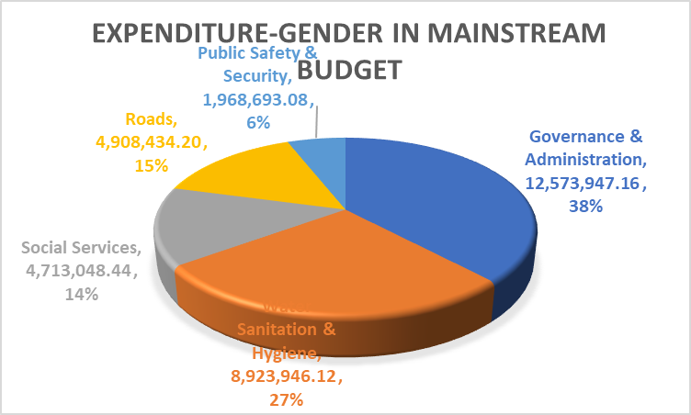
V. EXPENDITURE- GENDER IN MAINSTREAM BUDGET
Draw Pie chart here

Slide 13
V. EXPENDITURE- ANALYSIS OF ONE SECTOR EG
 | Women |  |  |  |  |  | Men
 | Age |  |  |  |  |  | Age
 | Below 15 | 15-35 | 36-59 | 60+ | PLWD | Total | Below 15 | 15-35 | 36-59 | 60+ | PLWD | Total
Education
Housing
Social amenities
Total
✓ Currently there is no expenditure related to sex-disaggregated data
✓ Council has not started conducting beneficiary assessments (client satisfaction surveys)

Slide 14
V. EXPENDITURE- GENDER IN MAINSTREAM BUDGET
Council ensures that women and men, boys and girls benefit equally by:
Ensuring that the required budget inputs are looked at equally, for example by doing projects requested by the different consulted groups respectively.
If women requested water, then council embarks on water projects; if the youth requested for sporting facilities, then council constructs them.

Slide 15
VI. BUDGET CROSS SUBSIDISATION ANALYSIS

Slide 16
VI. BUDGET CROSS SUBSIDISATION ANALYSIS
Governance and Administration generates more revenue than the other all other programmes and is also have the more expenditure and its surplus is used in other programs

Slide 17
VII. CONCLUSIONS AND NEXT STEPS
Council ensures that women and men, boys and girls benefit equally by consulting all stakeholders so that no one is excluded in the budget process (Leaving no one behind)
There is a need to adjust the budget line in the following budget year, to increase to 5% from the 1% of the budget)

