Slide 1




PROMOTING GENDER-INCLUSIVEE LOCAL ECONOMIC DEVELOPMENT IN ZIMBABWE
Business name : Might woman flea market
Participant name: Lydia muponda
Council Municipality Of Kariba
Please include photographs of the business!

Slide 2
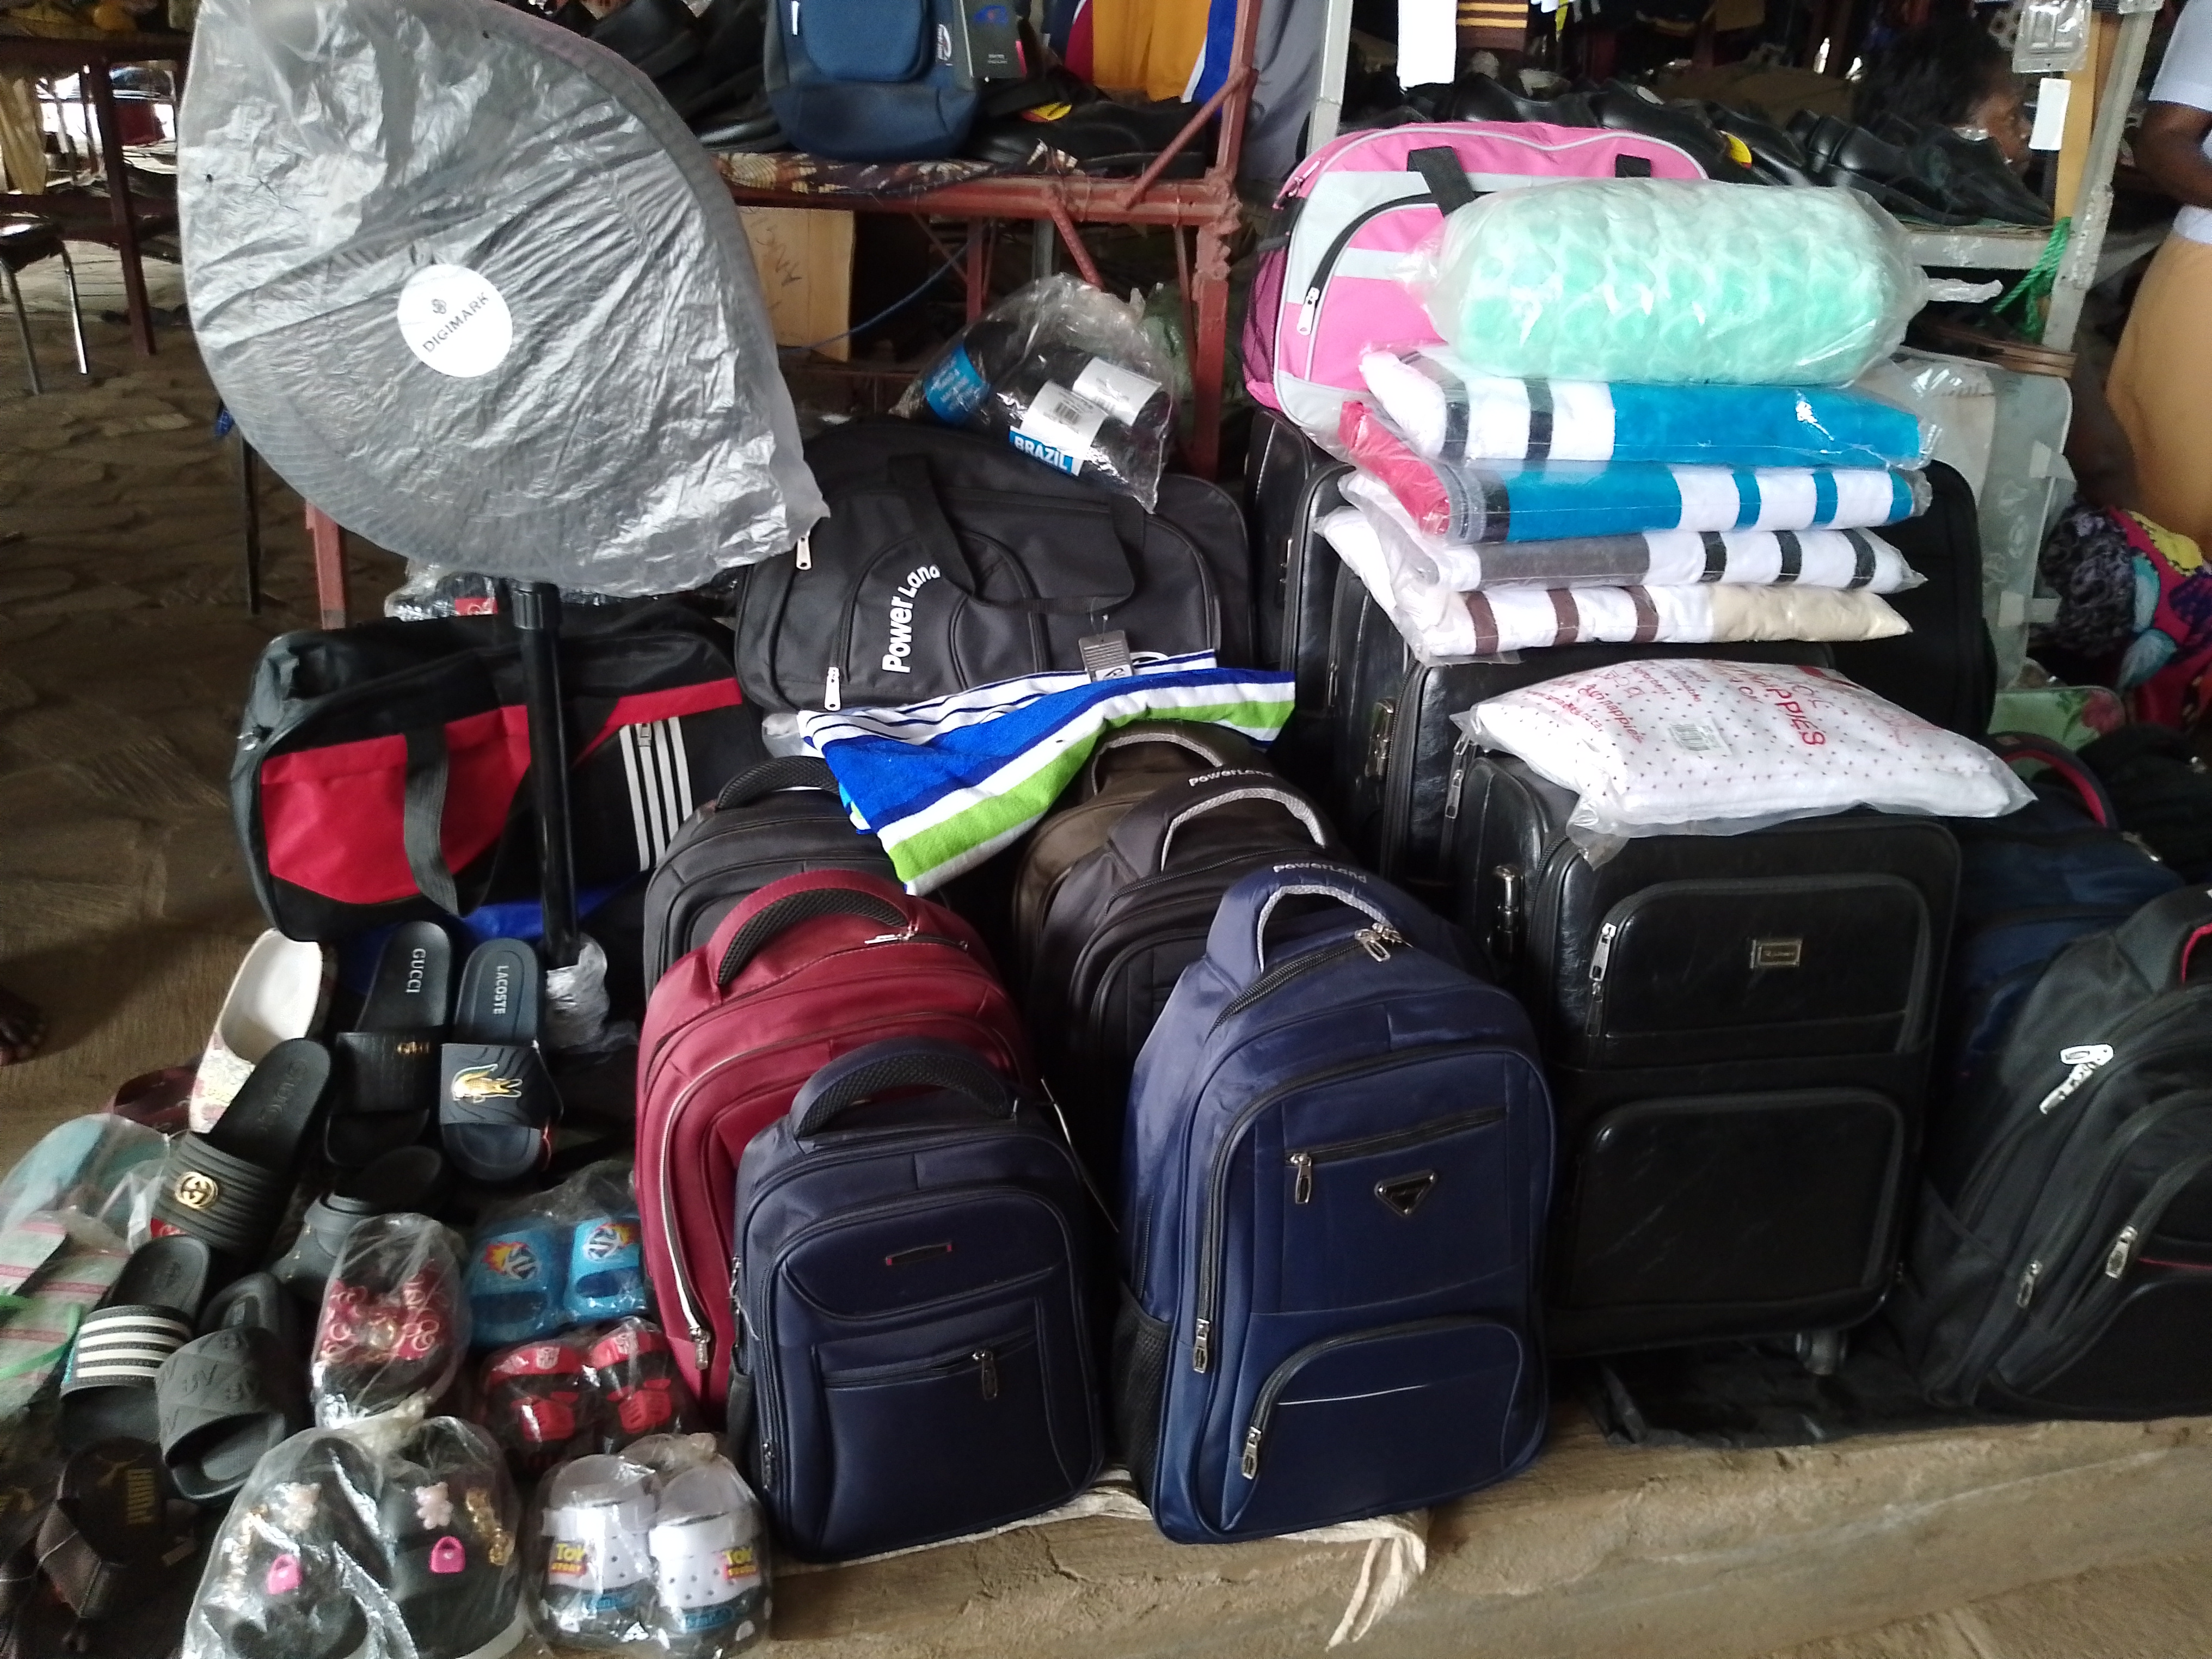
PLEASE DESCRIBE THE BUSINESS
My business is to sell a variety of goods, catering to my community needs and preferences while providing a source of income for myself.The items that i sell include clothing, Bags, household goods, and handmade crafts.My job involves good customer service, pricing goods , good table presentation.
I engage with customers in a friendly and approachable manner, understanding their needs, and providing excellent service to their needs.Additionally, I ensure that my table is well-stocked with products that meet local demand, i am always staying attuned to customer preferences and market trends.

Slide 3
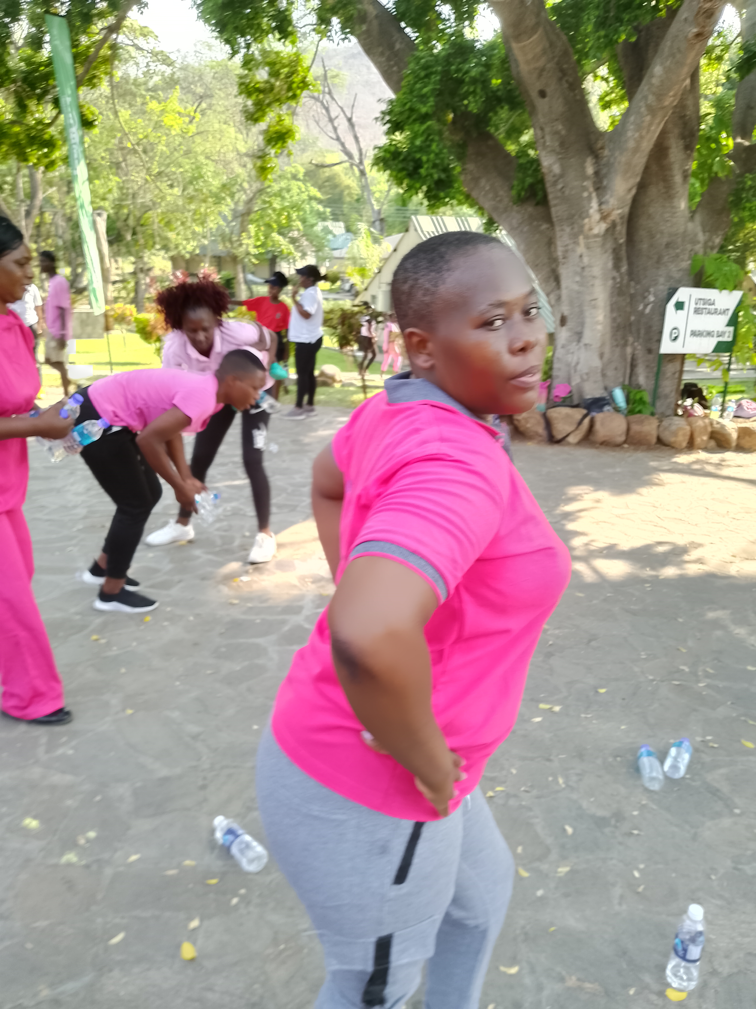
CUSTOMER BASE?
Local residents in my community are my main target customers they seek affordable products to use in their day to day lives, Also people from the fishing camps like ndombo,Gatche Gatche, Fothergill, are also my target customers.Moreso vendors from nearby rural areas like nyamakate makande e.t.c We call them Varimi they come to sell their farm produce.Also Tourists are my significant customers they usually buy crafts and traditional clothing
Yes i have increased the number of customer since i started led.
I created a welcoming atmosphere at my table that encourage repeat visits of customers this include listening to their feedback, i started to offer quality products, ordering original clothing and appliances. I started to offer promotions and discounts to attract more customers.I am now using the social media to promote my table by sharing photos of my products reaching a wider audience and attracted customers far away from where i am. I took part in community events like the recent Zumba dance for breast cancer awareness, this helped me network and i gained visibility in my community.
Photo

Slide 4
COMPETITION
My competitors in this field are tables that sell similar products with mine .Also local boutiques and clothing shops and online runners from Harare and other big cities they are my competition
I handle competition in my business by Understanding my competitors pricing and the type of products they offer helps me position my table effectively. Doing promotions like buy one get one for free helps, I am always aware what others are offering such that i adjust my strategy accordingly.i also encourage people not to order online as far as outside the country advising them that they might get scammed so I emphasize the benefits of buying at my table such as products that are readily available and personal interaction that brings satisfactory.

Slide 5
NEW PRODUCTS OR SERVICES?
I have new business products that I introduced to Carter for religious people now I am selling well crafted clay plates called Mbiya also together with white , red, green, garments that are used by different people in their religious sect. The new products are sellingfast.Now I have a program that reward repeat customers with discounts this I am doing to encourage customer retention and I am building customer base

Slide 6
QUALITY AND PACKAGING
Are your customers happy with the quality of your products or services?
If you have answered yes please give more information.
Do you have any branding available for your products? Explain
Have you changed the packaging or marketing of your business to attract more customers? Please explain.
Yes my customers are happy They keep coming back for more this is indication that my customer are satisfied with what I am offering. They turn out to be my referrals more than just returning for more, some customers frequently bring their friends or relatives. Nobradding for my products yet. But Ihave changed marketing of my bussines by using more socia media platforms like face book, whatsapp and telegram.

Slide 7
BUSINESS MANAGEMENT
Have you hired more staff? How many full-time and how many part-time?
How do you manage your stock and check regularly? Please explain.
Have you been able to price your products better so that you can earn a surplus from the business? Please explain.
Currently I have not hired more staff ,
I do stock take every month checking product purchased versus products in stock.
Yes usually I price my products targeting about 40 percentage the amount I order with,this gives my bussiness surplus.

Slide 8
FINANCIAL MANAGEMENT
Do you have a record-keeping system in place? Explain.
If yes, how is it helping you to manage your business?
Do you have a bank account for your business?
I do have a record book in place where I record everyday income and expenses
It helps me to identify and understand where money is coming in and going out from and have an accurate projection for the near future of my business
I recent opned a personalbank account which I am looking forward to use in my business

Slide 9
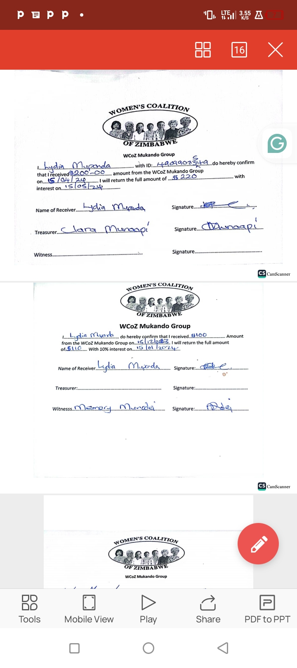
SAVINGS AND SELF SUFFICIENCY
Are you a member of a savings group? Yes I am member of mukando
Are you saving money? How much have you been able to save so far? Isaved about $600
Have you managed to increase household income? Yes I managed to increase income at home
Insert Photo

Slide 10
INCOME AND EXPENSES FOR THE BUSINESS FOR THE PAST SIX MONTHS
Income
Expenses
ITEM | AMOUNT
Clothes | $400
Fans | 250
Mornach | $100
School shoes | $129
Bags | $105
Baby blankets | $50
Men shoes | $380
Baby crocs | $50
Men crocs | $70
Travelling bags | $130
Comfters | $150
TOTAL | 1814
ITEM | AMOUNT
Rent table | $180
Rates | $78
Temporary helper musika batonga | $270
Maid at home for the baby | $360
Groceries and upkeep | $300
TOTAL | $1200

Slide 11
INCOME AND EXPENSES FOR THE BUSINESS FOR NEXT SIX MONTHS
Income
Expenses
ITEM | AMOUNT
Bags | $200
Clothes | $600
Morach | $150
School shoes | $200
Baby blankets | $100
Men shoes | $450
Baby crocs | $80
Men crocs | $100
Traveling bags | $180
Comfters | $250
Fan | #200
TOTAL | $2510
ITEM | AMOUNT
Rent table | $180
Rates table | $78
Table helper | $270
Maid at home | $300
Groceries and upkeep | $400
TOTAL | $1228

Slide 12
WHAT PLANS HAVE YOU MADE TO GROW YOUR BUSINESS IN THE NEXT 6 MONTHS?
To grow my business i want to focus on providing superior customer service. If my customers are happy they are likely to tell their friends, family and followers about my business
I want to acquire new customers through use of digital marketing tools like social media, facebook ,whatsapp, and telegram.

Slide 13
CHALLENGES
What challenges have you experienced in your business?
How have you addressed these?
finding qualified, hardworking helpers in my other table is a big problem that I am facing Also another problem is a lack of funds funds for growth.
To address these problems I train the helper before comencing work.
I wrote a proposal to women affairs looking for money to grow my bussiness

Slide 14
SUSTAINABILITY
How will you sustain your business?
What other sustainability measures are you putting in place for your business?
Cut expenses and eliminate the need for a maid when I wean off my baby. Also I want to improve social media presence to get customers .I want to focus on the quality of my products and services.
I am formalising my bussiness from being mare vendor , I want to transiform into formal businesses and create jobs for others.

Slide 15
ADDITIONAL INFORMATION?
My bussiness is vulnerable to unstable economic shocks that are happening these are inflation, currency devaluation, and fluctuations in consumer purchasing power. This is affecting my profit . Zimbabwe Gold is out powered by other currencies.

