Slide 1




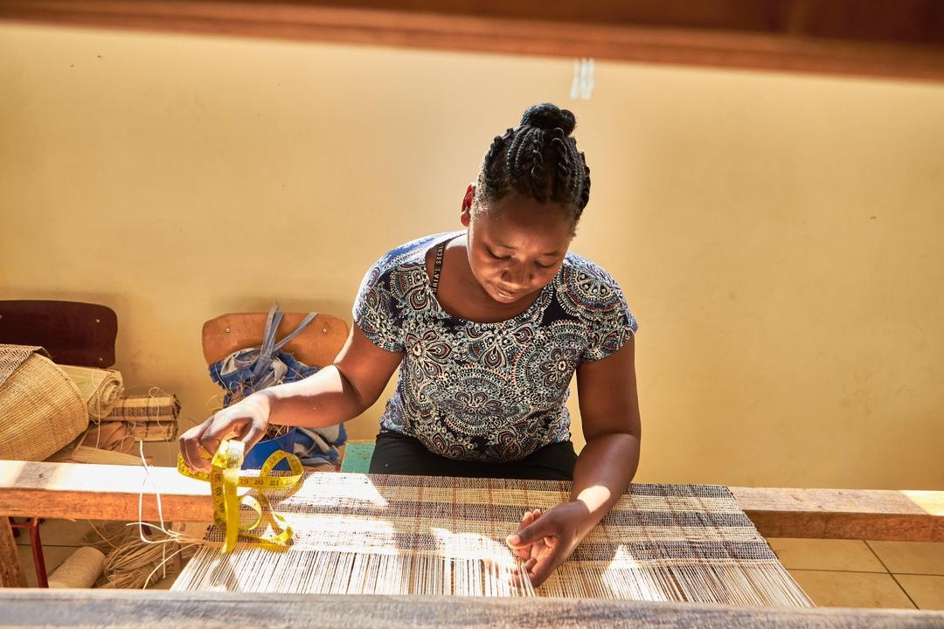

PROMOTING GENDER-INCLUSIVE LOCAL ECONOMIC DEVELOPMENT IN ZIMBABWE
Business name: Lincs Bests Shop
Participant name: Thenjiwe Ndlovu
CITY OF BULAWAYO
Zimbabwe
11 November 2024
Thenjiwe Ndlovu at Bulawayo Home Industry weaving table mates: 18 September 2024

Slide 2
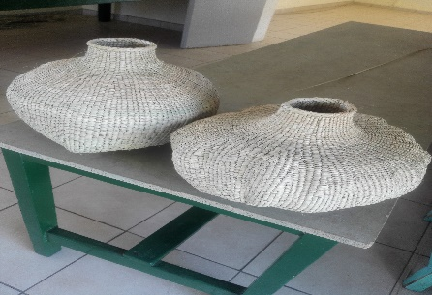
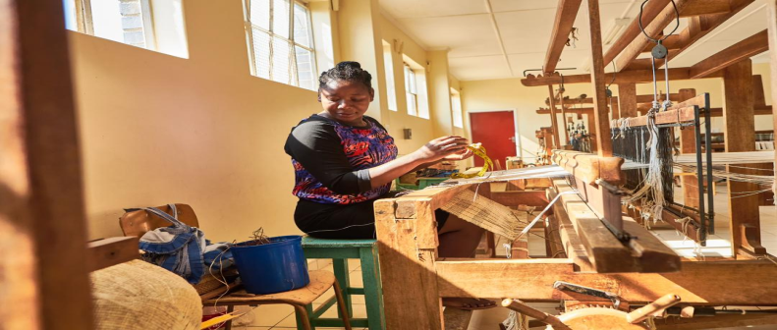
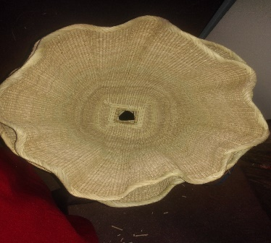
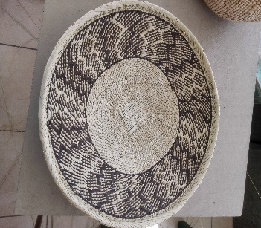
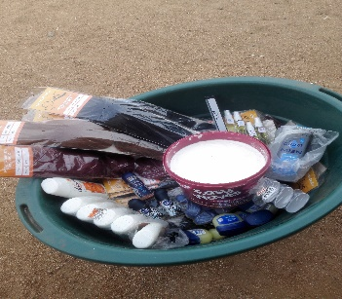
THE BUSINESS
Basketry weaving and selling
Buying and selling of hair products for example braids, relaxers
Buying and selling of beauty products for example roll-ons, Vaseline, body lotions, and body sprays

Slide 3
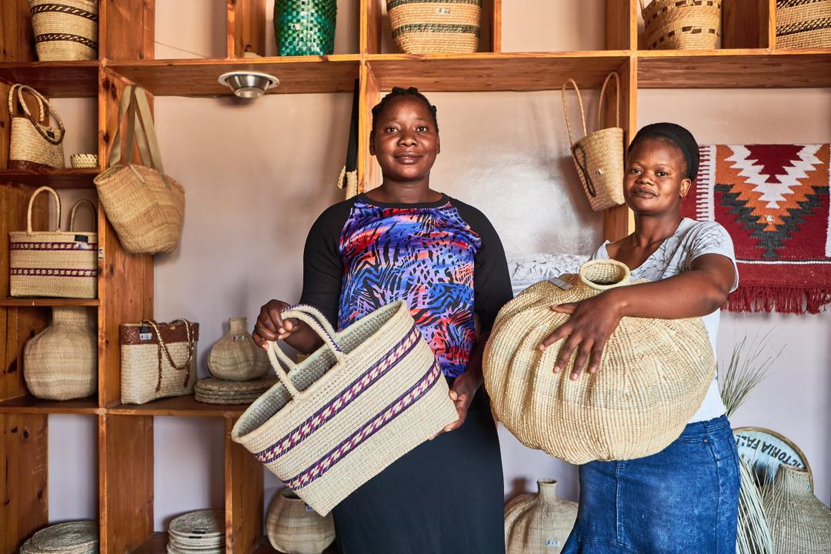
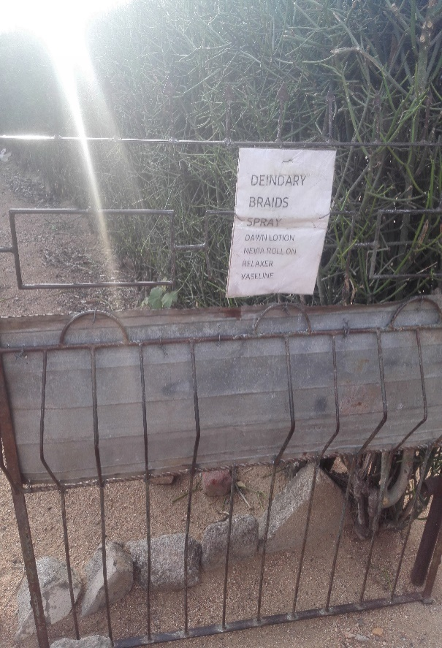
CUSTOMER BASE
The business has customers from the communities of Njube and neighboring suburbs
Local hotels and lodges interested in basketry
Clients from neighbouring countries especially on basketry weaving
The business customers have improved since the beginning of LED training. The LED training impacted us with knowledge of how to be an entrepreneur, business management, and marketing strategies
Through training, social media, and the internet
Gate poster
Thenjiwe with a happy client

Slide 4
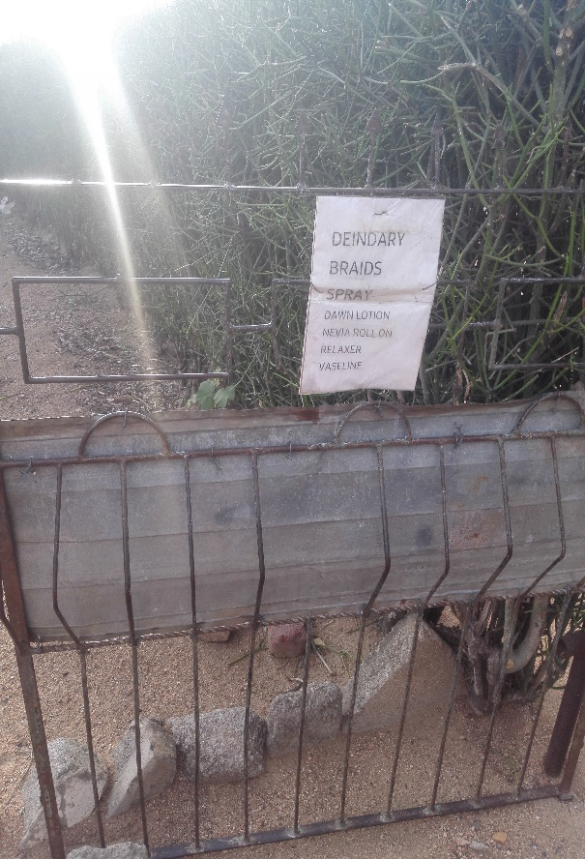
CUSTOMER BASE
The business customers have improved since the beginning of LED training.
The LED training impacted us with knowledge on how to be an entrepreneur, business management, and marketing strategies
Gate poster

Slide 5
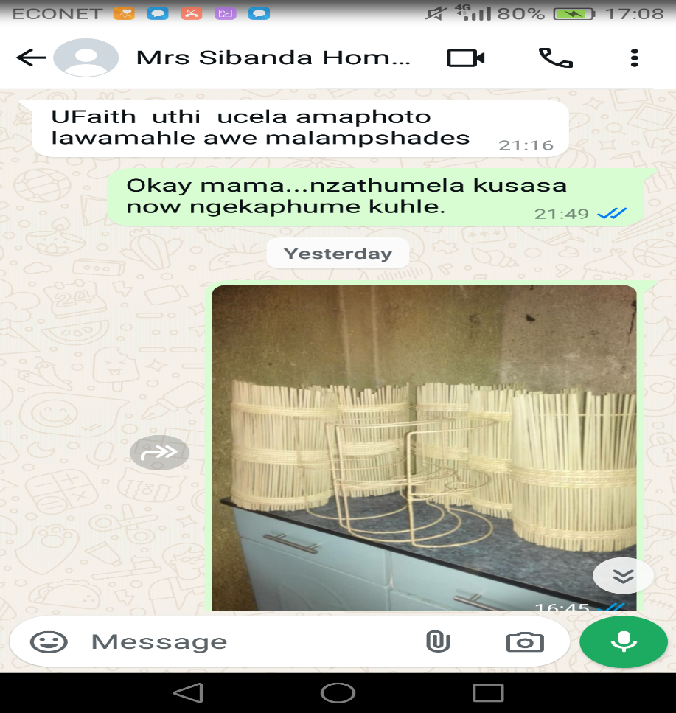
COMPETITION
On basketry weaving competitors come from Lupane and Binga
Hair and body products competition comes from a nearby tuckshop and local shops
My secret to success is elegant craftsmanship, timely delivery, and a passion for excellence
Message from a happy customer placing an order

Slide 6
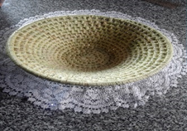
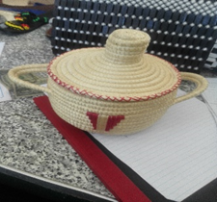
NEW PRODUCTS OR SERVICES?
The business has new products: fruit vases and sisal pots
They are performing quite well, they are only on stock when someone has placed an order
I advertise through social media, and a gate poster at my home.
Fruit vase
Sisal pot

Slide 7
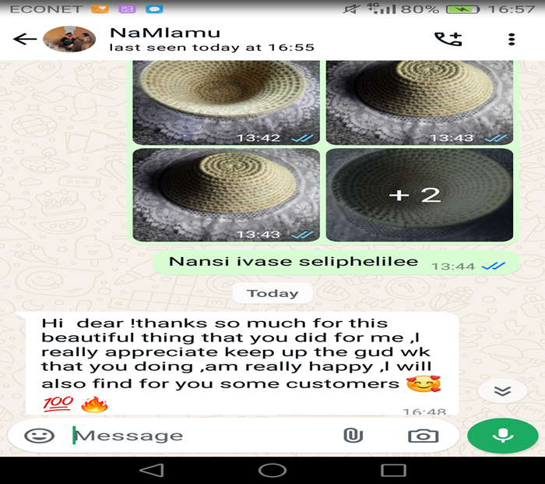
QUALITY AND PACKAGING
The customers are quite pleased with the business products and services.
Being able to produce desired products and services has increased customers and also being able to meet due dates.
The branding for the available products is work in progress. The business is still growing.
The business has successfully attracted customers by implementing effective marketing strategies through social media
Message from a happy client

Slide 8
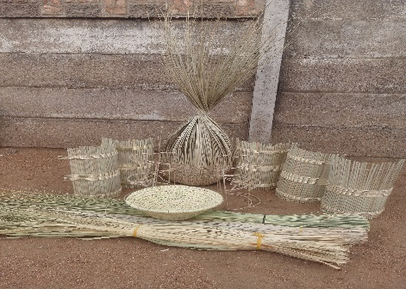
BUSINESS MANAGEMENT
The business has not been able to hire a full-time worker
There is one part-time worker who looks after the shop when I go buy materials and deliver orders.
The business stock is managed through record-keeping and tracking: input material, baskets produced, baskets sold, and baskets in stock
Update of stock monthly
Through effective cost management, I have been able to optimize the pricing of my basketry products, ensuring a sustainable surplus for the business and affordable prices to the community
Production process

Slide 9
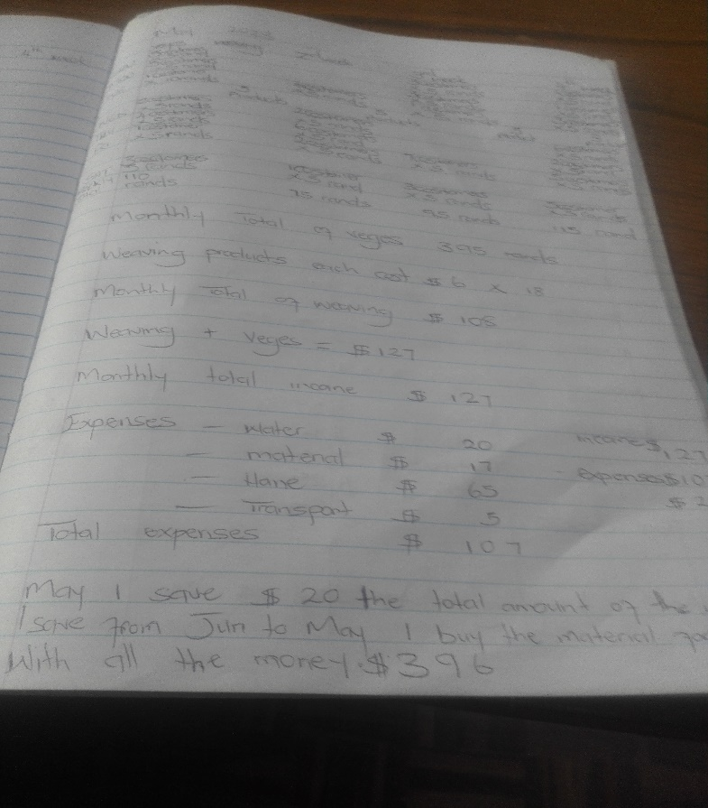
FINANCIAL MANAGEMENT
The business keeps record of:
Input materials, baskets produced and sold
Record-keeping helps track sales, cost, and inventory
The business has a bank account at First Capital
Sample of the record book

Slide 10
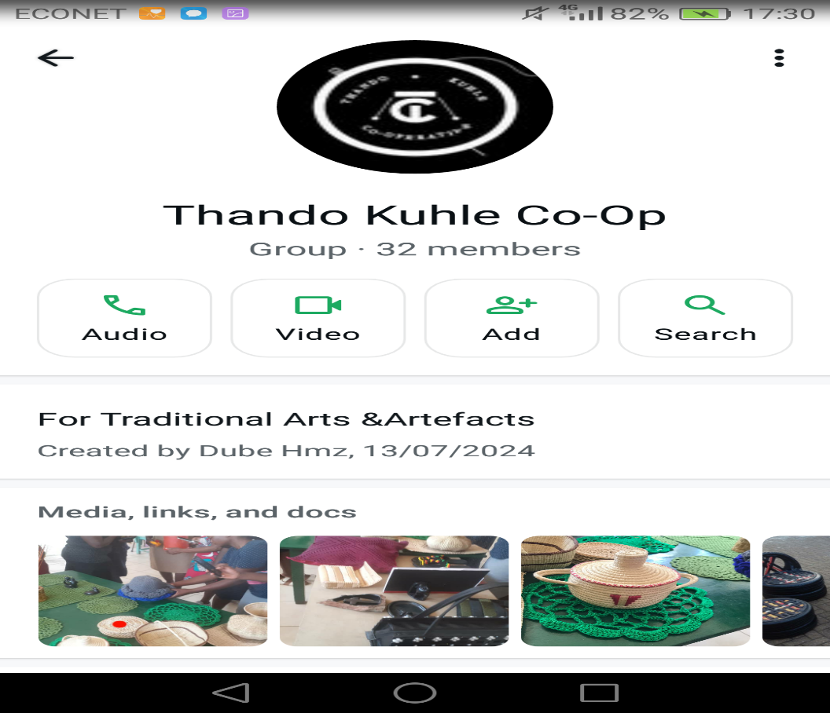
SAVINGS AND SELF SUFFICIENCY
Member of Thando Kuhle Co-Op
The business has managed to save 288USD
The business has helped in the increase of house hold income.
It has helped with the payment of school fees and rentals
Insert Photo
Savings whatsapp group

Slide 11
INCOME AND EXPENSES FOR THE BUSINESS FOR THE PAST SIX MONTHS
Income
Expenses
ITEM | AMOUNTUSD
Ndaza 75 | 75
Lala 55 | 55
Mthala 24 | 24
transport | 45
Braids 50 | 15
Body products | 55
Relaxer | 14
Airtime | 75
TOTAL | 358
ITEM | AMOUNT USD
Lamp sheds 34 | 340
Gold basket 15 | 120
Trays 11 | 99
Loveness drum 10 | 180
Braids 50 | 50
Roll-ons 25 | 62.5
Body sprays 16 | 32
Vaseline 24 | 24
Body lotion 11 | 33
Relaxer 11 | 11
TOTAL | 951

Slide 12
INCOME AND EXPENSES FOR THE BUSINESS FOR
NEXT SIX MONTHS
Income
Expenses
ITEM | AMOUNT
Lamp sheds 70 | 700
Gold basket 30 | 240
Trays 25 | 225
Loveness drum 22 | 396
Braids 100 | 100
Roll-ons 50 | 125
Body sprays 32 | 96
Vaseline 48 | 48
Body lotion 22 | 55
Relaxer 68 | 68
TOTAL | 2 053
ITEM | AMOUNT
Ndaza 160 | 160
Lala 110 | 110
Mthala 38 | 38
transport | 80
Braids 100 | 30
Body products | 110
Relaxer 2 | 28
airtime | 75
TOTAL | 631

Slide 13
WHAT PLANS HAVE YOU MADE TO GROW YOUR BUSINESS IN THE NEXT 6 MONTHS?
To grow the basketry, hair and body products business:
Enhance online presence,
Optimize production
Train and employ local artisans
Target December vacationers with handmade baskets as travel treasures, collect contact information, and encourage future sales
Aim: 20% sales increase, community empowerment

Slide 14
CHALLENGES
When a customer requests a new, untested design, challenges are encountered during the initial production attempt.
This often results in material waste due to: trial and error processes, inability to reuse materials if the design doesn’t turn out as expected and increased time consumption
Raw materials affected by season
To mitigate the challenge of material waste and extended production timelines associated with customer designs, the business seeks to collaborate with a skilled designer to accurately interpret customer design requirement

Slide 15
SUSTAINABILITY
The business will be managed through:
Management of cost: monitoring expenses, optimizing production, and negotiating supplier deals
Set realistic pricing: balance profitability with customer affordability
Maintain cash flow
Other sustainability measures that are in place for my business include:
Engaging in savings group
Managing cost and maintaining cash flow through record-keeping
Setting realistic pricing

Slide 16
ADDITIONAL INFORMATION?
The business has experienced transformative growth through customer-driven design collaborations. By embracing customer design requests, I’ve expanded my skill set and craftsmanship, tackling new and challenging designs that have inspired fresh ideas and enhanced my product offerings.
As a self-employed entrepreneur, my involvement in LED has not only improved my financial stability but also empowered me to break free from the constraints of gender-based violence in my community, promoting a culture of respect and equality.

Slide 17

SIYABONGA...
TATENDA...
THANK YOU...

