Slide 1




SADC PROTOCOL@WORK SUMMITS AND AWARDS
2024
GENDER RESPONSIVE BUDGETING presentation by K. S. Zenda
Zimbabwe,
Mutasa Rural District Council,
11 November 2024
.

Slide 2
OVERVIEW
COUNTRY | ZIMBABWE
COUNCIL (HUB/SPOKE) | MUTASA RURAL DISTRICT COUNCIL
GENDER CHAMPION | RUFARO MUDONHI
GENDER FOCAL PERSON | SPIWE CHIKUKWA
Latest score (year)
 | Income | Expenditure | % Gender Specific
Budget (YEAR)
 | Women | Men | Total | % Women
Council | 14 | 26 | 40 | 35
Management | 5 | 14 | 19 | 26.32
Council staff overall | 25 | 63 | 88 | 28.41
Population served | 197,808
Key characteristics | The population of 197,808 comprises of 103,863 females and 93,945 males. There are 52,370 households in the Mutasa District.

Slide 3

I. POLICY FRAMEWORK
Mutasa RDC has a policy which partly incorporates the Post 2015 SADC Gender Protocol, SDGs.
The policy is not well known by the new Councillors
The policy was recently reviewed and the reviews were not communicated to all employees.
Management are aware of the changes
Photo of the Gender Policy

Slide 4
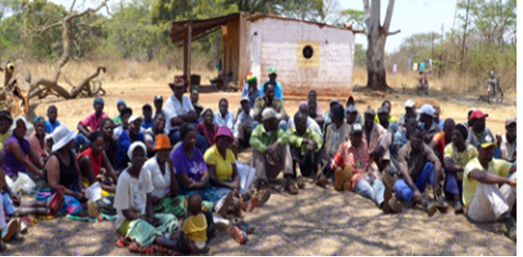
II. THE BUDGET PROCESS
How did the council integrate gender and inclusion in budget planning?
Resources were allocated to address the various needs brought in by its citizens.
How did the council integrate gender and inclusion into budget consultations? (Include all the methodologies used during the budget consultation process e.g., civic engagements, online consultations, etc.)
Council used the print media to sensitize about the budget.
Consultations for specific groups were made ie PWD, Women in Business, Women in Mining, Youths.
How did the council ensure that the budget consultation process was inclusive i.e., “no one is left behind”, e.g., that every resident including the hearing and visually impaired knew about meetings. Please cite all methods used.
Hwizo clinic consultation

Slide 5
II. THE BUDGET PROCESS
Detail
Evidence
What time, venue and meeting strategies did the council use to ensure inclusion? E.g., were women consulted about what day/time would work best for them?
Did the council make use of technology to broaden your reach? How? E.g. WhatsApp.
How effective was this technology?
A proposed consultation programme is shared with all concerned stakeholders.
Programme is shared in Social Media groups of various stakeholders
The method reaches out to many people though physical participation is limited.

Slide 6
II. THE BUDGET PROCESS
Does the council have sex/age/PLWD statistics on those who participated in the consultations? – refer to consultation registers and populate table below
Consultation | Women |  |  |  |  | Total | Men |  |  |  |  | Total | % Women
 | Age |  |  |  |  |  | Age
 | - 15 | 15-35 | 36-59 | 60+ | PWD |  | - 15 | 15-35 | 36-59 | 60+ | PWD
 | 0 | 89 | 39 | 21 | 0 | 149 | 0 | 50 | 61 | 11 | 0 | 122 | 54.98
% |  |  |  |  |  | 100% |  |  |  |  |  | 100%

Slide 7
III. REVENUE
What is the break down between internal and external sources of funding?
Internal-13 049 076
External -4 492 709
How did gender considerations informed decisions concerning the budgeting of revenue?
How were these decisions influenced by budget consultations, in particular the views of women?
Is any of the external financing specifically targeted at gender?

Slide 8
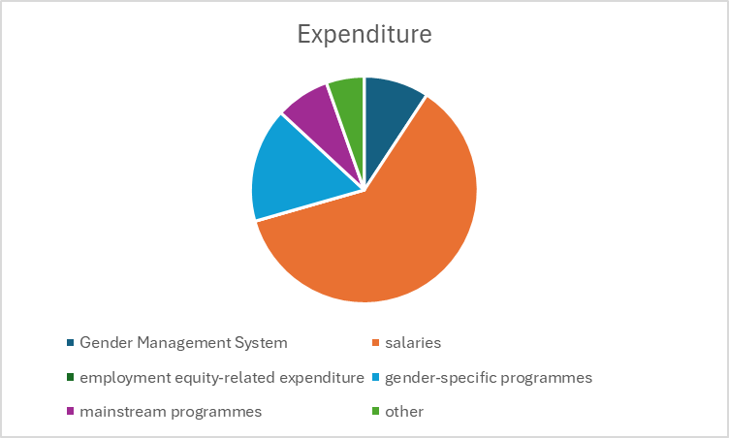
IV. EXPENDITURE
Gender Mgt Systems | 9%
Salaries | 61%
Employment equity related | 0%
Gender Specific programmes | 16%
Mainstream programmes | 9%
Other | 5%

Slide 9
IV. EXPENDITURE
Type of Expenditure | Amount | Proportion (%)
Gender Management System (GMS) | 2 982 | 9
Employment expenditure (Human Capital Expenditure) | 19 720 | 61
Employment equity related expenditure | 0 | 0
Gender Specific Programming | 5 250 | 16
Mainstream Programmes | 2 480 | 9
Other | 1 740 | 5
Total | 32 172 | 100

Slide 10
IV. EXPENDITURE- GMS
Does the council have a Gender Management System?
Yes. Gender Committee in place with the Chairperson being the Gender Champion, 2 Organisational Gender Focal Persons, Departmental Gender Focal Persons.
Are GMS activities budgeted for ?
Council budgets for the Gender Committee expenses and the Committee members’ expenses, Office expenses and training expenses.
Where are these budgets found?
The budget is under the Governance programme.

Slide 11
IV. Gender Specific expenditure
What gender-specific programmes does the council have?
Commemorations of 16 Days of Activism against GBV.
Construction of waiting mothers’ shelter at Council clinics
Borehole Repairs and maintenance.
Provision of vending sites.
Where are these budget lines found? Are they visible?
Budget under Programmes 2 and 3. Yes they are visible.
What proportion of the council budget is allocated for gender-specific programming?
1%
How were these programmes/ projects informed by budget consultations?
Most women are actively partaking in vending activities and this represent a bigger chunk of budgeted revenue under fees for vending.
A larger proportion of men are involved in businesses, small to medium enterprises and this translates to a larger budget estimate of revenue from licencing and trading permits considering the high stats of participants as well.
How are the gender-specific projects helping to promote gender equality and women’s empowerment?
How do you measure the expenditure on gender-specific programmes (outputs, outcomes and impact)?

Slide 12
IV. EMPLOYMENT EXPENDITURE
 | Women |  |  | Men |  |  | Total | % women
 | Managers | Staff | Total | Managers | Staff | Total |  | Managers | Staff | Total
Full Time | 2 | 22 | 24 | 6 | 38 | 44 | 68 | 33 | 57 | 35
Part time | 0 | 2 | 2 | 0 | 5 | 5 | 7 | 0 | 40 | 29
Casual | 0 | 36 | 36 | 0 | 42 | 42 | 78 | 0 | 86 | 46
Total
What percentage do women comprise of the full-time, part-time and casual, labour force?
40.52%
What are the reasons for the this employee breakdown?
Nature of work done
No required qualifications.

Slide 13
IV. EMPLOYMENT EXPENDITURE- Gender Wage Gap Analysis
 | Women | Women- Total earned | Women average earned | Men-no | Men total earned | Average earnings
Full Time | 24 | 923 027.48 | 38 459,47 | 44 | 2 312 948,39 | 52 567
Part Time | 2 | 12 000 | 6 000 | 5 | 31 200 | 6 240
Casual | 36 | 16 727.04 | 464,64 | 42 | 19 514,88
Total | 62 | 951,754.52 | 15 350,87 | 91 | 2,363,663.27 | 25 974,32
What is the gender wage gap?= 0,69
What does the wage gap reflect?
Women occupy lower grades of employment in the Council.
The lower grades are mostly administrative and clerical work.
What plans does the Council have in place to close the gender wage gap?
Council provides equal employment opportunities when a vacancy arises. Shortlisting of prospective employees is 50-50.

Slide 14
V. EXPENDITURE- GENDER IN MAINSTREAM BUDGET
Programmes | Amount | % budget
Governance & Administration | 5,737,922.60 | 32.55
Water Sanitation & Hygiene | 2,167,334.79 | 12.30
Social Services | 3,390,674.18 | 19.24
Roads | 5,463,808.59 | 31.00
Public Safety & Security | 575,551.45 | 3.27
Natural Resources & Conservation | 291,107.88 | 1.65
Total | 17,626,399.49 | 100

Slide 15
V. EXPENDITURE- ANALYSIS OF ONE SECTOR EG
 | Women |  |  |  |  |  | Men
 | Age |  |  |  |  |  | Age
 | Below 15 | 15-35 | 36-59 | 60+ | PLWD | Total | Below 15 | 15-35 | 36-59 | 60+ | PLWD | Total
Education | 0 | 0 | 0 | 0 | 0 | 0 | 0 | 0 | 2 | 0 | 0 | 2
Housing | 0 | 1 | 0 | 0 | 0 | 1 | 0 | 1 | 2 | 0 | 0 | 2
Social amenities | 0 | 0 | 0 | 0 | 0 | 0 | 0 | 0 | 0 | 0 | 0 | 0
Total | 0 | 1 | 0 | 0 | 0 | 1 | 0 | 1 | 4 | 0 | 0 | 4

Slide 16
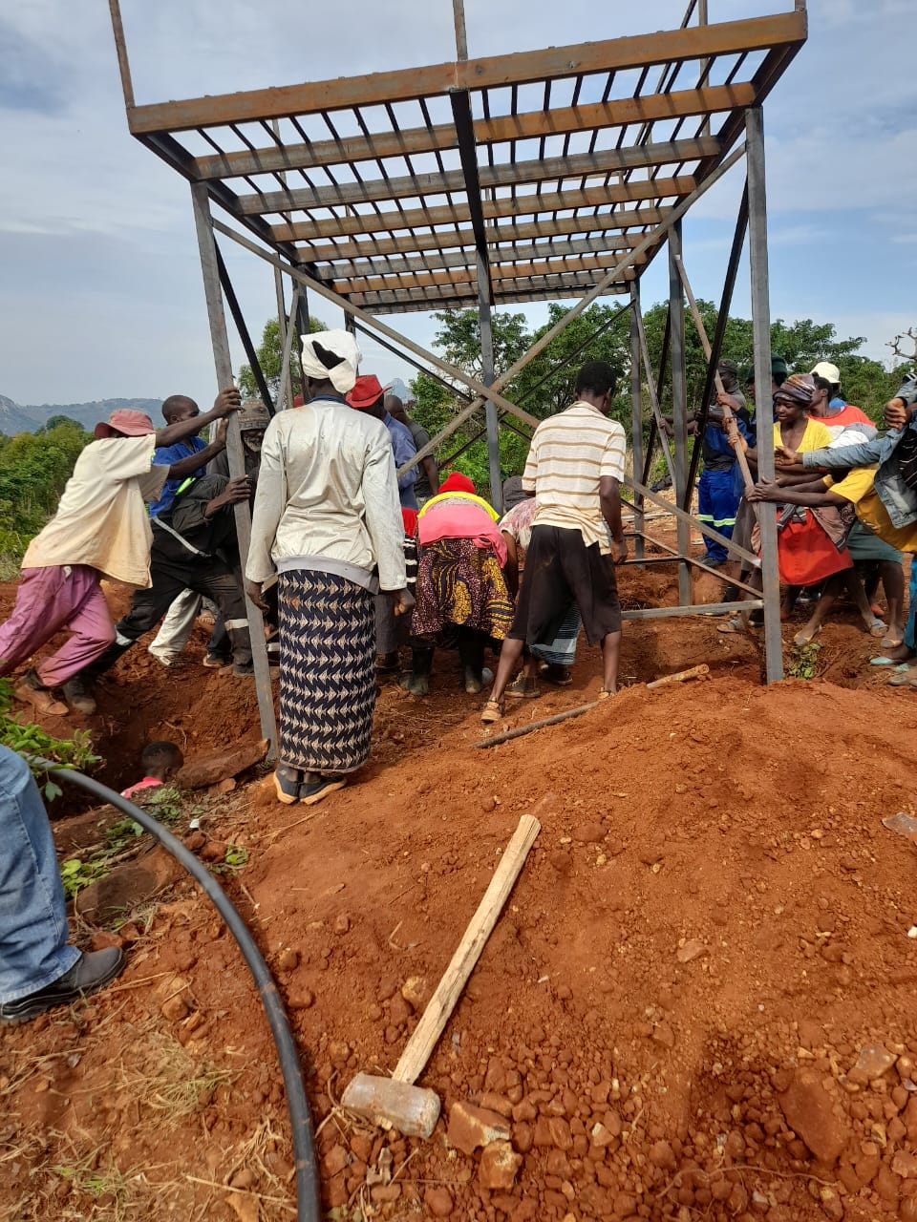
V. EXPENDITURE- GENDER IN MAINSTREAM BUDGET
Please explain how you are ensuring that women and men, boys and girls benefit equally, or that disparities are challenged through GRB
Council has created a Junior Council.
Women participation is encouraged in all projects.
WASH programmes centered on women.
PHOTO

Slide 17
V. EXPENDITURE- GENDER IN MAINSTREAM BUDGET – EXAMPLE
 | Amount | No of beneficiaries | Percentage
Total Expenditure | 1 257 742
No. of Men benefiting from council allocations | 842 687 | 4 277 | 67
No. of Women benefiting from council allocations | 415 055 | 2 147 | 33
Total beneficiaries |  | 6 424 | 100%

Slide 18
VI. BUDGET CROSS SUBSIDISATION ANALYSIS
 | Income (A) | % of total budget | Expenditure (B) | % of total budget | Surplus/Deficit
Governance & Administration | 5,737,922.60 | 32.55 | 5,737,922.60 | 32.55
Water, Sanitation & Hygiene | 2,167,334.79 | 12.3 | 2,167,334.79 | 12.3
Social Services | 3,390,674.18 | 19.24 | 3,390,674.18 | 19.24
Roads | 5,463,808.59 | 31 | 5,463,808.59 | 31
Public Safety and Security | 575,551.45 | 3.27 | 575,551.45 | 3.27
Natural Resources & Conservation Mgt | 291,107.88 | 1.65 | 291,107.88 | 1.65
Total | 17,626,399.49 | 100 | 17,626,399.49 | 100

Slide 19
VI. BUDGET CROSS SUBSIDISATION ANALYSIS
Which programmes generate more income than expenditure?
The Social Services programme generates more income than expenditure.
Which programmes spend more than they generate (i.e. they are being subsidised). Specify nature of activities being subsidised and funding source.
Programme 1 (Governance) and Programme 4 (Roads). Activities are basically labour related costs, road making and servicing of equipment.
Are there any policies to support or guide cross-subsidisation?
Yes, the viramenting policy is in place.
How have gender considerations influenced the cross-subsidisation of services?
No as there are a lot of programmes to be done under the Social Services programme.
What percentage of allocations have been influenced by gender considerations?
33.69%

Slide 20
VII. CONCLUSIONS AND NEXT STEPS
To what extent has the council budget contributed to gender equality and women’s empowerment?
Almost over 56% of Council’s budget has been directly attributed to Gender equality issues, Youths recreational facilities, Health, Education and Women empowerment, Girl Child initiative programs, Sanitation and Hygiene, and Roads Infrastructure among others. As such the budget has been prepared in such a way that it promotes equality and accessibility of basic necessities of life to everyone
What are the next steps regards gender budgeting for the council?
To allocate resources clearly to gender activities(unbundling).

