Slide 1




SADC PROTOCOL@WORK SUMMIT 2024
Youth Leadership Presentation
PRESENTER: DENZEL WHATA (CHITUNGWIZA JUNIOR MAYOR)
COUNTRY: ZIMBABWE
LOCATION: CHITUNGWIZA
DATE: 11 NOVEMBER 2024

Slide 2
Quotable Quotes
“At some point, ability and character will collide and what will matter then is who you are, not what you can do. A good personality is always the best skill one could ever ask for.”
Throughout my leadership journey I realised
Being reliable, accountable, correctable, honest and kind is key.
Working on your attitude is crucial.
Personal relationship with work is essential.

Slide 3
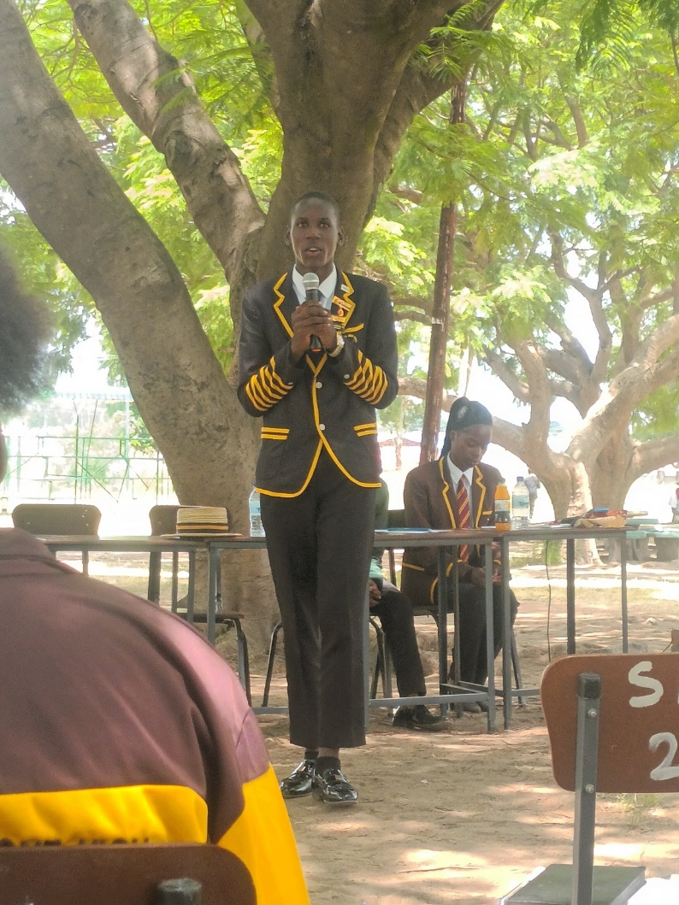
Experience as a leader
Started when I was in primary school where I would report class bullies mocking girls and urged boys and girls to play together during break time
In secondary school I decided to move from defensive activism to offensive activism
Joined girls empowerment club at my school
Joined the junior council to amplify my reach
Organized outreaches, awareness campaigns and workshops to bring about gender equality.
In all this I never stopped trying to reach another person, change another life and do more for gender equality

Slide 4
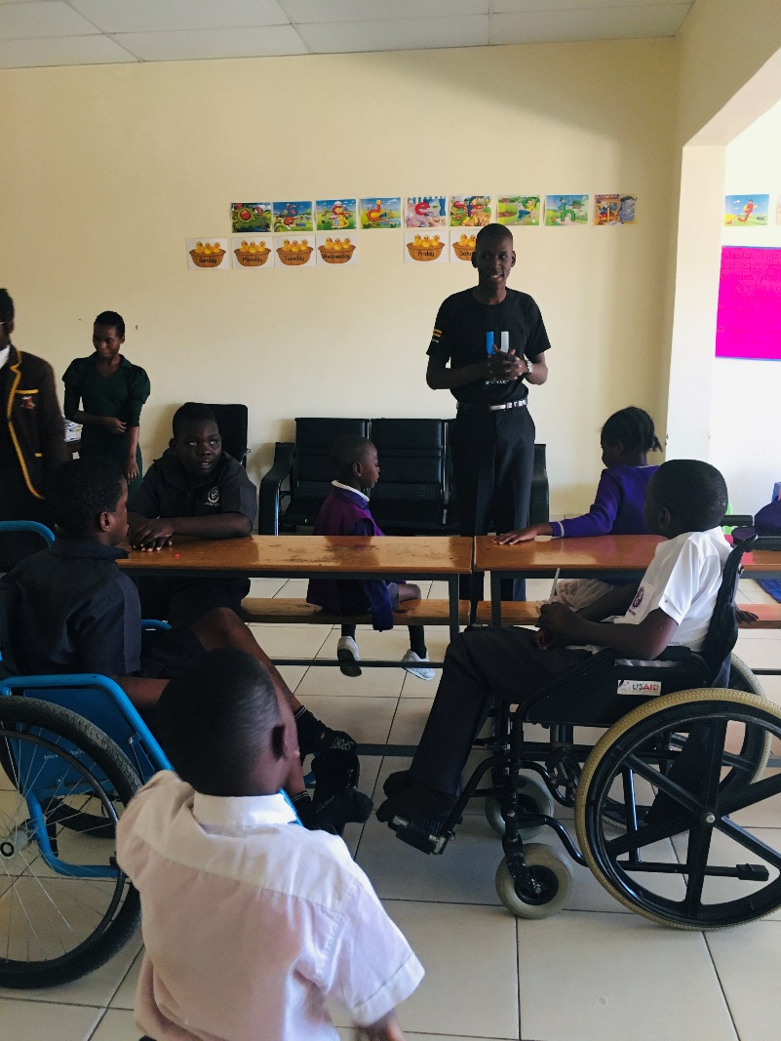
WHO IS THIS YOUTH CHAMPION?
Before anything else I am a son, a brother, a friend, a student and a helper.
Gender equality activist
18 year old youth advocate
I hail from the great city of Chitungwiza
I work to reach and include everyone regardless of circumstances or background

Slide 5
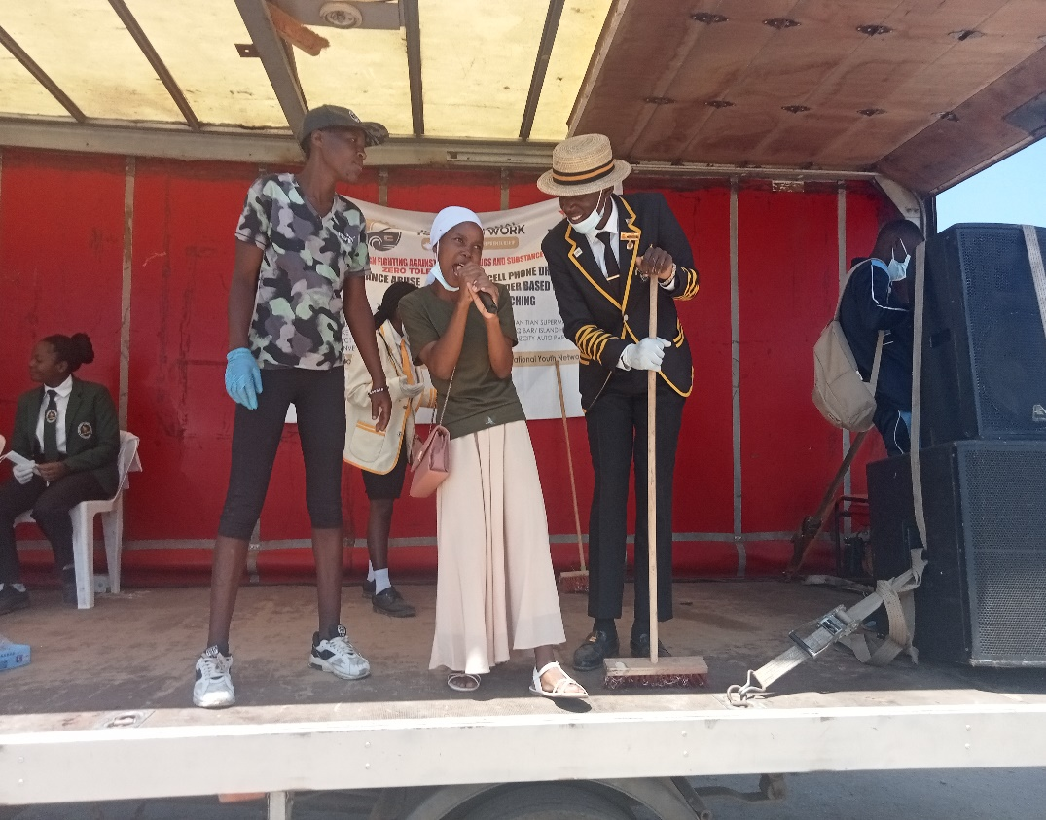
WHAT DRIVES YOU?
I envision a world where everyone's opinion and well-being are valued irrespective of their gender or age.
I work to
raise awareness of negative impacts of gender-based bullying in schools.
equip young girls with knowledge and skills to stand up and advocate for themselves.
lessen the stigma on mental health and menstrual issues.
I am committed to having opinions of young people on gender equality heard and understood by responsible duty bearers

Slide 6
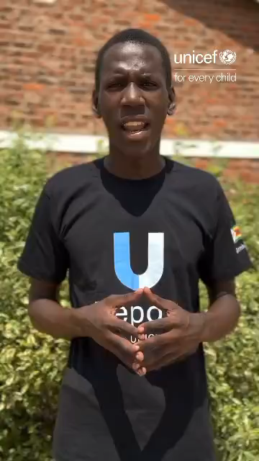
WHAT DO YOU DO?
Primary and secondary school outreaches
Hospital visits
Visits to schools for children with special needs
Raising awareness on mental health and gender equality through videos on social media
Empower female youth advocates by collaborating with them on my initiatives
attend budget consultations, national and international conferences to speak on the issue of gender-based violence in my community.

Slide 7
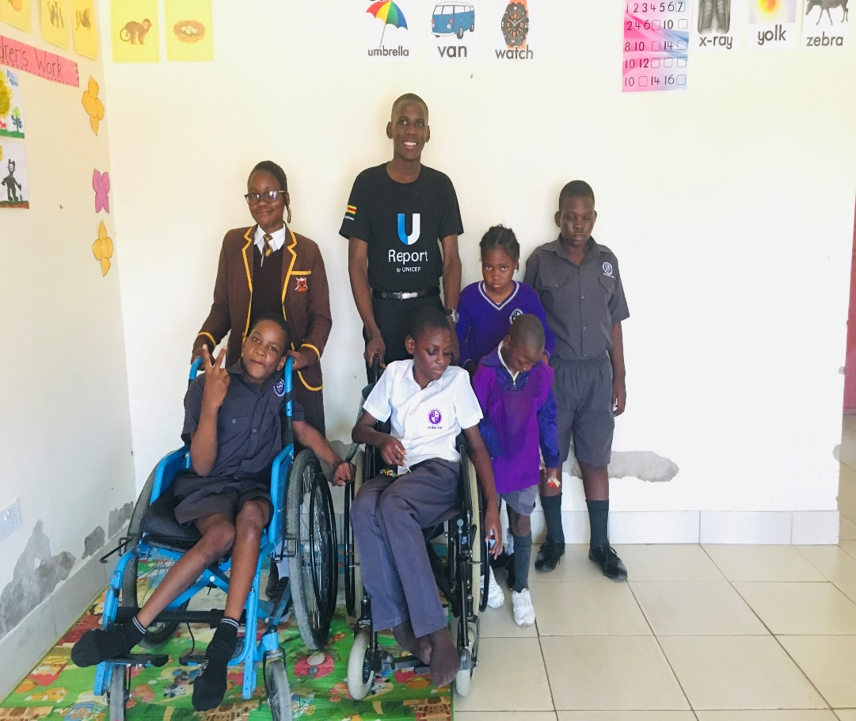
CHALLENGES
Lack of finances - used personal money, I walked long distances, sought aid form community well wishers
Resistance by girls because I was a boy - collaborated with girls on most of my initiatives
Undermining of initiatives by some community members because of age – continued without their help until they realised its significance and joined me
Denial of access by authorities e.g. school headmasters - sought relevant permissions and kept on going back until I was accepted

Slide 8

What has changed in your life?
Gained valuable skills like public speaking, report writing and event planning.
Started performing better in other aspects of my life, my school assignments, projects and house chores.
I now have a stronger social capital.
I am grateful to my matron/ mentor.
NGOs I work with in my community e.g. Team Rescue Mission and Shamwari Yemwanasikana.

Slide 9
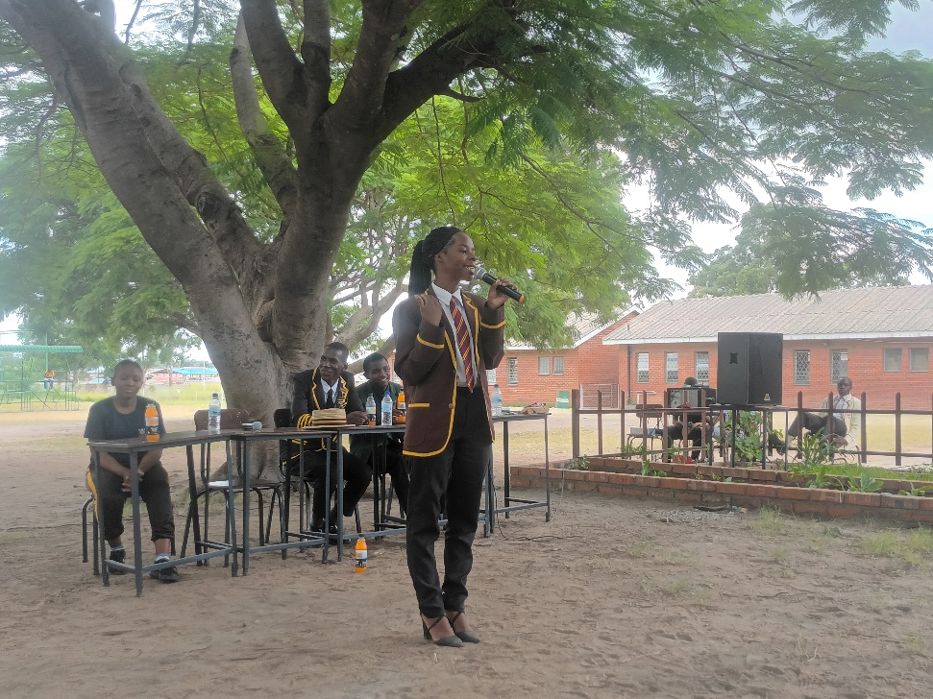
What Capacity Building Initiatives Have You Initiated?
Puberty workshop - training students of Seke One High School on how to build a puberty friendly environment for all.
Gender Based Violence workshop at Beverly Hills College – teaching students of Beverly hills college on how, when and where to report GBV in their communities and school
Collaborated with Seke One High School Head Girl, Girls Empowerment Club President on most of my initiatives.

Slide 10
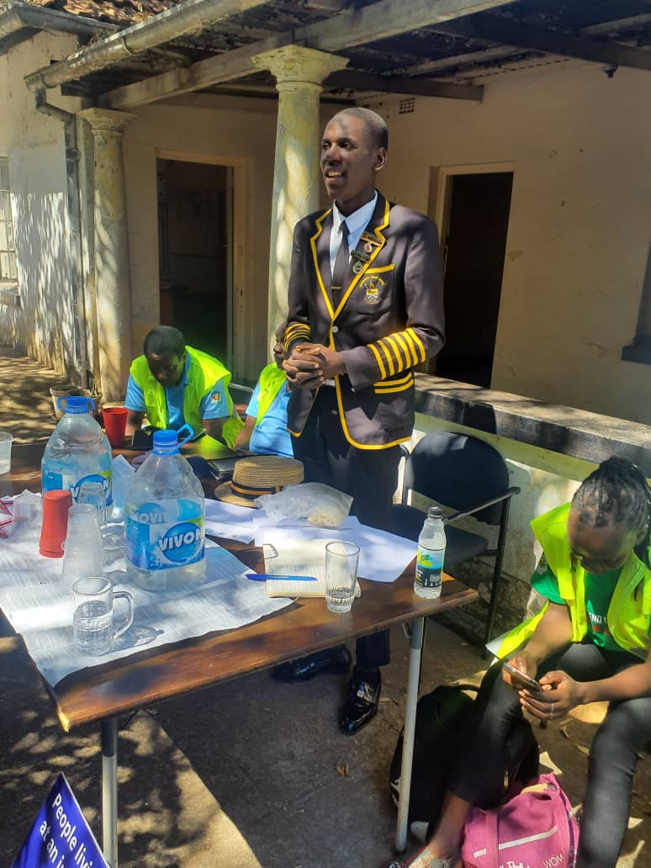
Lessons Learnt
Realized the potential and ability in the Girl child
Discovered importance of proper planning, patience and persistence in all you do.
Learnt of the greater joy in helping others.
Learnt how crucial it is to surround yourself with like minded individuals.
You must be the change you want to see.

Slide 11
NEXT STEPS
01
02
03
04
05
Team
Transition
Go Beyond
Collaborate
Grow
Build a team of like minded individuals to help me in my initiatives
Not only focus on schools but also transition my efforts to the community
Go beyond Chitungwiza to other schools and communities in other parts of Harare
Collaborate with NGOs and individuals focusing on gender equality in my initiatives
Continue to grow and learn from others, developing new strategies along the way

