Slide 1
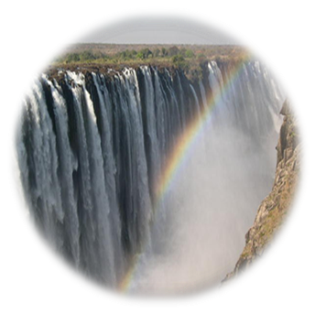





SADC PROTOCOL@WORK SUMMITS AND AWARDS
2024
GENDER RESPONSIVE BUDGETING
(Zimbabwe, City of Victoria Falls, T Mpofu)
.

Slide 2
OVERVIEW
COUNTRY | ZIMBABWE
COUNCIL (HUB/SPOKE) | CITY OF VICTORIA FALLS
GENDER CHAMPION | COUNCILLOR PRISCILLA MHLANGA
GENDER FOCAL PERSON | MS KHOLWANI MANGENA,Ms N NCUBE and Ms S RUDZUNA
Latest score (year) | -
 | Income | Expenditure | % Gender Specific
Budget (YEAR) 2024 | 22,153,717 | 20,789.409.49 | >1%
 | Women | Men | Total | % Women
Council | 4 | 10 | 14 | 29%
Management | 5 | 13 | 18 | 27.7%
Council staff overall | 103 | 268 | 376 | 28.7%
Population served | 35761
Key characteristics | CITY OF VICTORIA FALLS IS LOCATED IN THE TOURIST HUB OF ZIMBABWE AND HAS A WORKFORCE WITH MORE MALES THAN FEMALES .

Slide 3

  I. POLICY FRAMEWORK
What gender provisions and policies guide the council budget?
Urban Councils Act Chapter 29:15
Public Finance Management Act Chapter 22:19
Consultative meetings – stakeholders’ input
Does the council have a gender policy and does it address issues on gender budgeting?
Council has a gender policy in place which was approved in 2019. According to the policy allocation of resources should be gender sensitive e.g. Council to consider quota allocation of land for women, youth and people living with disabilities, waiting list now gender sensitive as it includes age, sex, able bodied and disabled
Council allocates informal trading facilities to women, men, able bodied and disabled
Council ensures women and men have equal access to employment opportunities

Slide 4
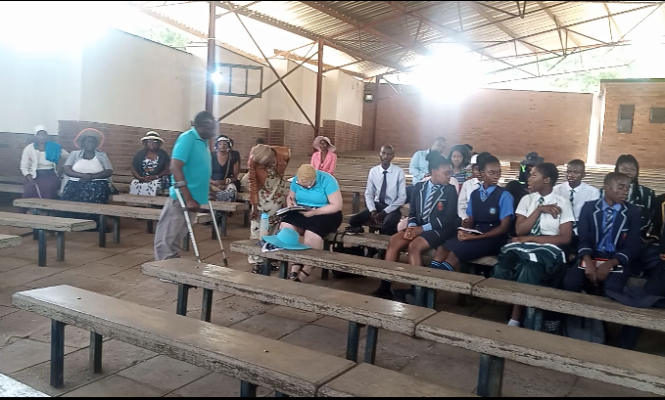
II. THE BUDGET PROCESS
Detail
Evidence
How did the council integrate gender and inclusion in budget planning?
The 2024 budget consultation meetings were all inclusive no one was left behind.
The consultation meeting registers are attached and they were crafted in such way that data on gender participation can be analysed
Council invited stakeholders which include, men, women, youths, elderly and people living with disabilities (PLWD) to the budget consultation meetings through the hailer, notices and telephone calls. The invitation for PLWD’s also was sent to their secretary, while the one for women was also sent to various specific women’s WhatsApp groups.
How did the council integrate gender and inclusion into budget consultations?
People were invited for meetings, given platform to air their views, and the contributions and observations from stakeholders were taken into consideration and these were done through face to face consultations
PWD and Youth during budget consultation

Slide 5
Budget Process
How did the council ensure that the budget consultation process was inclusive i.e., “no one is left behind”, e.g., that every resident including the hearing and visually impaired knew about meetings. Please cite all methods used.
People were invited for meetings, given platform to air their views. The contributions and observations from stakeholders were taken into consideration and these were done through face-to-face consultations
Council used handheld hailer, public notices, resident’s WhatsApp groups, emails, Council structures, to invite the public to the consultative meeting. In some cases where the turnout was low Council rescheduled the meetings to ensure total involvement of the residents

Slide 6
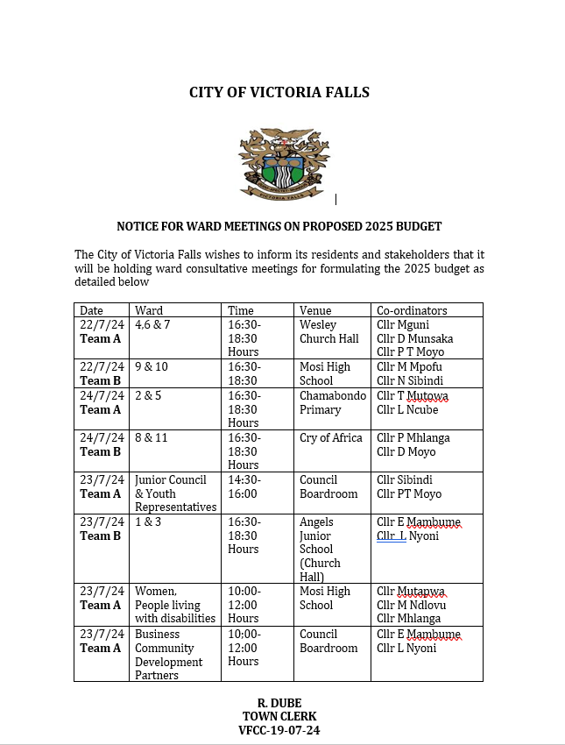
II. THE BUDGET PROCESS
Detail
Evidence
What time, venue and meeting strategies did the council use to ensure inclusion? E.g., were women consulted about what day/time would work best for them?
Council ensured that the meeting venues for all groups were accessible, some meetings were held during the day while others after hours.
PWD’s, women and youth had their own scheduled meeting from 1400hrs to 1600hrs, while for the general populace meetings were scheduled from 1630hrs to 1830hrs.
The Community Hall was used as the venue for the special group, as it has a ramp, good ventilation amongst other things.
Meetings were held at respective wards venues, to allow ease access for the residents
Council will continue engaging stakeholders on the most convenient time for them to attend meetings.

Slide 7
II. THE BUDGET PROCESS
Detail
Did the council make use of technology to broaden your reach? How? E.g. WhatsApp.
How effective was this technology?
Council used website, residents/stakeholders WhatsApp groups, emails, public notice and phone calls
Council is aware that not all people are familiar with the above ICT’s used, hence it also used a hailer to sensitize the community about scheduled budget meetings.

Slide 8
II. THE BUDGET PROCESS
Does the council have sex/age/PLWD statistics on those who participated in the consultations? – refer to consultation registers and populate table below
Consultation | Women |  |  |  |  | Total | Men |  |  |  |  | Total | % Women
 | Age |  |  |  |  |  | Age
 | - 15 | 15-35 | 36-59 | 60+ | PWD |  | - 15 | 15-35 | 36-59 | 60+ | PWD
 | 6 | 56 | 84 | 18 | 1 | 165 | 7 | 50 | 83 | 14 | 2 | 156
% | 4 | 34 | 51 | 10.9 | 0.01 | 100% | 5 | 32 | 53 | 9 | 1 | 100% | 51

Slide 9
III. REVENUE
What is the break down between internal and external sources of funding?
External Funding -8%
Internal Funding -92%
How did gender considerations informed decisions concerning the budgeting of revenue?
Gender consideration, integrates goals and social responsibilities which allows for better spending analysis e.g. establishment of the rehabilitation centre, targeting mainly youth will mean escalation of revenue in the social service programme if grant funded.
Gender considerations also highlight how council policies, combined with budget respond to the potentially different needs of women, men, youth and PWD e.g. Sexual Harassment Policy.

Slide 10
III. REVENUE
How were these decisions influenced by budget consultations, in particular the views of women?
Women, men, youth and PLWD were given specific/special slot during the budget process to deliberate freely on issues affecting them which were then factored into the budget, e.g. Women market was established following their request during budget consultation meeting.
Is any of the external financing specifically targeted at gender?
None at the moment
Council work in collaboration with other NGO’s for various trainings of women, men, youth and PWD.

Slide 11
IV. EXPENDITURE
Analysis of Expenditure in Council Budget
GMS and GPS general constitute less than 1% of the total expenditure
Human Capital Expenditure 26.3%
Mainstreaming Programs 72.5%
Insert Pie Chart/Table

Slide 12
IV. EXPENDITURE
Type of Expenditure | Amount | Proportion (%)
Gender Management System (GMS) | $7,160.00 | 0.03%
Employment expenditure (Human Capital Expenditure) | $5,539,658.50 | 26.7%
Employment equity related expenditure
Gender Specific Programming | $42,862.00 | 0.2%
Mainstream Programmes | $15,099,727.99 | 72.6%
Other
Total | $20,789,409.49 | 100%

Slide 13
IV. EXPENDITURE- GMS
Does the council have a Gender Management System? (E.g., Gender Committee, Gender Focal Person, Gender Champion).
Council has a Gender Management System in place.
The Gender Focal persons (Ms Kholwani Mangena, Ms Ntombizami Ncube and Ms Sheila Rudzuna) all not full time
The Gender Champion is Cllr P Mhlanga and a Gender Committee comprising of Departmental GFP’s.
Are GMS activities budgeted for ? (E.g., Committee meetings, Hub/ spoke activities, exhibitions, Training, Policy formulation, Exchange visits, Office equipment and stationery, other activities?
GMS activities are budgeted, and fall under Central Admin budget, amounting to $7,160.00. The fund are for attending meeting/trainings and look & learn visits to the Hub Council(Bulawayo City Council).

Slide 14
IV. Gender Specific expenditure
What gender-specific programmes does the council have?
Gender Training workshops e.g. Women’s Coalition Zimbabwe training
Junior Council in place
Commemoration of international days e.g., International Women's Day, Sixteen Days of Activism, Youth Day, International Men's Day
Maternal health and men’s health programs e.g. Breast Cancer Screening
Sexual Reproductive Health and Rights.
Youth Center identification need.
Gender desk activities.
Facilitation of various training by NGO’s e.g. Umhambi Children's Foundation of Hope hairdressing & dressing making courses
The GMS are budgeted under Central Admin
GSP have an allocation of >1% of council budget

Slide 15
IV. Gender Specific expenditure
How were these programmes/ projects informed by budget consultations?
Through inclusion of all stakeholder ,men, women, youth and PWD’s during the budget consultations
How are the gender-specific projects helping to promote gender equality and women’s empowerment?
There is knowledge sharing
Create inclusive work environments, by establishing equal opportunities for women in various platform and at different level
Addressing cultural and social barriers, as both women and men now can occupy positions that were previously stereotyped to a certain gender
They empower women with knowledge and various skills, enhancing their entrepreneurship skills e.g Women markets
How do you measure the expenditure on gender-specific programmes (outputs, outcomes and impact)?
Knowledgeable and empowered women
Improved access to resources , opportunities and equal rewards regardless of gender at all levels
Sound organizational policies that address various individual level needs

Slide 16
IV. EMPLOYMENT EXPENDITURE
 | Women |  |  | Men |  |  | Total | % women
 | Managers | Staff | Total | Managers | Staff | Total |  | Managers | Staff | Total
Full Time | 5 | 75 | 80 | 13 | 203 | 216 | 296 | 27.7% | 26.9% | 35.7%
Part time | 0 | 0 | 0 | 0 | 0 | 0 | 0 | 0 | 0 | 0
Casual | 0 | 28 | 28 |  | 52 | 52 | 80 | 0 | 35% | 35%
Total | 5 | 103 | 108 | 13 | 255 | 268 | 376 | 27.7% | 21.78% | 28.7%
What are the reasons for the this employee breakdown?
Women are fewer in the organization
Women though few and occupy clerical and nursing positions, while men occupy lower grade positions like refuse collection, road maintenance, water and sewer where there is high labor force

Slide 17
IV. EMPLOYMENT EXPENDITURE- Gender Wage Gap Analysis
 | Women | Women- Total earned | Women average earned | Men-no | Men total earned | Average earnings
Full Time | 80 | 98,568.75 | 1,232.10 | 216 | 260,736.83 | 1,207.12
Part Time |  | 0 | 0 | 0 | 0 | 0
Casual | 28 | 17,508.67 | 625.31 | 52 | 22,489.74 | 432.50
Total | 108 | 116,077.42 | 1074.79 | 268 | 283,226.57 | 1,056.82
Wage Gap Analysis
The gender wage gap is -1.7%
Women are fewer in the organization however they are in positions that earn more than men
Women though few occupy higher grade positions e.g. clerical and nursing positions, while men occupy lower grade positions like refuse collection, road maintenance, water and sewer treatment plants etc.

Slide 18
V. EXPENDITURE- GENDER IN MAINSTREAM BUDGET
Programmes | Amount | % budget
Governance & Administration | 3,836,458.53 | 32
Water Sanitation & Hygiene | 4,607,472.98 | 38
Social Services | 1,311,821.79 | 11
Roads | 1,023,919.54 | 8
Public Safety & Security | 1,377,016.45 | 11
Natural Resources & Conservation
Total | 12,156,689.29 | 100
Draw Pie chart here

Slide 19
V. EXPENDITURE- ANALYSIS OF ONE SECTOR EG
 | Women |  |  |  |  |  | Men
 | Age |  |  |  |  |  | Age
 | Below 15 | 15-35 | 36-59 | 60+ | PWD | Total | Below 15 | 15-35 | 36-59 | 60+ | PWD | Total
Education | 875 | 432 |  |  | 3 | 1310 | 772 | 373 |  |  | 1 | 1146
Housing |  | 50 | 129 |  |  | 179 |  | 30 | 108 |  |  | 338
Social amenities | 2945 | 2214 | 4603 | 962 | 12 | 10,736 | 1605 | 1111 | 2612 | 629 | 5 | 5962
Total | 3820 | 2696 | 4732 | 962 | 15 | 12,225 | 2377 | 1514 | 2720 | 629 | 6 | 7446

Slide 20
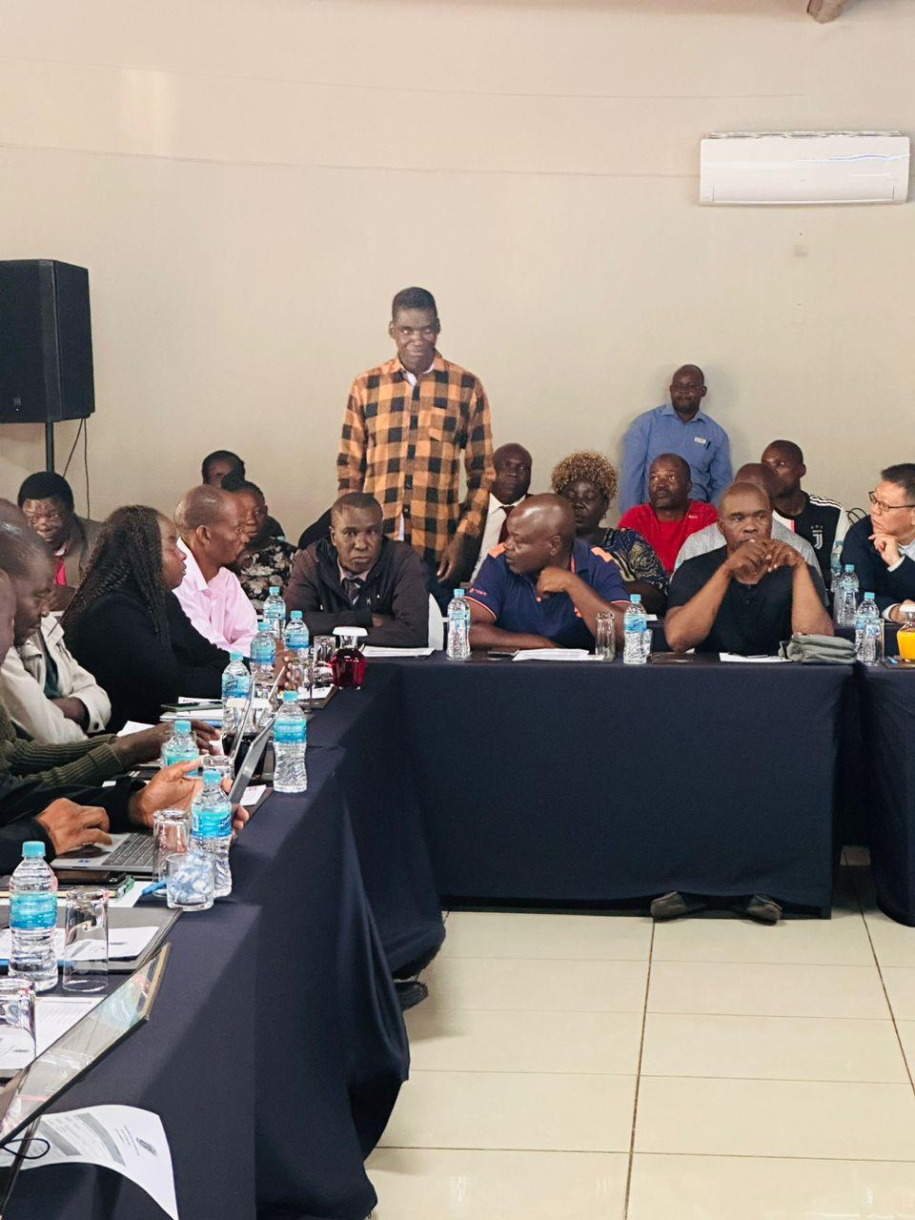
V. EXPENDITURE- GENDER IN MAINSTREAM BUDGET
Please explain how you are ensuring that women and men, boys and girls benefit equally, or that disparities are challenged through GRB
Council creates awareness on opportunities available e.g. through commemoration days where there is knowledge sharing
Through creation of inclusive work environments, by establishing equal opportunities for women in various platform and at different level
Addressing cultural and social barriers, as both women and men now can occupy positions that were previously stereotyped to a certain gender
By empowering women with knowledge and various skills, enhancing their entrepreneurship skills e.g. Women markets
PHOTO

Slide 21
V. EXPENDITURE- GENDER IN MAINSTREAM BUDGET – EXAMPLE
 | Amount | No of beneficiaries | Percentage
Total Expenditure
No. of Men benefiting from council allocations | 4,056,000 | 338 | 65.4%
No. of Women benefiting from council allocations | 2,148,000 | 179 | 34.6%
Total beneficiaries | 6,204,000 | 517 | 100%

Slide 22
VI. BUDGET CROSS SUBSIDISATION ANALYSIS
 | Income (A) | % of total budget | Expenditure (B) | % of total budget | Surplus/Deficit
Governance & Administration | 5,493,013.16 | 25 | 6,944,276.50 | 33 | (1,451,263)
Water, Sanitation & Hygiene | 12,725,519.47 | 58 | 7,128,151.17 | 16 | 5,597,368
Social Services | 2,224,245.00 | 10 | 3,280,106.51 | 34 | (1,055,862)
Roads | 1,629,380.04 | 7 | 1,956,264.93 | 9 | (326,884.89)
Public Safety and Security | 21,559.00 |  | 1,480,610.38 | 7 | (1,459,051)
Natural Resources & Conservation Mgt
Total | 22,093,716.68 | 100 | 20,789,409.49 | 100 | 1,304,307

Slide 23
VI. BUDGET CROSS SUBSIDISATION ANALYSIS
Which programmes generate more income than expenditure?
Water & Sanitation
Which programmes spend more than they generate (i.e. they are being subsidised). Specify nature of activities being subsidised and funding source
Public Safety & Security and the Clinics, services are being subsidized and are financed by other income generating programmes
Are there any policies to support or guide cross-subsidisation?
The finance policy supports cross subsidization through interfund
How have gender considerations influenced the cross-subsidisation of services?
Gender consideration assist in guiding council to close gender gaps hence affecting expenditure patterns of various programmes
What percentage of allocations have been influenced by gender considerations?
100%

Slide 24
VII. CONCLUSIONS AND NEXT STEPS
The council has significantly contributed to gender equality and women's empowerment. The implementation of a gender-responsive and mainstreamed budget has facilitated the creation of policies, such as Gender, Sexual Harassment , Selection and Recruitment policies, that are sensitive to gender issues.
This approach addresses gender-based barriers and respects gender differences; for instance, it now allows women to own land in their own right.
Council's initiatives ensure that there is gender parity in a broader strategy aimed at advancing gender equality.
City of Victoria Falls evolving measures to close gaps and eradicate gender-based violence through commemoration days and other gender-specific activities.
These efforts have led to improvements in both customer and employee satisfaction by creating an inclusive environment that acknowledges and addresses the diverse needs of all individuals.
Council's commitment to integrating gender perspectives into budgeting processes has not only fostered policy development but also promoted a more equitable society where women can thrive and participate fully in all aspects of life.

Slide 25

THE END

