Slide 1




PROMOTING GENDER-INCLUSIVEE LOCAL ECONOMIC DEVELOPMENT IN ZIMBABWE
Business Name: Mother and daughters grocery shop
Council: Norton Town Council
Please include photographs of the business!

Slide 2
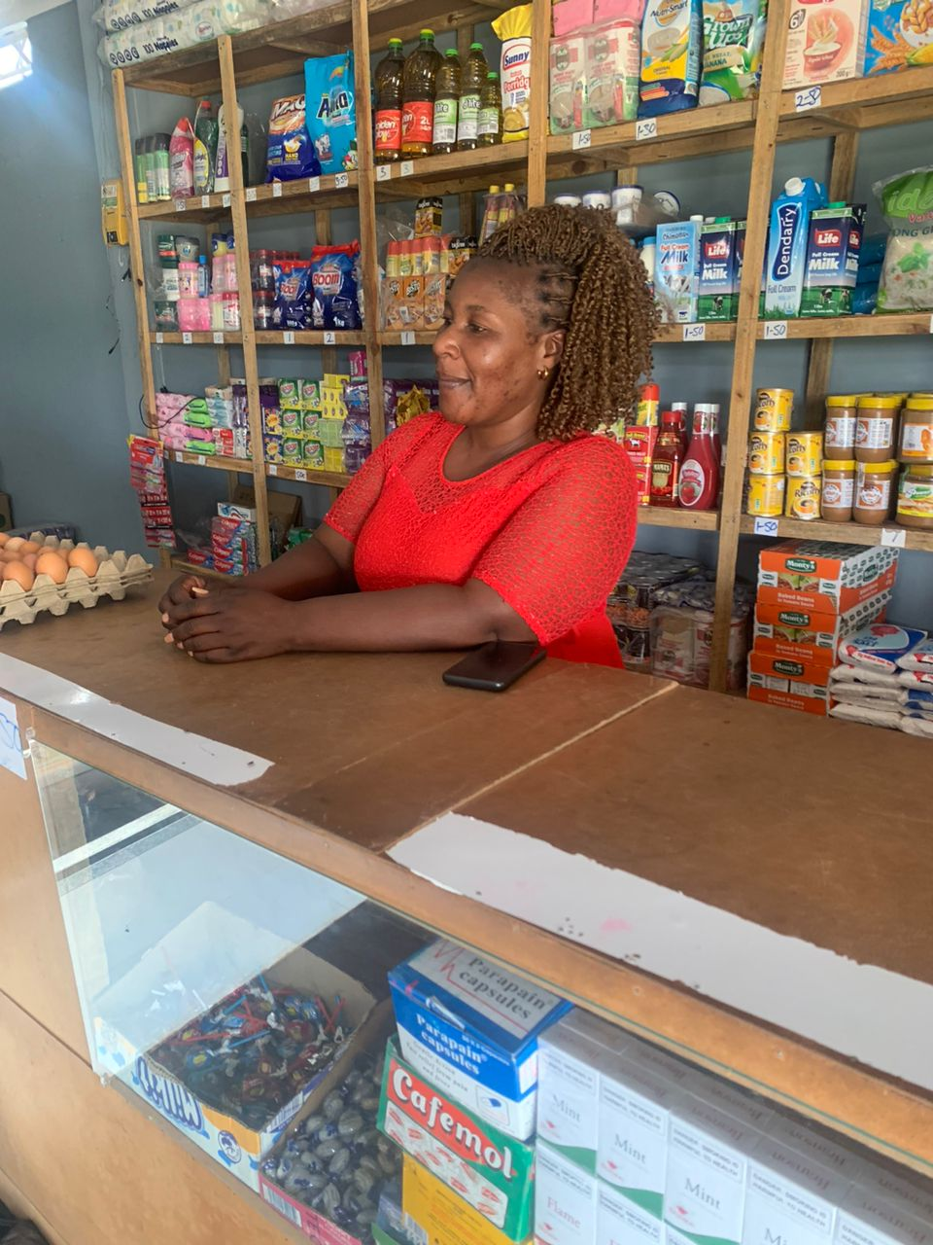
PLEASE DESCRIBE THE BUSINESS
Grocery ,fruits and vegetables ,jewellery and cosmetics

Slide 3
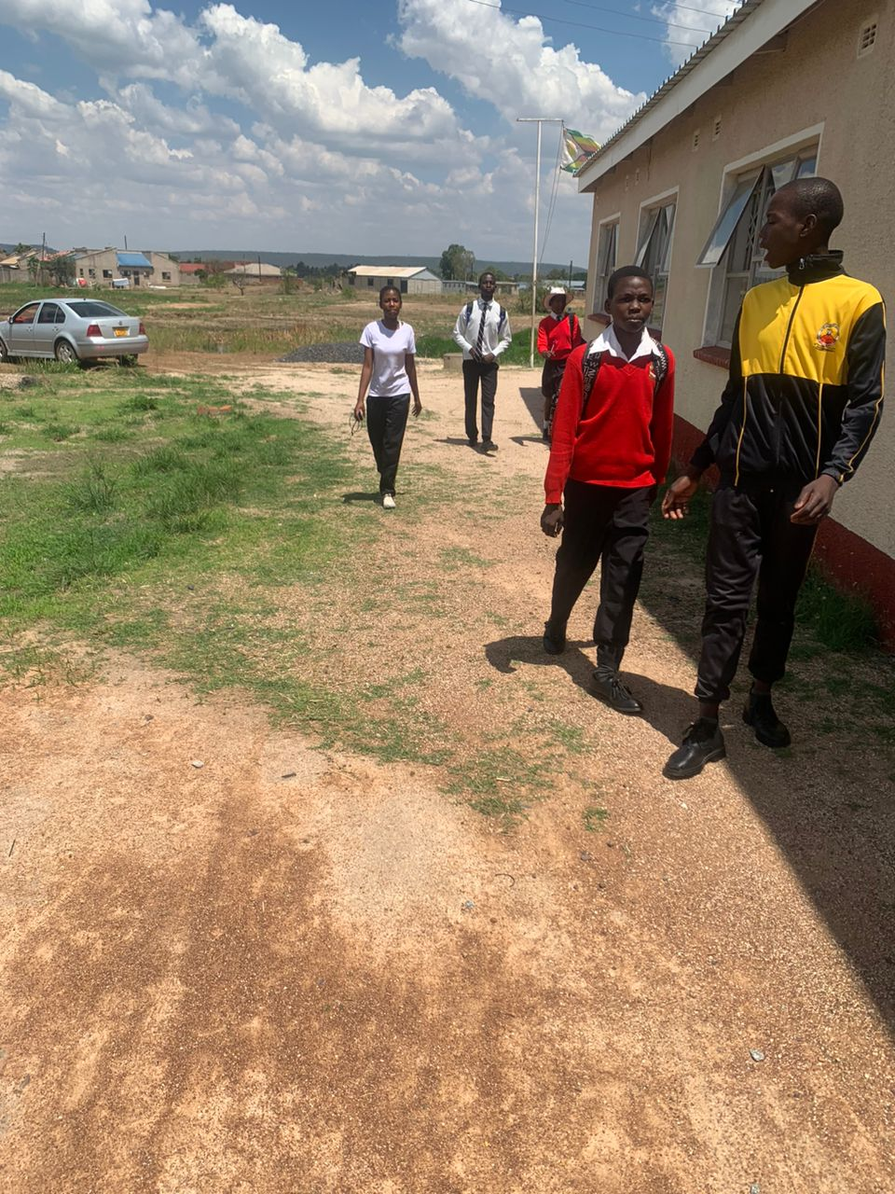
CUSTOMER BASE?
Who are your customers?
School children and the surrounding community
Have you increased the number of customers since starting the LED Programme? Yes or No
How did you do this?
Yes
Advertising online and word of mouth

Slide 4
COMPETITION
Who is your competition?
How do you handle competition in your business?
Neighbouring shops
Giving discounts and promotions

Slide 5
NEW PRODUCTS OR SERVICES?
Do you have any new business products or services?
What new products are in the business?
How are they performing compared to your initial products?
How do you advertise/market your products?
Yes
Fruits ,vegetables and cosmetics
Adding value and profits
Word of mouth and online

Slide 6
QUALITY AND PACKAGING
Are your customers happy with the quality of your products or services?
If you have answered yes please give more information.
Do you have any branding available for your products? Explain
Have you changed the packaging or marketing of your business to attract more customers? Please explain.
Yes
By treating the customers as Kings and giving them promotions
No
No

Slide 7
BUSINESS MANAGEMENT
Have you hired more staff? How many full-time and how many part-time?
How do you manage your stock and check regularly? Please explain.
Have you been able to price your products better so that you can earn a surplus from the business? Please explain.
One full time staff and myself
Weekly stock
Yes because I calculate the buying price and the selling price so that I can earn a surplus

Slide 8
FINANCIAL MANAGEMENT
Do you have a record-keeping system in place? Explain.
If yes, how is it helping you to manage your business?
Do you have a bank account for your business?
Yes
It helps me to see whether I am getting profits and to minimise expenses

Slide 9
SAVINGS AND SELF SUFFICIENCY
Are you a member of a savings group?
Are you saving money? How much have you been able to save so far?
Have you managed to increase household income?
No
No
Yes

Slide 10
INCOME AND EXPENSES FOR THE BUSINESS FOR THE PAST SIX MONTHS
Income
Expenses
ITEM | AMOUNT
Sugar | $200
Rice | $50
Cooking oil | $100
Surf | $100
Flour | $100
Fruits and vegetables | $50
Cosmetics | $100
TOTAL | $700
ITEM | AMOUNT
Transport | $50
Rent | $100
Salary | $100
Electricity | $20
Food | $ 80
TOTAL | $350

Slide 11
CHALLENGES
What challenges have you experienced in your business?
How have you addressed these?
Electricity and transport
Buying ice blocks to maintain freshness

Slide 12
INCOME AND EXPENSES FOR THE BUSINESS FOR NEXT SIX MONTHS
Income
Expenses
ITEM | AMOUNT
Sugar | $150
Rice | $150
Cooking oil | $200
Flour | $100
Cosmetics | $150
Surf | $150
Fruits and vegetable | $100
Jewellery | $100
TOTAL | $1 100
ITEM | AMOUNT
Rent | $100
Transport | $100
Electricity | $20
Salary | $150
Food | $100
Fees | $200
Water | $30
TOTAL | $670

Slide 13
WHAT PLANS HAVE YOU MADE TO GROW YOUR BUSINESS IN THE NEXT 6 MONTHS?
Purchasing a vehicle and Marketing online and word of mouth

Slide 14
SUSTAINABILITY
How will you sustain your business?
What other sustainability measures are you putting in place for your business?
Minimising expenses and bulk orders
Buying goods needed by customers

Slide 15
ADDITIONAL INFORMATION?
What other changes have you experienced in your business? Explain
Do you have any additional information to share?
I am thinking into buying cosmetics and jewellery
No

