Slide 1




SADC PROTOCOL@WORK SUMMIT 2024
Youth Leadership Template
(country, location, date and presenter)
Please use your own background photos to make your presentation unique. Quotes and any other visuals make your presentation more engaging!

Slide 2
Quotable Quotes
Provide a quote from the work/project you are presenting.
How does this reflect your leadership capabilities/qualities?
-We cannot all succeed when half of us are held back.”
Commitment to Inclusivity
Empowerment of Others
Advocacy for Change
Visionary Leadership

Slide 3
Experience as a leader
Share a short story of your leadership journey.
* l began my leadership journey since l was a child and I'm still going not yet reached the destination and l won't. Through this journey l achieved many accolades that l really do cherish.
In what way do you qualify to be a leader/driver of change?
- My key qualities and skills:
Self-Awareness
Communication Skills
Empathy and Compassion
Vision
Adaptability

Slide 4
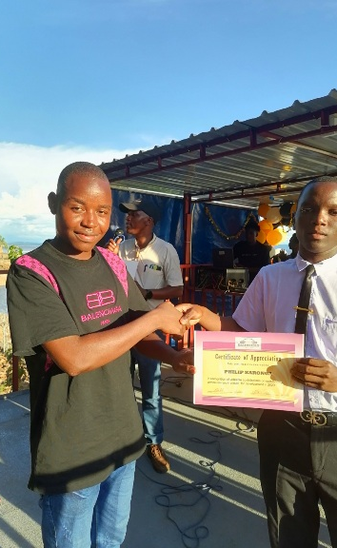
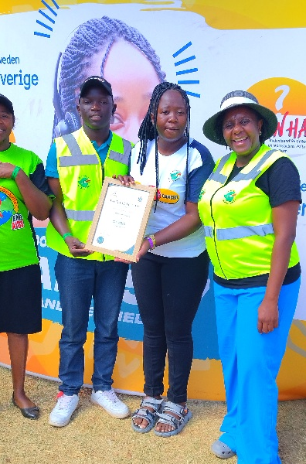

Slide 5
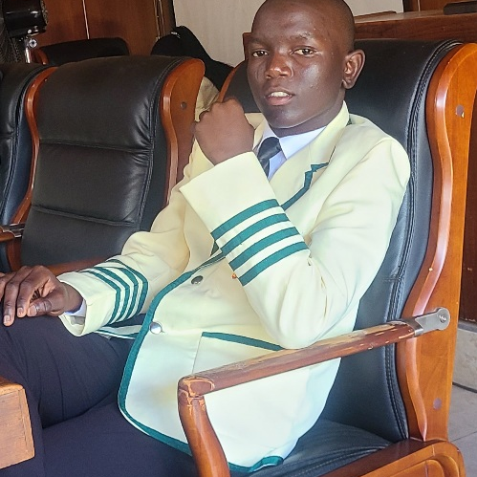
WHO IS THIS YOUTH CHAMPION?
Detail
Who you are
- Phillip T. Karonga but that doesn't tell the whole story
Where you are from
- Cherima a ghetto community in Chinhoyi, Zimbabwe
What makes you unique
-Self-Awareness
Visionary Leadership
Resilience
Passion for Change
Include Photos or videos

Slide 6
WHAT DRIVES YOU?
Detail
Vision
- A world where all individuals, regardless of gender, have equal rights and opportunities to thrive.
Objectives
- Achieve my academic goals
- Be a world renowned leader/ driver of change, motivator
• Your commitment to gender equality, youth participation
-Championing Inclusivity
-Empowering Peers
-Advocating for Gender-Sensitive Policies
-Mentorship and Support
-Community Engagement

Slide 7
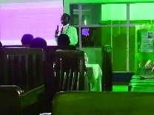
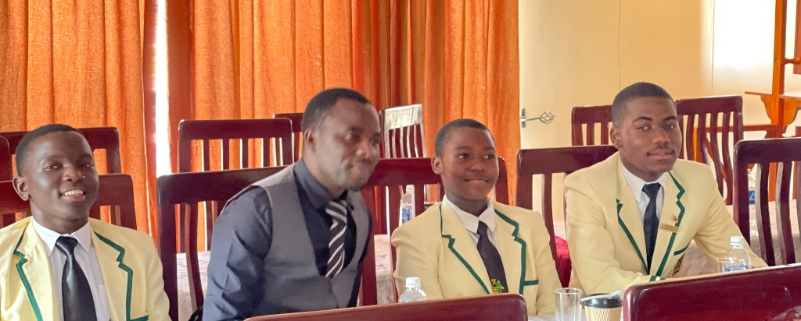

Slide 8
WHAT DO YOU DO?
Detail
Describe your work and how you have influenced gender equality e.g. gender mainstreaming, youth participation, gender budgeting etc.
- I have the unique capabilities lead my peers and make a positive impact in our community. One of my main focuses has been on promoting gender equality, which is important for creating a fair and inclusive society for everyone.

Slide 9
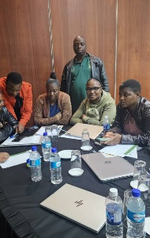
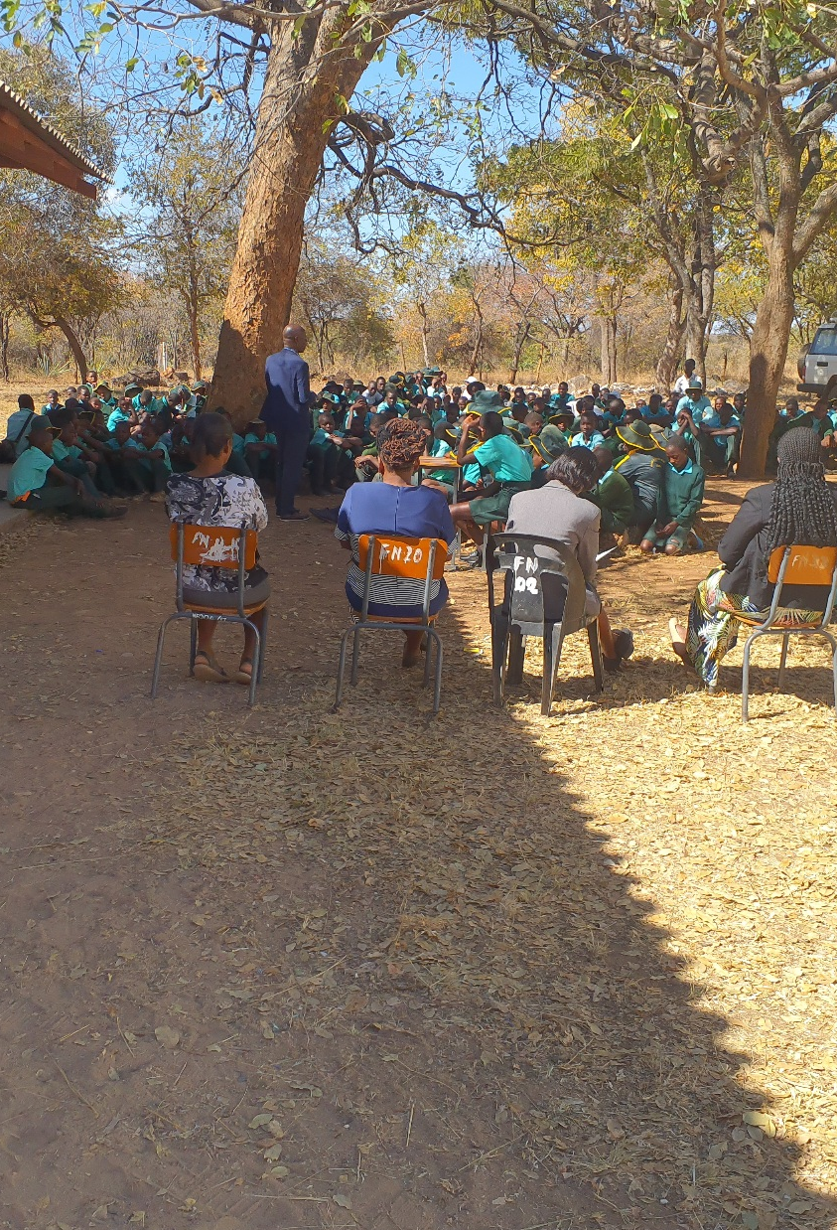

Slide 10
CHALLENGES
Describe the challenges faced in pushing for gender equality in your work.
1. Resistance to Change
2. Limited Resources
3.Cultural Barriers
4. Balancing Priorities
How have you addressed the challenges?
- Building Awareness and Education
2. Engaging Stakeholders
3. Advocating for Resources
4. Promoting Inclusive initiatives
5. Utilizing Technology
6. Creating Safe Spaces for Dialogue

Slide 11
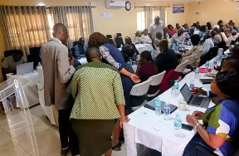
Low attendance
Improved attendance

Slide 12
What has changed in your life?
What has changed in your life because of your work?
What or who is responsible for this change?
-Enhanced Leadership Skills
-Stronger Network
-Commitment to Lifelong Learning
-Impact on Career Aspirations
-Time management
-Supportive Networks
-Educational Initiatives

Slide 13
What Capacity Building Initiatives Have You Initiated?
How have you built the capacity of others through your work?
What exactly have you done?
-Mentorship Programs
-Collaborative Projects
-Awareness Campaigns
1. Organized Dialogue Sessions
2. Mentored Peers and Younger Students
3.Launched Awareness Campaigns
4. Facilitated Discussions and Forums

Slide 14
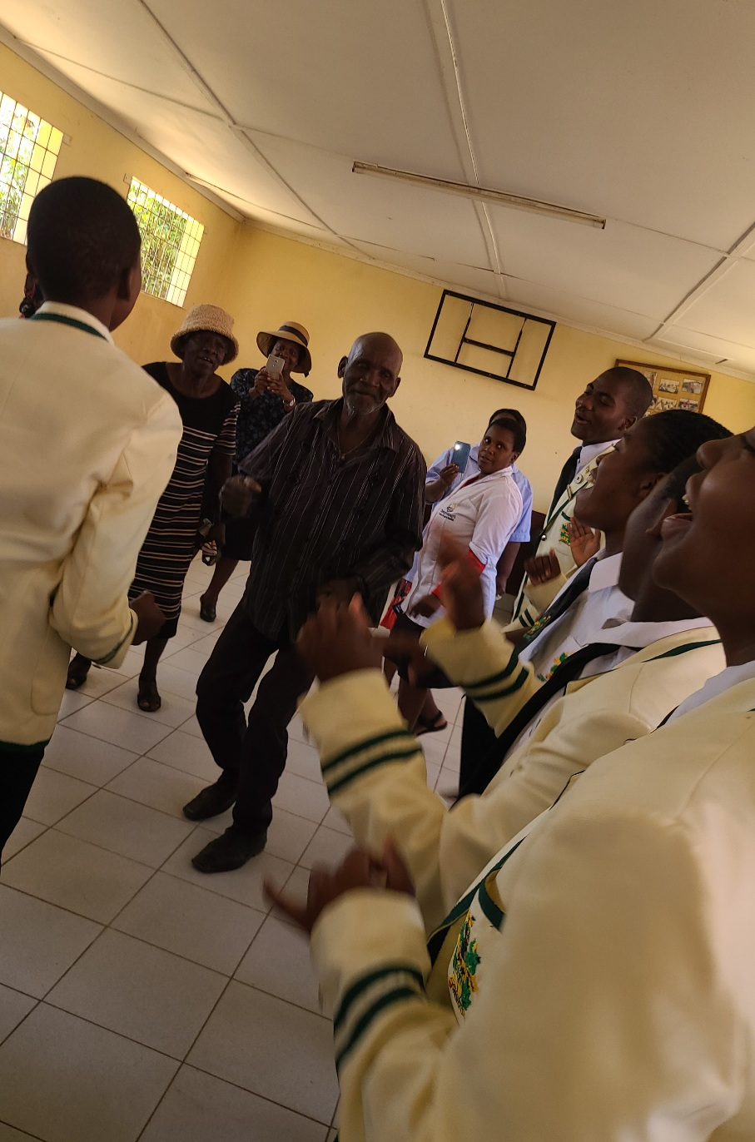
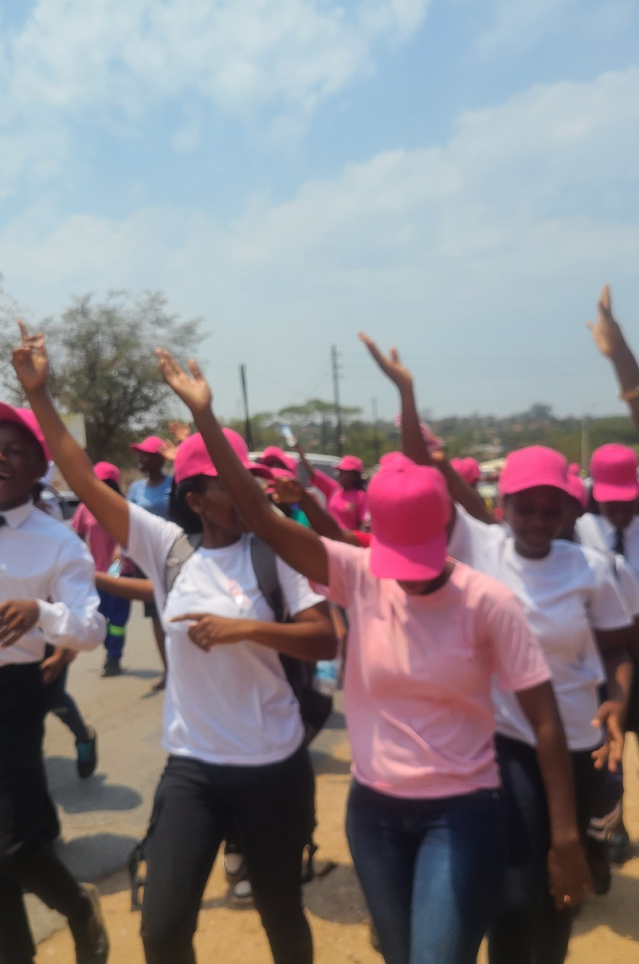

Slide 15
Lessons Learnt
What lessons have you learnt?
1.The Importance of Listening
2. Adaptability is Key
3.Persistence Pays Off
4.The Impact of Youth Voices Shouldn't Be Undermined

Slide 16
NEXT STEPS
What are your future plans?
1. Personal Development
2. Advocacy for Gender Equality Policies
3.Participation in Global Initiatives
Any concluding thoughts?
-Meaningful change begins with individual and collective action. By empowering yourself and others, you demonstrate that everyone has a role to play in advocating for gender equality and fostering inclusive communities.

Slide 17
Focus Area | Goals | Actions
Personal Development | Enhance knowledge and skills | Pursue further in academics, advocacy and other aspects of life
Advocacy for Gender Equality Policies | Ensure gender sensitive policies are implemented | Engage with policymakers stakeholders to advocate for reforms and participate in relevant forums
Youth Empowerment Programs | Facilitate / being part of empowerment of young leaders | Be part of leadership training programs and mentorship opportunities for youth
Community Awareness Campaigns | Raise awareness about gender issues and other social ills | Launch campaigns using social media and community events to disseminate information

Slide 18
Focus Area | Goals | Actions
Collaboration with Organizations | Strengthen partnerships for greater impact | Be involved in multi-sectoral response with NGOs and local groups to coordinate initiatives
Participation in Global Initiatives | Engage in international discussions | Contribute/ participate in Global online or physical meetings and summits

Slide 19
Thank you

