Slide 1
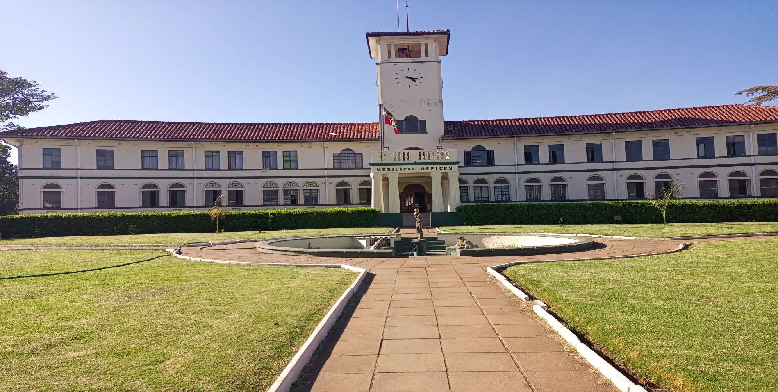




SADC PROTOCOL@WORK SUMMITS AND AWARDS
2024
GENDER RESPONSIVE BUDGETING
ZIMBABWE
CITY OF GWERU,
NOVEMBER 2024
PROCTOR CHAUKE
.

Slide 2
OVERVIEW
COUNTRY | ZIMBABWE
COUNCIL (HUB/SPOKE) | HUB
GENDER CHAMPION | HIS WORSHIP THE MAYOR CLLR CHIVHOKO
GENDER FOCAL PERSON | MRS U JAJI
Latest score (year)
 | Income | Expenditure | % Gender Specific
Budget (YEAR) | 43 490 206.00 | 43 490 206.00 | 1%
 | Women | Men | Total | % Women
Council | 9 | 14 | 23 | 39%
Management | 2 | 11 | 13 | 15%
Council staff overall | 455 | 719 | 1174 | 38%
Population served | 182 062
Key characteristics | We are a central capital and we are a garrison City

Slide 3
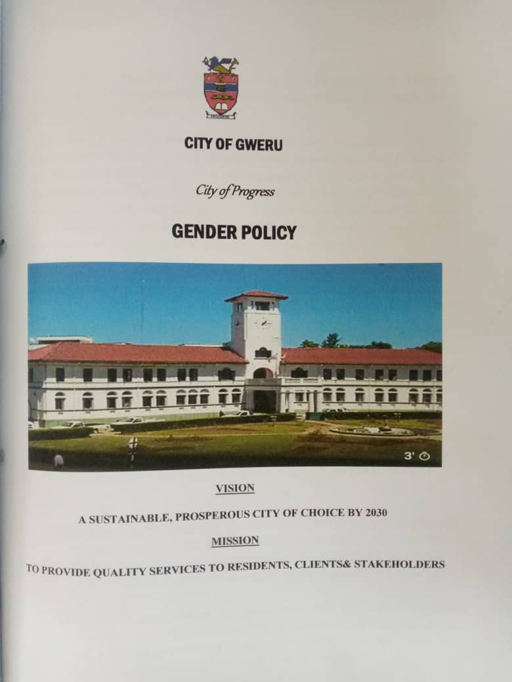
I. POLICY FRAMEWORK
City of Gweru is guided by these policies in budget preparation:
Constitution of Zimbabwe
National Gender policy
National development Strategy1
Sustainable Development Goals(SDGs)
International Protocols
City of Gweru Strategic plan (2021-2025)
City of Gweru Gender policy
City of gweru has a gender policy and section 9.4 (a) addresses issues on gender budgeting.

Slide 4
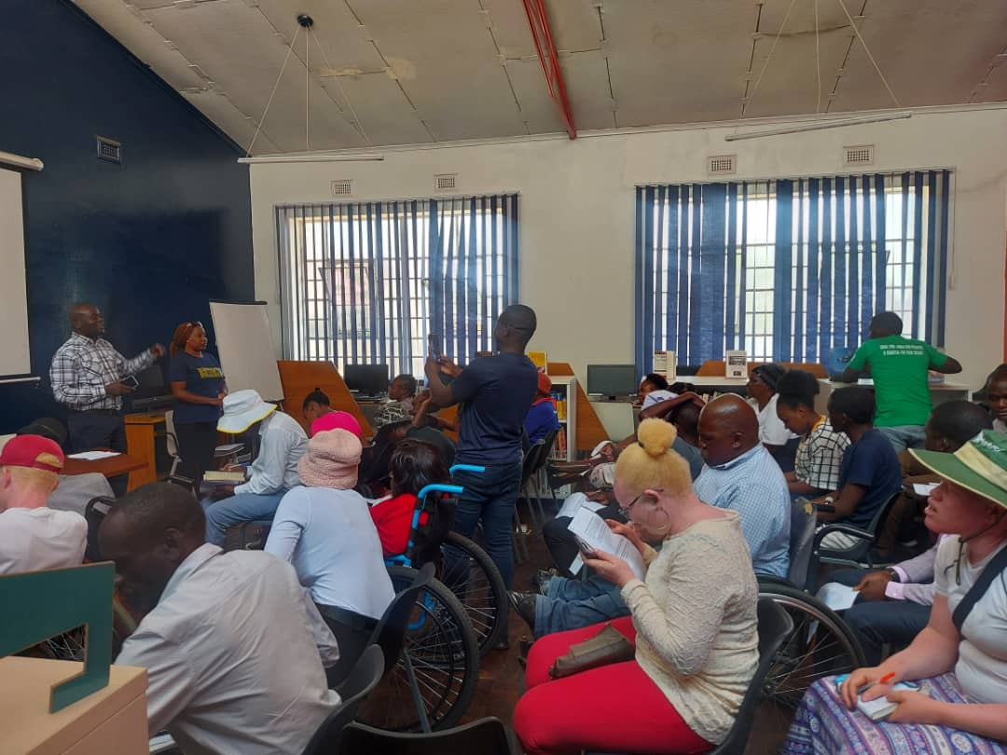
II. THE BUDGET PROCESS
Detail
Evidence
Council integrated gender and inclusion in budget planning through;
Budget performance feedback meetings,
Consultative meetings in wards,
separate budget consultative meetings with People with Disabilities (PWD)
Methodologies used during the budget consultation process:
civic engagements WICOZ ,man’s association PADARE, people with disabilities,
online consultations through questionnaires,
whatsapp groups and
live streaming on facebook, etc.)
To make sure everyone is included Council used:
Radio announcements
Advertisements in local newspapers
Community hailing
Social media platforms e.g whatsapp and facebook
Use of councilors and residents associations to inform residents
Sign language interpreters

Slide 5
II. THE BUDGET PROCESS
Detail
Evidence
We hold consultations during the day and on weekends to ensure inclusion in the budget processes. We also engaged women of their desired time through women and residents associations.
To broaden our reach, we used technology like Whatsapp and facebook live streaming.
It was effective, since we received suggestions and perspectives through various sites

Slide 6
II. THE BUDGET PROCESS
Does the council have sex/age/PLWD statistics on those who participated in the consultations? – refer to consultation registers and populate table below
Consultation | Women |  |  |  |  | Total | Men |  |  |  |  | Total | % Women
 | Age |  |  |  |  |  | Age
 | - 15 | 15-35 | 36-59 | 60+ | PWD |  | - 15 | 15-35 | 36-59 | 60+ | PWD
 | 14 | 80 | 280 | 56 | 14 | 444 | 6 | 205 | 423 | 103 | 23 | 760 | 37
% |  |  |  |  |  | 100% |  |  |  |  |  | 100%

Slide 7
III. REVENUE
Some of the external finances are focused on clinic upgrades, ambulances, and borehole digging.
The debate on tariffs informed decisions concerning the budgeting of revenue.
The decision to reduce clinic fees was influenced by budget consultations after concerns were raised by women e.g maternity fees and family planning fees
Some of the external finances are targeted on Clinic renovations, Ambulances acquisition and borehole drilling

Slide 8
IV. EXPENDITURE
 | Amount USD
Gender management system (GMS) | 139 169.00
Employment expenditure | 7 880 425.00
Employment equity related expenditure | 13 047.00
Gender specific Programming | 535 080.00
Mainstream Programmes | 24 793 616.00
Other | 10 128 869.00
Total | 43 490 206.00

Slide 9
IV. EXPENDITURE
Type of Expenditure | Amount | Proportion (%)
Gender Management System (GMS) | 139 169.00 | 1%
Employment expenditure (Human Capital Expenditure) | 7 880 425.00 | 18%
Employment equity related expenditure | 13 047.00
Gender Specific Programming | 535 080.00 | 1%
Mainstream Programmes | 24 793 616.00 | 57%
Other | 10 128 869.00 | 23%
Total | 43 490 206.00 | 100%

Slide 10
IV. EXPENDITURE- GMS
Council have a Gender Management System in place. This comprises of the Gender inter departmental committee, Gender focal person and a Gender Champion.
These activities are budgeted for (E.g., Committee meetings, Hub/ spoke activities, exhibitions, Training, Policy formulation, Exchange visits, Office equipment and stationery, other activities and they are under Governance and administration programme

Slide 11
IV. Gender Specific expenditure
.
As a local authority we have the junior council, Gender training workshop, entrepreneurship skills training women in communities, commemorations, women’s health education ,Youth centres
These budget line are visible with the main budget
0.23 % of the council budget is allocated gender specific programs
These programs were influenced by requests from different constituencies
Gender specific programs empower and sensitise people thus ensuring a gender responsive council
We measure expenditure on gender specific programmes by analyzing financial reports to determine actual spending versus budgeted amounts, Compare data before and after program participation to evaluate changes in knowledge, attitudes, or behaviors, Conduct studies over time to assess how outcomes translate into long-term changes in gender equality. etc

Slide 12
IV. EMPLOYMENT EXPENDITURE
 | Women |  |  | Men |  |  | Total | % women
 | Managers | Staff | Total | Managers | Staff | Total |  | Managers | Staff | Total
Full Time | 87 | 321 | 408 | 64 | 588 | 652 | 1060 | 58% | 35% | 38%
Part time |  | 14 | 14 |  | 6 | 6 | 20 |  | 70% | 70%
Casual |  | 33 | 33 |  | 61 | 61 | 94 |  | 35% | 35%
Total | 87 | 368 | 455 | 64 | 655 | 719 | 1174 | 58% | 36% | 39%
Women comprise 39% of the total workforce
58 % of women are in the management
Women comprise 38 % of the full-time, 70% part-time and 35% casual, labour force?
The reason for this breakdown is because there are a lot of women in the middle management in the health department

Slide 13
IV. EMPLOYMENT EXPENDITURE- Gender Wage Gap Analysis
 | Women | Women- Total earned | Women average earned | Men-no | Men total earned | Average earnings
Full Time |  | 4 211 015 | 9 255 | 719 | 762 3237 | 10 603
Part Time |  | F | F/E | G | H | H/G
Casual |  | I | I/H | J | K | K/J
Total | 455 | 4 211 015 | 9 255 | 719 | 7 623 237 | 10 603
The average gender-wage 14.58%
Although women are fewer than men, women hold higher positions in middle management than men resulting in the wage gap being in favor of women. We have nurses who earn much more than the laborers who constitute the bulk of men
To close the gender wage gap, Council is planning to employ more male nurses and more women in the Senior management positions

Slide 14
V. EXPENDITURE- GENDER IN MAINSTREAM BUDGET
Programmes | Amount | % budget
Governance & Administration | 14 719 728 | 34%
Water Sanitation & Hygiene | 19 196 159 | 44%
Social Services | 3 483 946 | 8%
Roads | 2 620 993 | 6%
Public Safety & Security | 2 518 710 | 6%
Natural Resources & Conservation | 950 670 | 2%
Total | 43 490 206 | 100%

Slide 15
V. EXPENDITURE- ANALYSIS OF ONE SECTOR EG
 | Women |  |  |  |  |  | Men
 | Age |  |  |  |  |  | Age
 | Below 15 | 15-35 | 36-59 | 60+ | PLWD | Total | Below 15 | 15-35 | 36-59 | 60+ | PLWD | Total
Education
Housing
Social amenities
Total

Slide 16
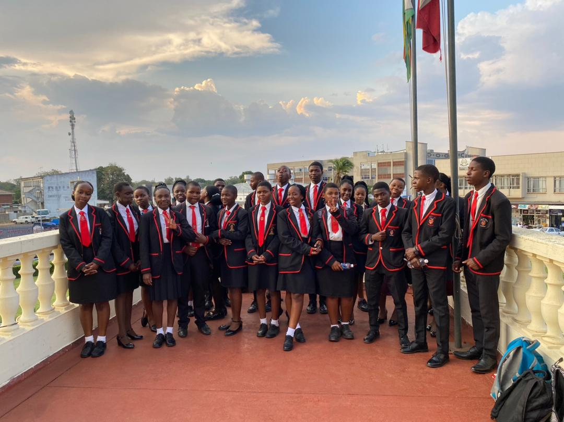
V. EXPENDITURE- GENDER IN MAINSTREAM BUDGET
To ensure that women and men, boys and girls benefit equally council:
Conduct Gender Analysis
Gathering sex-disaggregated data to assess the needs and challenges faced by different genders in the community.
Analyzing how current budget allocations impact various groups, identifying any disparities.
2. Engage Stakeholders
Involving local women’s groups, youth organizations, and other stakeholders in the budgeting process to ensure diverse voices are heard.
Holding forums and discussions to gather input on budget priorities and strategies from all community members.
3. Prioritize Gender Equality in Budgeting
Allocating resources specifically for programs that address the needs of women and girls, such as health care, education, and safety initiatives.
Ensuring that public services are accessible and tailored to meet the needs of all genders, such as providing safe transport for women and girls.

Slide 17
V. EXPENDITURE- GENDER IN MAINSTREAM BUDGET – EXAMPLE
 | Amount | No of beneficiaries | Percentage
Total Expenditure | 24 793 616.00
No. of Men benefiting from council allocations | 11,652,999.52 | 85,569 | 47%
No. of Women benefiting from council allocations | 13,140,616.48 | 96,493 | 53%
Total beneficiaries |  | 182 062 | 100%

Slide 18
VI. BUDGET CROSS SUBSIDISATION ANALYSIS
 | Income (A) | % of total budget | Expenditure (B) | % of total budget | Surplus/Deficit
Governance & Administration | 20 356 445 | 47 | 14 719 728 | 34 | 5 636 718
Water, Sanitation & Hygiene | 18 379 059 | 42 | 19 196 159 | 44 | (817 100)
Social Services | 1 04 507 | 2 | 3 483 946 | 8 | (2 443 439)
Roads | 2 555 489 | 6 | 2 620 993 | 6 | (65 505)
Public Safety and Security | 854 652 | 2 | 2 518 710 | 6 | (1 664 058)
Natural Resources & Conservation Mgt | 304 652 | 1 | 950 870 | 2 | (646 616)
Total | 43 490 206 | 100 | 43 490 206 | 100 | 0

Slide 19
VI. BUDGET CROSS SUBSIDISATION ANALYSIS
Governance and administration generates more revenue than expenditure
Below are programmes which spend more than they generate:
Social services from Governance and administration
Public safety and public lighting from governance and administration
Water sanitation and hygiene from governance and administration
Public Finance Management Act allows for cross- subsidization as rates can fund activities other sub-programmes like public lighting, roads repairs etc.
Gender analysis reveals that men and women often have different needs and preferences regarding services. For example, women may require more health services related to reproductive health, which can lead to targeted subsidies in these areas.

Slide 20
VII. CONCLUSIONS AND NEXT STEPS
To a greater extent the City of Gweru budget has contributed to gender equality and women empowerment through:
1. Budget Allocation for Gender-Specific Programs
Reviewing the proportion of the budget allocated to programs directly benefiting women, such as healthcare, education, and economic empowerment initiatives.
Evaluating specific projects aimed at addressing gender disparities, such as maternal health services, vocational training for women, and support for gender-based violence prevention.
2. Impact on Key Indicators
Analyzing improvements in maternal health, family planning access, and general health services for women, linked to budget allocations.
Examining changes in enrollment and completion rates for girls in schools, which may correlate with education funding.
Assessing increases in women’s participation in the workforce or entrepreneurship linked to budgetary support for training and resources.
Next steps to be taken
1.Adopt Gender-Responsive Budgeting Framework
Establishing a formal policy for gender-responsive budgeting, ensuring that all departments consider gender impact in their budget proposals.
Providing training for council staff on gender analysis and budgeting techniques, enhancing their ability to integrate gender considerations into financial planning.
2. Set Clear Gender Equality Goals
Setting specific, measurable goals for gender equality and women’s empowerment within the budget, such as targets for funding certain programs or improving specific outcomes.
Developing key performance indicators (KPIs) to monitor progress toward these goals, allowing for ongoing assessment and adjustment.

