Slide 1




SADC PROTOCOL@WORK SUMMITS AND AWARDS
2024
GENDER RESPONSIVE BUDGETING Template
(Zimbabwe, Mwenezi Rural District Council, 29 October 2024 and James Chauke)
.

Slide 2
OVERVIEW
COUNTRY | ZIMBABWE
COUNCIL (HUB/SPOKE) | MWENEZI RURAL DISTRICT COUNCIL
GENDER CHAMPION | COUNCILLOR H SINGO
GENDER FOCAL PERSON | MS C CHIBAYA
Latest score (year) | GREEN CATEGORY (50-60%)
 | Income | Expenditure | % Gender Specific
Budget (YEAR) | 47 612 074 020.00 | 47 612 050 500.00 | 99.99%
 | Women | Men | Total | % Women
Council | 5 | 18 | 23 | 21%
Management | 0 | 6 | 6 | 0%
Council staff overall | 13 | 35 | 48 | 27%
Population served | 89 458 | 76 805 | 166 263 | 53.81%
Key characteristics | A local Authority situated in Natural Region 5 characterized by low rainfalls and a population centred on Subsistence farming. Mwenezi Rural District Council’s main source of revenue is from Stand Sales and Unit Tax payments.

Slide 3
I. POLICY FRAMEWORK
Constitution of Zimbabwe Amendment No. 20 Act of 2013 (Chapter 13 Part 2)
Public Finance Management Act
Rural District Council Act (Chapter 29:15 )
Labour Act (Chapter 28:01)
National Gender Policy
SADC Policy on Gender and Development
Sustainable Development Goals (S.D.Gs)
Council Gender Policy
MWENEZI RDC HAVE A GENDER POLICY WHICH ADDRESSES GENDER BUDGETING
Photo of the Gender Policy

Slide 4
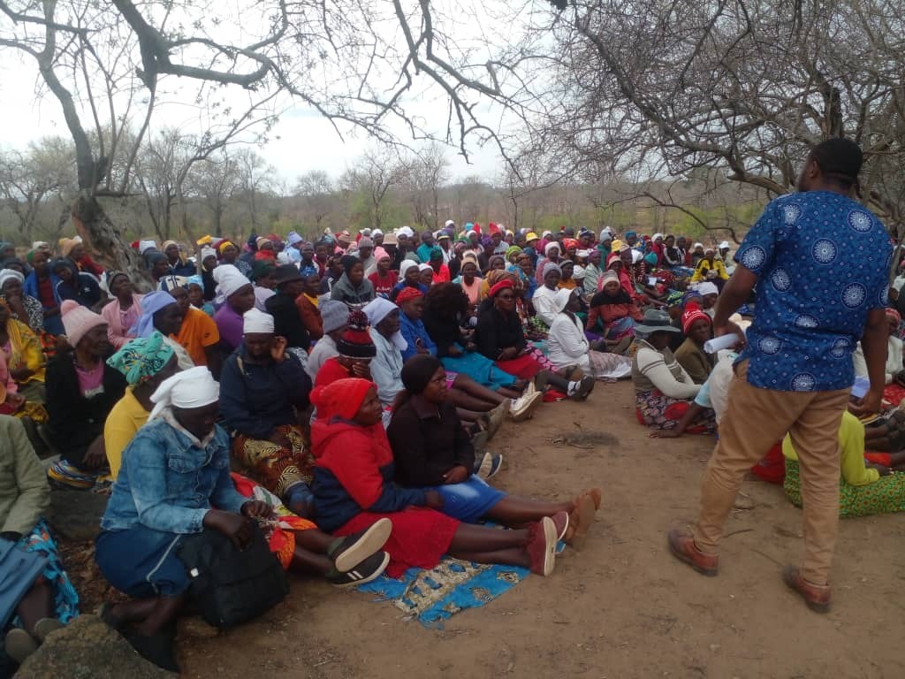
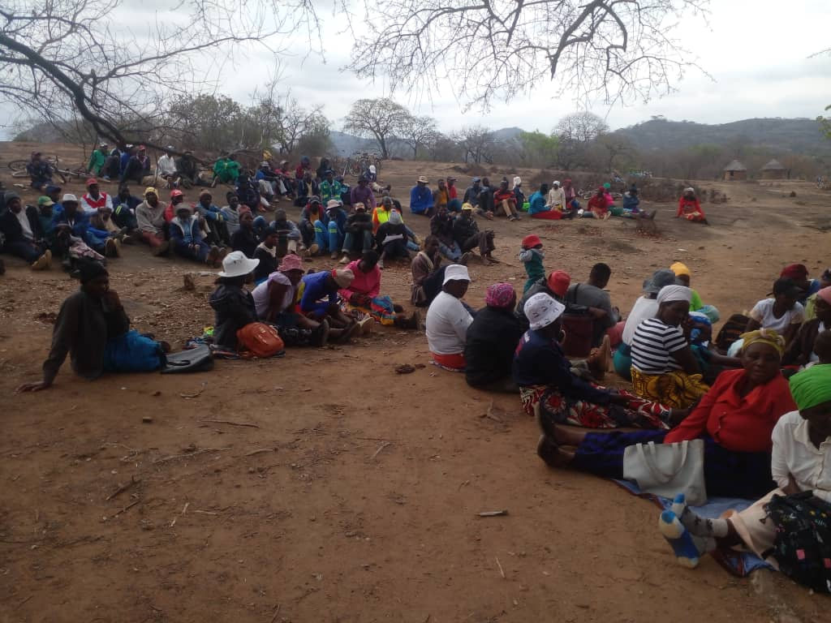
II. THE BUDGET PROCESS
Evidence
Detail
Mwenezi Rural District council used participatory gender budgeting approaches involving the local population mainly focusing on;
analysis of budgets and policies from a gender perspective;
Effective mobilization of stakeholders and policy makers before the budget consultation.
linking gender budgeting to overall gender equality objectives;
restructuring budgets and amending policies;
integrating gender perspectives throughout the budget cycle;
monitoring and evaluation of achievements;
transparency of the budget process;
participation in the budget process.
Gender sensitive budget allocation that is prioritizing areas like education,healthcare ,social protection
Assessing proposed expenditures projects from a gender perspective
Having budget meetings at convenient hours for women and girls

Slide 5

II. THE BUDGET PROCESS
mainstreaming gender perspectives into the whole process of public finance management;
integrating gender perspectives into performance-based and programme-based budgeting;
categorising budget programmes and gender analysis requirements;
linking gender budgeting and participatory budgeting;
tracking financial allocations to promote women’s rights and gender equality;
applying standard gender budgeting tools such as gender aware policy and budget appraisal, gender disaggregated public expenditure and revenue incidence analysis, and gender responsive beneficiary needs assessments;
wellbeing gender budgeting;
combining gender budgeting with impact assessments.

Slide 6
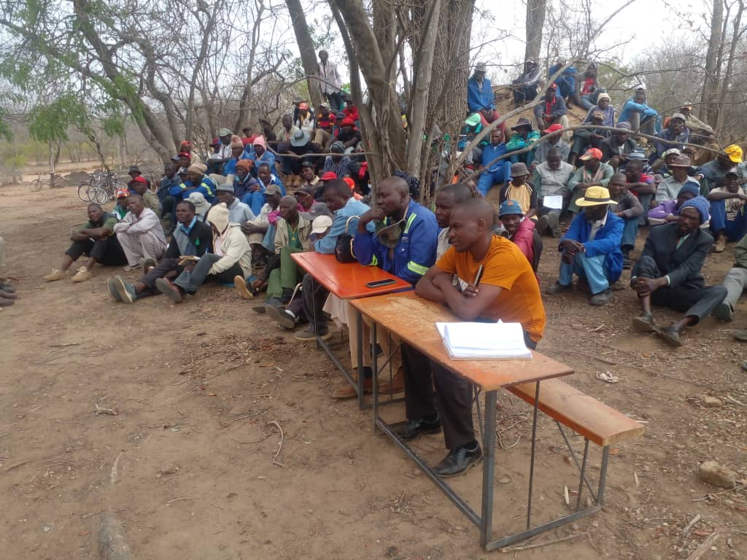
II. THE BUDGET PROCESS
Evidence
Detail
Time and venue for budget consultations were planned with the effective participation of the participants giving high priority to the women and female youths. As a result there Council budget consultations were carried out at either around 0900 hrs or 1400hrs as preferred by the majority of the women population. The attached consultation calendar was used by Mwenezi RDC
The Council engaged consultations through social media platform mainly whatsapp group video calls, whatsapp group calls and zoom video conferencing.
The participation through whatsapp was satisfactory however participation through zoom encountered various challenges including lack of devices and poor network.

Slide 7
II. THE BUDGET PROCESS
Does the council have sex/age/PLWD statistics on those who participated in the consultations? – refer to consultation registers and populate table below
Consultation | Women |  |  |  |  | Total | Men |  |  |  |  | Total | % Women
 | Age |  |  |  |  |  | Age
 | - 15 | 15-35 | 36-59 | 60+ | PWD |  | - 15 | 15-35 | 36-59 | 60+ | PWD
 | 0 | 121 | 435 | 16 |  | 572 | 0 | 296 | 820 | 46 |  | 1162 | 32.98
% |  |  |  |  |  | 100% |  |  |  |  |  | 100%

Slide 8
III. REVENUE
Council funding from Internal Sources is estimated to be $3,854,919.52 (USD) and funding from external sources is estimated to be $ 4,417,229.31 (USD) as illustrated by the pie chart.
How did gender considerations informed decisions concerning the budgeting of revenue?
How were these decisions influenced by budget consultations, in particular the views of women?
Is any of the external financing specifically targeted at gender?

Slide 9
IV. EXPENDITURE
 | ZWL
Gender Management System; | 123,230.97
Salaries | 295,887.74
employment equity-related expenditure | 433,588.54
gender-specific programmes | 672,584.24
mainstream programmes. | 575,703.40

Slide 10
IV. EXPENDITURE
Type of Expenditure | Amount | Proportion (%)
Gender Management System (GMS) | 123,230.97 | 5%
Employment expenditure (Human Capital Expenditure) | 295,887.74 | 13%
Employment equity related expenditure | 433,588.54 | 18%
Gender Specific Programming | 672,584.24 | 29%
Mainstream Programmes | 575,703.40 | 24%
Other | 257,757.79 | 11%
Total | 2,358,752.68 | 100%

Slide 11
IV. EXPENDITURE- GMS
Mwenezi rdc have a gender committee , a gender champion councillor h singo and gender focal person Ms C chibaya.
MWENEZI RDC BUDGETS FOR GMS activities. THE INCLUDING Committee meetings, Hub/ spoke activities, exhibitions, Training, Policy formulation, Exchange visits, Office equipment and stationery, other activities
THESE BUDGET LINES ARE FOUND WITHIN THE SOCIAL SERVICES PROGRAM BUDGET UNDER OPERATIONAL EXPENDITURES.

Slide 12
IV. Gender Specific expenditure
Mwenezi Rural District Council have gender specific programs falling under Education, Health and Social Amenities and welfare.
The gender specific programs are found within Mwenezi RDC 2024 budget. The main programs encompassing gender specific issues include, Education, Housing, Health and Social Amenities and welfare sub programs.
The Social Services program is the main program addressing gender specific programs and mainstreaming programs.
Under Education Mwenezi RDC empowers equality through providing educational facilities which accommodates all students despite gender or abilities.
A good example is a social service budget amount for construction of Rutenga Primary School classroom block with a total budget of ZWL1,134,617,890.00. The classroom block is expected to accommodate 34 female children and 22 male children. The classroom block is also expected to accommodate seven disabled children four girls and three boys.

Slide 13
IV. Gender Specific expenditure
Mwenezi RDC informed every village head and councilor about the budget consultation program. The council ensured that the message reached every participant and feedback was ensured from every corner as gender representatives and participants confirmed of the messages being delivered to them and making arrangements with the council on budget consultations attendance especially on diabled participants. Methods used involved;
Written communication
notice boards and random distribution of budget consultation letters
WhatsApp group messages
Text messages
random phone calls to all stakeholders.
The gender-specific projects are helping to promote gender equality and women’s empowerment through equal provision of services to service recipients regardless of gender.
Educational facilities are provided regardless of gender with special admittance being offered to women.
Health facilities seek to promote women and promote their needs especially development towards mother houses within clinics and hospitals. The council’s Health budget is towards the provision of Petronella clinic mother house and Boterere clinic mother house.
outputs | outcomes | impact
School classroom blocks erected | Empowerment of girl child to attend educational facilities | There is improvement in literacy rate especially to the girls across the district
Clinics mother houses erected | Improvement of martenal facilicites | Women have better convenience to martenal facilities.

Slide 14
IV. EMPLOYMENT EXPENDITURE
 | Women |  |  | Men |  |  | Total | % women
 | Managers | Staff | Total | Managers | Staff | Total |  | Managers | Staff | Total
Full Time | 6 | 12 | 18 | 9 | 33 | 42 | 59 | 40% | 27% | 31%
Part time | 0 | 0 | 0 | 0 | 0 | 0 | 0 | 0 | 0 | 0
Casual |  | 1 | 1 |  | 2 | 2 | 3 |  | 33% | 33%
Total | 6 | 13 | 19 | 9 | 35 | 44 | 63 | 40% | 27% | 31%
WOMEN ARE 24 % OF OVERALL STAFF
WOMEN IN MANAGEMENT PERCENTAGE IS 40%
women comprise 31% of the full-time LABOUR FORCE , casual labour force 33% AND THERE ARE NO ANY PART-TIME EMPLOYEES?
THIS EMPLOYEE BREAKDOWN IS MAINLY INFLUENCED BY THE GENDER POLICY HOWEVER THERE IS SHORTAGE OF SKILLED WOMEN TO MATCH THE LABOUR FORCE BREAKDOWN ANTICIPATED

Slide 15
IV. EMPLOYMENT EXPENDITURE- Gender Wage Gap Analysis
 | Women | Women- Total earned | Women average earned | Men-no | Men total earned | Average earnings
Full Time | 18 | 302,979.48 | 16,832.19 | 42 | 704,785.45 | 16,780.61
Part Time | 0 | 0 | 0 | 0 | 0 | 0
Casual | 1 | 9,971.08 | 9,971.08 | 2 | 19,942.16 | 9,971.08
Total | 19 | 312,950.56 | 16,471.08 | 44 | 724,727.62 | 16,471.08
gender wage gap?= (16,471.08 - 16,471.08 )/ 16,471.08 = 0%
THE WAGE GAP REFELECT FAIR COMPENSATION OF EMPLOYEES REGARDLESS OF GENDER

Slide 16
V. EXPENDITURE- GENDER IN MAINSTREAM BUDGET
Programmes | Amount | % budget
Governance & Administration | 86,355.51 | 16%
Water Sanitation & Hygiene | 115,140.68 | 22%
Social Services | 172,711.02 | 33%
Roads | 143,925.85 | 27%
Public Safety & Security | - | 0%
Natural Resources & Conservation | 5,757.04 | 1%
Total | 523,890.10 | 100%

Slide 17
V. EXPENDITURE- ANALYSIS OF ONE SECTOR EG
 | Women |  |  |  |  |  | Men
 | Age |  |  |  |  |  | Age
 | Below 15 | 15-35 | 36-59 | 60+ | PLWD | Total | Below 15 | 15-35 | 36-59 | 60+ | PLWD | Total
Education | 134 | 26 | 3 | - | 4 | 167 | 102 | 16 | 4 |  | 5 | 127
Housing | - | 10 | 16 | - | 3 | 29 | - | 20 | 46 |  | 4 | 70
Social amenities | 16 | 124 | 52 | - | 2 | 194 | 11 | 115 | 69 |  | 9 | 204
Total | 150 | 160 | 71 |  | 9 | 390 | 113 | 151 | 119 |  | 18 | 401

Slide 18
V. EXPENDITURE- GENDER IN MAINSTREAM BUDGET
Mwenezi RDC ensures that women and men, boys and girls benefit equally through;
Talk to women and girls
Let girls use mobile phones
Stop child marriage and sexual harassment
Make education gender sensitive
Raise aspirations of girls and their parents
Empower mothers
Give proper value to ‘women’s work’
Get women into power
Work together
Stop the violence

Slide 19
V. EXPENDITURE- GENDER IN MAINSTREAM BUDGET – EDUCATION
EDUCATION | Amount | No of beneficiaries | Percentage
Total Expenditure |  | 290
No. of Men benefiting from council allocations | 26,472.43 | 127 | 44%
No. of Women benefiting from council allocations | 33,976.43 | 163 | 56%
Total beneficiaries | 60,448.86 | 293 | 100%

Slide 20
V. EXPENDITURE- GENDER IN MAINSTREAM BUDGET – HOUSING
HOUSING | Amount | No of beneficiaries | Percentage
Total Expenditure
No. of Men benefiting from council allocations | 24,423.78 | 70 | 71%
No. of Women benefiting from council allocations | 10,118.42 | 29 | 29%
Total beneficiaries | 34,542.20 | 99 | 100%

Slide 21
V. EXPENDITURE- GENDER IN MAINSTREAM BUDGET – SOCIAL SERVICES
 | Amount | No of beneficiaries | Percentage
Total Expenditure
No. of Men benefiting from council allocations | 39,439.98 | 204 | 51%
No. of Women benefiting from council allocations | 38,279.98 | 198 | 49%
Total beneficiaries | 77,719.96 | 402 | 100%

Slide 22
VI. BUDGET CROSS SUBSIDISATION ANALYSIS
 | Income (A) | % of total budget | Expenditure (B) | % of total budget | Surplus/(Deficit)
Governance & Administration | 1,680,134.44 | 20% | 1,156,457.92 | 14% | 523,676.53
Water, Sanitation & Hygiene | 584,716.94 | 7% | 1,326,033.17 | 16% | - 741,316.24
Social Services | 5,035,186.88 | 61% | 2,248,392.82 | 27% | 2,786,794.05
Roads | 719,606.45 | 9% | 3,338,817.76 | 40% | - 2,619,211.31
Public Safety and Security |  | 0% |  | 0% | -
Natural Resources & Conservation Mgt | 252,504.12 | 3% | 202,443.07 | 2% | 50,061.05
Total | 8,272,148.83 | 100% | 8,272,144.74 | 100% | 4.09

Slide 23
VI. BUDGET CROSS SUBSIDISATION ANALYSIS
Social Services generates the most income and surplus, followed by Governance & Administration. The deficits are produced by Roads and Water, Sanitation & Hygiene. Theses are subsidised because of proposed payments related to capital expenditure and use of goods and services.
Currently Council does not have a policy to guide cross-subsidization. However, the policy shall be developed in FY 2025
Gender considerations continues to influence cross-subsidization, especially when it comes to such things as offering health services and providing educational facilities. Since women and girls use these facilities more than men, they are offered at nominal fees.
Council has implemented gender mainstreaming. All its planning takes into consideration a gender dimension, which impacts its cross-subsidization decision making

Slide 24
VII. CONCLUSIONS AND NEXT STEPS
The FY 2024 budget will contribute to gender equality and women empowerment by increasing opportunities for women and girls to make money. Council intends to allocate land and market stalls to them, where they can establish small business. They will also be trained in entrepreneurial skills, which they can use regardless of educational background (e.g. baking and draftsmanship). Council will also create networking platforms that will enable women and girls to meet and share business ideas.
The local authority shall avail employment opportunities for women, especially part-time work, casual work and graduate trainees, before providing them with additional full-time posts, which shall be created through natural attrition.
Council will also assists those who want to establish small businesses by offering its staff as advisers and providing them with links to local Ministeries, Departments and Agencies and to financial institution
Significantly, the local authority will continually improve in its data capture, in order to ensure that all its data is sex disaggregated. Council intends to monitor and evaluate its progress towards ensuring gender equality and women empowerment

