Slide 1
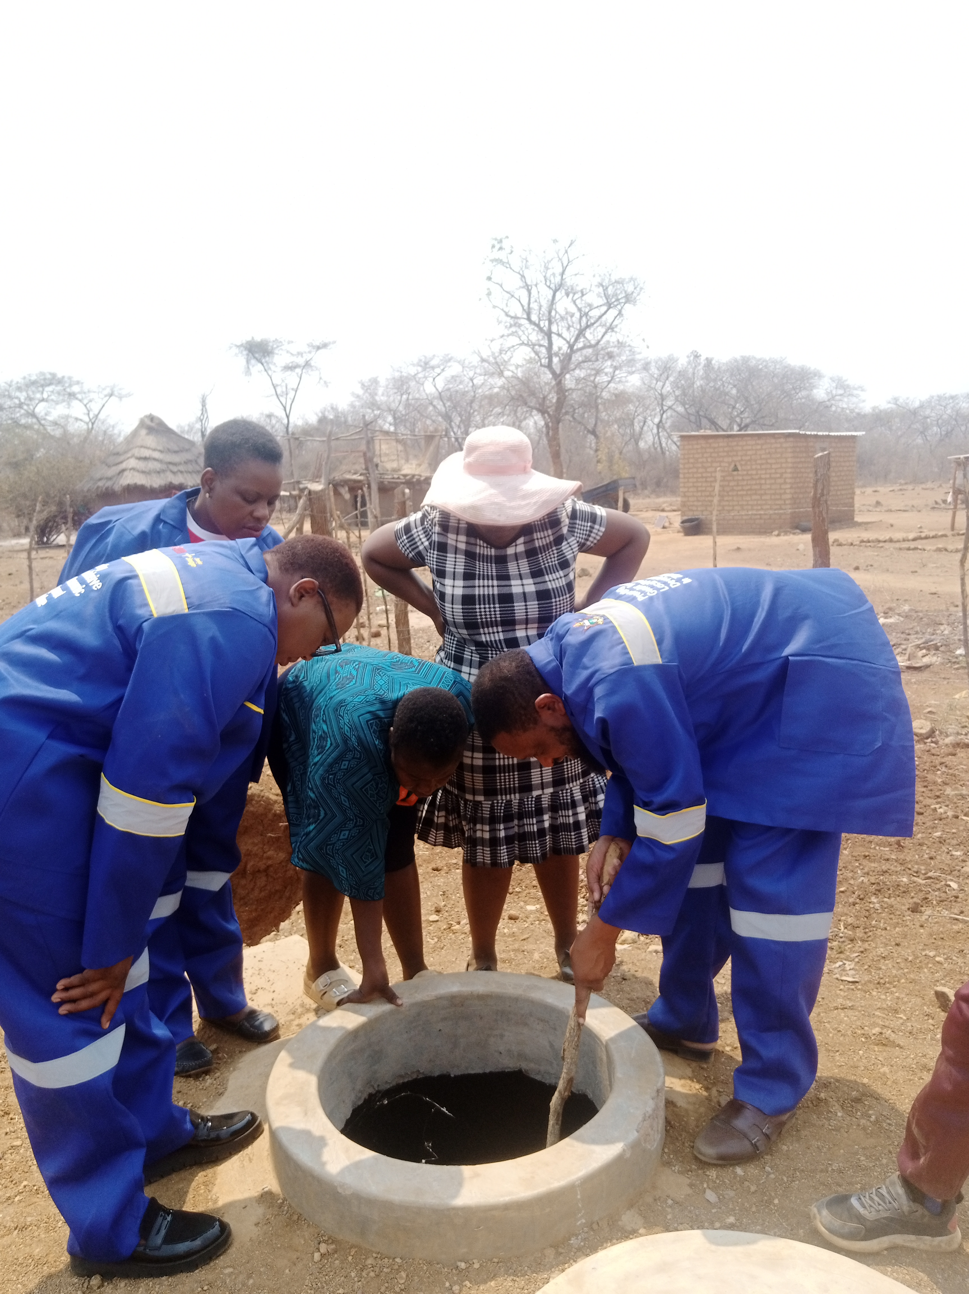





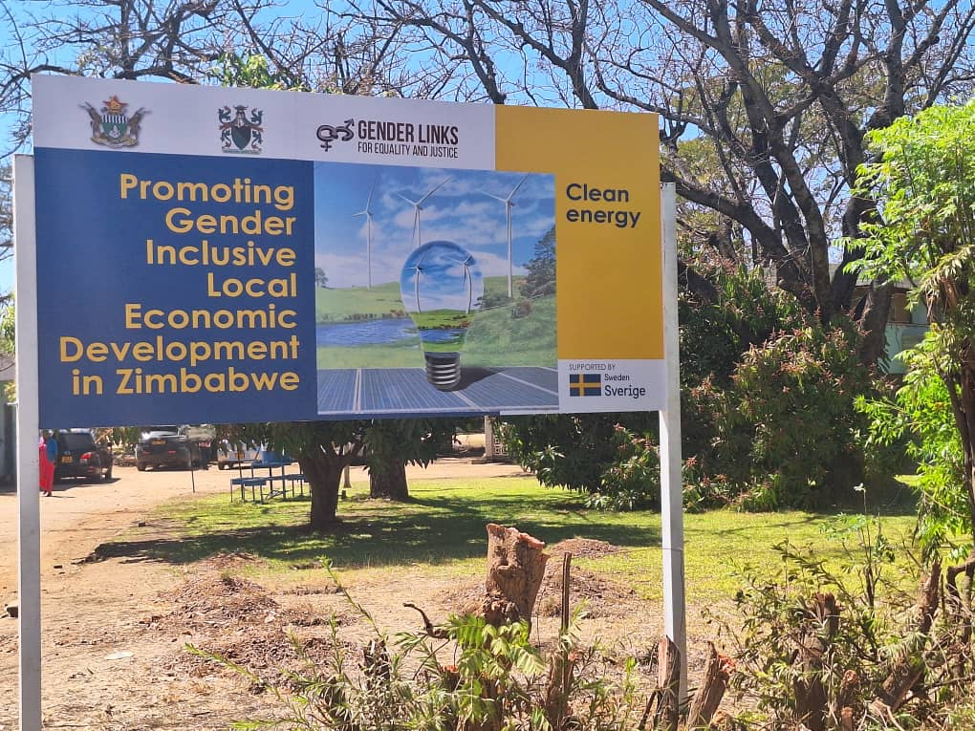
2024 COUNTRY SUMMIT
ZIBAGWE BIOHARVERST COOPERATIVE - ZINHANGA NYASHA

Slide 2
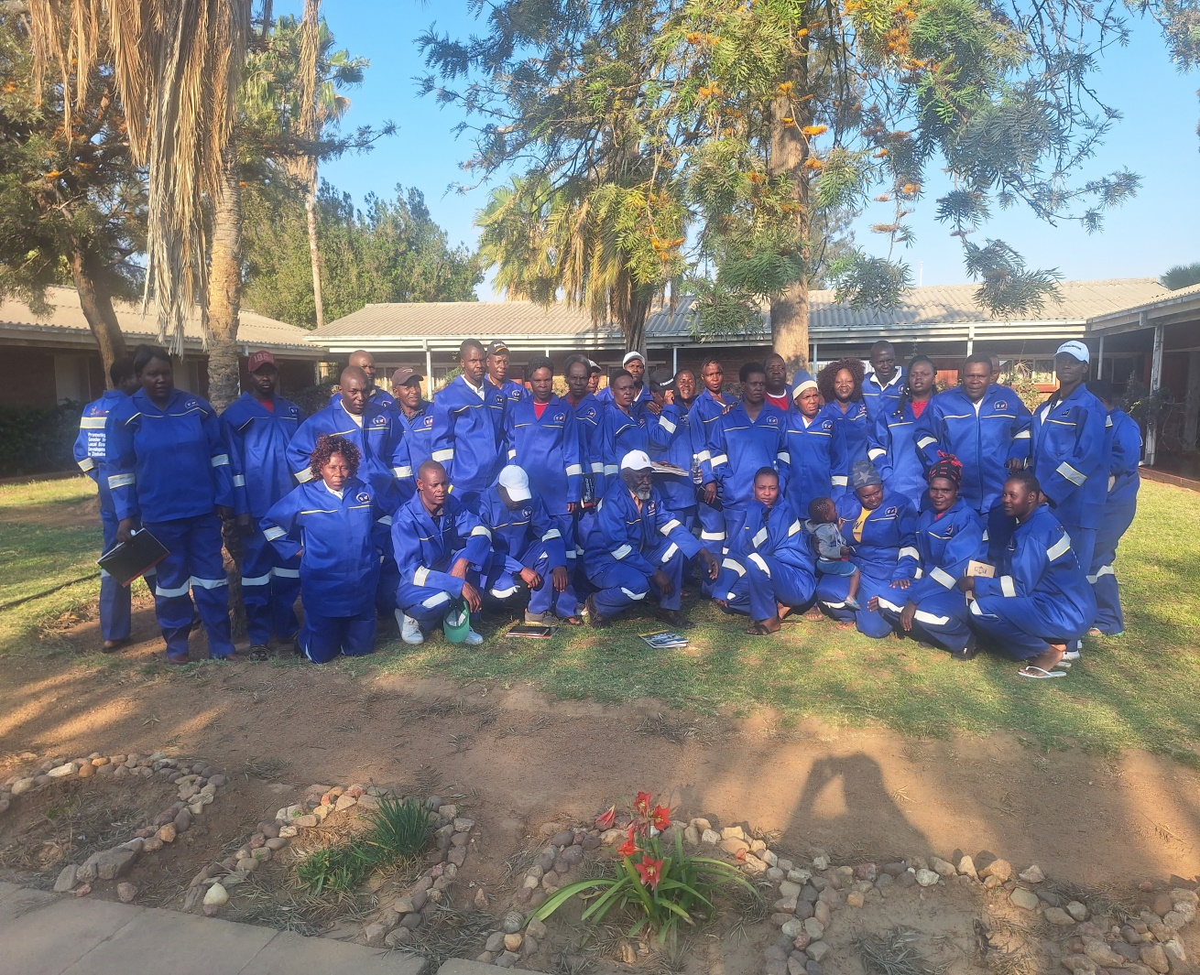
PLEASE DESCRIBE THE ENTERPRISE
Zibagwe has noted an increase in deforestation in its council area and also noted that energy needs are a growing concern in its communities that most households depend on firewood. For women and girls reliance on firewood translates into high labour, energy demands and increased health costs. The responsibility of collecting firewood often falls on girls leading to lower rates of school enrolment for school aged girls. Female headed households are more likely to be worried about health risks associated with smoke related illnesses, mitigate climate change and lower air pollution. Council constructed 46 biogas digesters around the district that are seeing women, youths ,PWD and men benefit through use of clean energy in the form of biogas.
Number of Members- 50.
Registration status – not yet registered
What type of registration is in place- In the process of registering as a cooperative
How often does the enterprise have meetings-
Monthly
Insert Photo or video
“Promoting Gender Inclusive Local Economic Development”

Slide 3
BUSINESS PLAN & MODEL?
Do you have a Business Plan in place? YES
Has the enterprise implemented the business plan- YES
Describe the business model
The business model is a framework a company uses to creat,deliver and capture value. It comprises how the business operate s, how it generates revenue and how it interact with customers.
What kind of support has the business received?
Construction of 46 Biogases
Procurement of 46 Biogas Bas and stoves.
Capacity building in the form of training of Entrepreneurs.
Support letters to access loans and company registration
LOCAL ECONOMIC DEVELOPMENT (LED) BUSINESS PLAN
ZIBAGWE BIOGAS PRODUCTION ENTERPRISE
1.0 Executive Summary
An outline of the Zibagwe Biogas Production Enterprise owned/managed by the Zibagwe Biogas Production Cooperative. Zibagwe Rural District Council (RDC) noted a marked increase in deforestation in its catchment area. The household energy requirements are rising steeply owing to the increasing population, with most households depending on firewood as a source of energy. For women and girls, over-reliance on firewood as an energy source translates to high labour and energy demands as well as increased health costs. The responsibility of collecting firewood often falls on girls leading to lower rates of school enrolment for school-aged girls. Unlike male-headed households, female-headed households are more likely to be worried about health risks associated with smoke-related illnesses, mitigate climate change and lower air pollution. Progress has been slow and limited for women in very poor countries. Women face a myriad of challenges, which revolve around reproduction, productive and community work. Among the challenges are; limited access to family productive assets, limited education, low economic status, limited access to social issues, regular domestic burden, all of which contribute to increased cases of domestic violence. The establishment of 46 x 10m3 biogas digesters in all the 33 wards of Zibagwe RDC is expected to address the challenges highlighted. Biogas use could dramatically improve women`s lives in terms of health as it limits their exposure to indoor smoke.
“Promoting Gender Inclusive Local Economic Development”

Slide 4
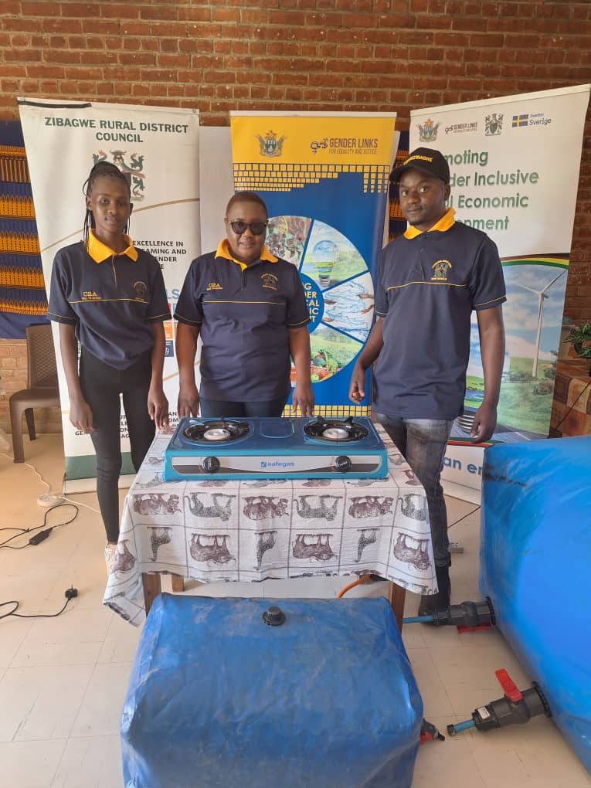
BUSINESS AND FINANCIAL MANAGEMENT?
Does the enterprise have a budget or forecasting tool for the business?
Yes the enterprise uses Microsoft spreadsheet as budget forecasting tool
Does the enterprise have a record keeping system that keeps track of expenses, sales and stock inventory?
Yes the enterprise has record keeping system as it has a register of enterprenuers and records of expenses that were incurred in the forming of the cooperative. At the moment there are no sales as our project is still at infancy stage.
Does the enterprise have a bank account – No the business does not have a business account as it is still at the infancy stage
Insert Photo
“Promoting Gender Inclusive Local Economic Development”

Slide 5
INCOME AND EXPENSES FOR THE BUSINESS FOR THE LAST SIX MONTHS
Month | Jan | Feb | Mar | Apr | May | Jun | Jul | Aug | Sept | Oct | Nov | Dec | Total
Sales (USD) | 0 | 0 | 0 | 0 | 0 | 0 | 0 | 0 | 0 | 0 | 0 | 0 | 0
Quantity (Kgs) | 0 | 0 | 0 | 0 | 0 | 0 | 0 | 0 | 0 | 0 | 0 | 0 | 0
Expenses | 0 | 0 | 0 | 0 | 0 | 0 | 0 | 0 | 0 | 0 | 0 | 0 | 0
“Promoting Gender Inclusive Local Economic Development”

Slide 6
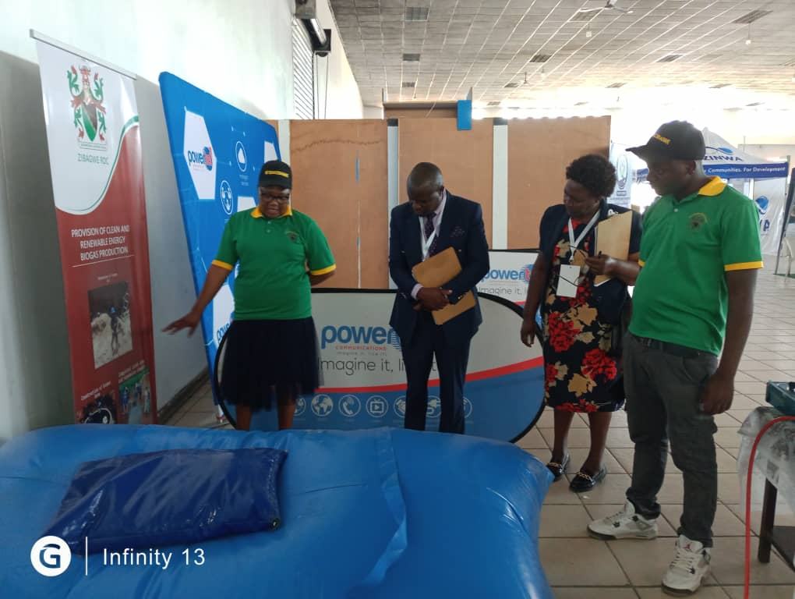
MARKETING AND SAVINGS
What/who is your main market?
The Zibagwe community and surrounding farmers
What marketing strategies has your enterprise employed?
Workshops and trainings- These are organised events to educate stakeholders on biogas benefits, technology and usage.
Showcasing at tradeshows, Expos, Symposiums and Agricultural shows to raise awareness on the importance of using biogas
Collaborating with influencers that is partnering with Environmental advocates, farmers and Industry experts eg the Backstopping workshop.
What challenges does the enterprise face in the market?
Limited public awareness and understanding of biogas benefits.
Low returns on investment due to high operating costs
Competition from established energy sources.
Limited expertise and trained personnel
What opportunities do you see in the market?
Increasing demand for renewable energy.
Attracting investors for biogas project development
Agriculture , Biogas-based (fertilizers, farm energy self-sufficiency.
Waste management - Biogas from organic waste
Intergration with other renewables e.g solar
Insert Photo
“Promoting Gender Inclusive Local Economic Development”

Slide 7
MARKETING AND SAVINGS
Does the enterprise have any savings? YES
Are group members organised into savings groups Yes
How effective are the savings groups.
They are very effective as the members have managed to create other income generating projects through the AISLES (Mikando)
What financial services has the group accessed- The group is in the process of applying for loans from Ministry of women Affairs, Ministry of Youth, Women’s Bank and Empower Bank
Insert Photo
“Promoting Gender Inclusive Local Economic Development”

Slide 8
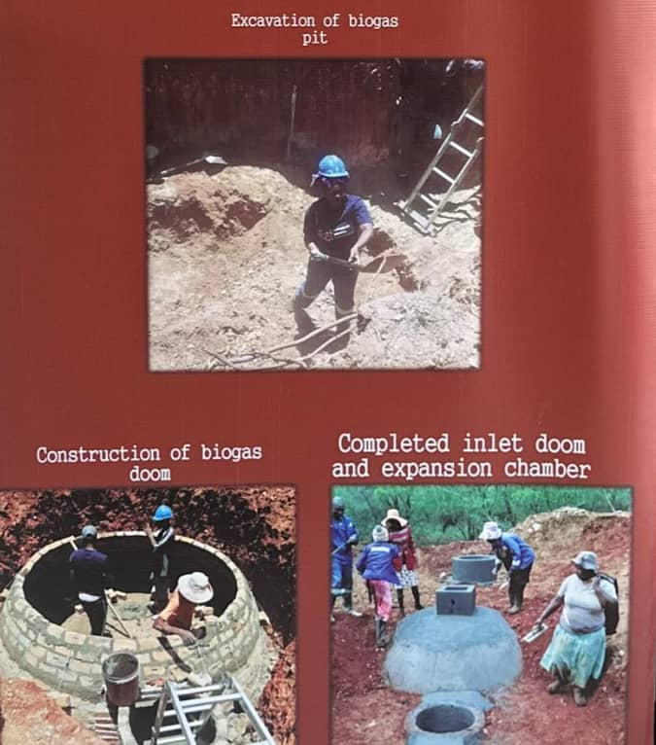
WHAT PLANS HAVE YOU MADE TO GROW YOUR BUSINESS IN THE NEXT 6 MONTHS?
Please list your plans to grow your existing business. Explain the growth strategy of the enterprise.
Training of Manson's to expand the biogas project as they would construct the biogases at low cost.
Explore new revenue streams buy selling excess energy, carbon credits.
Enhance marketing efforts by increasing awareness and educate stakeholders.
Fabrication of LP gas stove to be compatible to biogas so that they will be cheap to purchase
Expand feedstock sources- Diversify organic waste streams
Develop strategic partnerships- collaborating with complimentary businesses.
Invest in community development
Insert Photo
“Promoting Gender Inclusive Local Economic Development”

Slide 9
ENVIRONMENTAL PRACTICES
What environmentally friendly practices has your enterprise employed/used?
Organic waste reduction –utilize organic waste that would otherwise end up in landfills
Waste to energy – convert waste to energy, reducing greenhouse gas emissions
Digestate utilisation- use nutrient-rich digestate as fertilizer
Biogas production – generate energy from organic waste
Reduced odour emissions – minimize unpleasant odours through efficient digestion.
Landfill diversion- conserve landfill space, reducing environmental impacts
Curbing diforestation – as the community would be using biogas the reduction in cutting down of trees would be achieved as they will be using cow dung and garden and kitchen waste for biogas production.
Insert Photo
“Promoting Gender Inclusive Local Economic Development”

Slide 10
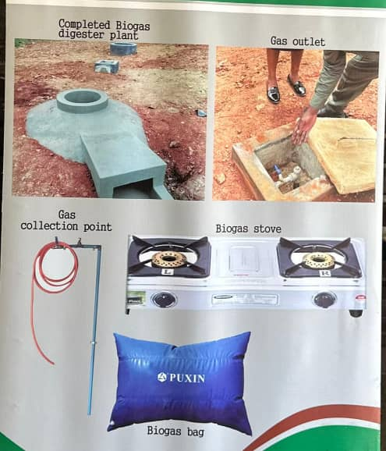
CHALLENGES
Challenges
1. Community Awareness: Limited understanding of biogas can lead to local resistance.
2. Limited access to skilled labour and expertise.
3. Remote locations and accessibility issues
4. Limited access to funding and financing.
5. Competition from other energy sources
6. Regulatory Hurdles: Navigating regulations and permits is complex and time-consuming.
7 Might be affected by weather as the biogas digester needs sunlight for anaerobic bacteria to be active for digestion to take place
To address these challenges
1. We implemented community awareness programs.
2.Provide training for local labor.
3. We engaged stakeholders for funding support and streamlined regulatory processes.
4. Additionally, we established reliable supply chains for feedstock and create market access strategies to enhance the viability of biogas projects.

Slide 11
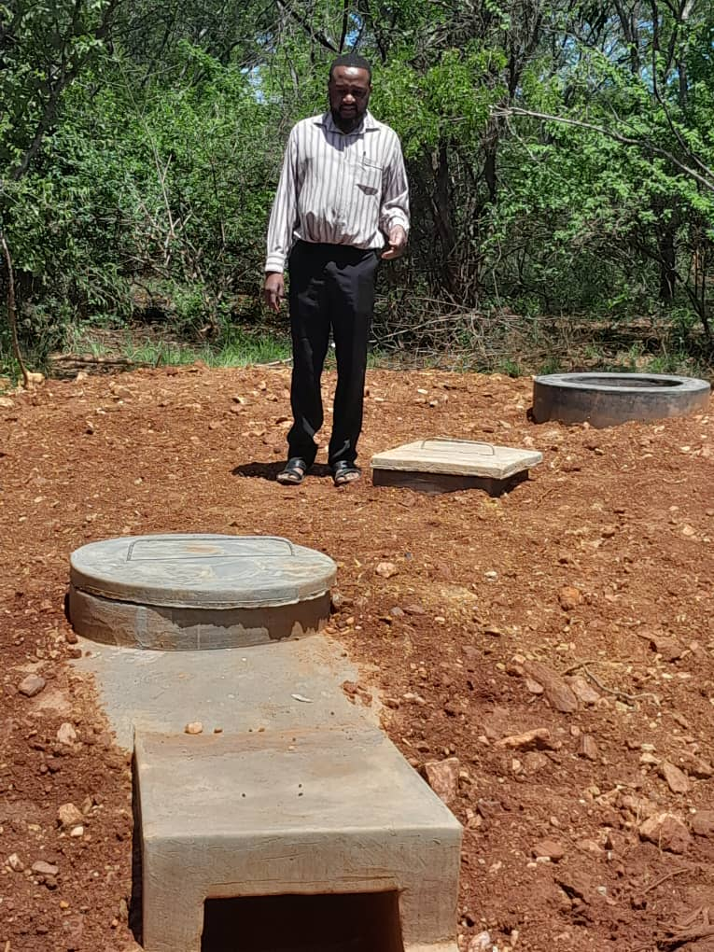
LESSONS LEARNED
What lessons have been learned?
1. Proper feedstock selection and management is crucial
2. Digestion process optimization requires continuous monitoring
3. Regular maintenance is essential for equipment longevity
4.Community engagement and education are vital for success.
5. Training and capacity building for operators and maintenance staff.
6. Mitigating potential environmental risks eg water and pollution.
7. Community acceptance and buy-in are critical
8. Effective communication and stakeholder communication
9. Job creation and local economic benefits

Slide 12
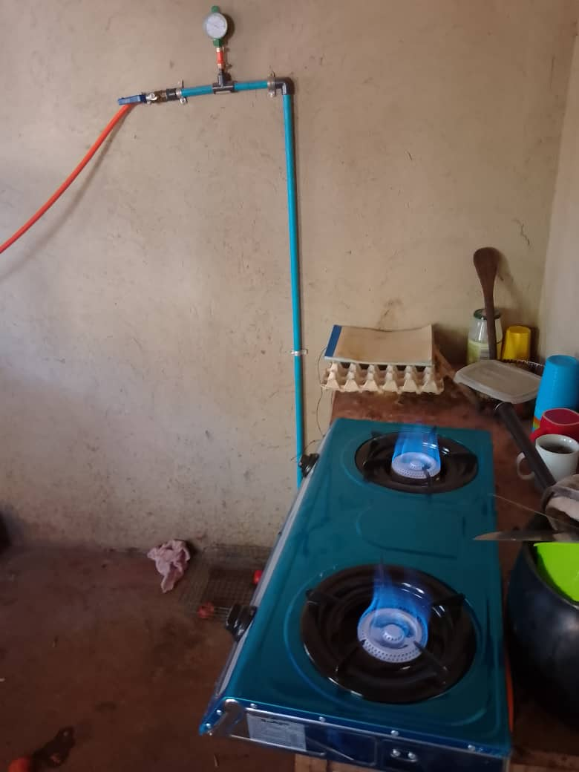
SUSTAINABILITY
What sustainability measures are in place for the enterprise
Community engagement- involving local communities in project planning and operations for them to own the project.
Renewable energy production- biogas generated from organic waste reduces greenhouse gas emissions
Waste reduction- utilizing organic waste that would otherwise end up in landfills
Soil conservation – Digestate (remaining organic matter used as fertiliser.
Job creation- biogas projects generate employment opportunities.
Economic empowerment- supporting small- scale farmers and enterprenuers
Continuous improvement –Regular assessments and adaptations
Regulatory compliance – adhering to environmental and health regulations
Education and Training – capacity building for entrepreneurs and maintenance staff.
Revenue generation- biogas sales, carbon credits and fertiliser production.
Insert Photo
“Promoting Gender Inclusive Local Economic Development”

Slide 13
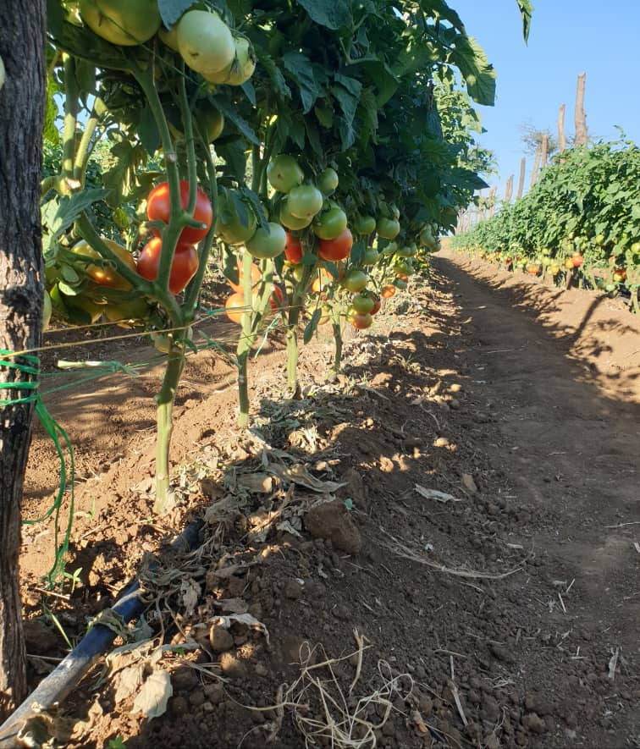
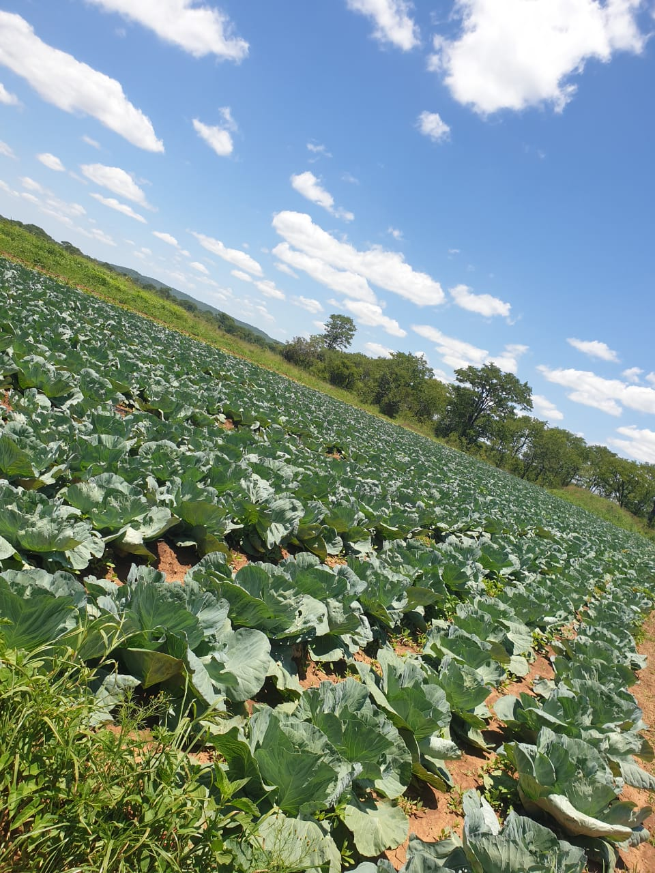
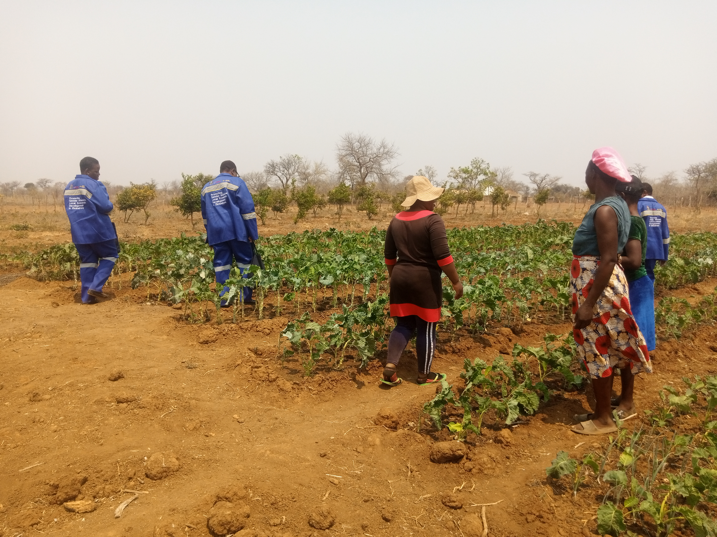
Next Steps
What are the next steps for the Enterprise/Business
Scaling up operations by increasing biogas production and expand facilities.
Invest in research and development that is exploring new technologies and process e. g fractation and combustion of biogas
Establish a community engagement program- educate involve local communities
Develop a strategic business plan- outlining growth, expansion strategies
Develop a sustainability report- track environmental, social, economic impacts
Establish a revenue diversification strategy- reduce dependence on single revenue streams

Slide 14
Additional information?
Currently our project has constructed 46 biogases around the Zibagwe District. The biogases were constructed at strategic points especially clinics and schools. In schools the program is complimenting the feed program that was introduced by His Excellency the President of Zimbabwe Dr. E.D. Mnangagwa. The schools are now using the biogas for cooking thereby saving the children falling prey to abusers when going into the bush fetching firewood.
The biogases were also constructed at the clinics where they cater for waiting mothers and connected to refrigerators for vaccine preservation. At all council clinics we have mother waiting shelters where we have expectant mothers waiting for delivering. The waiting mothers will not have hustles of going to fetch firewood for cooking where they might be raped by artisanal miners. The cooking is now easy for them as they will be using biogas for cooking. In all the 46 cites they have a biogas stove and biogas bag where biogas can be stored for later use when the weather is not conducive for the production of biogas.
We are encouraging our communities to purchase the biogas bags and stoves so that they can use biogas even if they do not have a biogas digester at their household. In the near future we see each and every household having a biogas digester.
“Promoting Gender Inclusive Local Economic Development”

