Slide 1



SADC PROTOCOL@WORK SUMMITS AND AWARDS
2024
GENDER RESPONSIVE BUDGETING
Zimbabwe
Umguza Rural District Council
07 November 2024
Jethro Nsimba

Slide 2
OVERVIEW
COUNTRY | ZIMBABWE
COUNCIL (HUB/SPOKE) | HUB
GENDER CHAMPION | GETRUDE GUMBO
GENDER FOCAL PERSON | LYNDER F MAPHOSA
Latest score (year) | 2024
 | Income | Expenditure | % Gender Specific
Budget (YEAR) | 6762262.58 | 6262220.32 | 7.98
 | Women | Men | Total | % Women
Council
Management | 5 | 4 | 9 | 55.56
Council staff overall | 31 | 72 | 103 | 30.1
Population served | 120 060
Key characteristics

Slide 3
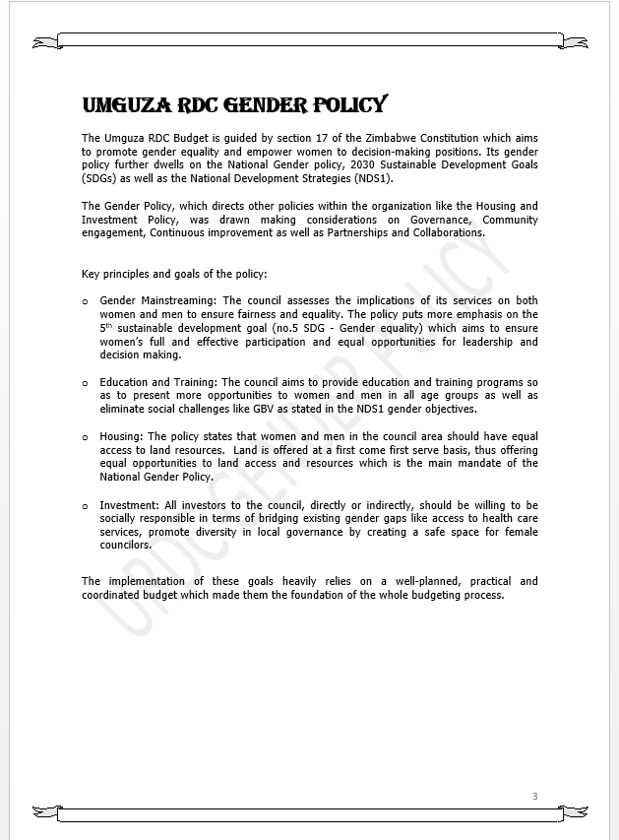
I. POLICY FRAMEWORK
What gender provisions and policies guide the council budget? E.g. National Gender Policy, Constitution of Zimbabwe, National Development Strategy 1, SADC Protocol on Gender and Development CEDAW SDGs.
The Umguza RDC Budget is guided by section 17 of the Zimbabwe Constitution which aims to promote gender equality and empower women to decision-making positions. It further dwells on the National Gender policy, 2030 Sustainable Development Goals (SDGs) as well as the National Development Strategies (NDS1).
Does the council have a gender policy and does it address issues on gender budgeting?
The Gender Policy, which directs other policies within the organization like the Housing and Investment Policy, was drawn making considerations on Gender Mainstreaming,

Slide 4
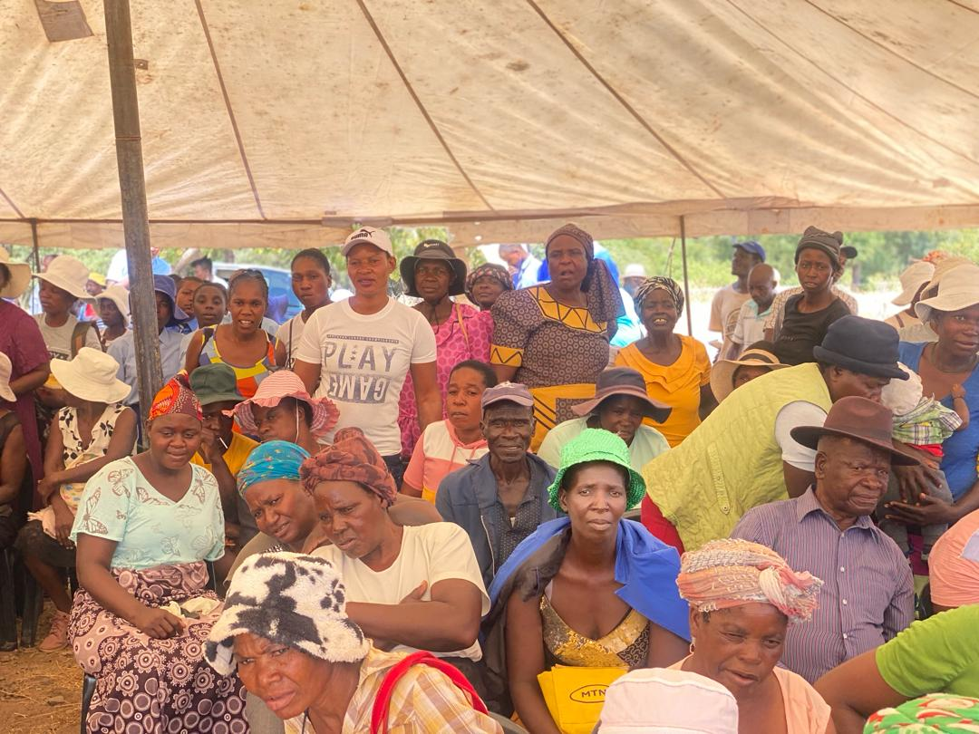
II. THE BUDGET PROCESS
Detail
Evidence
How did the council integrate gender and inclusion in budget planning?
The council provided extensive budgeting and gender education to the community and staff. The council's gender policy and the need of a gender-responsive budget were also explained to them.

Slide 5
How did the council integrate gender and inclusion into budget consultations? (Include all the methodologies used during the budget consultation process e.g., civic engagements, online consultations, etc.)
Public announcements and radio sessions were used. Every homeowner received the information they required, according to the follow-up questions from the radio sessions sent via WhatsApp. All aspects of the public's answers were covered by the active radio programs.
How did the council ensure that the budget consultation process was inclusive i.e., “no one is left behind”, e.g., that every resident including the hearing and visually impaired knew about meetings. Please cite all methods used.
While the radio sessions catered to the visually challenged, public notices catered to those with hearing impairments.
Through junior councilors, youths in schools were contacted, and they received feedback on the previous year's budget performance as well as information on budgetary requirements.

Slide 6
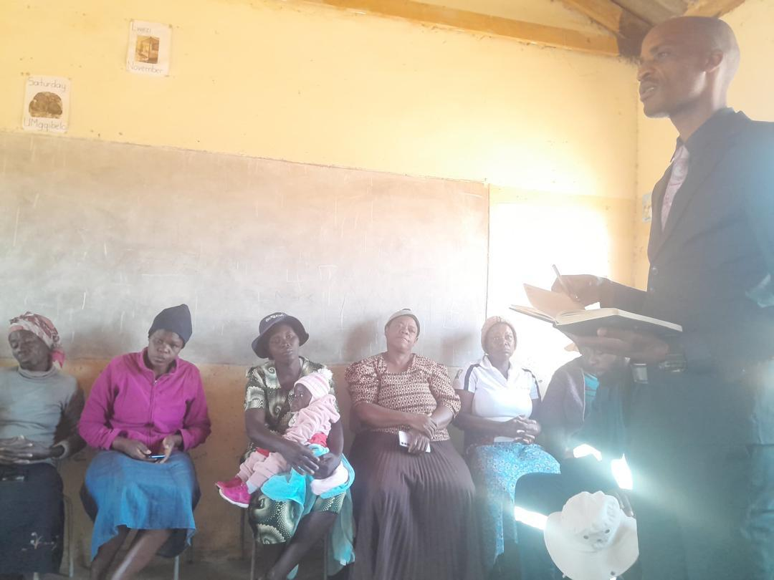
II. THE BUDGET PROCESS
Evidence
Detail
What time, venue and meeting strategies did the council use to ensure inclusion? E.g., were women consulted about what day/time would work best for them?
The meeting times were detected by the community.
Meetings were conducted in a variety of ways.
Students in schools pushed for lunch and recess periods (assembly points). Prep was the recommended time to meet those attending boarding institutions.
During assembly time, council members were also given platforms to speak to the students in their respective schools.
In different wards, residents were grouped by age and sex during consultations.
In general, communities were contacted and their schedules were followed; as a result, the community chose the locations and times of the meetings,

Slide 7
Did the council make use of technology to broaden your reach? How? E.g. WhatsApp.
Yes, WhatsApp communities and talks on the Radio were made use of.
How effective was this technology?
To ensure that everyone in the community was contacted, mass texting was employed, with a particular focus on women though with no discrimination to men.
Based on observations, some women still did not own smartphones. Older models were also utilized, so for households with young school-age children communication was made via them. (It was noted that women tend to relate to children better than men do, which is why this approach was chosen.)
Councilors were asked to engage with the communities' through existing WhatsApp groups, which already had councilor wards.

Slide 8
II. THE BUDGET PROCESS
Does the council have sex/age/PLWD statistics on those who participated in the consultations? – refer to consultation registers and populate table below
Consultation | Women |  |  |  |  | Total | Men |  |  |  |  | Total | % Women
 | Age |  |  |  |  |  | Age
 | - 15 | 15-35 | 36-59 | 60+ | PWD |  | - 15 | 15-35 | 36-59 | 60+ | PWD
 | 868 | 3413 | 6891 | 108 |  | 11280 | 674 | 2364 | 8234 | 76 |  | 11348 | 50%
% |  |  |  |  |  | 100% |  |  |  |  |  | 100%

Slide 9
III. REVENUE
What is the break down between internal and external sources of funding?
Internal sources $2 904 958.
External sources $3 857 303.8

Slide 10
How did gender considerations informed decisions concerning the budgeting of revenue?
By identify areas where women are disadvantaged or have limited access to resources
How were these decisions influenced by budget consultations, in particular the views of women?
Through engaging communities, there was a two way communication between the council and the community, it helped to identify and satisfy a need. I.e. mother shelters and computer labs.
Is any of the external financing specifically targeted at gender?
Capital devolution is targeted to mother shelters.

Slide 11
IV. EXPENDITURE BY CATEGORY
Gender Management System – 0.36%
Employment expenditure - 13.46%
Employment equity-related expenditure - 0.15%
Gender-specific programmes – 7.98%
Mainstream programmes – 78.05%

Slide 12
IV. EXPENDITURE
Type of Expenditure | Amount | Proportion (%)
Gender Management System (GMS) | 24120 | 0.36
Employment expenditure (Human Capital Expenditure) | 910173 | 13.46
Employment equity related expenditure | 10000 | 0.15
Gender Specific Programming | 539900 | 7.98
Mainstream Programmes | 5278027.32 | 78.05
Other | - | -
Total | 6762220.32 | 100

Slide 13
IV. EXPENDITURE- GMS
Does the council have a Gender Management System? (E.g., Gender Committee, Gender Focal Person, Gender Champion).
Yes
Are GMS activities budgeted for ? (E.g., Committee meetings, Hub/ spoke activities, exhibitions, Training, Policy formulation, Exchange visits, Office equipment and stationery, other activities?
Yes
Where are these budgets found?
they are budgeted for under social services and some as standalone activities in general expenditure.

Slide 14
IV. Gender Specific expenditure
What gender-specific programmes does the council have?
Gender training workshops
Junior councils
Youth centres
Sexual Reproductive Health and Rights
Vocational Training Centres and Home Craft Centre
Commemorations of international days eg. Women’s day, sixteen days of activism, girl child

Slide 15
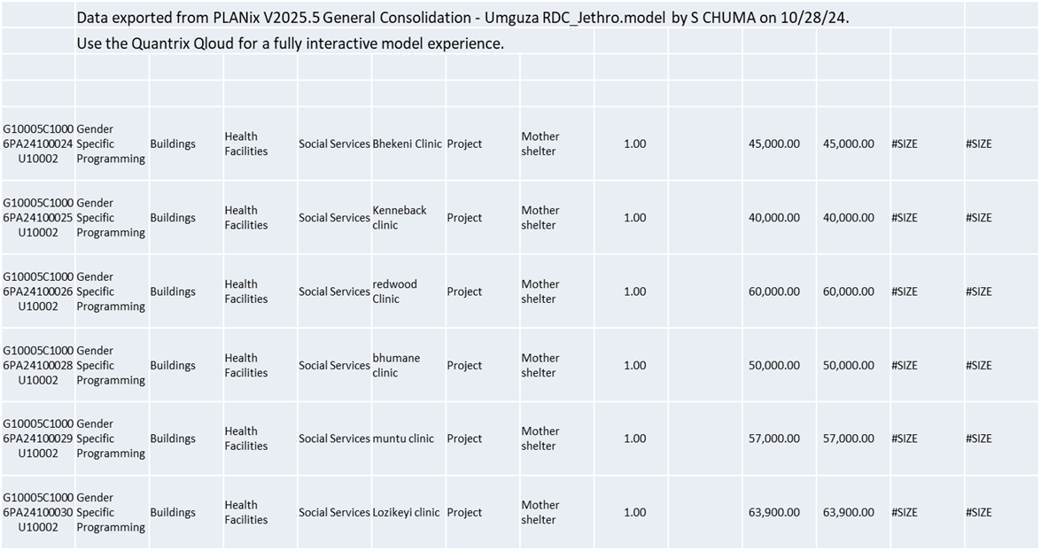
Where are these budget lines found? Are they visible?
Yes,
What proportion of the council budget is allocated for gender-specific programming?
7.98%

Slide 16
How were these programmes/ projects informed by budget consultations?
The inclusion of more mother shelters was because that is what most women advocated for during the consultations. This was so to always maintain home deliveries at zero.
Men stressed the need to improve access to quality paternal health care hence some structures were allocated to these.
How are the gender-specific projects helping to promote gender equality and women’s empowerment?
Junior council activities for boys and girls encouraged both from a young age that none is above the other.
Gender training workshops equip both genders with relevant skills which eliminates the problem of discrimination amongst each other. Commemorations for days like woman’s day or the day of the girl child restore the dignity of women encouraging them to match and even surpass men in their efforts.

Slide 17
IV. EMPLOYMENT EXPENDITURE
How do you measure the expenditure on gender-specific programmes (outputs, outcomes and impact)?
Through tracking and balancing the changes in participation of both genders in competitive environments like commits and academics.
 | Women |  |  | Men |  |  | Total | % women
 | Managers | Staff | Total | Managers | Staff | Total |  | Managers | Staff | Total
Full Time | 5 | 7 | 12 | 4 | 35 | 39 | 51 | 55.6 | 15.2 | 23.5
Part time |  | 16 | 16 |  | 4 | 4 | 20 |  | 80 | 80
Casual |  | 3 | 3 |  | 29 | 29 | 32 |  | 9.4 | 9.4
Total | 5 | 26 | 31 | 4 | 68 | 72 | 103 | 55.6 | 14 | 38

Slide 18
.
What proportion of the work force do women comprise overall?
30%
What is the percentage of women in management?
55.6%
What percentage do women comprise of the full-time, part-time and casual, labour force?
23.5%, 80% and 9.4% respectively
What are the reasons for the this employee breakdown
There has been gender disparity on the full time segment with few women hence the extensive measures to increase their participation in experiential learning with 80% representation.

Slide 19
IV. EMPLOYMENT EXPENDITURE- Gender Wage Gap Analysis
 | Women | Women- Total earned | Women average earned | Men-no | Men total earned | Average earnings
Full Time | A=12 | B=282550 | B/A=23545.83 | C=39 | D=607248 | D/C=15570.46
Part Time | E=16 | F=1500 | F/E=93.75 | G=4 | H=875 | H/G=218.75
Casual | H=3 | I=3500 | I/H=1166.67 | J=29 | K=14500 | K/J=500
Total | A+E+H X=31 | B+F+I Y=287550 | Y/X W=9275.81 | C+G+J Q=72 | D+H+K R=622623 | R/Q=8647.54
What is the gender wage gap?= (Average earnings of Men - Average earnings of Women)/ Average earnings of Women
Gender wage gap = (8647.54-9275.81)/9275.81 = -6.77%
What does the wage gap reflect with regard to 1) the different levels occupied by women and men in the Council
It reflects that averagely speaking, women earn 6.77% higher than males even though they are fewer than males.

Slide 20
2) the different types of work that they do?
A large number of men is skewed to general work that attracts low incomes where as women occupy higher ranks. Hence the negative wage gap.
Most men are general workers
Most women occupy clerk ranks or higher.
What plans does the Council have in place to close the gender wage gap?
Men are encouraged to further their studies so as to occupy higher ranks
However in terms of number of females there is a gap, hence the budget for 80% female students compared to 20 % male students. This is a deliberate move to increase the number of females in council while minimizing the wage bill of females ,especially considering that the wage gap currently favors the females.

Slide 21
V. EXPENDITURE- GENDER IN MAINSTREAM BUDGET
Programmes | Amount | % budget
Governance & Administration | 1079525.96 | 15.96
Water Sanitation & Hygiene | 1393000 | 20.60
Social Services | 1990402.10 | 29.43
Roads | 1860263.21 | 27.51
Public Safety & Security | 151180.32 | 2.24
Natural Resources & Conservation | 287848.73 | 4.6
Total | 6762220.32 | 100

Slide 22
V. EXPENDITURE- ANALYSIS OF ONE SECTOR EG
 | Women |  |  |  |  |  | Men
 | Age |  |  |  |  |  | Age
 | Below 15 | 15-35 | 36-59 | 60+ | PLWD | Total | Below 15 | 15-35 | 36-59 | 60+ | PLWD | Total
Education | 5955 | 4926 | 347 |  | 55 | 11283 | 6553 | 5001 | 388 | 0 | 93 | 12035
Housing
Social amenities
Total | 5955 | 4926 | 347 |  | 55 | 11283 | 6553 | 5001 | 388 | 0 | 93 | 12035

Slide 23
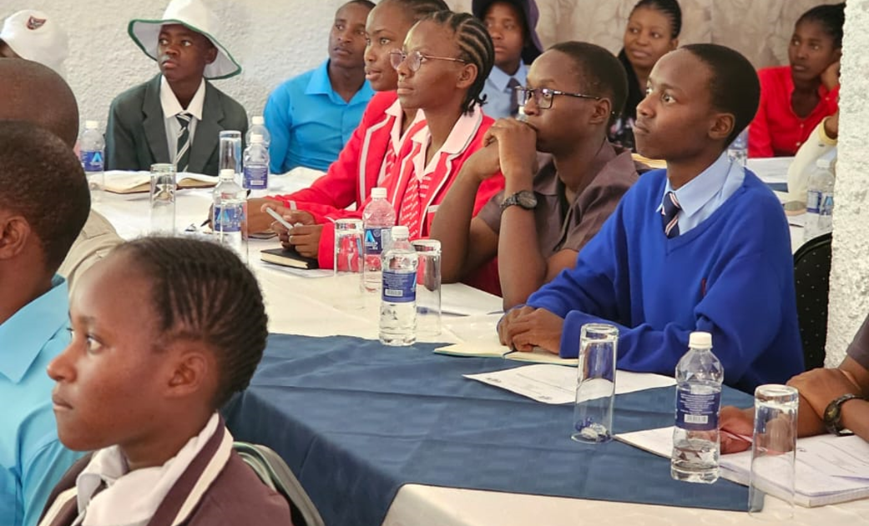
V. EXPENDITURE- GENDER IN MAINSTREAM BUDGET
Please explain how you are ensuring that women and men, boys and girls benefit equally, or that disparities are challenged through GRB
Junior council activities for boys and girls encouraged both from a young age that none is above the other.
Gender training workshops equip both genders with relevant skills which eliminates the problem of discrimination amongst each other. Commemorations for days like woman’s day or the day of the girl child restore the dignity of women encouraging them to match and even surpass men in their efforts.

Slide 24
V. EXPENDITURE- GENDER IN MAINSTREAM BUDGET – EXAMPLE
EDUCATION | Amount | No of beneficiaries | Percentage
Total Expenditure | 1026334.38
No. of Men benefiting from council allocations | 528582.67 | 11624 | 51.5
No. of Women benefiting from council allocations | 497751.71 | 10946 | 48.5
Total beneficiaries |  | 22570 | 100%

Slide 25
VI. BUDGET CROSS SUBSIDISATION ANALYSIS
 | Income (A) | % of total budget | Expenditure (B) | % of total budget | Surplus/Deficit
Governance & Administration | 1079526 | 16 | 1079526 | 16 | 0
Water, Sanitation & Hygiene | 1393000 | 21 | 1393000 | 21 | 0
Social Services | 1990402 | 29 | 1990402 | 29 | 0
Roads | 1860263 | 28 | 1860263 | 22 | 0
Public Safety and Security | 151223 | 2 | 151180 | 2 | 42
Natural Resources & Conservation Mgt | 287849 | 4 | 287849 | 4 | 0
Total | 6762262 | 100 | 6762220 | 100 | 42

Slide 26
VI. BUDGET CROSS SUBSIDISATION ANALYSIS
Which programmes generate more income than expenditure?
Public Safety and Security Services
Which programmes spend more than they generate (i.e. they are being subsidised). Specify nature of activities being subsidised and funding source.
None
Are there any policies to support or guide cross-subsidisation?
Public Sector budgets in Zimbabwe do not have a surplus or deficit, they are cost recovery budgets. So the Public sector policy guides the council on cross subsidization issues.
The Council is not a profit making organization, hence the need to cross subsidize other departments if one has a surplus.
How have gender considerations influenced the cross-subsidisation of services?
Gender considerations inform prioritisation of services focusing on those benefiting low income households as well as women and girls.
What percentage of allocations have been influenced by gender considerations?
8.34% ( GMS + Gender specific programming)

Slide 27
VII. CONCLUSIONS AND NEXT STEPS
To what extent has the council budget contributed to gender equality and women’s empowerment?
Umguza Rural District Council, being a hub of excellence in gender mainstreaming, allocated more funds (78.05%) to mainstream programmes, with 8.34% being channelled to gender considerations. Employment expenditure was 13.46% whilst equity related expenditure rounded up the total to 14%.
This means that the council managed to conform to the 70 – 30% ratio for essential services to operating cost respectively which is required for local authorities.
The 8.34% channelled to gender activities managed to surpass the minimum requirement of at least 5% for the council. The figure comprised of $315 900 (4.67% of the budget) from capital devolution which was allocated to the construction of mother shelters, some from scratch whilst some are already a work in progress.
Boys and Girls have been travelling long distances to get water. Expenditure allocated to the construction of boreholes could cut on their study time and preserve their concentration energy. Hence the move to build schools with boreholes nearer to their places of residence.
This will protect the girl child, a lot of abuse could occur as they walk long distances to fetch water. As a socially responsible and gender responsive council ,the URDC considered the needs of the community in the budget process, hence scoring a substantial amount of percentage to respond to gender needs of the society.
This also helps the mothers too, they can now fetch water from nearby schools and concentrate more on their other chores. Long distances to fetch water was also a cry from women during budget consultations.

Slide 28
What are the next steps regards gender budgeting for the council?
Through yet another gender program, the council will attempt to address the underlying causes of gender inequality and restructure unequal power relations.
This will be a financial undertaking. The council will utilize junior council members to hold a large public speaking competition on the underlying reasons of gender inequality since research has power. The budget for the upcoming fiscal year will make use of some of the data.
Following their investigation, the junior council members will try to involve their district colleagues in order to jointly develop potential solutions for future budgets.
Mobilization of budget consultation (move to exceed 30% participation)
The council intends to eliminate all gender disparities and transition from a financially gender-responsive to being a financially gender transformative council.

