Slide 1
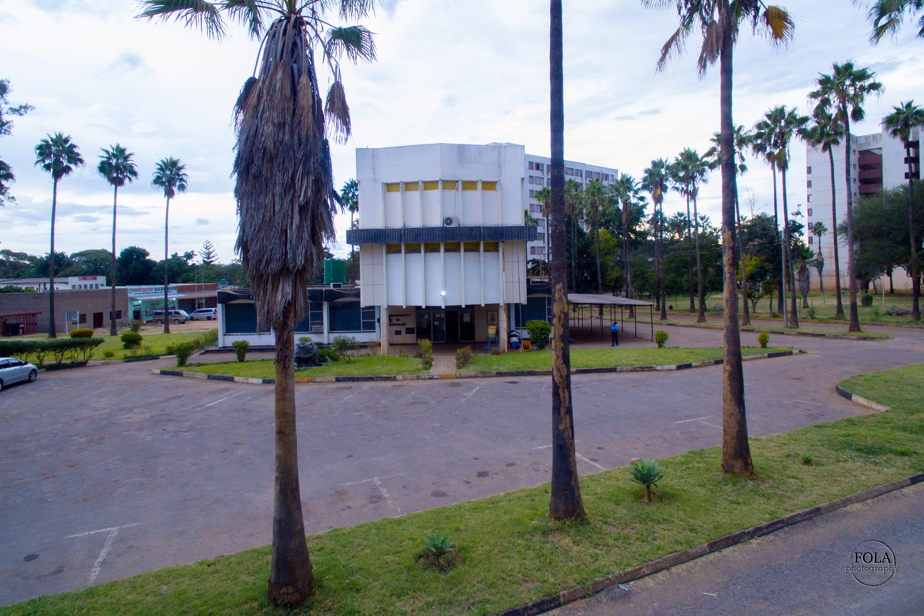





SADC PROTOCOL@WORK SUMMITS AND AWARDS
2024
INSTITUTIONAL COE PRESENTATION
(ZIMBABWE, MUNICIPALITY OF REDCLIFF, 01/11/2024, KAUNYE R. M)
MOVING TOWARDS A CITY BY 2030

Slide 2
OVERVIEW
COUNTRY | ZIMBABWE
COUNCIL | MUNICIPALITY OF REDCLIFF
GENDER CHAMPION | MRS. L. WHATA
GENDER FOCAL PERSON | RUMBIDZAI M. KAUNYE
IS THE COUNCIL A HUB OR SPOKE COUNCIL? SPOKE
Latest score (year) | 69%
 | Women | Men | Total | % Women
Council | 6 | 6 | 12 | 50
Management | 3 | 8 | 11 | 27
Council staff overall | 89 | 171 | 260 | 34
Population served | 41,526 (2022 Population and Housing Census Preliminary report)
Key characteristics | DIVERSE COMMUNITY IN TERMS CULTURAL AND SOCIAL BACKGROUND
MOVING TOWARDS A CITY BY 2030

Slide 3
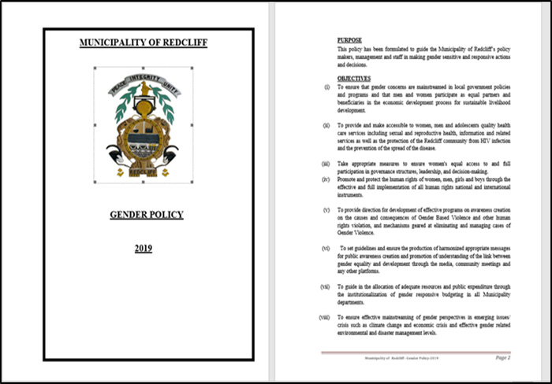
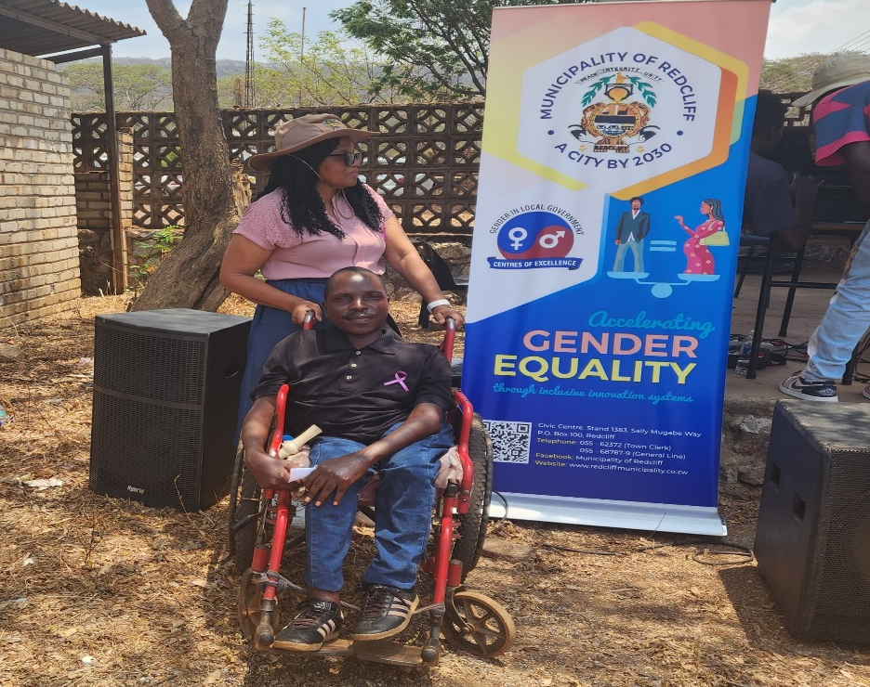
  I. GENDER POLICY, ACTION PLAN, HUB AND SPOKE
Yes, Redcliff Municipality has a gender policy and action plan that incorporates the Post 2015 SADC Gender Protocol, SDGs and other relevant targets.
The policy is well known and has a high profile champion (Mrs. L. Whata) within the council.
MOVING TOWARDS A CITY BY 2030

Slide 4
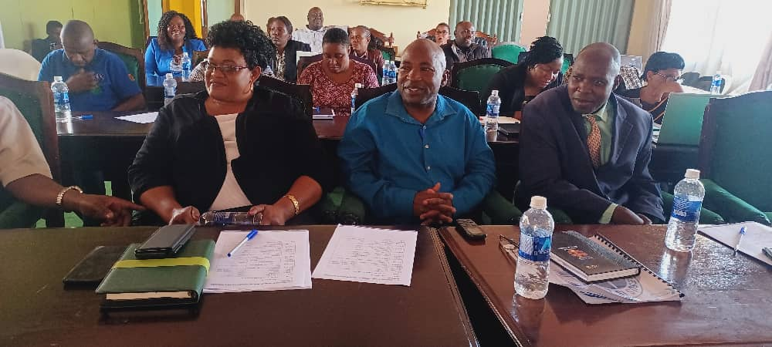
  I. GENDER POLICY, ACTION PLAN, HUB AND SPOKE
The council attended provincial hub and spoke strategy meetings.
Sharing information on gender responsive projects.
Council had 2 hub and spoke activities. Council has budgeted for gender mainstreaming programmes using its own funds in order to have more of the hub and spoke activities.
MOVING TOWARDS A CITY BY 2030

Slide 5
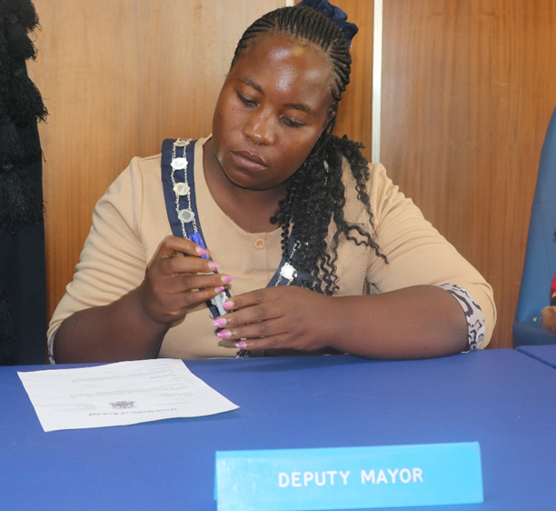
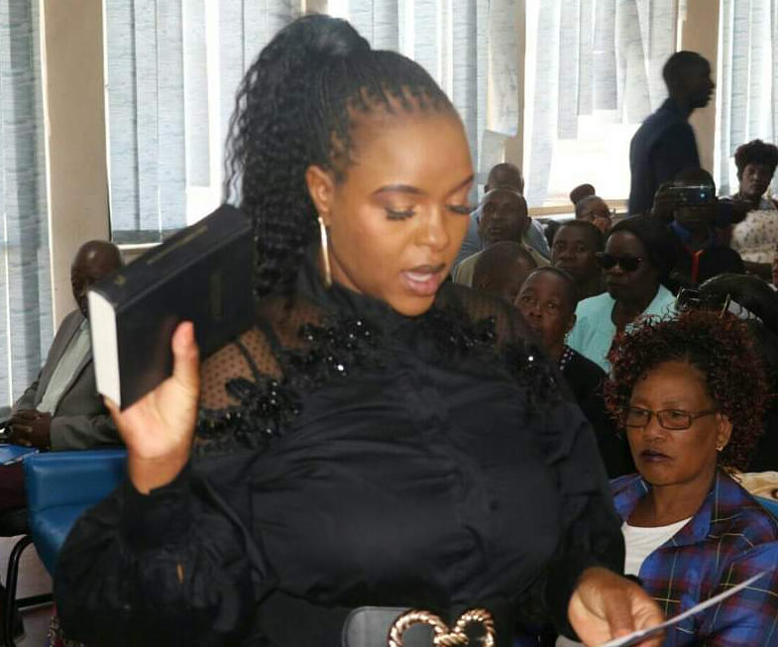
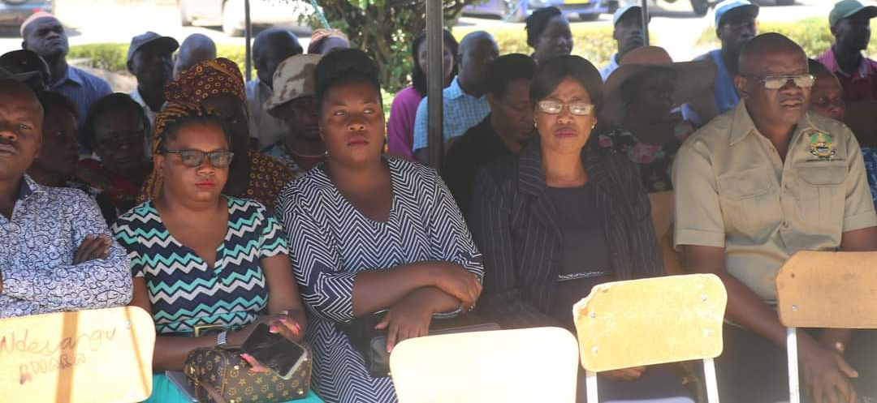
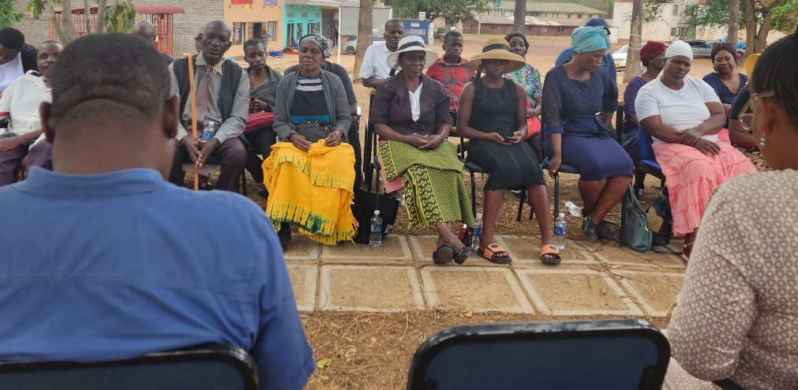
II. GOVERNANCE
50% Proportion of women’s representation in council as councillors. For years Municipality of Redcliff have had an imbalance in terms of gender , however in 2024 there is equal representation in Council. Council also witnessed its first Female Deputy Mayor.
3 (25%) are elected and 3 (25%) are from quota.
Council has 7 committees.
2 committees are chaired by women.
0 committees are chaired by PWD.
Women/ youth/ PWD participate in council consultations and decision-making through participation in public meetings such as feedback meetings, full council meetings, budget consultations, other ward based development meetings, complaints and correspondence. Public gatherings and cleaning campaigns.
MOVING TOWARDS A CITY BY 2030

Slide 6
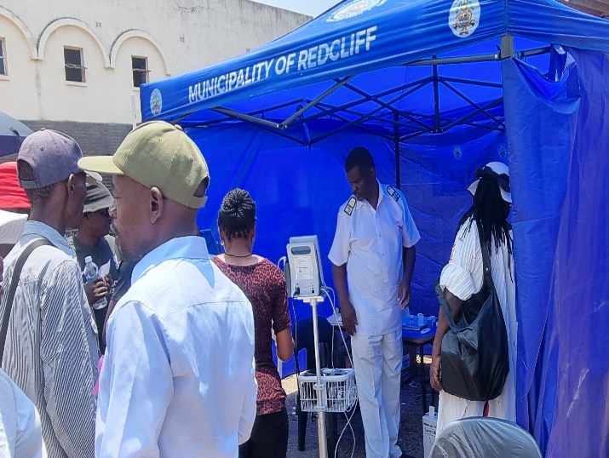
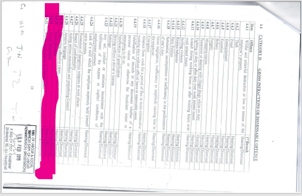
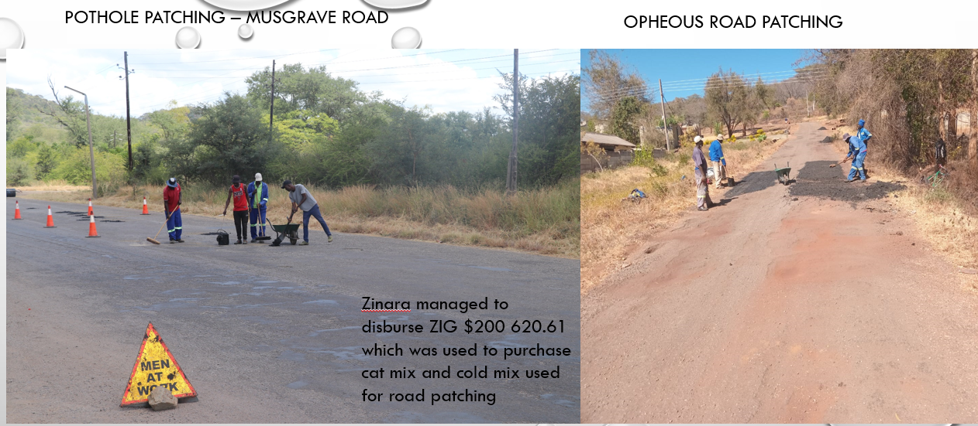
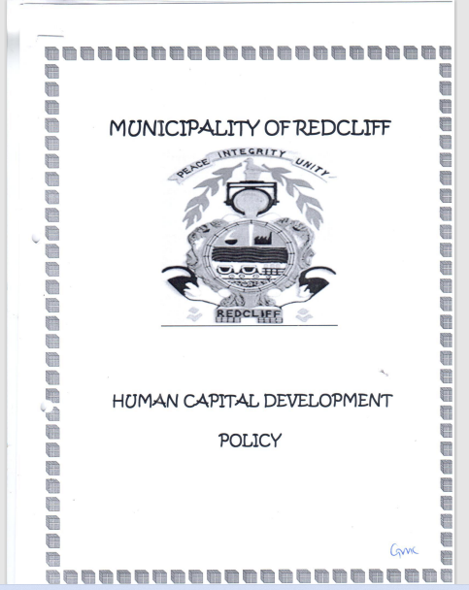
III. WORK PLACE POLICY AND PRACTICE
Municipality of Redcliff has a working environment which is gender sensitive. For example:
  employs women in fields that were traditionally occupied by men. i.e. Director of Finance and in middle management and section head positions e.g. the Senior Environmental Health officer, Civil Engineer, Systems Admin.
  women earn the same salaries as men for the same job status or position.
  equal opportunities and outcomes for women and men, i.e., when applying for a job both qualifying men and women are shortlisted and called for interviews.
  It has clearly labelled Gender sensitive ablution facilities.
34% proportion of the workforce is women.
Council is supporting women in the workplace so they are better placed to work by:
Inclusive recruitment: Use inclusive recruitment practices to attract women to your organization.
Equal Pay: Be transparent about wages to ensure women aren't paid less than men for the same work
Supporting Women’s Advancement Through Education (training and development programs.)
Promotion of women who excel in their works.
Use workplace policies to help parents balance their work and home lives and also making sure Women’s Ideas are heard.
21% of youth and 0.3% PWDs are employed by the council.
The sexual harassment policy is being drafted.
Sexual harassment cases are currently being referred to the code of conduct and its treated as a very serious dismissible offence.
MOVING TOWARDS A CITY BY 2030

Slide 7
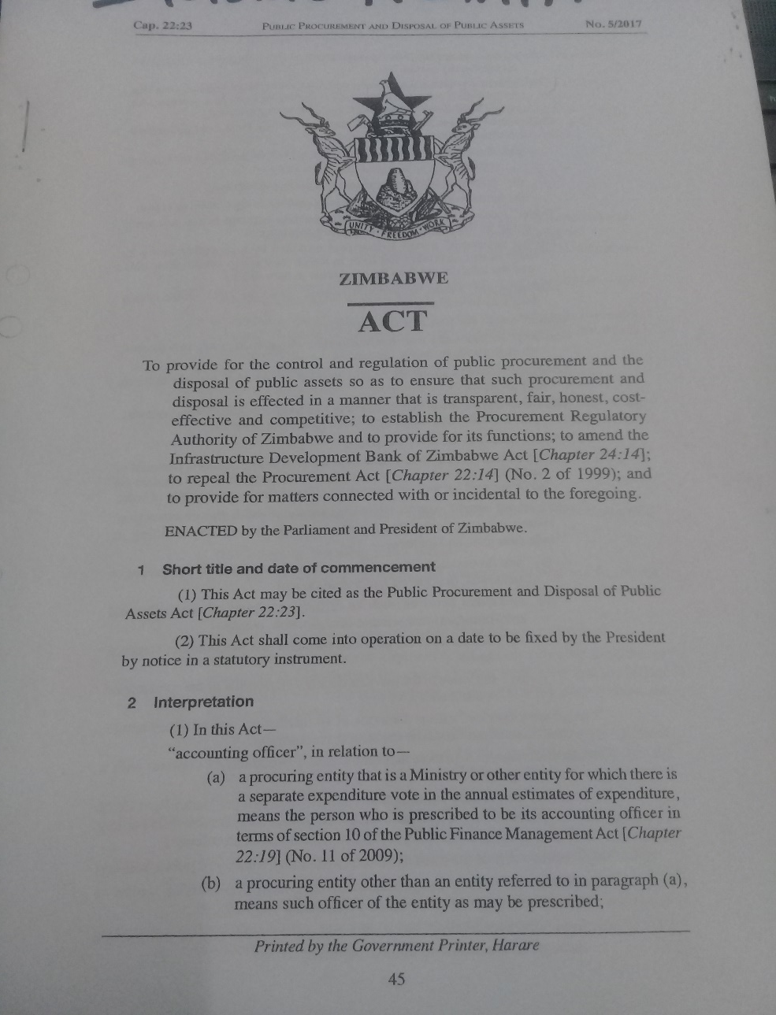
IV. LOCAL ECONOMIC DEVELOPMENT
The Council have local economic development plan or projects that target women, PWD, and youth entrepreneurs.
Market places designed, 5 vegetable markets, 2 flea market stalls and 27.5 %% of stands allocated to women. 70% of vending space occupied by women, 10% men, 15% occupied by youths and 5% by PWD.
with external sources of finance to promote access to finance for local entrepreneurs, especially women, PWD and the youth council offers: Training, Mentorship, Market/business linkages and Participating at tradeshows (local, provincial or national).
Women are considered when tenders are there. However, there were no tenders awarded during the period under review.
Council sometimes allocates tenders to women-owned businesses. Mostly they have small scale businesses such as canteens
MOVING TOWARDS A CITY BY 2030

Slide 8
V. INFRASTRUCTURE AND SOCIAL DEVELOPMENT
Land and housing
Council keeps sex disaggregated data of land allocations for council & community beneficiaries. 290 men were allocated land by the council. 110 women allocated land by the council.
40 housing allocations were made, as council rented houses. 32 men and 8 women were allocated council houses.
Water and sanitation
There is a Work and Planning Committee that deals with Water & Sanitation on a monthly basis.
Types of water and sanitation projects:
  Upgrading of sewer and water reticulation infrastructure.
  Water provision.
  Improving on Customer care platforms.
  Updating Billing.
The projects are gender responsive as consultations are done involving all stakeholders, men & women, youths, PWD.
Improvements of WASH services in all spaces support gender equity. Women and girls are more vulnerable
Provision of water services. Water provision is gender responsive because it considers the different needs, opportunities and roles of women and men in the community.
In partnership with different stakeholders, boreholes are being put in every ward to complement water challenges.
Housing Allocations | Number | Proportion (%)
Women | 8 | 20
Men | 32 | 80
Total | 40 | 100
.
Water Committees | Number | Chairpersons of Water Committees | Vice Chairpersons of water committees
Women | 1 | 0 | 0
Men | 5 | 1 | 1
Total | 6 | 1 | 1

Slide 9
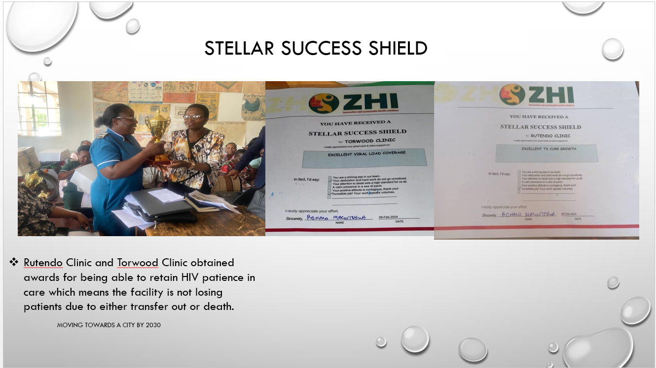
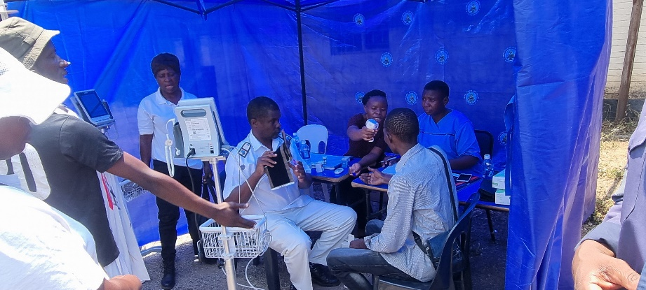
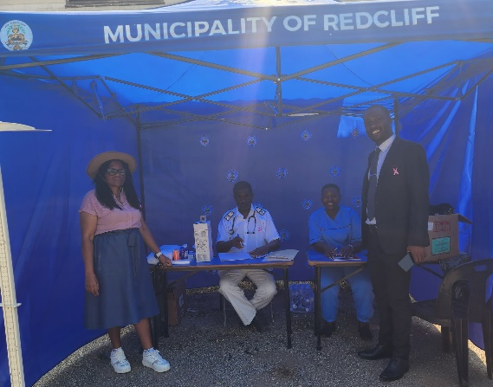
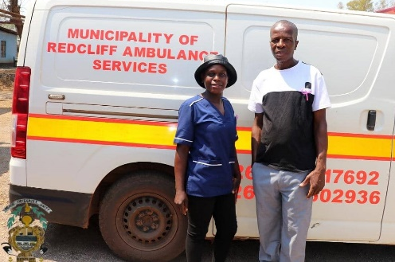
VI. SEXUAL AND REPRODUCTIVE HEALTH, HIV AND AIDS
Council promote SRHR by making sure that men, Women, youths, PWD have access health care services. Awareness campaigns on SRHR, HIV and AIDS.
Council also provides testing services for HIV and AIDS at the clinics as well as providing free counselling services.
The youth are also educated at the clinics about SRHR as they visit the clinics, youth friendly corners are available.
Yes women, men, people living with disability, and youth have equal access to treatment.
Council has ensured that health/SRHR facilities are more accessible to these groups by:
  Reduced distance to the health facilities - having 3 clinics, 1 hospital available which offer the services.
  A resident Doctor is available
  Counselling, and treatment services available.
  ANC & PNC is provided to young women and also, Well trained mid-wives available.
Council encourage or support Comprehensive Sexual Education (CSE) in schools by having School health programmes and mobile clinics with the health staff educating children in schools and respective wards. Also, by receiving comprehensive sexuality education in all health facilities.

Slide 10
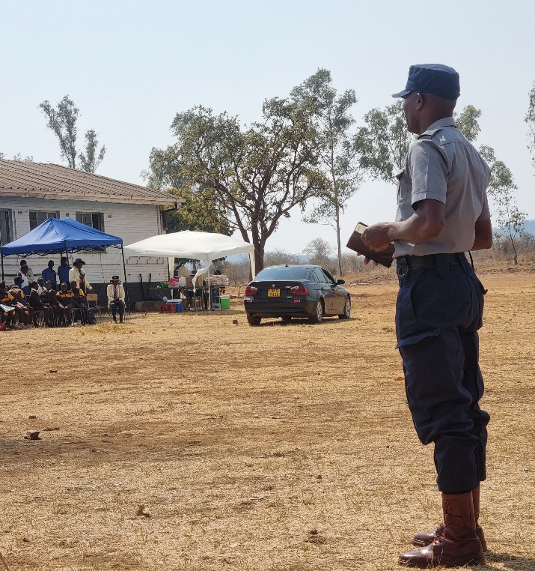
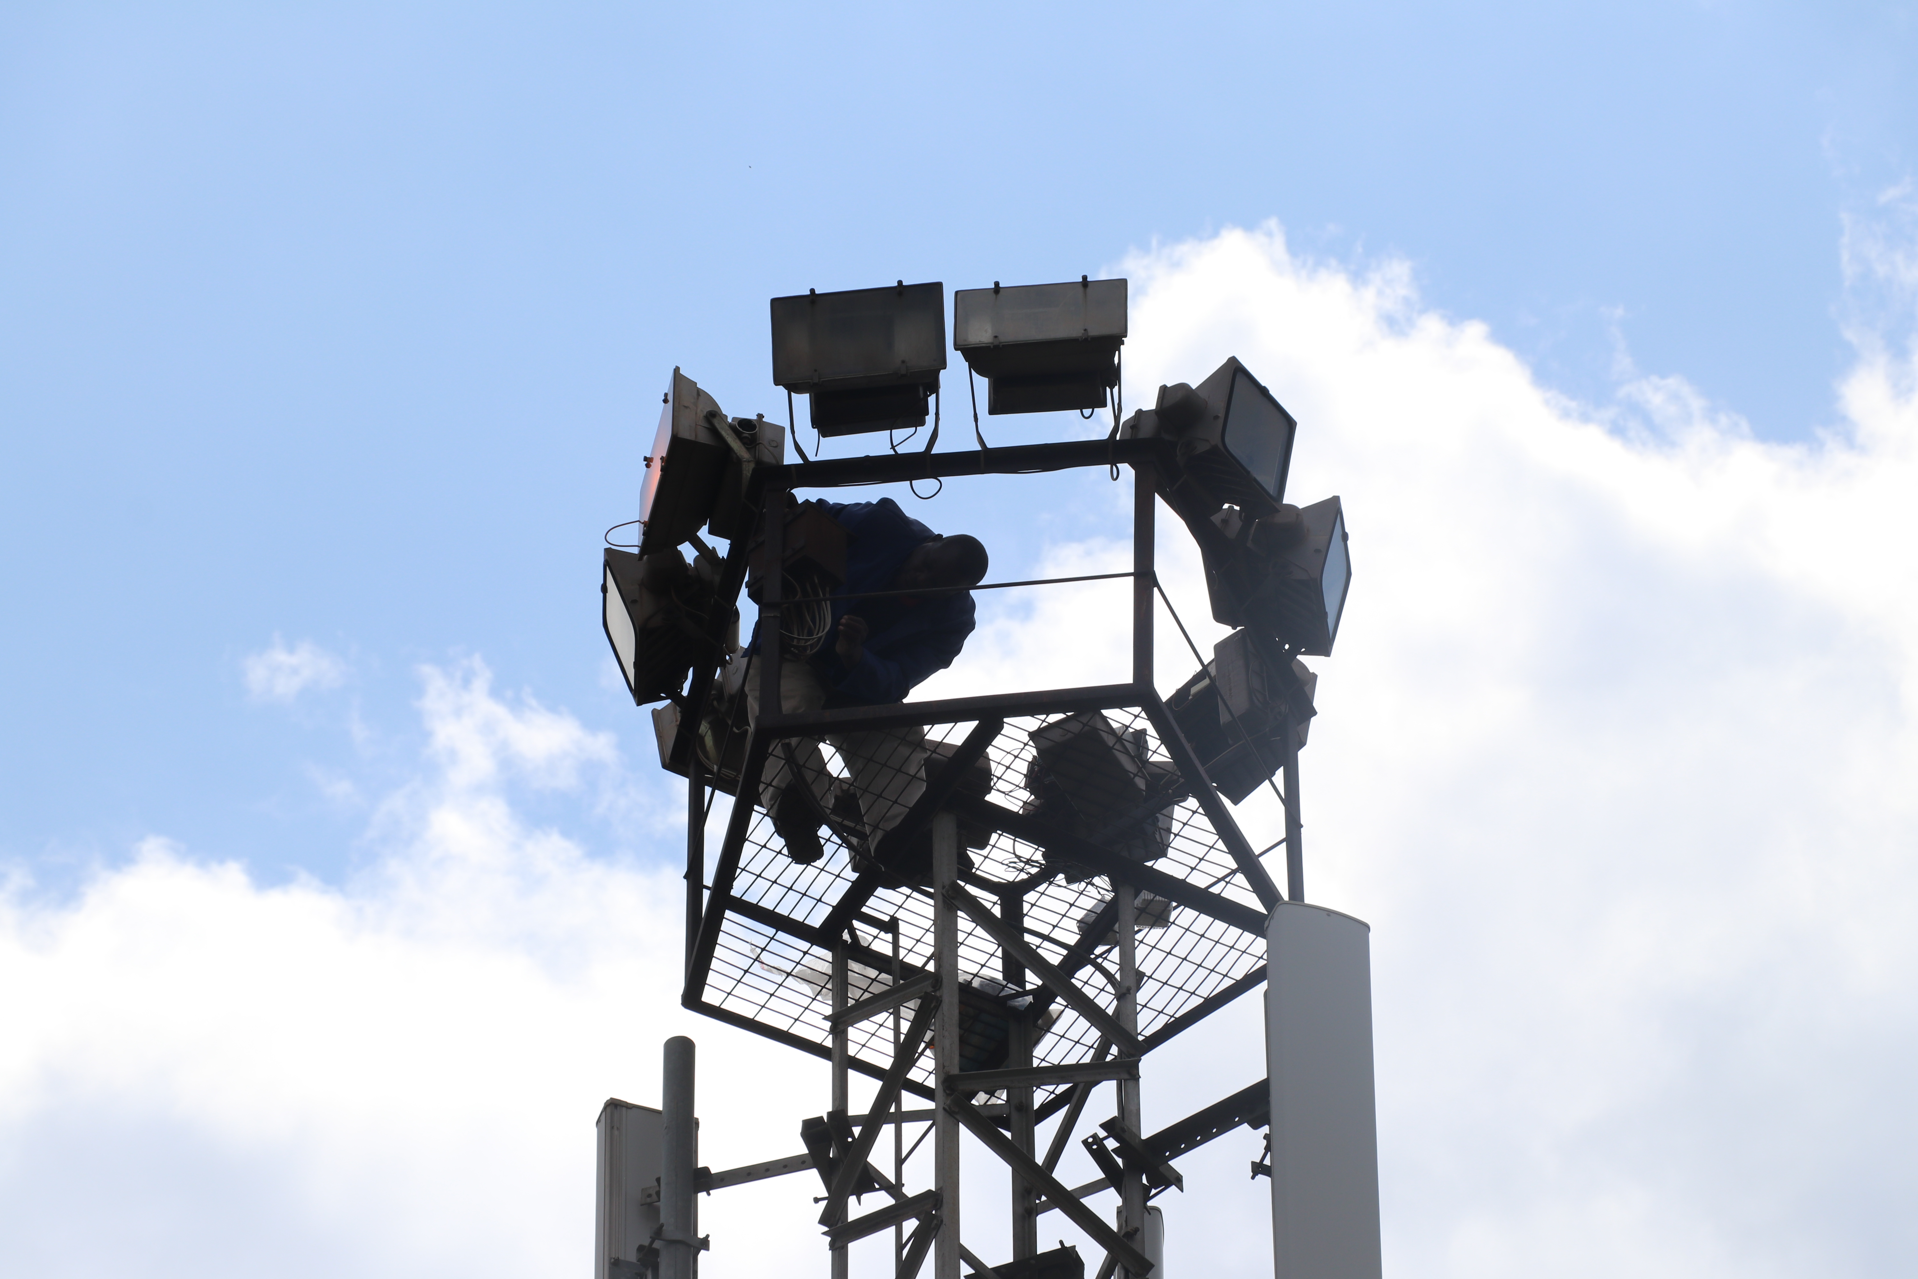
VII. GENDER BASED VIOLENCE
List key actions council has taken towards:
Prevention: There is sufficient lighting (electrical & solar) are available on the streets and also Tower lights are also available in each and every ward in public spaces; streets are named, and some are named after women.
Public awareness:
  Council has commemorated the day of the African Child, the 16 Days of Activism campaign as a District.
  Consultative Meetings with district stakeholders. Policy dialogues e.g. with youths.
  Awareness campaigns, where the VFU raise about GBV. Trainings conducted and Capacity building on survivors.
Response and coordination:
  There is a District One stop centre assisting victims.
  Victim Friendly Unit to deal with GBV at the Police Station
  They are well equipped male, and female officers are available that assist victims.
  Council provide treatment and counselling on its clinics and also do follow ups on reported cases.
Support and empowerment :
  Support and counselling and treatment services are provided to the survivors of GBV by council at our clinics
  Encourage adoption of GBV victims by families-
  Community are empowered through training on GBV. Workshop training sessions allow participants to examine ways to empower women against GBV.

Slide 11
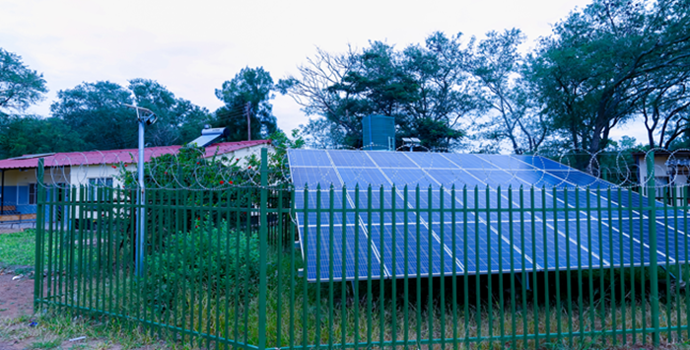
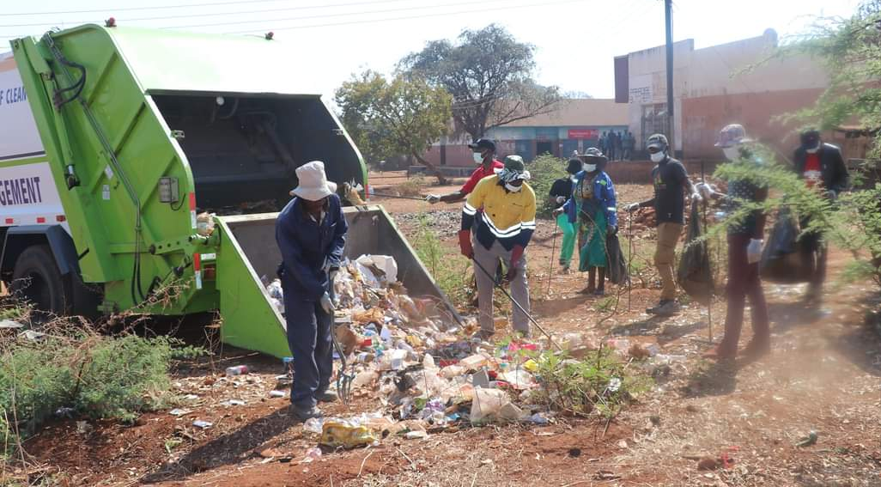
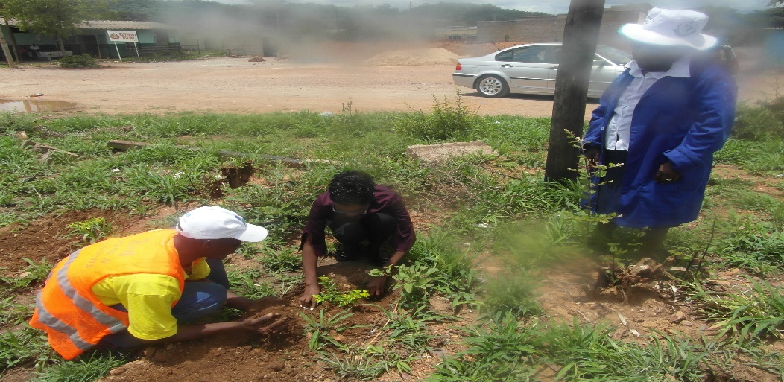
VIII. CLIMATE JUSTICE
Council doesn’t have a climate change policy.
Women, PWD, and youth are equally involved in projects that prevent climate change such as waste management, sustainable energy and recycling. For example they participate in Solid waste segregation for recycling (community based), Clean up campaigns that are being held by the Council.
Council adapted or mitigated against climate change:
  Solar Energy - Use of solar energies as power backup for example solar installed at the 3 clinics and now installing at centres.
  Solid waste segregation for recycling (community based)
  Reforestation
  Clean-up Campaigns

Slide 12
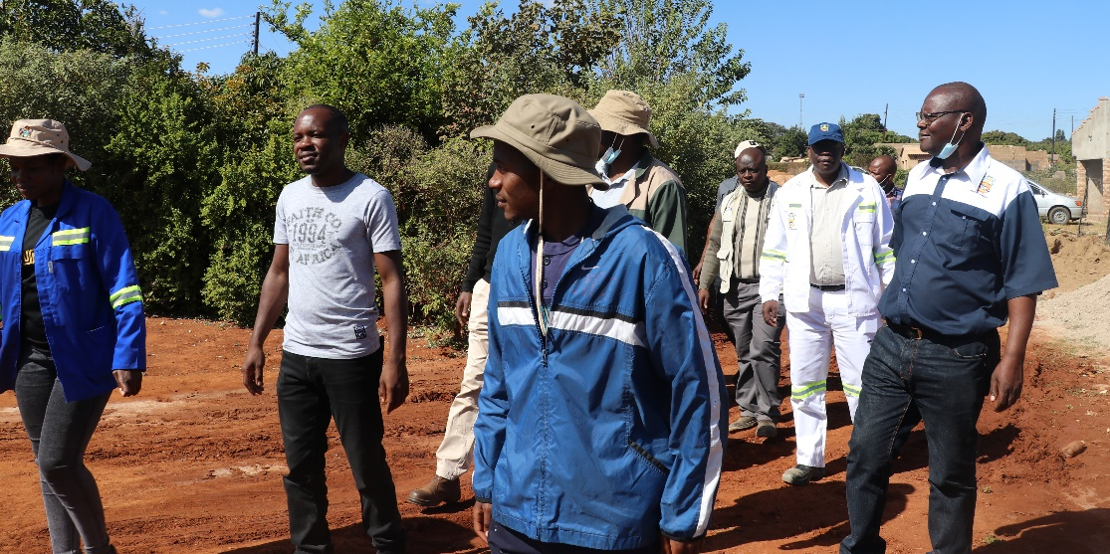
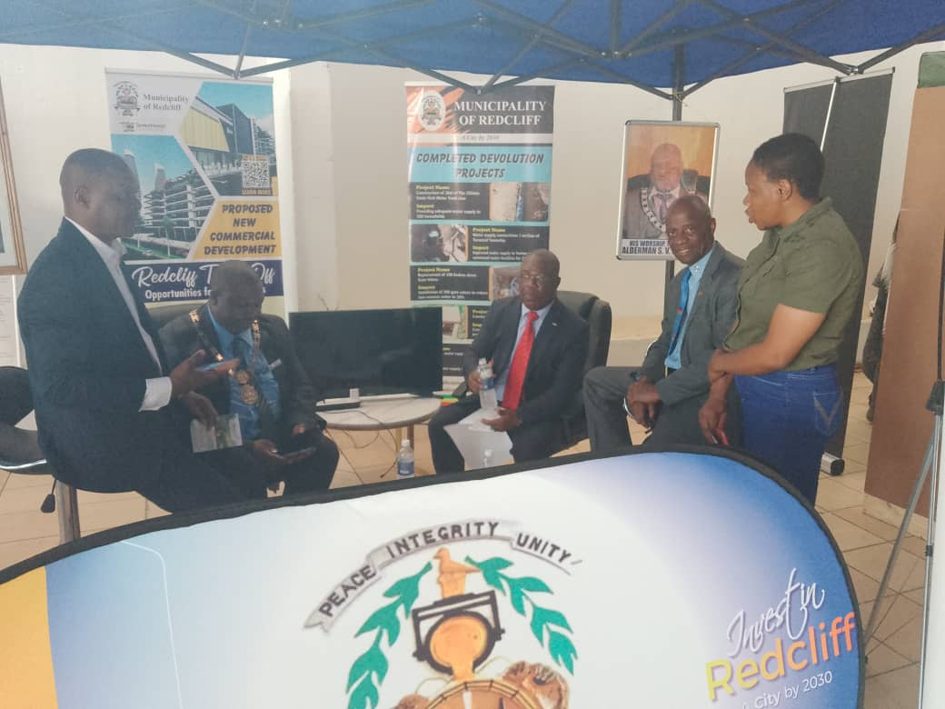
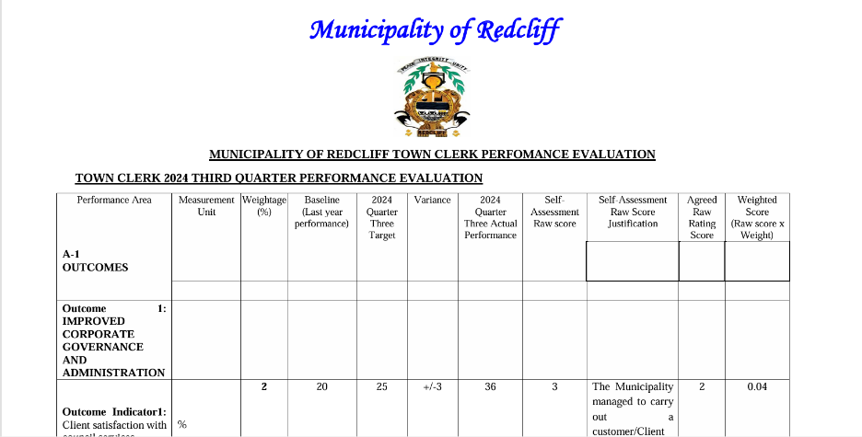
IX. GENDER MANAGEMENT SYSTEM
Gender structures exist in council- e.g. Gender focal person, a departmental GFPs, gender committee has recently been set consisting of policy makers, gender champion.
Yes the council’s Gender Action Plan aligned to the Council’s strategic plan. The projects in the Strategic plan are gender responsive.
The Town Clerk's as well as HOD's performance contract has gender mainstreaming key functionaries written.
Monitoring and Evaluation is done through quarterly performance appraisals and reports, exhibitions.
Council gender sensitive and responsive budgeting and Action Plans are used for monitoring.
The strategic plan is used for monitoring as well.
The performance contract of the Town Clerk is another monitoring tool as well.

Slide 13
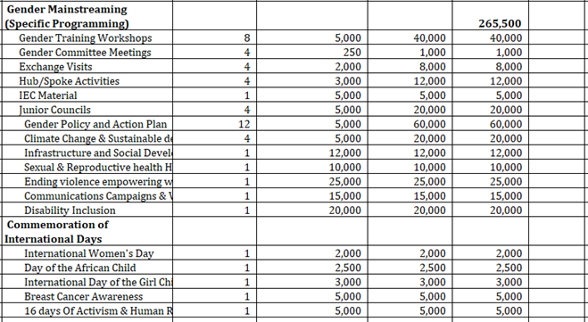
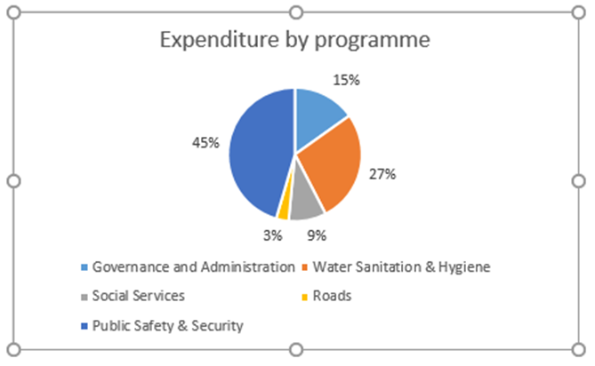
X. GENDER RESPONSIVE BUDGETING
Yes, the Council submitted an entry in the GRB category.
The Council is drawing up a Gender Responsive Budget statement as per Ministry Guidelines.
Council has budgeted for Gender mainstreaming activities and projects – including gender specific and all mainstream projects.
Employment equity has also been included in the budget, looking at, capacity building, internships and staff development for all women, men and youth, PWD.

Slide 14
CHALLENGES
Ignorance from other counterparts: managed through gender awareness campaigns and positive response can be noted.
Poor local participation: managed through gender awareness campaigns and positive response.
Financial constrains to do some activities pertaining to gender specific programmes and also to hold the hub and spoke meetings, look and learns: Council has budgeted for all the activities to be done in the following budget year.

Slide 15
LESSON LEARNED AND INNOVATION
Gender mainstreaming is a cross cutting issue in every council section.
With the COEs, hub and spoke, we have learnt to adopt laws and/or policies that require equitable representation of women on decision-making bodies.
Council now have sex disaggregated data, gender issues are now being considered in the budgeting process, housing allocations, provision of market stall and in the recruitment process.
These COEs actively increased female participation in local government especially in areas which were believed to be male areas only.

Slide 16
SUSTAINABILITY AND REPLICATION
COE, hub and spoke work can be sustained in Council by engaging all stakeholders and representatives from all the Council Departments, from Councilors and all other stakeholders.
COE work can be shared to other local authorities through exchange visits and sharing of best practices. Council can encourage other local authorities to join the Centre of Excellence as well as other projects that are available in gender mainstreaming.
Council can share ideas on COE when during workshops and trainings as well as hub and spoke meetings.

