Slide 1

PRESENTATION FOR
THE WONDERS SOLE TRADER
PARTICIPANT NAME
BEAUTY MURERA
COUNCIL
NORTON TOWN COUNCIL

Slide 2
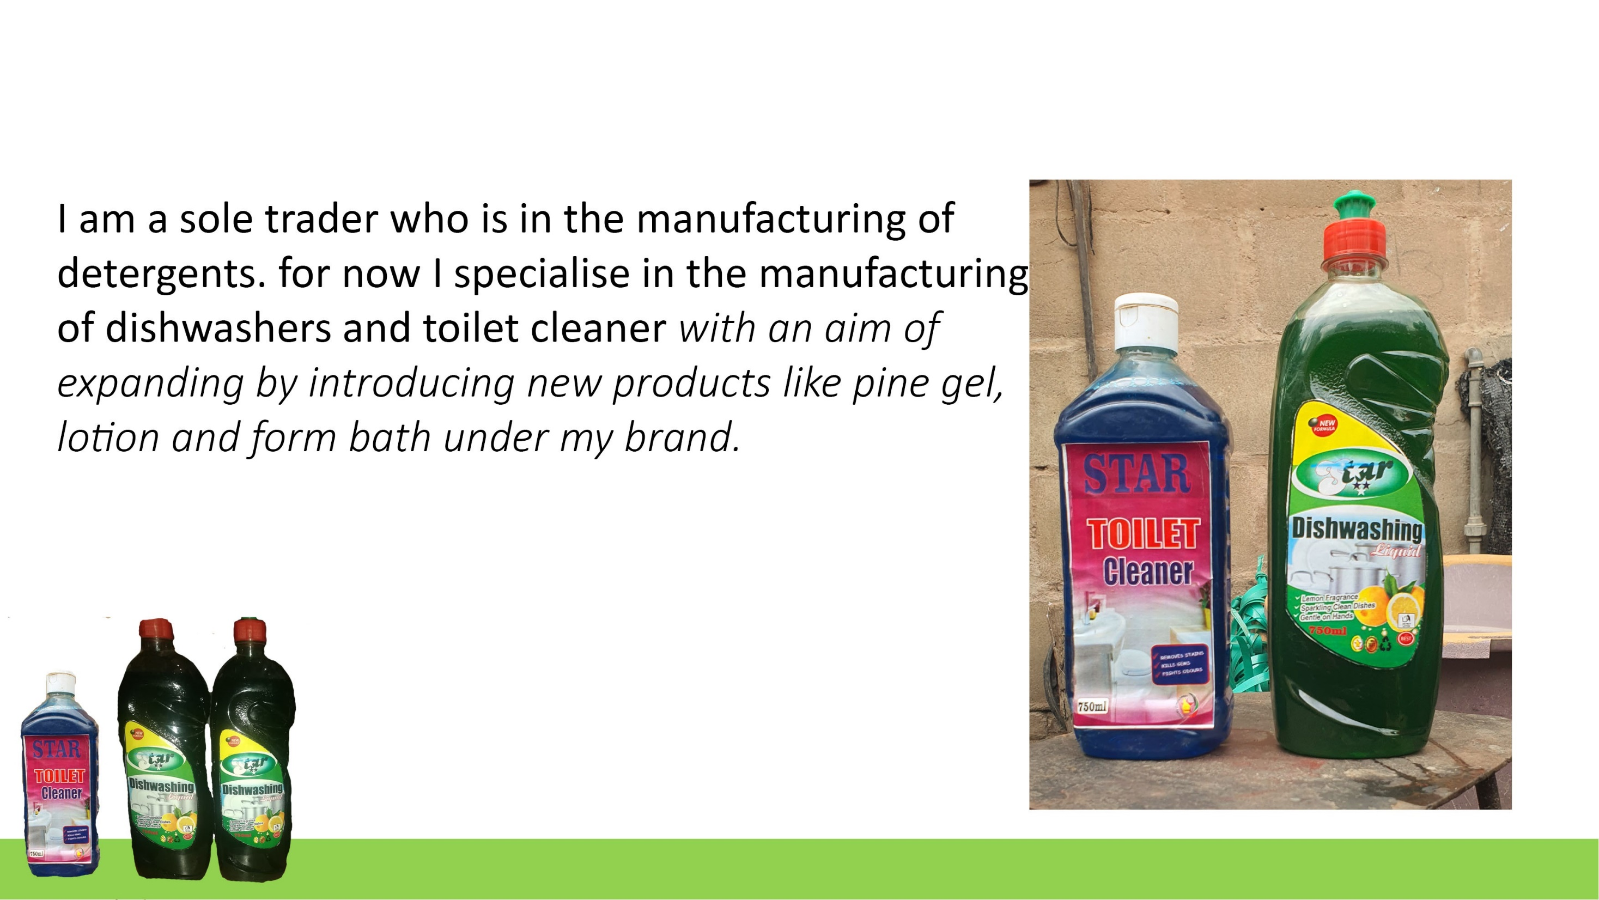

Slide 3
3
I supply my products to the local markets by means of wholesale ( to mini shops) and retail (which is door to door and online sales via social platforms). My customers are mainly local for now.
I have increased the number of customers significantly since I started the program.
I have managed to do so by advancing my advertising skills online (joining many local whatsapp groups), making fliers and giving out promotions.

Slide 4
4
My competition is mainly from bigger manufacturing firms and also some individuals who are venturing in the business.
I handle my competition by providing affordable pricing, door to door supplies and promotions (like buy 2 and get 1 free)
I also do deliveries to my customers who are close by so as to ensure good customer relations.
More so, I offer credit sales to my reliable regular customers.

Slide 5
5. For now I do not have new products on the market, but I am thinking of launching three more products which are lotions, pine gel and foam bath.

Slide 6
My customers are happy with the quality of my products.
This is evidenced by my increased sales and I have had a positive feedback from my customers.
I have branded my products so that they can be easily identified on the market.
I have increased my marketing skills through the use of internet as highlighted on slide 3 point (c)

Slide 7
I hire 2 party time workers to help with the manufacturing.
I manage my stock by doing the packaging myself so as to avoid losses through spillages and keep records of my production.
I have priced my products better so as to ensure that its convenient to both me(to earn surplus) and the customers (to be affordable)
This I achieve by bulk buying so that I earn discounts which reduces my cost of production.

Slide 8
I record my sales and productions in books
This has helped to keep track of my production numbers, my sales and customers who I sell to on credit.
For now I do not have a bank account for my business

Slide 9
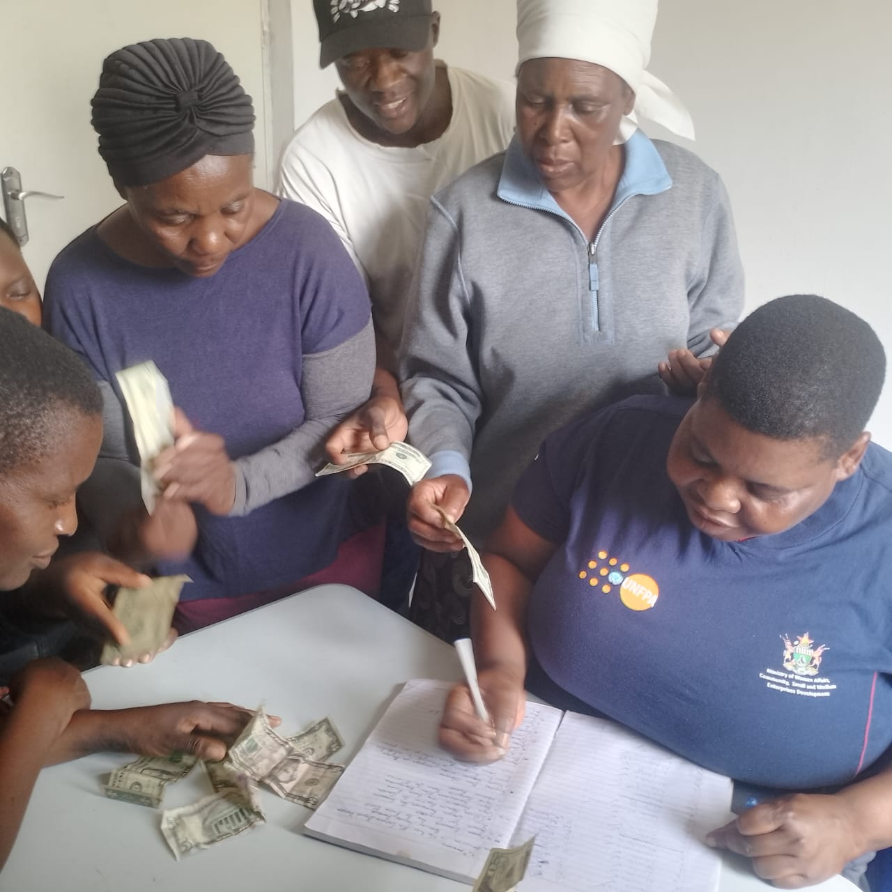

I am a member of several savings groups
I have been able to save over $300 through the savings groups.
This has helped to increase my house hold income and ease pressure on my business income.

Slide 10
INCOME AND EXPENSES FOR THE PAST SIX MONTHS
INCOME
ITEM | AMOUNT
DISHWASHER 100 LITRES (@ $/LITRE) x 6 MONTHS | $ 600
TOILET CLEANER 100 LITRES (@ $/LITRE) x 6 MONTHS | $ 600
TOTAL | $ 1 200
EXPENSES
ITEM | AMOUNT
CHEMICALS | $ 330
PACKAGING | $ 90
BRANDING | $ 48
WAGES | $ 240
TOTAL | $ 708

Slide 11
INCOME FOR THE NEXT 6 MONTHS
ITEM | AMOUNT
DISHWASHER 200 LITRES (@ $/LITRE) | $ 1 200
TOILET CLEANER 200 LITRES (@ $/LITRE) | $ 1 200
FOAM BATH 100 LITRES (@ $1.50/LITRE) | $ 900
PINE GEL 50 LITRES (@$2/LITRE) | $ 600
LOTION 30 LIRES (@ $3/LITRE) | $ 540
TOTAL | $ 4 440
EXPENSES FOR THE NEXT 6 MONTHS
ITEM | AMOUNT
CHEMICALS | $ 1 065
BRANDING | $ 200
PACKAGING | $ 350
WAGES | $ 240
TOTALS | $ 1 855

Slide 12
TO GROW MY BUSINESS, I AM PLANNING TO INTRODUCE NEW PRODUCTS UNDER MY BRANDING.
  THESE PRODUCTS INCLUDE; LOTIONS, PINE GEL AND FOAM BATH.
  MORESO, I AM LOOKING TO EXTEND MY MARKET BEYOND MY TOWN, TO NATIONALISE THE BRAND. I WILL DO SO BY ENGAGING BIG RETAILERS IN THE COUNTRY.

Slide 13
THE MAIN CHALLENGES I HAVE FACED IN MY BUSINESS IS COMPETION FROM BOTH BIG MANUFACTURES AND INDIVIDUALS WHO ARE ALSO MANUFACTURING DETERGENTS.
I HAVE ADDRESSED THIS CHALLENGE BY;
LOWERING MY PRICES ENSURING AFFORDABILITY
INTRODUSING PROMOTIONS (buy 2 get 1 free)
OFFERING CREDITS TO LOYAL CUSTOMERS
DOOR TO DOOR SALES AND DELIVERIES

Slide 14
I will sustain my business by making sure that there will be consistent supply of my products in the market and also making sure that my products are affordable on the market.
Also, I will engage my customers for feed backs so that I can improve the quality of my products.
To ensure continual sustainability of my business I will also introduce other product lines (pine gel, lotion and foam bath) as mentioned on slide 5 and slide 13.

Slide 15
The changes I have experienced in my business include ;
Handling competitions through price adjustments
Introducing delivery
Engaging other markets like small retailers.
I am looking forward to exploring other business plans like mushroom farming. This will be a backyard project which I expect to have high income yield.

