Slide 1




SADC PROTOCOL@WORK SUMMITS AND AWARDS
2024
GENDER RESPONSIVE BUDGETING Template
(Zimbabwe, Chikomba RDC, November 2024 and Chari K.B.)

Slide 2
OVERVIEW
COUNTRY | ZIMBABWE
COUNCIL (HUB/SPOKE) | SPOKE
GENDER CHAMPION | FLORENCE MUDZAMIRI
GENDER FOCAL PERSON | NYARADZAI CHISHUMBA
Latest score (year) | N/A
 | Income | Expenditure | % Gender Specific
Budget (YEAR)
 | Women | Men | Total | % Women
Council | 12 | 27 | 39 | 30
Management | 0 | 7 | 7 | 0
Council staff overall | 26 | 61 | 87 | 26
Population served | 120 248
Key characteristics

Slide 3
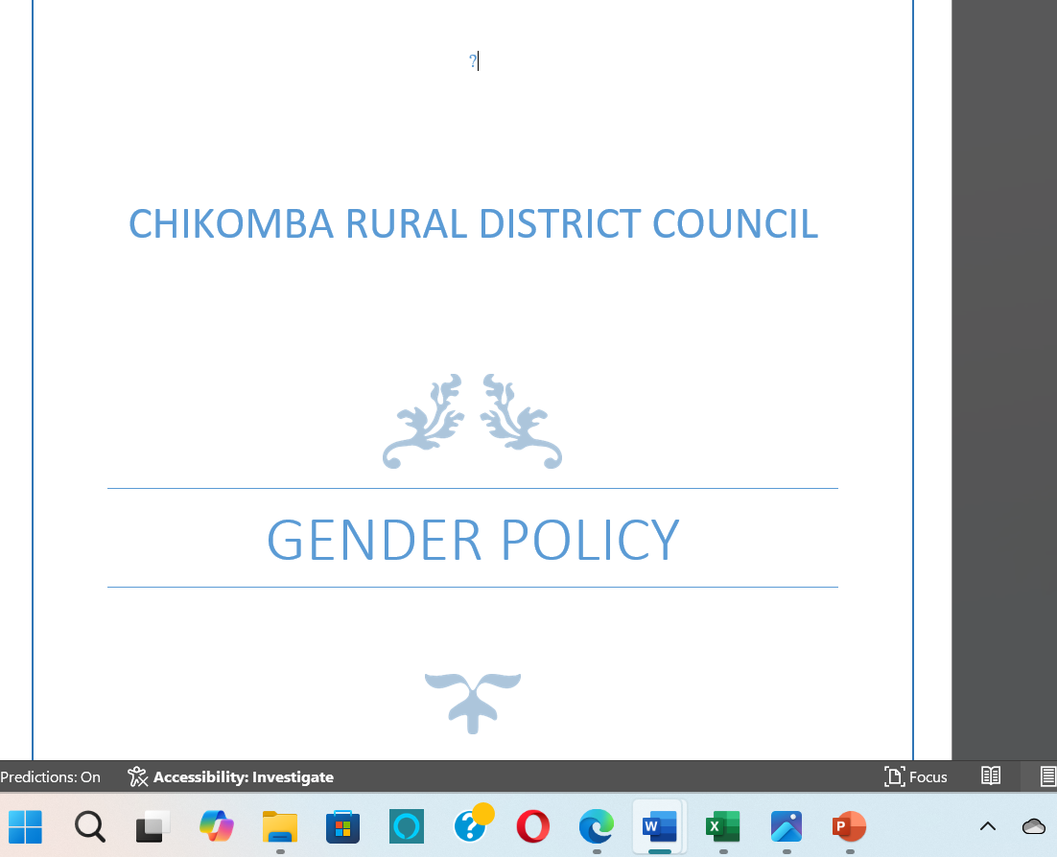
  I. POLICY FRAMEWORK
Council is guided by National Gender Policy, Constitution of Zimbabwe, National Development Strategy 1, SADC Protocol on Gender, Council Gender Policy and Development CEDAW SDGs.
Does the council have a gender policy and does it address issues on gender budgeting?- Yes it does
Photo of the Gender Policy

Slide 4
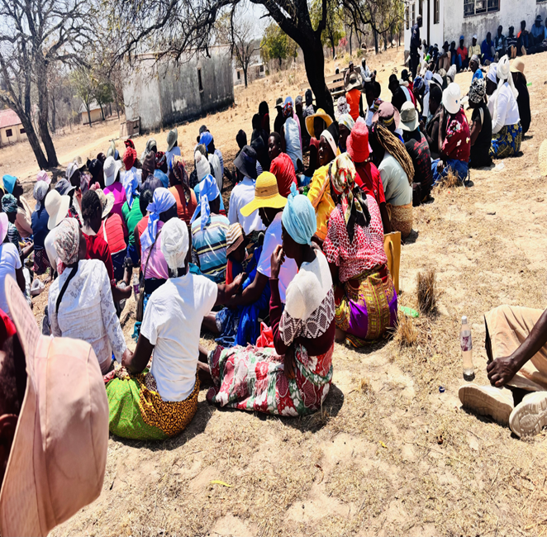
II. THE BUDGET PROCESS
Detail
Evidence
How did the council integrate gender and inclusion in budget planning? Consultations
How did the council integrate gender and inclusion into budget consultations?– Council carried out physical budget consultation with various groups including PWD, business communities, informal traders e.t.c
How did the council ensure that the budget consultation process was inclusive i.e., “no one is left behind”, e.g., that every resident including the hearing and visually impaired knew about meetings. Please cite all methods used. Coummunication was done through local leadership and through public notices
Photos or video of budget consultation

Slide 5
II. THE BUDGET PROCESS
Times and venues for consultation were given by the Ward Councillors and usually the meetings would start at 0900hrs and women , youths and PWD would participate
Did the council make use of technology to broaden your reach? How? Use of facebook to give updates to those who are abroad and they also give their areas of improvement to Council via that platform

Slide 6
II. THE BUDGET PROCESS
Does the council have sex/age/PLWD statistics on those who participated in the consultations? – refer to consultation registers and populate table below
Consultation | Women |  |  |  |  | Total | Men |  |  |  |  | Total | % Women
 | Age |  |  |  |  |  | Age
 | - 15 | 15-35 | 36-59 | 60+ | PWD |  | - 15 | 15-35 | 36-59 | 60+ | PWD
% |  |  |  |  |  | 100% |  |  |  |  |  | 100%

Slide 7
III. REVENUE
What is the break down between internal and external sources of funding? Internal 64% 7 082 765
External 35% 3 732 802
The needs of the people coming from budget consultation were addressing gender needs and budget consolidation was based on the consultations
The decisions were influenced by budget consultations, in particular the views of women in the sense that the projects budgeted for are for people and are identified by those same people
The external financing does specifically target gender but focus on service delivery and most of service delivery initiatives address gender mainstreaming such as construction of school and clinics, grading of roads etc

Slide 8
IV. EXPENDITURE
Analyze the council budget and categorise expenditure into Gender Management System $4080; Salaries $9150; employment equity-related expenditure $11 692; gender-specific programmes $1740 and mainstream programmes $76 374.
What proportion (%) does each constitute?
Insert Pie Chart/Table

Slide 9
IV. EXPENDITURE
Type of Expenditure | Amount | Proportion (%)
Gender Management System (GMS) | 4080 | 4
Employment expenditure (Human Capital Expenditure) | 9150 | 9
Employment equity related expenditure | 11 692 | 11
Gender Specific Programming | 1740 | 2
Mainstream Programmes | 76 374 | 74
Other
Total | 103 036

Slide 10
IV. EXPENDITURE- GMS
Does the council have a Gender Management System? Yes, it does have a Gender Committee, Gender Focal Person, Gender Champion
Are GMS activities budgeted for ? (E.g., Committee meetings, Hub/ spoke activities, exhibitions, Training, Policy formulation, Exchange visits, Office equipment and stationery, other activities? – the activities are budgeted for under the Gender committee budget
Gender committee has its own budget

Slide 11
IV. Gender Specific expenditure
What gender-specific programmes does the council have? -Pro-gender campaigns, support and monitoring, exchange visits, hub and spoke activities, committee meetings, revolving funds, community gardens
Where are these budget lines found? Are they visible? In the Gender committee budget and they are visible
What proportion of the council budget is allocated for gender-specific programming? 0.5 % of the total budget
How were these programmes/ projects informed by budget consultations? They came from feedback meetings where drug abuse reports and GBV reports were too high9
How are the gender-specific projects helping to promote gender equality and women’s empowerment?- These initiatives often enhance women's leadership abilities, enabling them to take on decision-making roles in their communities.
How do you measure the expenditure on gender-specific programmes (outputs, outcomes and impact)? These are measured through number of workshops, programs and meetings held, changes occurred as a result of programs held and the effects of the programms

Slide 12
IV. EMPLOYMENT EXPENDITURE
 | Women |  |  | Men |  |  | Total | % women
 | Managers | Staff | Total | Managers | Staff | Total |  | Managers | Staff | Total
Full Time | 0 | 19 | 19 | 7 | 43 | 50 | 69 | 0 | 38 | 38
Part time | 0 | 1 | 1 | 0 | 0 | 0 | 0 | 0 | 1 | 1
Casual | 0 | 6 | 6 | 0 | 11 | 11 | 17 | 0 | 35 | 35
Total | 0 | 26 | 26 | 0 | 61 | 61 | 76 | 0 | 26 | 26
What proportion of the work force do women comprise overall?
What is the percentage of women in management?
What percentage do women comprise of the full-time, part-time and casual, labour force?
Recruitment is based on qualifications and performance

Slide 13
IV. EMPLOYMENT EXPENDITURE- Gender Wage Gap Analysis
 | Women | Women- Total earned | Women average earned | Men-no | Men total earned | Average earnings
Full Time | A | 213,406,328 | 6,466,858.42 | 60 | 555,023,062 | 9,250,384.37
Part Time | E |  | 0 | 5 | 45,098,216 | 9,019,643.2
Casual | H | 0 | 0 | 0 | 0 | 0
Total | A+E+H=X | 213,406,328 | 6,466,858.42 | 65 | 600,121,278 | 9,232,635.05
What is the gender wage gap?= (Average earnings of Men - Average earnings of Women)/ Average earnings of Women
What does the wage gap reflect with regard to 1) the different levels occupied by women and men in the Council 2) the different types of work that they do?
What plans does the Council have in place to close the gender wage gap?

Slide 14
V. EXPENDITURE- GENDER IN MAINSTREAM BUDGET
Programmes | Amount | % budget
Governance & Administration | 1731594,75 | 28
Water Sanitation & Hygiene | 916072.5 | 14
Social Services | 1608337.5 | 26
Roads | 3498839.19 | 57
Public Safety & Security | 114150 | 2
Natural Resources & Conservation | 37500 | 1
Total | 6 174 899
Draw Pie chart here

Slide 15
V. EXPENDITURE- ANALYSIS OF ONE SECTOR EG
 | Women |  |  |  |  |  | Men
 | Age |  |  |  |  |  | Age
 | Below 15 | 15-35 | 36-59 | 60+ | PLWD | Total | Below 15 | 15-35 | 36-59 | 60+ | PLWD | Total
Education | 500 | 200 | 30 |  | 10 | 740 | 600 | 150 | 15 | - | 7 | 772
Housing | 50 | 200 | 150 | 80 | 5 | 585 | 65 | 450 | 100 | - | 3 | 618
Social amenities | 300 | 600 | 450 | 50 | 15 | 1415 | 350 | 650 | 500 | - | 20 | 1500
Total | 850 | 1000 | 680 | 130 | 30 | 1790 | 915 | 1250 | 615 | - | 30 | 2890

Slide 16
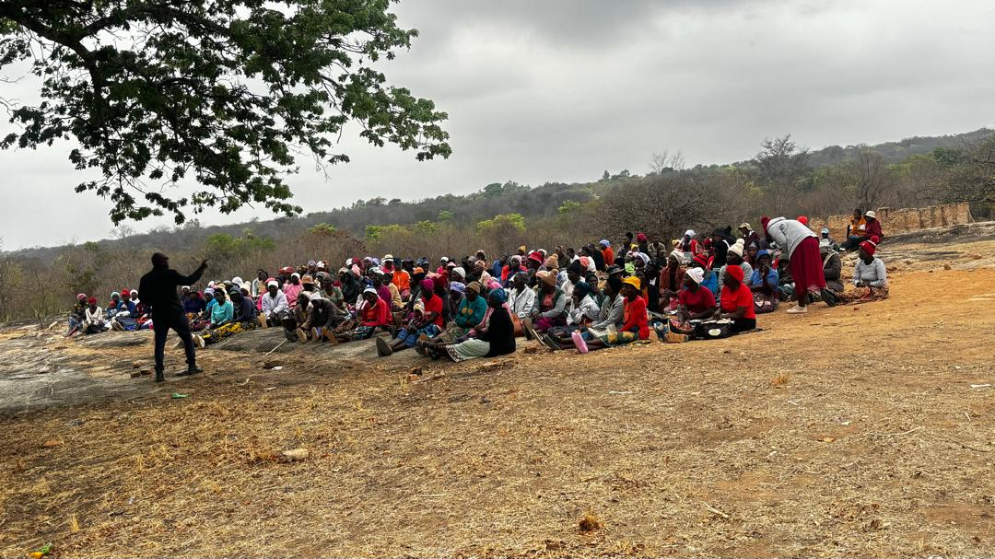
V. EXPENDITURE- GENDER IN MAINSTREAM BUDGET
Please explain how you are ensuring that women and men, boys and girls benefit equally, or that disparities are challenged through GRB
- Involve Diverse Voices: Engage women, men, boys, and girls from various backgrounds in the budgeting process. This can be done through public consultations, focus groups, and surveys to ensure that their perspectives and needs are considered.
PHOTO

Slide 17
V. EXPENDITURE- GENDER IN MAINSTREAM BUDGET – EXAMPLE
 | Amount | No of beneficiaries | Percentage
Total Expenditure | 636,355,476.00
No. of Men benefiting from council allocations | 618 | 618 | 51.3%
No. of Women benefiting from council allocations | 585 | 585 | 48,6%
Total beneficiaries |  |  | 100%

Slide 18
VI. BUDGET CROSS SUBSIDISATION ANALYSIS
 | Income (A) | % of total budget | Expenditure (B) | % of total budget | Surplus/Deficit
Governance & Administration | 2 008 649.91 |  | 2 068 738.4
Water, Sanitation & Hygiene | 964 929.7 |  | 614 506.67
Social Services | 1 779 893,5 |  | 2 654 985.33
Roads | 3 778 746, 3 |  | 3 535 472.93
Public Safety and Security | 91 320 |  | 113 711.92
Natural Resources & Conservation Mgt | 210 323.75 |  | 171 738.08
Total |  |  | 9 159 153.33

Slide 19
VI. BUDGET CROSS SUBSIDISATION ANALYSIS
Which programmes generate more income than expenditure? WASH & Natural Resources
Which programmes spend more than they generate (i.e. they are being subsidised). Specify nature of activities being subsidised and funding source. Roads & Governance
Are there any policies to support or guide cross-subsidization? PFM Act
How have gender considerations influenced the cross-subsidisation of services? N/A
What percentage of allocations have been influenced by gender considerations? 60%

Slide 20
VII. CONCLUSIONS AND NEXT STEPS
To what extent has the council budget contributed to gender equality and women’s empowerment?-
- 70% of the budget is service delivery which include gender mainstreaming activities which leads to gender equality
What are the next steps regards gender budgeting for the council? -Document and share successful gender budgeting initiatives and outcomes to encourage further commitment and action.

