Slide 1
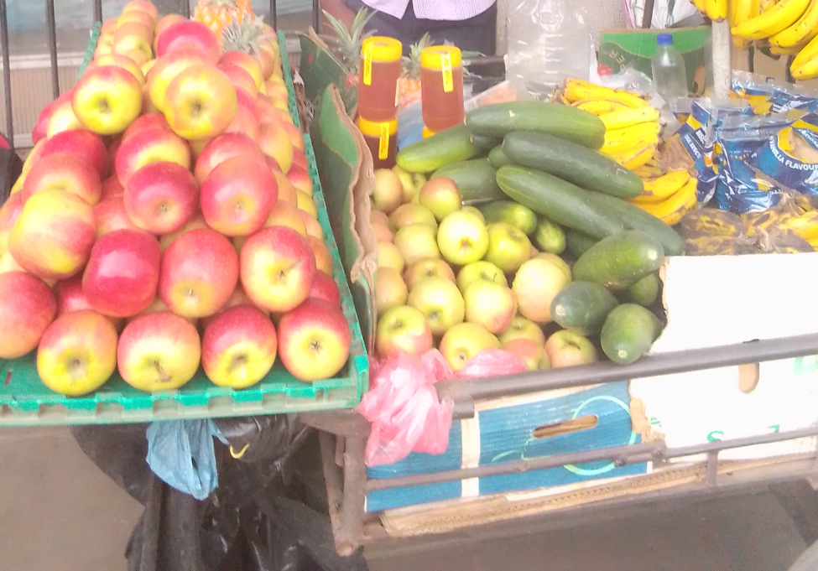




PROMOTING GENDER-INCLUSIVEE LOCAL ECONOMIC DEVELOPMENT IN ZIMBABWE
Business name Donjane Fruit and vegetables
Participant name George Ntini
Council Zibagwe Rural District Council (ZRDC)
Please include photographs of the business!

Slide 2
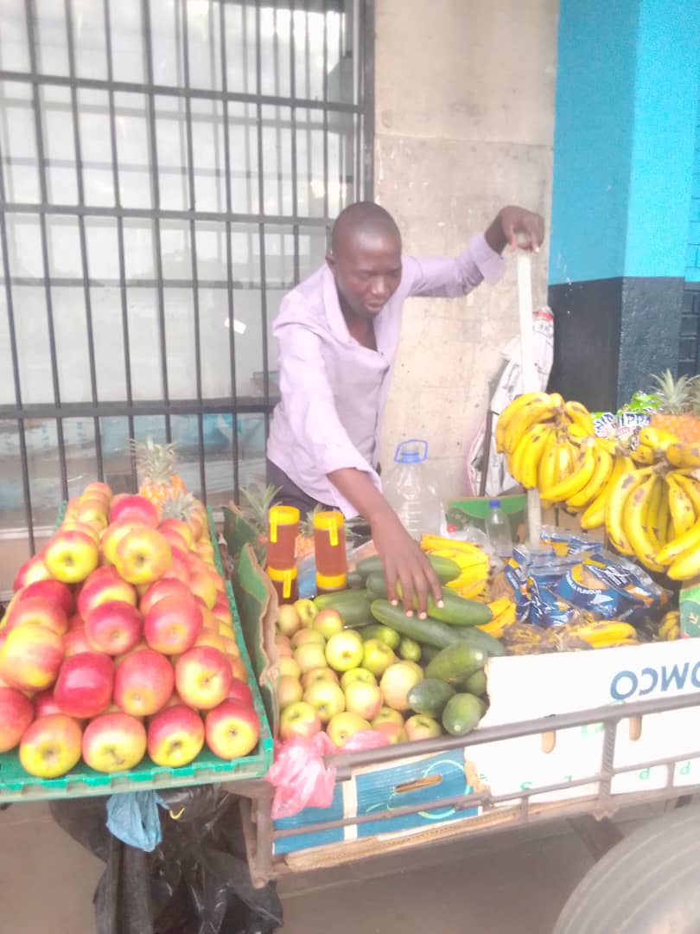
PLEASE DESCRIBE THE BUSINESS
I am into vegetable and fruit vending located at Zhombe
Growth Point
I order my stock from Commercial farmers
Photo or video

Slide 3
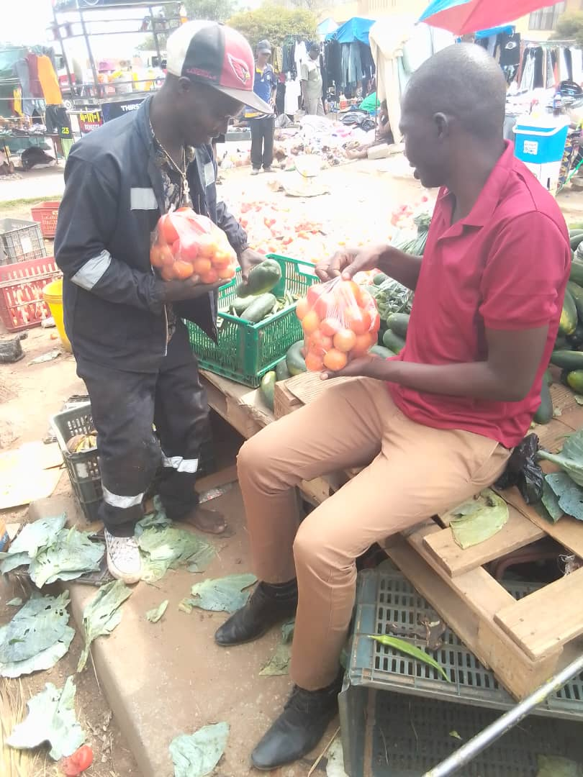
CUSTOMER BASE?
Photo
Who are your customers?
Customers all around Zhombe rural
Have you increased the number of customers since starting the LED Programme? Yes or No
Yes
How did you do this?
Social Media Marketing ( Whatsapp groups ) through the skills and techniques I acquired at workshops

Slide 4
COMPETITION
Who is your competition?
Commercial Farmers
How do you handle competition in your business?
Analyzing their strengths weaknesses and market share

Slide 5
NEW PRODUCTS OR SERVICES?
Do you have any new business products or services
Yes
What new products are in the business?
Seasonal fruits e.g strawberries and pumkins
How are they performing compared to your initial products?
Higher demand and sales during peak seasons
Potential for higher profit margins
How do you advertise/market your products?
Word of mouth marketing
Social media
Sales promotions

Slide 6
QUALITY AND PACKAGING
Are your customers happy with the quality of your products or services?
Yes
If you have answered yes please give more information.
Consistent performance over time
Do you have any branding available for your products? Explain
Fosters customer loyalty
Have you changed the packaging or marketing of your business to attract more customers? Please explain.
Yes for increased visibility through eye catching designs.

Slide 7
BUSINESS MANAGEMENT
Have you hired more staff? How many full-time and how many part-time?
Full time workers 2
Part time 0
How do you manage your stock and check regularly? Please explain.
First-In First-Out
Have you been able to price your products better so that you can earn a surplus from the business? Please explain.
Small profits quick return

Slide 8
FINANCIAL MANAGEMENT
Do you have a record-keeping system in place? Explain.
Demonstrate transparency and accountability
If yes, how is it helping you to manage your business?
Monitor income and expenditure
Do you have a bank account for your business?
No

Slide 9
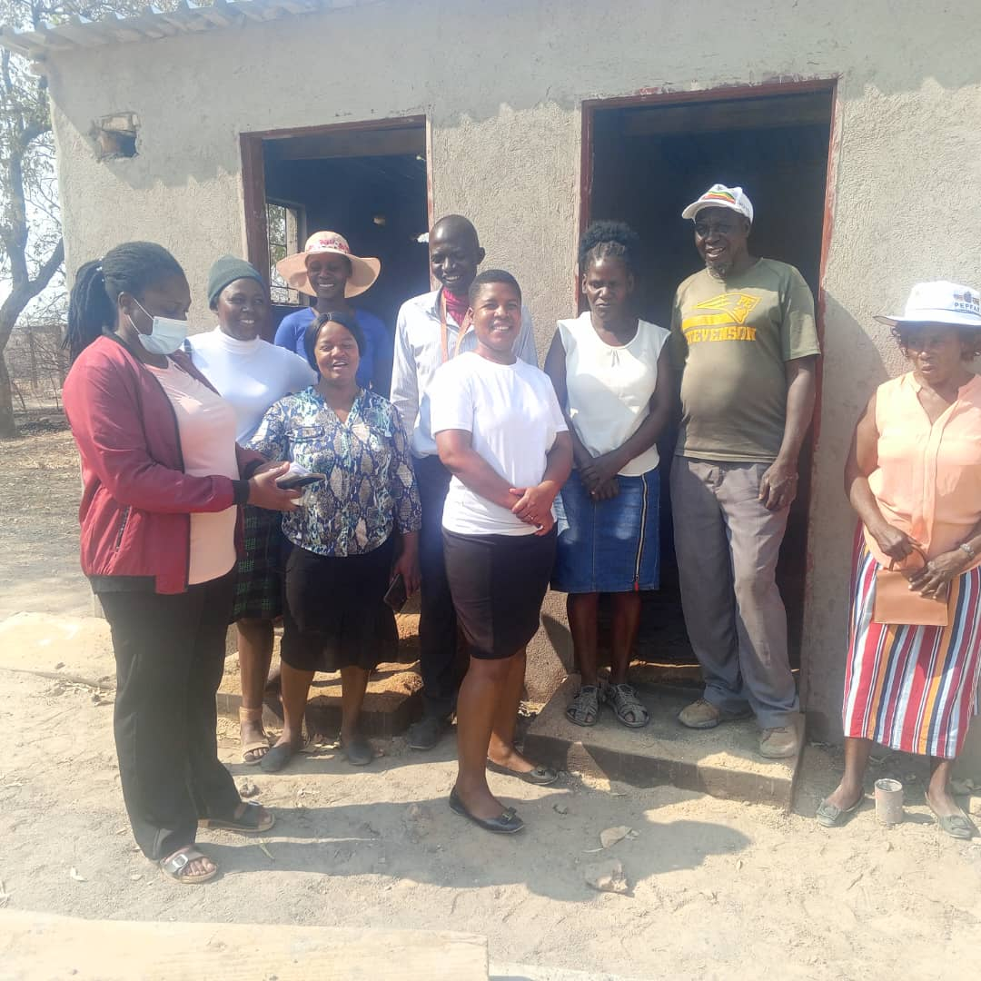
SAVINGS AND SELF SUFFICIENCY
Are you a member of a savings group?
Yes
Are you saving money? How much have you been able to save so far?
$300
Have you managed to increase household income?
Yes
Insert Photo

Slide 10
INCOME AND EXPENSES FOR THE BUSINESS FOR THE PAST SIX MONTHS
Income
Expenses
ITEM | AMOUNT
Bananas | 612
Apples | 372
Greens | 732
Tomatoes | 492
Onion | 252
Transport
TOTAL | 2460
ITEM | AMOUNT
Bananas | 300
Apples | 180
Greens | 360
Tomatoes | 240
Onion | 120
Transport | 60
TOTAL | 1260

Slide 11
INCOME AND EXPENSES FOR THE BUSINESS FOR NEXT SIX MONTHS
Income
Expenses
ITEM | AMOUNT
Bananas | 734
Apples | 446
Greens | 878
Tomatoes | 590
Onions | 302
Transport
TOTAL | 2950
ITEM | AMOUNT
Bananas | 360
Apples | 216
Greens | 432
Tomatoes | 288
Onions | 144
Transport | 72
TOTAL | 1512

Slide 12
WHAT PLANS HAVE YOU MADE TO GROW YOUR BUSINESS IN THE NEXT 6 MONTHS?
Market Research : Identify Customer Preferences that is conducting surveys or interviews to understand what fruit and vegetables customers prefer.
Analyze Competitors : Observe local competition to identify their strengths and weaknesses.
Diversification of Products Introduce organic, exotic or locally sourced fruits and vegetables.
Value Added Products considering offering pre-cut packaged or prepared .items
Promotion Strategies implementing a reward system for repeat customers
Offer discounts or special bundles during holidays or peak seasons for certain fruits and vegetables.

Slide 13
CHALLENGES
What challenges have you experienced in your business?
Transport and logistic issues
Seasonal fluctuations in availability e.g apples
Managing inventory and stock levels
How have you addressed these?
Invest in logistics and transportation infrastructure
Diversify products to mitigate seasonal fluctuations
Implement just in time inventory management

Slide 14
SUSTAINABILITY
How will you sustain your business?
Monitoring and adjusting pricing
Manage cash flow effectively
Maintain a healthy profit margin
What other sustainability measures are you putting in place for your business?
Invest in employee training and development
Monitor and improve customer satisfaction
Maintain high quality products and services

Slide 15
ADDITIONAL INFORMATION?
What other changes have you experienced in your business? Explain
Inflation
Competition
Environmental factors e.g climate change
Do you have any additional information to share?
Importance of a fruit and vegetables business
Provides essential nutrients for optimal health
Access to fresh and nutritious foods
Contributes to local and national economic growth
Promotes sustainable agriculture practices

