Slide 1

www.1000women.co.za
1000women1voice
1000 Women Trust
#1000Women1Voice

Slide 2

hear me too
They (GBV survivors) need support groups that you can network with other women. And they need skills, that they can use their hands – it will really help too.
‘
‘
          GBV Survivor
#1000Women1Voice

Slide 3
hear me too
So as long as you are the better liar, you will remain in control and for an abuser, that is the prime seat to be in as you then still hold power over the victim. I've lost everything because of this person, and I will never escape him due to a child.
‘
‘
          Natasha, GBV Survivor
#1000Women1Voice

Slide 4
hello
In South Africa, we face a stark reality:
a high rate of GBV with minimal convictions.
But this presentation won't dwell on statistics you already know.
It's time to take action.
#1000Women1Voice
Notes:
Gender based violence is real. Like the two quotes above. Today I will not be sharing GBV stats with you, I will not give you GBV definitions. tell you about all our amazing volunteers and projects and I will not ask you to like, share and engange with us on social media.
Today, I will ask you for money. And I will tell you what we need the money for.
I do not intend to beat around the bush.
South Africa boasts the 3rd most raped country in the world.
We "Got the Tshirt".
We, big corporations, esteemed research insititutions, NGOs and NPOs, the government and us, South Africans have failed.
We have failed us. The woman and children of South Africa
But first, let me not forget my manners, I am Adrie Jurgensen and I represent the 1000 Woman Trust on behalf of Tina Thiart, who is in Europe at the moment. thanks for opportunity,
I do hope that you will sit tight and at the end, see the light at the end of a very long and dark GBV tunnel.

Slide 5
who are we
1000 Women Trust (2015) is a Women's Rights Organisation operating in South Africa dedicated to raising awareness about gender-based violence and femicide (GBVF) while providing capacity building to GBV Community Organisations.
#1000Women1Voice
Notes:
For the last 21 years, the 1000 woman trust has been in the trenches. We are on the ground, working with woman in townships and penthouses, wiping tears and sipping tea. In short, we are a Women's Rights Organisation operating in South Africa dedicated to raising awareness about gender-based violence and femicide (GBVF) while providing capacity building to GBV Community Organisations.

Slide 6
free GBV training
Trauma Support Volunteer
Anti-Bullying
GBV & Substance Abuse Awareness
GBV Life Coach
Talking to boys (about consent)
First Responder (New legislation)
#1000Women1Voice

Slide 7
Social Media Campaigns for Awareness and Advocacy
Aimed at bringing awareness to New Legislation
THE CRIMINAL LAW (SEXUAL OFFENCES AND RELATED MATTERS) AMENDMENT BILL
THE CRIMINAL AND RELATED MATTERS AMENDMENT BILL
THE DOMESTIC VIOLENCE AMENDMENT BILL
#1000Women1Voice

Slide 8
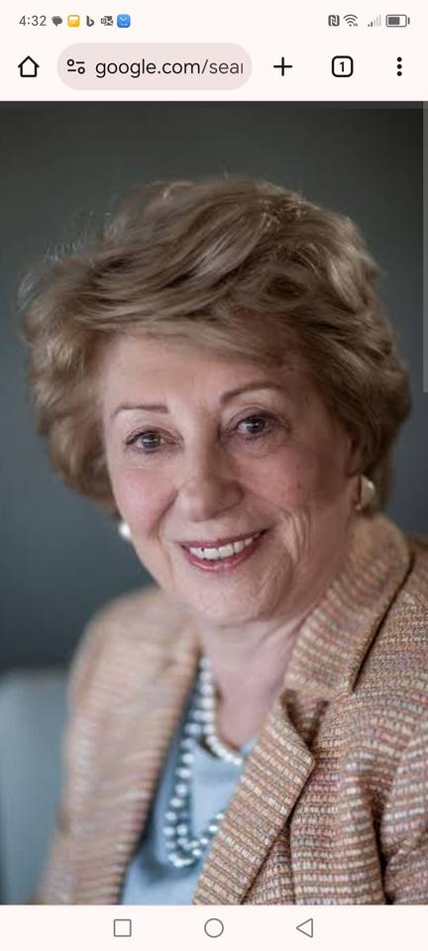
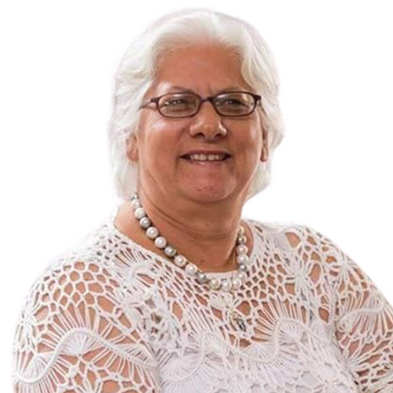
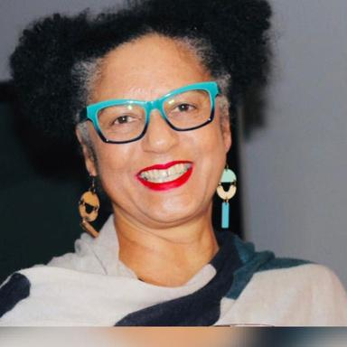
trustees
WENDY ACKERMAN
TINA THIART
LEONORA SAULS
#1000Women1Voice
Notes:
Our founders are Mrs. Wendy Ackerman and Tina Thiart who started this trust 21 years ago with a vision to make a difference. Recently, we welcomed Leonora Sauls as our third trustee.

Slide 9
theory of change
We collaborate with Community Based Organisations (CBOs) and women-led groups to raise awareness and support survivors of GBV. Our belief:, with access to knowledge, skills, and resources, women can find their own solutions. We advocate for gender equality in our communities.
#1000Women1Voice
Notes:
We believe that empowered woman, can and will find their own way. That is our theory of change.

Slide 10
#1000Women1Voice
getting to the point
In South Africa, GBV resources abound, but real help is scarce. In times of trouble, we don't need education; we need assistance. We need emergency tools like apps or hotlines for immediate aid and swift justice. We need safe spaces, skills training, and financial support to survive and thrive. We need Project Orange.
#1000Women1Voice
Notes:
There are many website explaining GBV. Thousands of articles and presentations on the topic - but very little real help
If I am in trouble don't want to know all the different forms of GBV, or how progressive we are with the laws we have, or the stats or even stories of survivors
Then I don’t want to be educated, I Only want to know someone is coming to help
So what do we need now? We need an emergency tool to get immediate help. Be it an app a website a WhatsApp group
We need more safe spaces to help woman in their hour of need
We need trained, compassionate, strong and dynamic woman in the communities to take charge and become GBV Warriors
We need to know that ·perpetrator (purpuh·tray·tuhz) will get sentenced. And kept in jail.
And that we do not have go through all the emotional trauma only to have to wait years or have a guilty man walk free.

Slide 11
#1000Women1Voice
project orange
Project Orange addresses the urgent need for emergency safe space by establishing GBV advice offices in vulnerable communities, staffed by trained GBV Warriors. In 2024, we're targeting 5 new 24-hour emergency GBV offices in key hotspots across South Africa: Ekurhuleni, Beaufort West, Graafwater, Nyanga East, and Centurion.
#1000Women1Voice
Notes:
Project Orange addresses the urgent need for emergency safe spaces by establishing GBV advice offices in vulnerable communities, staffed by trained GBV Warriors. In 2024 we aim to establish at least 5 of these 24 hour emergency GBV offices in key hotspots. E-ku-rhu-leni, Beaufort West, Graafwater, Nyanga East, and Centurion. Our pilot project in Beaufort west just kicked off now an E-ku-rhu-leni, will follow soon.
Project Orange will be a breathing space before the shelters and our GBV Warriors and trained community members a safe space for the healing process that will follow.

Slide 12
#1000Women1Voice
project orange
Additionally, funding is required for emergency supplies like food, data, transport, and security, furniture and bedding. Our aim is to establish a welcoming environment , featuring comfortable, bedding, inspiring wall art, and emergency packs for survivors and their children. We're committed to offering a safe and dedicated space for children to stay occupied while their caregivers receive support.
#1000Women1Voice
Notes:
We will need of funding for essential supplies such as food, data, transport, and security, as well as for furniture and bedding. Our goal is to create a warm and welcoming environment, reminiscent of an Air BnB, complete with comfortable, preferably branded bedding, inspirational wall art, and emergency packs for survivors and their children. We're committed to making sure kids have a safe and special place to hang out while their caregivers get the help they need.

Slide 13
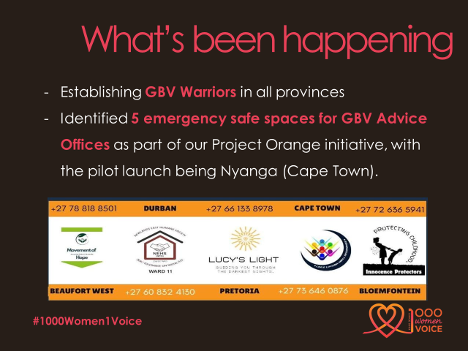
Notes:
In conclusion:
Real assistance is lacking, which is a significant issue in South Africa regarding gender-based violence (GBV). While there are numerous websites, apps, articles, and presentations explaining what GBV is, there's a glaring lack of tangible help when in distress.
Yes we need education. We need PR. We need buy -in and more than ever we need funds. We need real men and brave woman to stand up. But we need the basics.
We néed a number to call
We need trained and compassionate person to help us
We need a safe space for our kids and ourselves to gather our thoughts
We need to complete the tedious forms
We need speed in prosecuting
We need to trust the process again
Believe in the outcome
We need money to survive
Skills training and a cheerleader to help us get back on our feet again
We need your money to build 5 emergency safe spaces
We need your money to train thousands of South Africans for free in GBV
We need your money and expertise to Build the app.
We need your support and voices to get government to hear us, to make reporting easier and prosecution quicker
We need you to help us push through
We need 1000 things but today we one – your support.

Slide 14
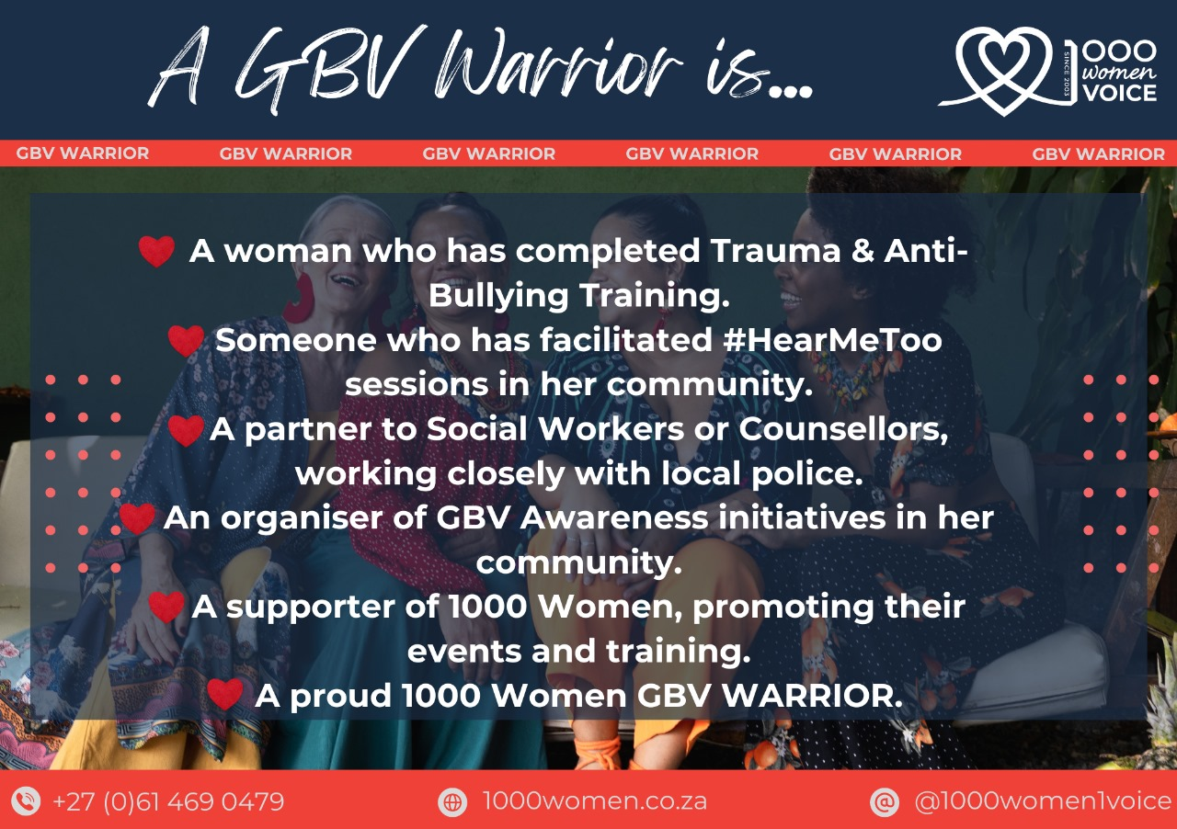
Notes:
In conclusion:
Real assistance is lacking, which is a significant issue in South Africa regarding gender-based violence (GBV). While there are numerous websites, apps, articles, and presentations explaining what GBV is, there's a glaring lack of tangible help when in distress.
Yes we need education. We need PR. We need buy -in and more than ever we need funds. We need real men and brave woman to stand up. But we need the basics.
We néed a number to call
We need trained and compassionate person to help us
We need a safe space for our kids and ourselves to gather our thoughts
We need to complete the tedious forms
We need speed in prosecuting
We need to trust the process again
Believe in the outcome
We need money to survive
Skills training and a cheerleader to help us get back on our feet again
We need your money to build 5 emergency safe spaces
We need your money to train thousands of South Africans for free in GBV
We need your money and expertise to Build the app.
We need your support and voices to get government to hear us, to make reporting easier and prosecution quicker
We need you to help us push through
We need 1000 things but today we one – your support.

Slide 15
#1000Women1Voice
backed up by the numbers
We have trained 11 925 people with human intervention for period March 2024 - Feb 2025 using Whatsapp technology.
Through educating and empowering women, we have established 117 GBV warriors across all provinces. These warriors become our trainers/ facilitators and First Responders in their communities #victim2warrior - Movement Building Model
We have distributed more than 40 000 brochures/pamphlets or period March 2024 - Feb 2025, creating awareness about GBV, Child Trafficking and Bullying.
#1000Women1Voice
Notes:
We will need of funding for essential supplies such as food, data, transport, and security, as well as for furniture and bedding. Our goal is to create a warm and welcoming environment, reminiscent of an Air BnB, complete with comfortable, preferably branded bedding, inspirational wall art, and emergency packs for survivors and their children. We're committed to making sure kids have a safe and special place to hang out while their caregivers get the help they need.

Slide 16
#1000Women1Voice
Enhancing our Communication and Reach through a Chatbot
Unlocking fluency - 24/7 support & access to 1000 Women Training. Training can take place at any time, increasing number of women empowered and educated
Instant responses - instant assistance in critical time.
Access to 1000 Women Material - equipping Warriors to adequately assist victims at safe rooms - project orange
Collection of data - analyse the needs of our warriors for research and policy advocacy
Enhance Digital Literacy among women
Follow link for more info - https://www.turn.io/
#1000Women1Voice
Notes:
We will need of funding for essential supplies such as food, data, transport, and security, as well as for furniture and bedding. Our goal is to create a warm and welcoming environment, reminiscent of an Air BnB, complete with comfortable, preferably branded bedding, inspirational wall art, and emergency packs for survivors and their children. We're committed to making sure kids have a safe and special place to hang out while their caregivers get the help they need.

Slide 17
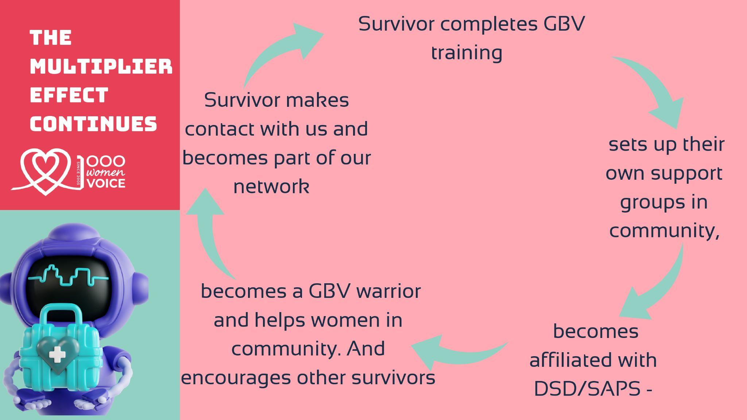
#1000Women1Voice
We know that most times the process does not flow in sequence - most of our Warriors are women who have already been supporting victims in their communities, but may not have the necessary training and resources to assist them - That’s where we come in - Movement Building - a network of WOMEN HELPING WOMEN
#1000Women1Voice
Notes:
We know that most times the process does not flow in sequence - most of our Warriors are women who have e already been supporting victims in their communities, but may not have the necessary training and resources to assist them - thats where we come in - building a network of WOMEN HELPING WOMEN

Slide 18

#1000Women1Voice
We know that most times the process does not flow in sequence - most of our Warriors are women who have already been supporting victims in their communities, but may not have the necessary training and resources to assist them - That’s where we come in - Movement Building - a network of WOMEN HELPING WOMEN
#1000Women1Voice
Notes:
We know that most times the process does not flow in sequence - most of our Warriors are women who have e already been supporting victims in their communities, but may not have the necessary training and resources to assist them - thats where we come in - building a network of WOMEN HELPING WOMEN

Slide 19
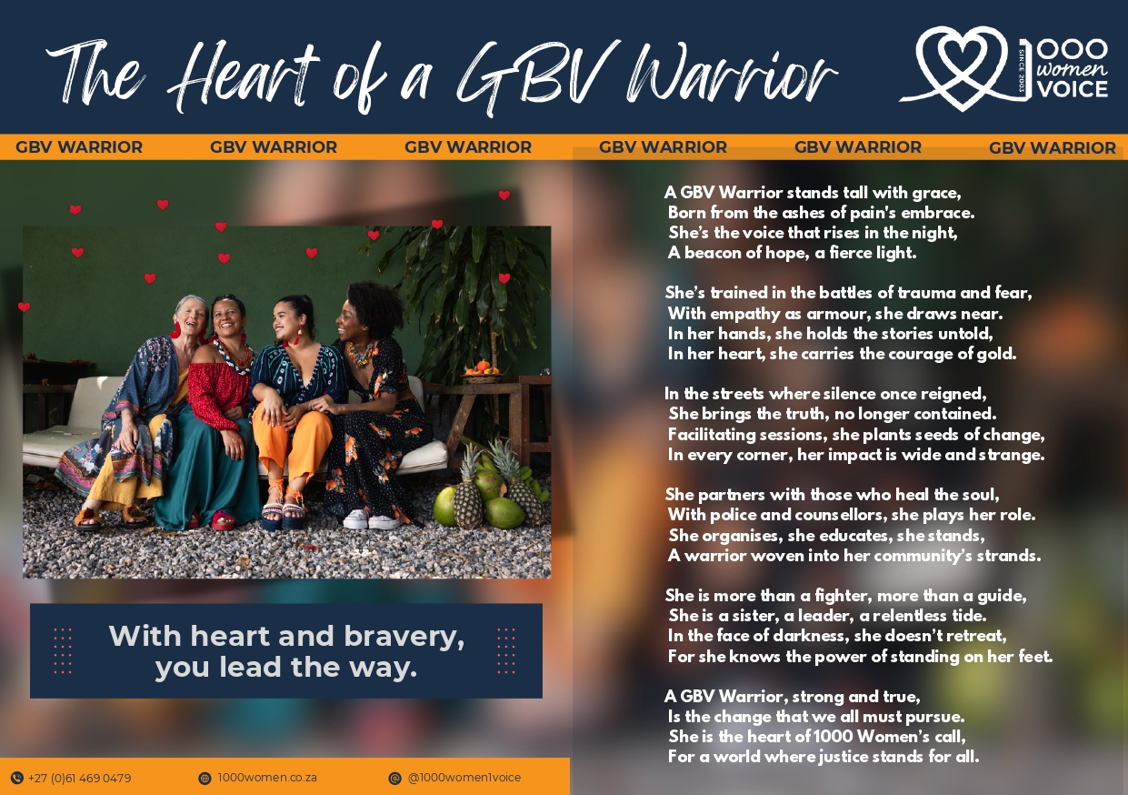
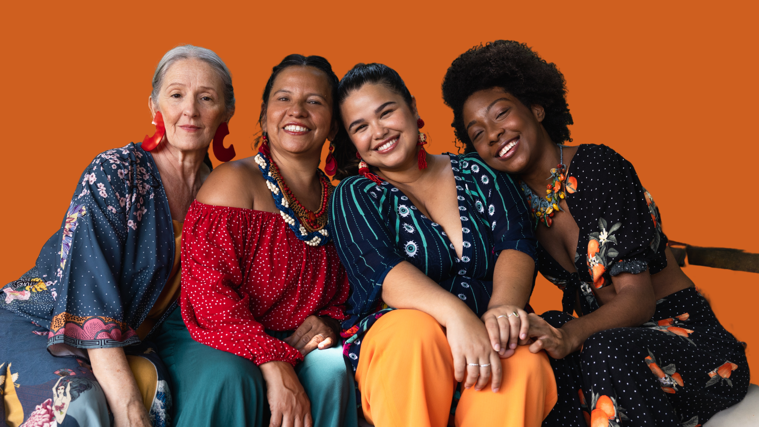
www.1000women.co.za
@1000women1voice
thank you!
Thank you
1000 Women Trust

