Slide 1




SADC PROTOCOL@WORK SUMMITS AND AWARDS
2024
GENDER RESPONSIVE BUDGETING Template
Zimbabwe, Mberengwa RDC, 12 November and presenter is Fadzai Zingwara
.

Slide 2
OVERVIEW
COUNTRY | ZIMBABWE
COUNCIL (HUB/SPOKE) | SPOKE
GENDER CHAMPION | FLORENCE KHUMALO
GENDER FOCAL PERSON | JOICE GUMBO
Latest score (year) | 2024
 | Income | Expenditure | % Gender Specific
Budget (YEAR) |  |  | 25
 | Women | Men | Total | % Women
Council | 8 | 25 | 33 | 24.24
Management | 1 | 5 | 6 | 16.67
Council staff overall | 9 | 30 | 39 | 23.07
Population served | 208 458
Key characteristics | A summary of measures taken by Council in response to the Ministry of Finance Budget Directive.

Slide 3
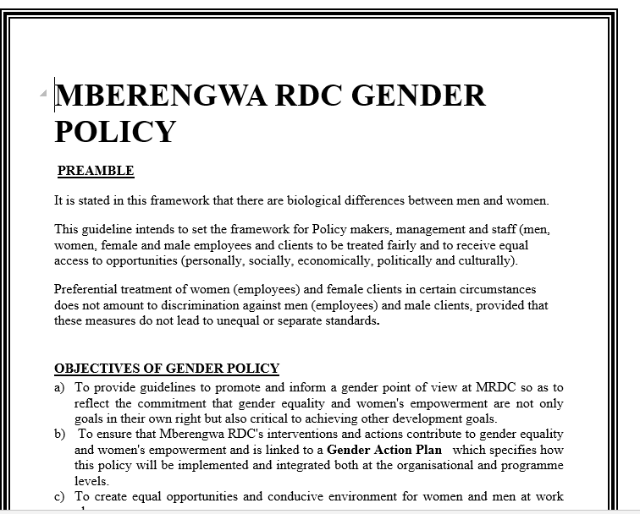
  I. POLICY FRAMEWORK
Gender provisions and policies guide the council budget National Gender Policy, Constitution of Zimbabwe, National Development Strategy 1, SADC Protocol on Gender and Development CEDAW SDGs.
The council have a gender policy and does make address issues on gender budgeting through equal involvement in budget consultations.
Photo of the Gender Policy

Slide 4
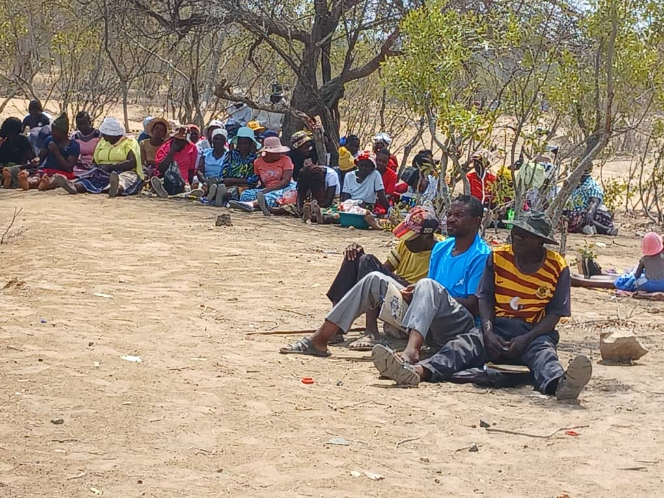
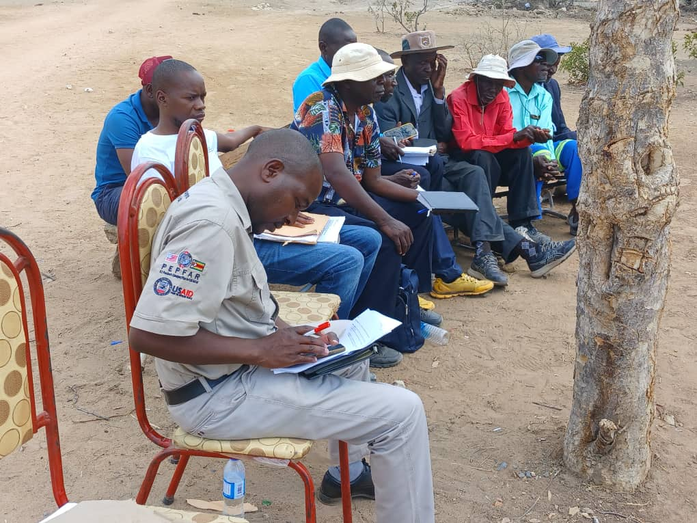
II. THE BUDGET PROCESS
Detail
The council integrate gender by doing citizen engagements where everyone would participate and electronic means such as telephone calls, text messages and emails were used to disseminate information.
The council integrate gender and inclusion into budget consultations through physical meetings and online meetings with special groups for example Electronic means such as telephone calls, text messages and emails were used to disseminate information. Mberengwa Rural District Council have sex/age/disability statistics on those who participated in the consultations.
The council ensure that the budget consultation process was inclusive of everyone is left behind through intensive campaign news paper advertisement and schedule of meetings including the use of sign language for the visually impaired knew about meetings.
Photos of budget consultation

Slide 5
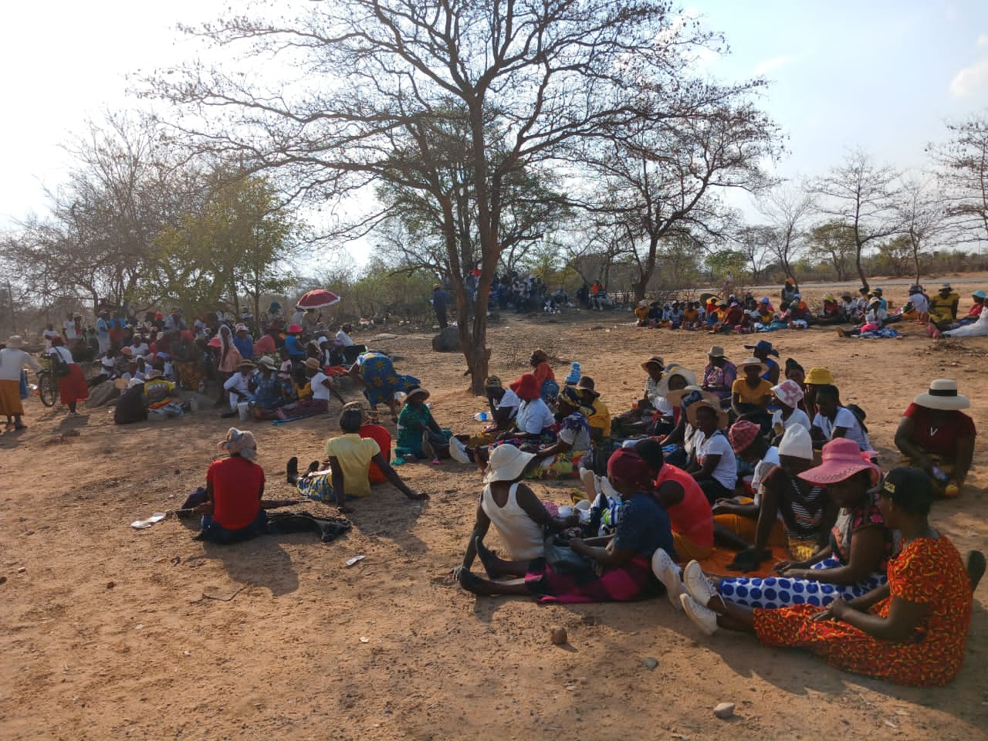
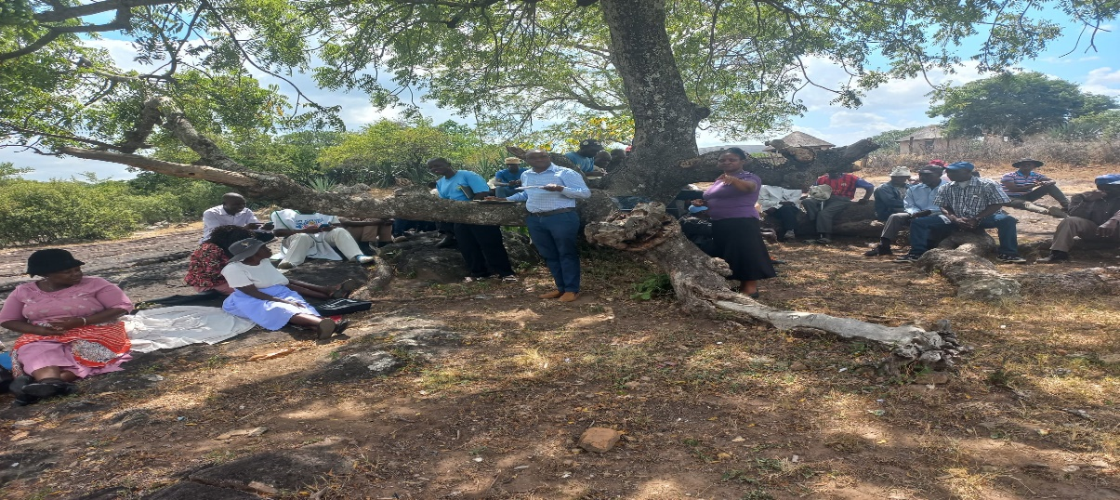
II. THE BUDGET PROCESS
Detail
Evidence
Last quarter of the year all wards and implemented meeting strategies through consultations , trainings to ensure inclusion targeting women to be consulted targeting churches, ward meeting suiting their needs capabilities.
The council make use of technology through the networking through Facebook, twitter and WhatsApp interactions.
The technological input has bought about efficiency in communication channelling

Slide 6
II. THE BUDGET PROCESS
Does the council have sex/age/PLWD statistics on those who participated in the consultations? – refer to consultation registers and populate table below
Consultation | Women |  |  |  |  | Total | Men |  |  |  |  | Total | % Women
 | Age |  |  |  |  |  | Age
 | - 15 | 15-35 | 36-59 | 60+ | PWD |  | - 15 | 15-35 | 36-59 | 60+ | PWD
37 wards | 4 | 300 | 900 | 100 | 4 | 1308 | 10 | 200 | 1000 | 67 | 3 | 1280 | 50.54%
% |  |  |  |  |  | 100% |  |  |  |  |  | 100%

Slide 7
III. REVENUE
The break down internal and external sources of funding is mainly dependant on external funds as per pie chart
Gender considerations informed decisions concerning the budgeting of revenue through budget consultation, building of shelter waiting rooms at clinics and inclusion in water and sanitation identification of water points, committees
The decisions are influenced by budget consultations, in particular the views of women through the statistics
The external financing are specifically targeted at gender through WASH and roads and infrastructure by Zinara and devolution funding for building schools, clinics, boreholes

Slide 8
IV. EXPENDITURE
Employment equity related expenditure
There is expenditure allocated for policies/actions to bring about gender parity at all levels as council has put a Gender Policy in place with relevant structures in place. Equity is accorded in terms of job adverts as well students on attachment and graduate internship.and the proportion 25% of each

Slide 9
IV. EXPENDITURE
Type of Expenditure | Amount | %
Gender Management System (GMS) | 3,721,918,401.60 | 7.93%
Employment expenditure (Human Capital Expenditure) | 6,430,678,306.08 | 29.76%
Gender Specific Programming | 20,817,975,736.32 | 44.35%
Mainstream Programmes | 13,966,063,212.64 | 29.76%
Other | 1,998,976,000.00 | 4.26%
Total | 46,935,611,656.64 | 100.00%

Slide 10
IV. EXPENDITURE- GMS
Mberengwa RDC have a Gender Management System through Gender Focal Person and Gender Champion.
GMS activities budgeted for look and learn meetings (exchange visits), Hub/ spoke activities, training for the team, policy formulation, office equipment and stationery.
The budgets is found within the social service committee budget within council budget

Slide 11
IV. Gender Specific expenditure
The Council has the following Gender specific programmes -Gender Training workshops, Junior Councils., Commemoration of international days e.g., Women's Day, Sixteen Days of Activism, Girl Child., Sexual Reproductive Health and Rights done in all Council Health facilities, Entrepreneurship training for men and women including youth and disabled
Gender mainstreaming, gender management systems, employment expenditure and specific programmes
Proportion of the council budget is allocated for gender-specific programming is 25%
These programmes allows informed by budget consultations allows the informative decision making
The gender-specific projects helping to promote gender equality and women’s empowerment include water provision reservoirs enhancing empowerment through nutritional gardens.
Measuring the expenditure on gender-specific programmes throughout drilling boreholes at 37 wards, improved water supply and reduced walking distance

Slide 12
IV. EMPLOYMENT EXPENDITURE
 | Women |  |  |  | Men |  |  | Total | % women
 | Managers |  | Staff | Total | Managers | Staff | Total |  | Managers | Staff | Total
Full Time |  | Women |  |  | Men |  |  | Total | %Women
 |  | Managers | Staff | Total | Managers | Staff | Total |  | Managers | Staff | Total
 | Full time | 1 | 8 | 9 | 5 | 25 | 30 | 39 | 16.67% | 32.00% | 23.08%
Part time | Casual |  | 2 | 2 |  | 7 | 7 | 9 |  | 28.57% | 22.22%
Casual | Outsourced
Total | Overall | 1 | 10 | 11 | 5 | 32 | 37 | 48 | 16.67% | 60.57% | 45.30%
Proportion of the work force comprise women of 24.24% overally
The percentage of women in management is 16.67 %
The percentage do women comprise of the full-time, part-time and casual, labour force is 25.58%
This is due to that employee creation and employment still in the process

Slide 13
IV. EMPLOYMENT EXPENDITURE- Gender Wage Gap Analysis
 | Women | Women- Total earned | Women average earned | Men-no | Men total earned | Average earnings
Full Time | 9 | 4761 | 529 | 30 | 17700 | 590
Casual | 2 | 7440 | 310 | 7 | 26040 | 310
Part time
Total | 11 | 12201 | 839 | 37 | 43740 | 900
The gender wage gap is 0.07 which shows that men earn more than women.
The wage gap reflect women have low earnings than men, the different levels occupied by women and men in the Council due to the nature of jobs occupied
Council is recruiting to occupy the gender wage bill and also consider the provision of payment of maternity leave to casual workers

Slide 14
V. EXPENDITURE- GENDER IN MAINSTREAM BUDGET
Draw Pie chart here
Type of Expenditure | Amount | %
Gender Management System (GMS) | 3,721,918,401.60 | 7.93%
Employment expenditure (Human Capital Expenditure) | 6,430,678,306.08 | 29.76%
Gender Specific Programming | 20,817,975,736.32 | 44.35%
Mainstream Programmes | 13,966,063,212.64 | 29.76%
Other | 1,998,976,000.00 | 4.26%
Total | 46,935,611,656.64 | 100.00%

Slide 15
V. EXPENDITURE- ANALYSIS OF ONE SECTOR =HOUSING ALLOCATION
 | Women |  |  |  |  |  | Men
 | Age |  |  |  |  |  | Age
 | Below 15 | 15-35 | 36-59 | 60+ | PLWD | Total | Below 15 | 15-35 | 36-59 | 60+ | PLWD | Total
Education | 12 | 35 | 125 | 21 | 2 | 195 | 23 | 15 | 4 | 0 | 4 | 46
Housing | 0 | 20 | 52 | 5 | 3 | 80 | 0 | 25 | 89 | 75 | 48 | 237
Total | 12 | 55 | 177 | 26 | 5 | 275 | 23 | 40 | 93 | 75 | 52 | 283

Slide 16
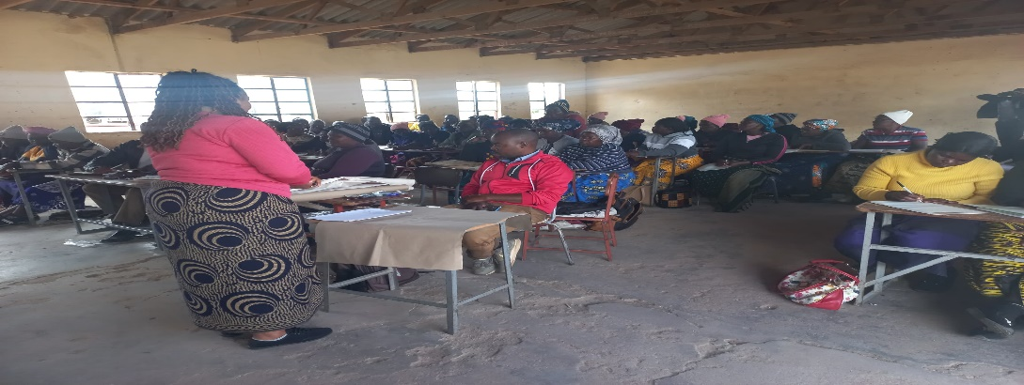
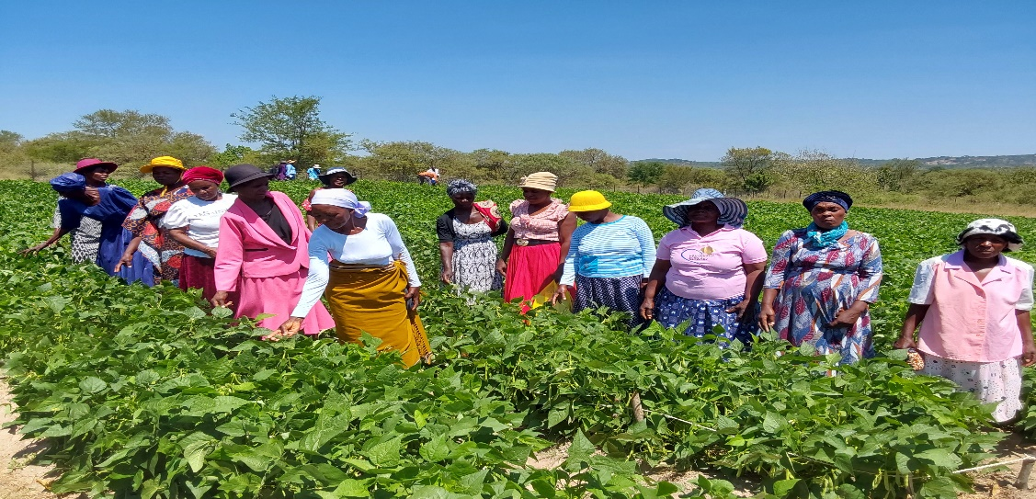
V. EXPENDITURE- GENDER IN MAINSTREAM BUDGET
Women who wish to enter into business ventures are being encouraged through savings clubs and opportunities are equally accorded to both men and women for stand seekers. Flea Markets and Green Markets are mostly allocated to women since they are affordable.
The data is sex disaggregated.

Slide 17
V. EXPENDITURE- GENDER IN MAINSTREAM BUDGET – EXAMPLE
 | Amount | No of beneficiaries | Percentage
Total Expenditure | 13,054,150,119.40
No. of Men benefiting from council allocations |  | 2400 | 65%
No. of Women benefiting from council allocations |  | 1270 | 35%
Total beneficiaries |  | 3670 | 100%

Slide 18
VI. BUDGET CROSS SUBSIDISATION ANALYSIS
 | Income (A) | % of total budget | Expenditure (B) | % of total budget | Surplus/Deficit
Governance & Administration | 2473212105 | 4.57 | 14206654410 | 26.31 | -11733442305
Water, Sanitation & Hygiene | 1643356000 | 3.05 | 2040380745 | 3.78 | -397024745
Social Services | 34353026630 | 63.62 | 22557124980 | 41.77 | 11795901650
Roads | 9675020550 | 17.91 | 13260449150 | 24.55 | -3585428600
Public Safety and Security | 0.00 | 0.00 | 0.00 | 0.00 | 0.00
Natural Resources & Conservation Mgt | 5860725000 | 10.85 | 1940731000 | 3.59 | 3919994000
Total | 54005340285 | 100 | 54005340285 | 100 | 0.00

Slide 19
VI. BUDGET CROSS SUBSIDISATION ANALYSIS
The Local Authority is non-profit organization and hence expenditure is equal to income. In addition, Governance, WASH and Roads incurs the highest expenditure whilst incurring huge being subsided by other programs such as Natural Resources and Social Services.
Gender considerations has influenced the cross-subsidisation of services as resources have been directed to wash, empowerment, employment creation
The percentage of allocations have been influenced by gender considerations is 25%

Slide 20
VII. CONCLUSIONS AND NEXT STEPS
The council budget addressed gender equality by involving both men and women in the planning processes i.e. budget consultations. This has addressed both practical and strategic needs.
25% of the budget has been spent on gender programmes as council is planning and constructing more schools and health facilities to reduce the walking distance.
Council to follow-up on budgeted projects and review all gender management systems. Council to source and ensure adequate funding of gender specific programmes.

