Slide 1





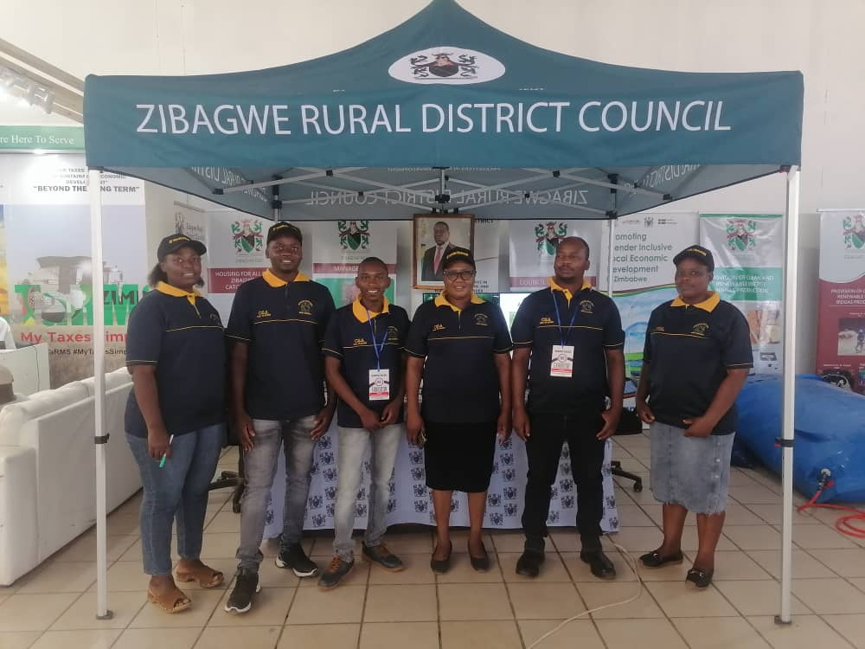
SADC PROTOCOL@WORK SUMMITS AND AWARDS
2024
GENDER RESPONSIVE BUDGETING
ZIMBABWE, ZIBAGWE RURAL DISTRICT COUNCIL, NOVEMBER 2024
ZINHANGA NYASHA

Slide 2
OVERVIEW
COUNTRY | ZIMBABWE
COUNCIL (HUB/SPOKE) | ZIBAGWE RURAL DISTRICT COUNCIL
GENDER CHAMPION | ANASTANCIA MANGANI
GENDER FOCAL PERSON | GRACE NYIKAVARANDA
Latest score (2024) | 85
 | Income | Expenditure | % Gender Specific
Budget (2024) | 90,460,590.35 | 90,460,590.35 | 6%
 | Women | Men | Total | % Women
Council | 12 | 31 | 43 | 30
Management | 4 | 10 | 14 | 29
Council staff overall | 9 | 19 | 28 | 30
Population served | Females 98,299 and Males98,763 (197062) 2022 Population and Housing Census
Key characteristics | Zibagwe Rural district constitutes primarily rural areas outside the City of Kwekwe and the town of Redcliff. Its jurisdiction covers three administration zones namely ,Zhombe Communal, Silobela Communal and Kwekwe Rural.

Slide 3
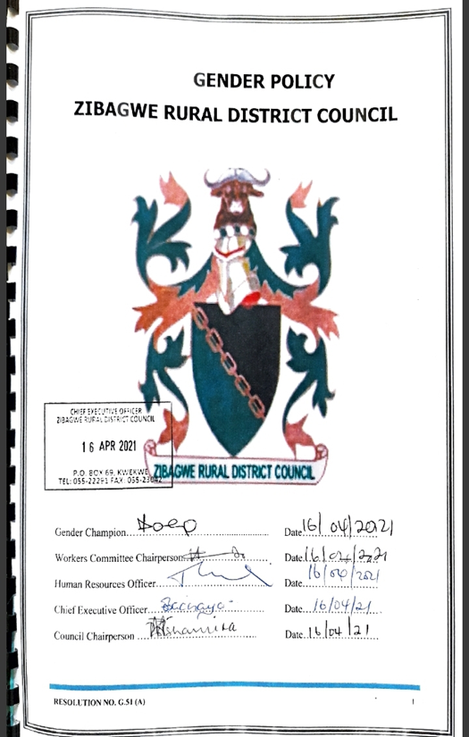
  I. POLICY FRAMEWORK
Constitution of Zimbabwe, National Development Strategy 1, SADC Protocol on Gender and Development CEDAW SDGs,
These frameworks collectively guide the council in ensuring that the budgeting processes is sensitive to gender issues, promoting equality and inclusivity in resource allocation and policy implementation.
Council has a gender policy, and it addresses issues on gender budgeting.

Slide 4
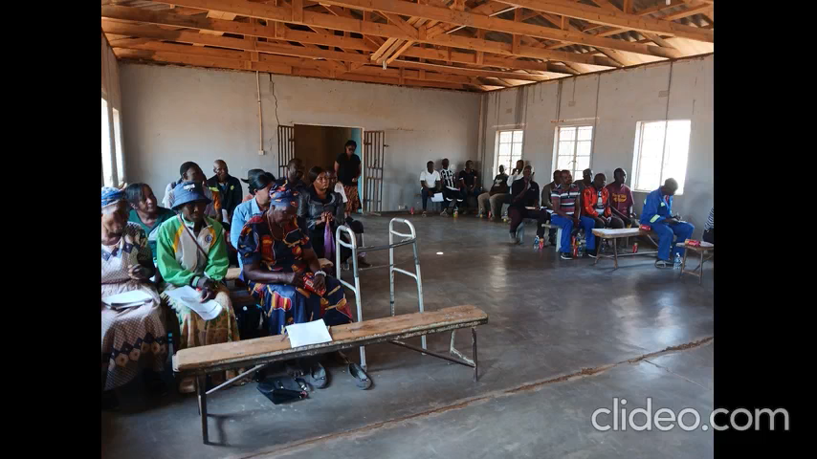
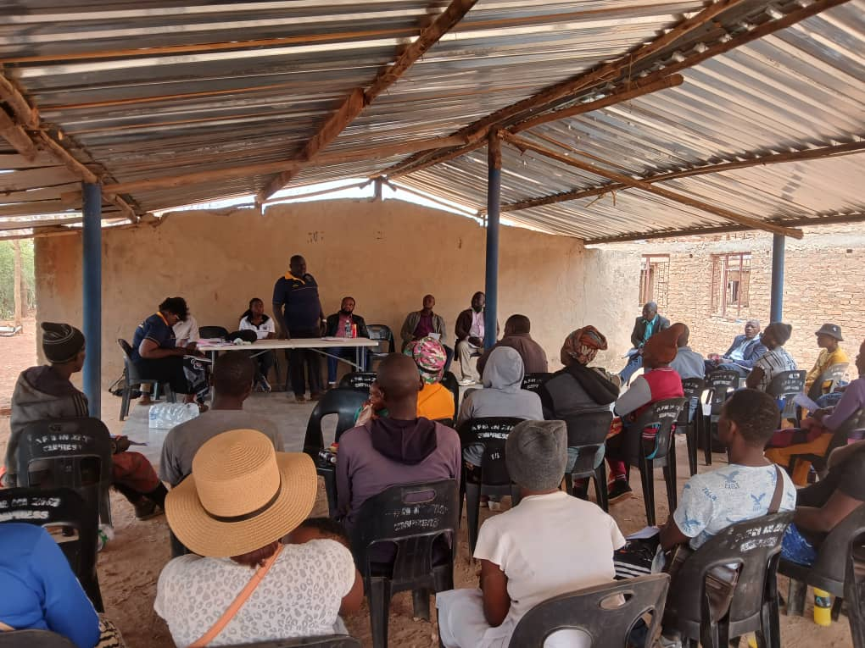
II. THE BUDGET PROCESS
Detail
Evidence
We put notices of budget meetings at clinics, business centers and schools. Make use of village health workers, make use of whatsapp platform, bulk sms, Councilors in ward based budget consultations to enable women to be able to attend. We also categorize our rate payers basing on their nature business operations or revenue head.
Women, youths and PWDs were also encouraged to participate in budget consultation meetings.
We set time for the meetings which will also enable women for example to attend for instance 2pm

Slide 5
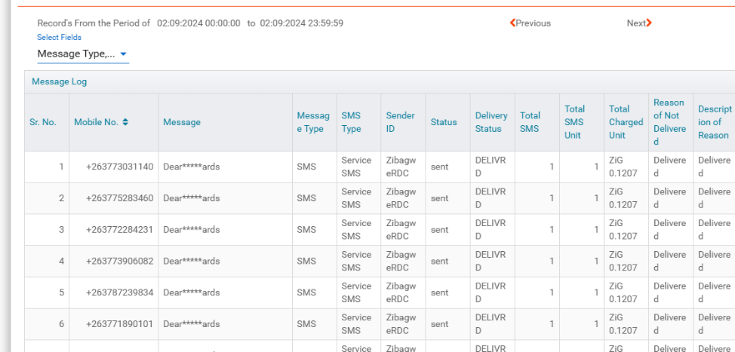
II. THE BUDGET PROCESS
Detail
Evidence
We make use of ward based budget consultation to embrace women because they don’t usually come at traditional budget meetings centers. We also set time in the afternoon and go to their respective places rather than inviting them to the offices. We also make use of the WhatsApp platform and bulk sms platform

Slide 6
II. THE BUDGET PROCESS
The following is a summarized sex/age/PLWD statistics on those who participated in the consultations and it’s a summary of 17 budget consultations with different stakeholders such as residents, villagized farmers, commercial farmers, companies, chiefs
Consultation | Women |  |  |  |  | Total | Men |  |  |  |  | Total | % Women
 | Age |  |  |  |  |  | Age
 | - 15 | 15-35 | 36-59 | 60+ | PWD |  | - 15 | 15-35 | 36-59 | 60+ | PWD
ALL | 0 | 117 | 227 | 10 | 3 | 357 | 0 | 46 | 190 | 136 | 1 | 373 | 48.9%
% | 0 | 33 | 64 | 2.8 | 0.8 | 100% | 0 | 12.3 | 51 | 36.5 | 0.3 | 100% | 48.9%
“Voice and Choice! Empower Women, End Violence .”

Slide 7
III. REVENUE
It’s 47and 53 breakdown of internal and external sources of funding respectively
Needs based assessment, We had to keep an eye on the nature and source of revenue during budgeting. For instance flea markets where women practise business to determine the number of them.
Women were more particular about water and sanitation issues because they are the mostly affected relative to men.
Yes, for example construction of mothers waiting shelter utilising devolution funds.

Slide 8
IV. EXPENDITURE
It is evident that Mainstream Programmes account for the largest share of expenditure at 43%, followed by Other at 28% and Employment expenditure (Human Capital Expenditure) at 21%. The small unlabelled segment represents 2% of the total expenditure.

Slide 9
IV. EXPENDITURE
Type of Expenditure | Amount | Proportion (%)
Gender Management System (GMS) | 87,200.00 | 2%
Employment expenditure (Human Capital Expenditure) | 1,149,906.80 | 21%
Employment equity related expenditure
Gender Specific Programming | 311,300.00 | 6%
Mainstream Programmes | 2,313,422.66 | 43%
Other | 1,488,258.46 | 28%
Total | 5,350,087.92 | 100%

Slide 10
IV. EXPENDITURE- GMS
The council does have a Gender Management System in place, which includes structures such as a Gender Committee, Gender Focal Person, and Gender Champion to oversee gender-related initiatives.
Activities within the Gender Management System, are indeed budgeted for
These budget allocations can typically be found within the Governance and Administration program specifically presented to the Gender Committee for review and approval

Slide 11
IV. Gender Specific expenditure
The Council has the following Gender specific programmes
Gender Training workshops.
Junior Councils.
Commemoration of international days e.g., Women's Day, Sixteen Days of Activism, Girl Child.
Sexual Reproductive Health and Rights
Construction of mothers waiting shelter, SRHR facilities, girl user friendly toilets
On budget consultation There was a surge in home deliveries, teenage pregnancies. Also women were travelling long distances and some ended up giving birth in homes and we had to budget for the construction of mothers waiting shelter at every clinic. Provision of SRHR facilities at clinics to educate people on comprehensive sexual health rights.
Measurement will be determined , By the number of mothers waiting shelters constructed against the total clinics in the district and the reduction in the number of women giving birth at home and also decrease in maternal mortality.
GSE @ 6%

Slide 12
IV. EMPLOYMENT EXPENDITURE
 | Women |  |  | Men |  |  | Total | % women
 | Managers | Staff | Total | Managers | Staff | Total |  | Managers | Staff | Total
Full Time | 4 | 9 | 13 | 10 | 19 | 29 | 42 | 29 | 24 | 31
Part time | 0 | 0 | 0 | 0 | 0 | 0 | 0 | 0 | 0 | 0
Casual | 0 | 0 | 0 | 0 | 0 | 0 | 0 | 0 | 0 | 0
Total | 4 | 9 | 13 | 10 | 19 | 29 | 42 | 29 | 24 | 31
What proportion of the work force do women comprise overall? 31%
What is the percentage of women in management? 29%
What percentage do women comprise of the full-time, part-time and casual, labour force? N/A
What are the reasons for the this employee breakdown?
Leaving no one and no place behind

Slide 13
IV. EMPLOYMENT EXPENDITURE- Gender Wage Gap Analysis
 | Women | Women- Total earned | Women average earned | Men-no | Men total earned | Average earnings
Full Time | 13 | 192,274 | 14,790 | 29 | 457,833 | 15,787.34
Part Time | 0 | 0 | 0 | 0 | 0 | 0
Casual | 0 | 0 | 0 | 0 | 0 | 0
Total | 13 | 192,274 | 14,790 | 0 | 0 | 15,787.34
gender wage gap=0.0674
From the data, it is evident that there are more men in management roles compared to women. This disparity in the distribution of men and women across different levels of the organization can contribute to the gender wage gap. Typically, higher-level positions tend to have higher salaries, and if there are fewer women in these positions, it can lead to a wage gap.
Promote women in leadership roles and offer flexible work options.

Slide 14
V. EXPENDITURE- GENDER IN MAINSTREAM BUDGET
Programmes | Amount | % budget
Governance & Administration | 2,008,730.11 | 38%
Water Sanitation & Hygiene | 733,387.19 | 14%
Social Services | 1,214,025.62 | 23%
Roads | 1,068,822.20 | 20%
Public Safety & Security | 29,495.40 | 1%
Natural Resources & Conservation | 295,627.40 | 6%
Total | 5,350,087.92

Slide 15
V. EXPENDITURE- ANALYSIS OF ONE SECTOR EG
 | Women |  |  |  |  |  | Men
 | Age |  |  |  |  |  | Age
 | Below 15 | 15-35 | 36-59 | 60+ | PLWD | Total | Below 15 | 15-35 | 36-59 | 60+ | PLWD | Total
Education | 15 | 0 | 0 | 0 | 0 | 15 | 5 | 0 | 0 | 0 | 0 | 5
Housing | - | - | - | - | - | - | - | - | - | - | - | -
Social amenities | - | - | - | - | - | - | - | - | - | - | - | -
Total | 15 | 0 | 0 | 0 | 0 | 15 | 0 | 0 | 0 | 0 | 0 | 5

Slide 16
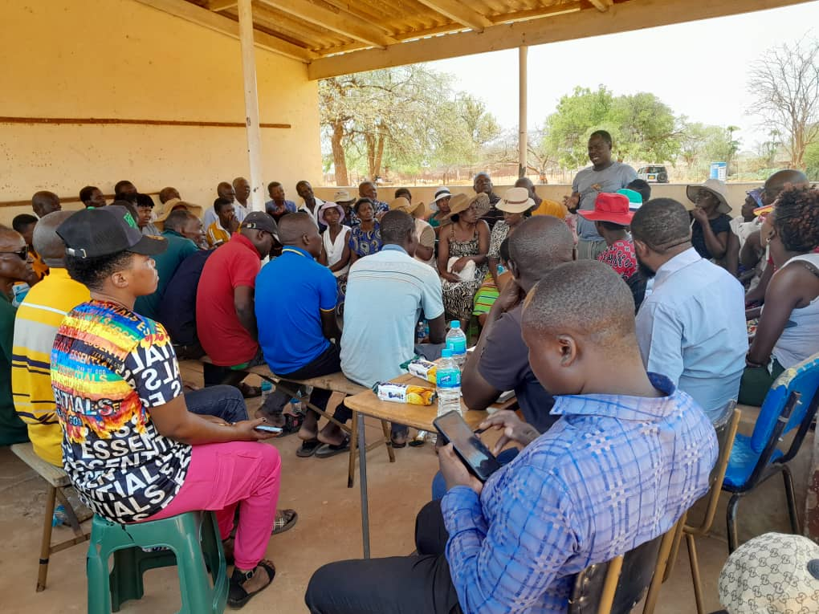
V. EXPENDITURE- GENDER IN MAINSTREAM BUDGET
Consultation which are inclusive and then undertook a needs based assessment. We will then come up with needs based projects and activities.

Slide 17
V. EXPENDITURE- GENDER IN MAINSTREAM BUDGET – EXAMPLE
 | Amount | No of beneficiaries | Percentage
Total Expenditure
No. of Men benefiting from council allocations | 10000 | 50000 | 42
No. of Women benefiting from council allocations | 15000 | 70000 | 58
Total beneficiaries | 25000 | 120000 | 100%

Slide 18
VI. BUDGET CROSS SUBSIDISATION ANALYSIS
 | Income (A) | % of total budget | Expenditure (B) | % of total budget | Surplus/Deficit
Governance & Administration | 120,350.00 | 2% | 2,008,730.11 | 38% | - 1,888,380.11
Water, Sanitation & Hygiene | 644,969.19 | 12% | 733,387.19 | 14% | - 88,418.00
Social Services | 2,126,364.12 | 40% | 1,214,025.62 | 23% | 912,338.50
Roads | 684,401.80 | 13% | 1,068,822.20 | 20% | - 384,420.40
Public Safety and Security | 30,785.40 | 1% | 29,495.40 | 1% | 1,290.00
Natural Resources & Conservation Mgt | 1,743,217.41 | 33% | 295,627.40 | 6% | 1,447,590.01
Total | 5,350,087.92 | 100% | 5,350,087.92 | 100%

Slide 19
VI. BUDGET CROSS SUBSIDISATION ANALYSIS
Which programmes generate more income than expenditure? NRA
Governance, WASH, Social Services, Roads & Public Safety. Most of the revenue of council is derived from Natural Resources. Hence the program finances most of the council programs
Are there any policies to support or guide cross-subsidisation? NO
Gender considerations may have influenced the cross-subsidisation of services by potentially allocating more funds to programs that address gender disparities and cater to the specific needs of women and other marginalized genders. For example, within the Social Services
What percentage of allocations have been influenced by gender considerations?

Slide 20
VII. CONCLUSIONS AND NEXT STEPS
To what extent has the council budget contributed to gender equality and women’s empowerment?
To a certain extent the budget’s thrust was aimed at addressing gender issues, however there is need to continue to improve on the resources allocation in future. We budgeted for the Bee keeping project for the youth and additional biogas digestors within the 4 constituencies under Zibagwe to empower women and nutritional gardens at Wozoli and Ngalaphi where women are now earning a living from their produce supporting SDG1. Awareness campaigns on stopping gender based violence and 50 50 campaigns have shown a positive impact on attaining gender equality SDG5
What are the next steps regards gender budgeting for the council?
We have to increase budget allocation to gender specific programmes and activities from the current 6% so that our budget is more gender responsive.
Also by Involving everyone in all council activities inorder to leave no one behind.

