Slide 1
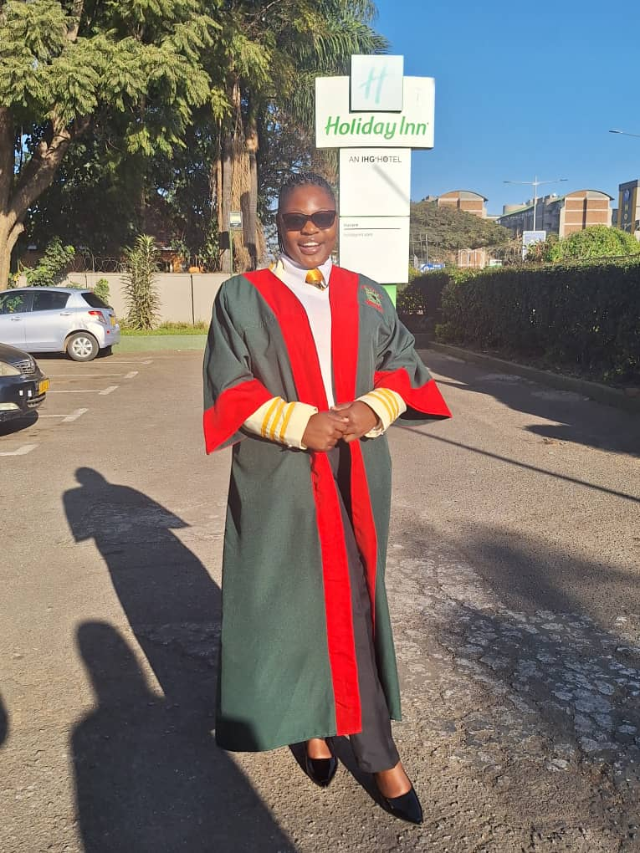




SADC PROTOCOL@WORK SUMMIT 2024
Youth Leadership Template
(Zibagwe, Kwekwe, and Ropafadzo Damira )

Slide 2
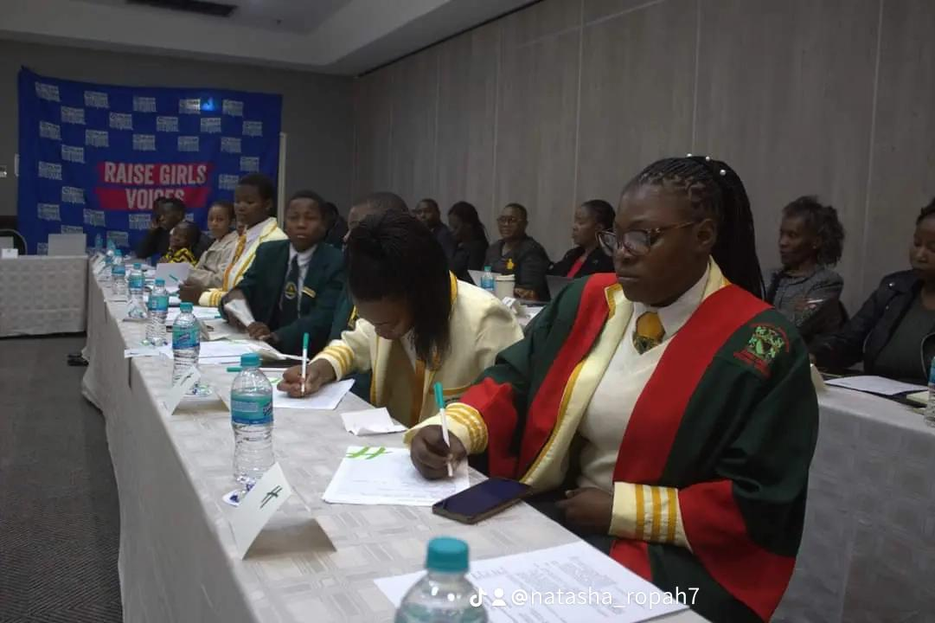
Quotable Quotes
Quote:
When women are heard, the world benefits; every voice matters in the pursuit of equality."
Leadership Qualities:
1. Empowerment: Uplift women's voices in decision-making.
2. Collaboration: Foster teamwork and value diverse perspectives.
3. **Commitment to Equality**: Advocate for social justice and equal rights.
4. Enhancing Effectivenes Embrace diverse viewpoints for better solutions.
5. Transformative Leadership: Ensure all voices are represented.
6. Social Justice Advocacy: Promote equality as a core leadership principle.

Slide 3
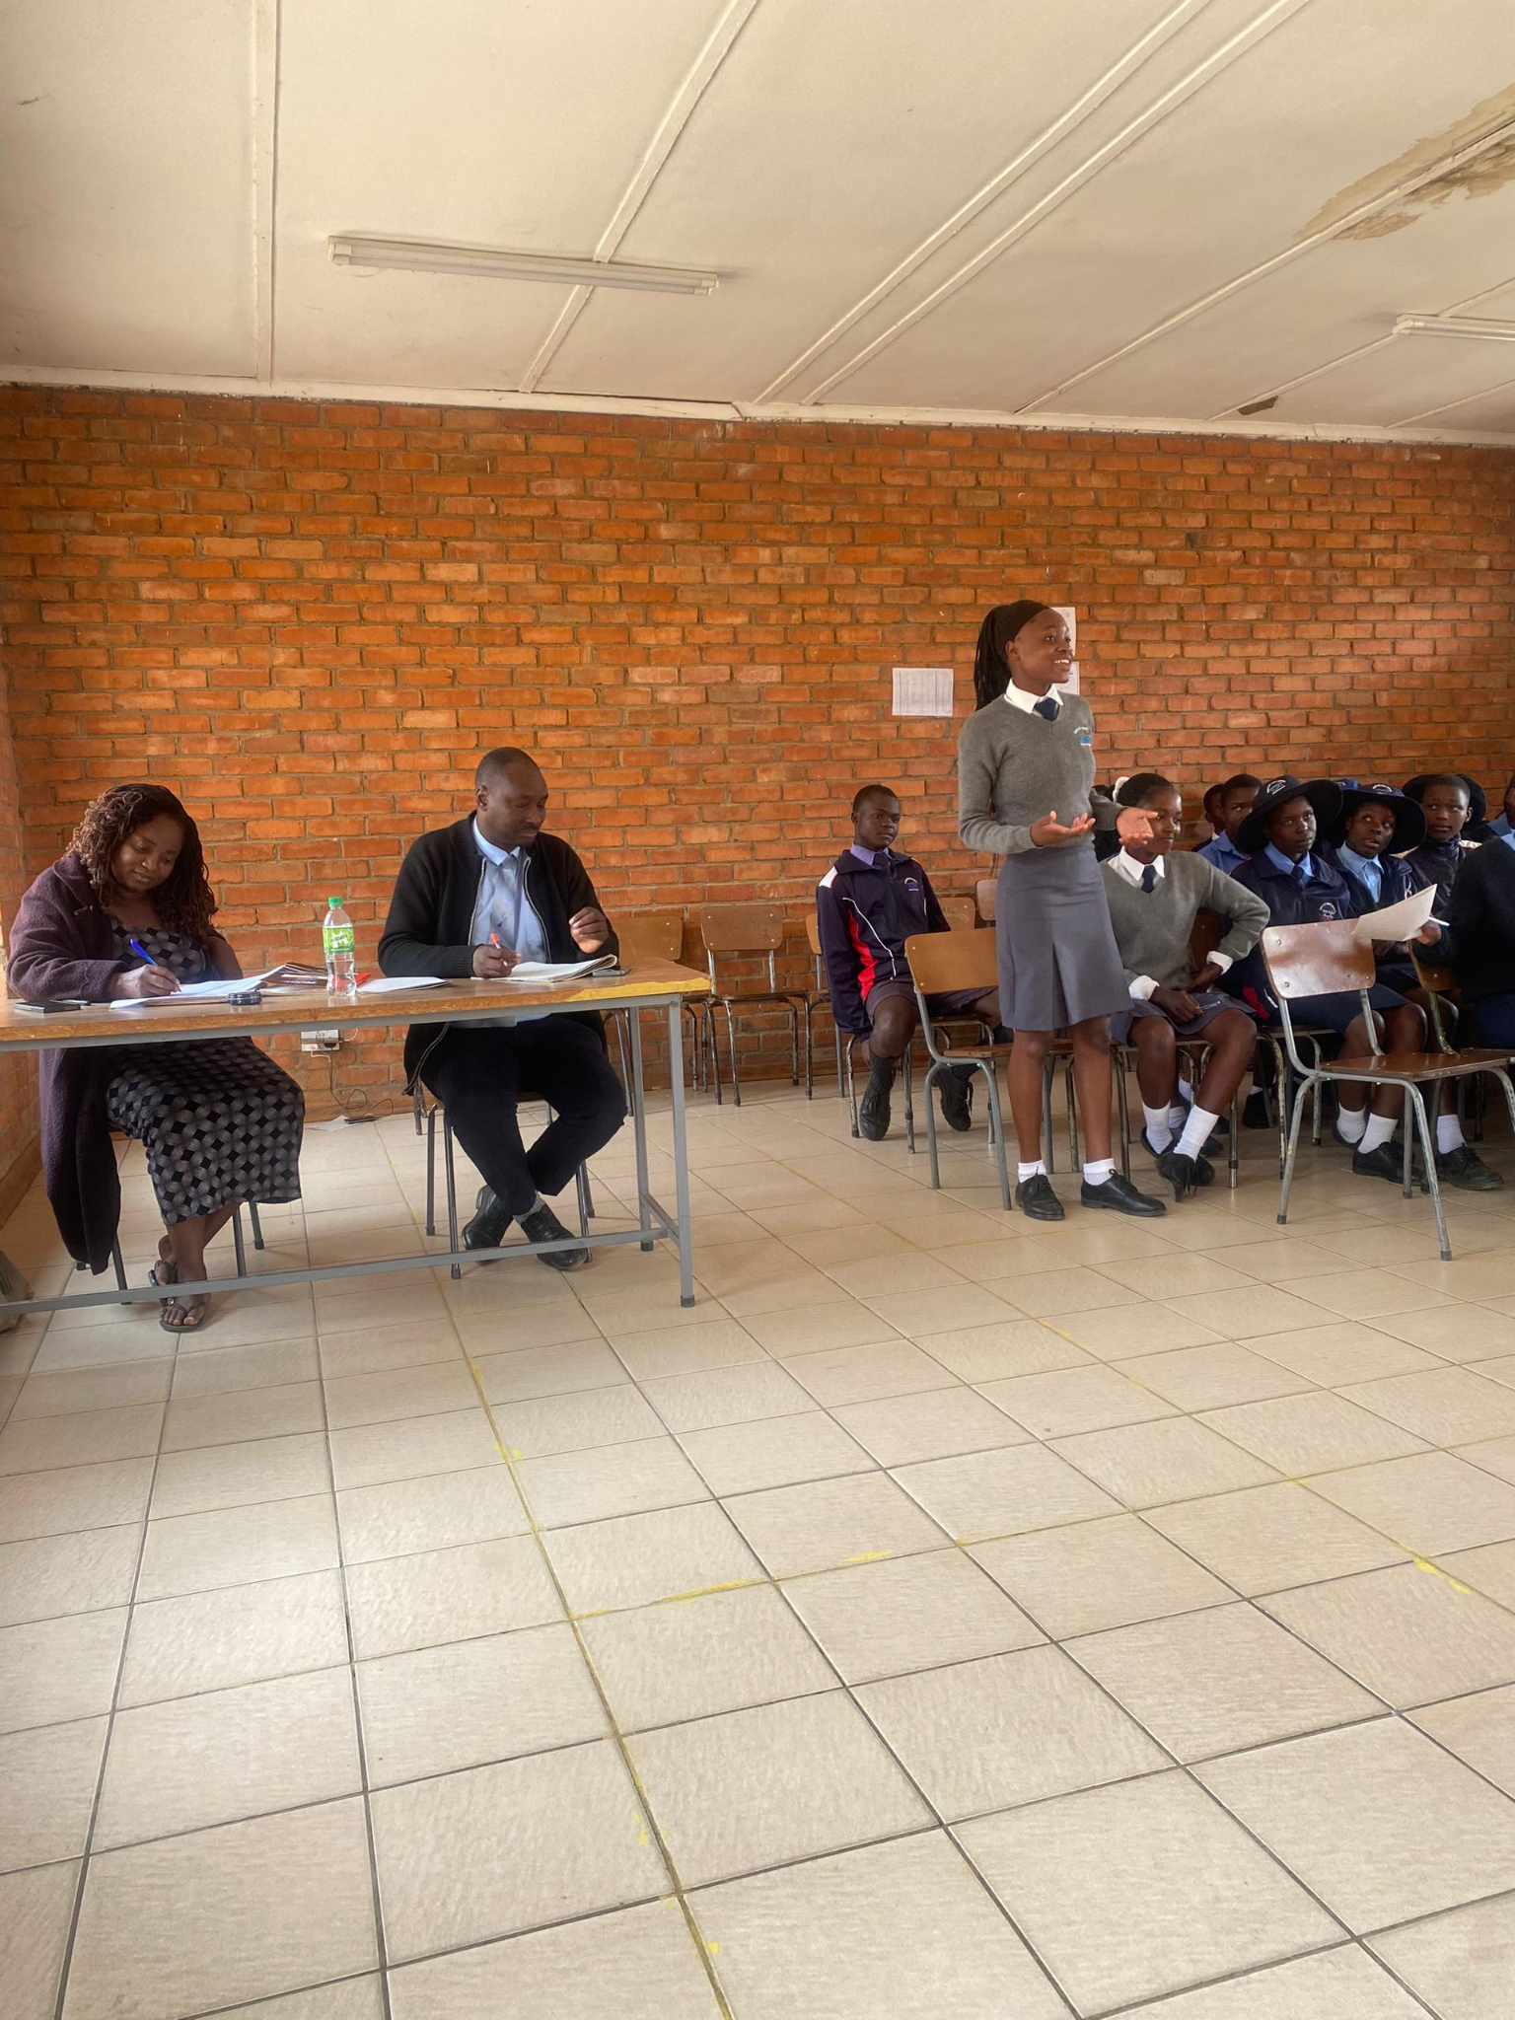
Experience as a leader
leadership journey.
1. Faced Resistance - Encountered skepticism while organizing community workshops on gender equality.
2.Active Listening: Engaged with community members to understand their concerns and perspectives.
3. Collaboration: Fostered partnerships with local organizations and advocates to strengthen the initiative.
4. Building Alliance: Created a network of supporters to amplify diverse voices in the movement.
parking Dialogue Initiated conversations that encouraged understanding and awareness around gender issues.
6.Transforming Skepticism Shifted initial resistance into support through consistent engagement and education.
Insert photo

Slide 4
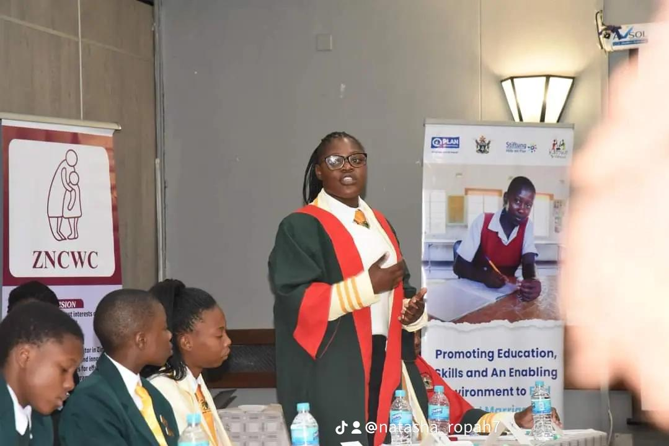
WHO IS THIS YOUTH CHAMPION?
Detail
Who Am I
Name: Ropafadzo Damira
Position: Junior Councillor for Ward 33, Zibagwe Rural District Council
Origin
Hometown: Munyati, a place that has shaped my values and perspective.
Uniqueness
Life Goals: Committed to fostering community development and gender equality in my role.
Adaptability: Ability to navigate challenges and embrace change, ensuring effective responses to community needs.
Personal Experiences: Life experiences that have enriched my understanding of local issues and motivated my advocacy for others.

Slide 5
WHAT DRIVES YOU?
Detail
Include Photos or videos
Vision
Empowered Voices: A community where every individual, regardless of gender, feels empowered to express their thoughts and opinions.
Equal Opportunities: A society where all genders have equal access to education, employment, and leadership roles, fostering a diverse workforce.
Objectives
Raise Awareness: Organize workshops and seminars to educate the community about gender equality issues, rights, and resources.
Empower Women: Create programs that provide skills training, mentorship, and leadership development for women and marginalized genders.
Your commitment to gender equality, youth participation.
Advocate for Inclusion: Actively support policies and initiatives that promote the inclusion of youth in gender equality discussions.
Empower Young Voices: Create platforms for young people to express their opinions and contribute to gender equality initiatives.
Provide Education: Organize workshops and seminars that educate youth about gender issues, rights, and leadership skills.

Slide 6
WHAT DO YOU DO?
Detail
NATURE OF MY WORK
Gender Mainstreaming:
Integrated gender perspectives into all community programs and initiatives to ensure equality is considered at every level.
Youth Participation:
Established youth councils that empower young people to voice their opinions on gender issues, ensuring their involvement in decision-making processes
Include Photos or videos

Slide 7
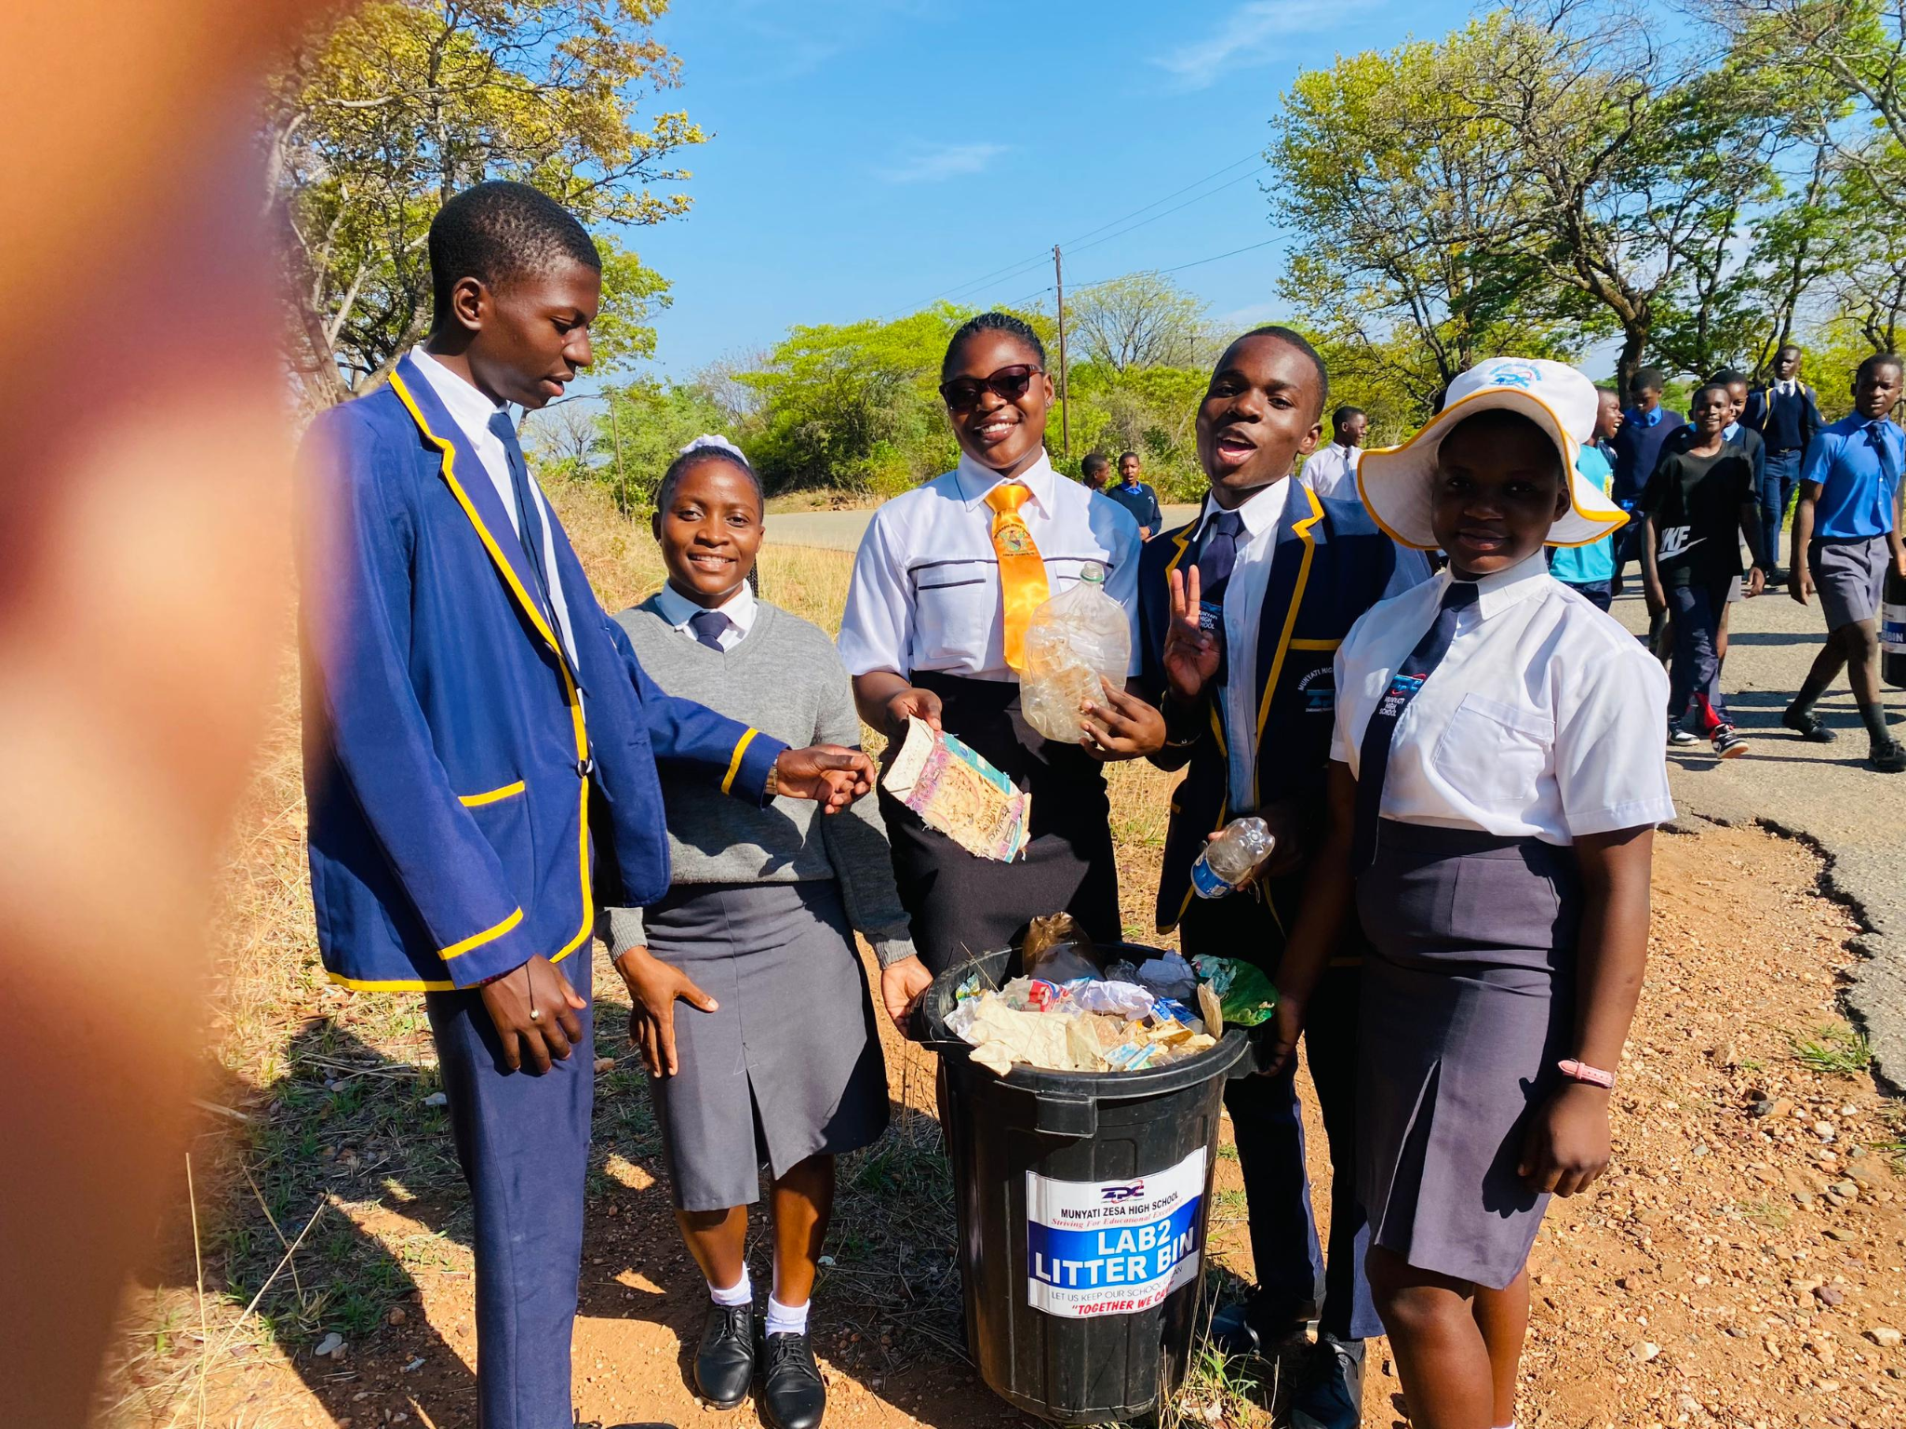
CHALLENGES
CHALLENGES I HAVE FACED IN PUSHING FOR GENDER EQUALITY
Resistance to Change:
Encountering skepticism and pushback from individuals and institutions resistant to gender equality initiatives.
Cultural Norms:
Navigating deeply ingrained cultural beliefs and practices that perpetuate gender inequality.
Share videos/photos of evidence

Slide 8
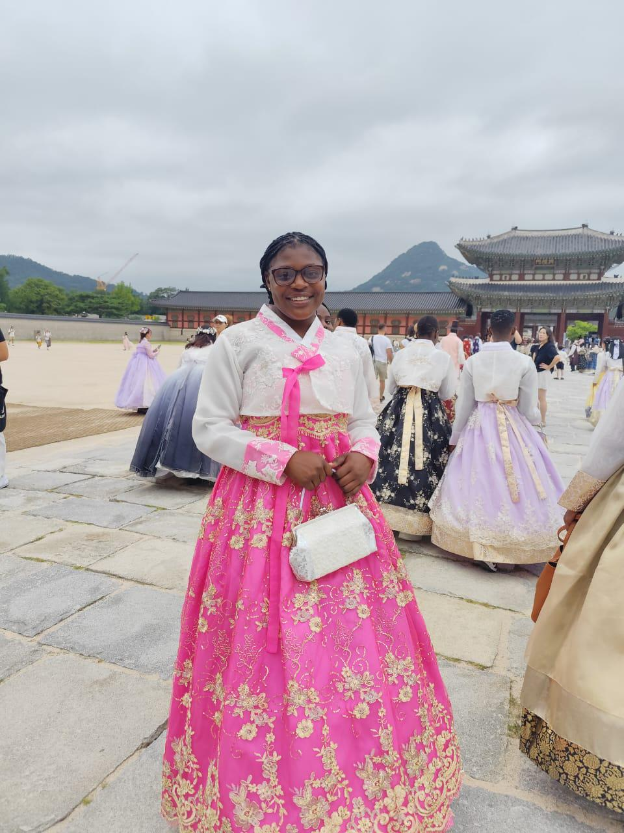
What has changed in your life?
What changed in my life because of your work?
Increased Awareness:
A deeper understanding of gender issues and the complexities surrounding them, leading to more informed perspectives.
Enhanced Empathy:
Greater empathy towards individuals facing gender-based discrimination, fostering stronger connections and support networks.
Expanded Network:
Building a diverse network of allies, advocates, and mentors committed to gender equality, enriching personal and professional relationships.
What or who is responsible for this change?
Personal Motivation:
A strong personal commitment to social justice and the desire to make a difference in the community.
Social Movements:
Participation in broader social movements that raise awareness and advocate for gender equality, amplifying collective efforts.

Slide 9
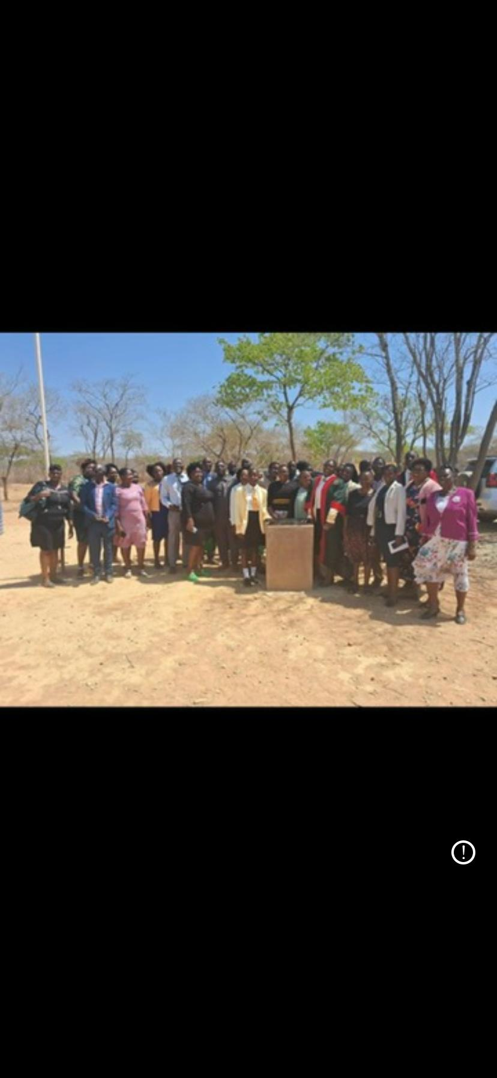
What Capacity Building Initiatives Have You Initiated?
HOW I HAVE BUILT THE CAPACITY OF OTHERS IN MY WORK
Training Workshops:
Organized and facilitated workshops focused on gender sensitivity, leadership skills, and advocacy techniques.
Mentorship Programs:
Established mentorship initiatives pairing experienced leaders with young advocates to provide guidance and support.
WHAT I HAVE DONE
Facilitated Workshops:
Organized and led workshops on topics such as gender sensitivity, unconscious bias, and advocacy skills, providing participants with practical tools and knowledge.
Developed Training Programs:
Created comprehensive training programs for organizations focused on implementing gender-responsive policies and practices.
Mentored Young Leaders:
Acted as a mentor for young women and marginalized genders, offering guidance on career development and leadership in gender advocacy.

Slide 10
Lessons Learnt
LESSONS I HAVE LEARNT
Importance of Inclusivity:
Engaging diverse voices, including those from various genders, backgrounds, and experiences, is essential for effective advocacy.
Patience and Persistence:
Change takes time. Persistence in the face of setbacks is crucial for achieving long-term goals in gender equality.
Education is Key:
Raising awareness and educating others about gender issues is foundational for shifting mindsets and fostering understanding.

Slide 11
NEXT STEPS
MY FUTURE PLANS
Expand Educational Initiatives:
Develop and implement comprehensive workshops and training programs focused on gender sensitivity, unconscious bias, and leadership skills for various community members, including youth and professionals.
Launch a Mentorship Program:
Create a mentorship program that connects young women and marginalized individuals with experienced professionals to foster leadership development and career advancement.
CONCLUDING THOUGHTS
Universal Importance: Gender equality is not just a women’s issue; it is a fundamental human rights issue that affects everyone. Achieving equality benefits society as a whole.
Collective Responsibility: Everyone has a role to play in promoting gender equality. Allies, advocates, and individuals can contribute to creating a more equitable society through education, advocacy, and support.Vision for the Future: A truly equitable society is one where everyone has the opportunity to thrive, free from discrimination and bias. Striving for this vision requires collaboration, innovation, and dedication.

